Slide 1
Module 8
Implementing Software Defined Networking
Notes:
Presentation: 70 minutes
Lab: 30 minutes
After completing this module, students will be able to:
Describe Software Defined Networking.
Implement network virtualization.
Implement Network Controller.
Required materials
To teach this module, you need the Microsoft PowerPoint file 20743C_08.pptx.
Preparation tasks
To prepare for this module, you should:
Read all of this module’s materials.
Practice performing the demonstrations and labs.
Work through the Module Review and Takeaways section to determine how you will use the information to reinforce student learning and promote knowledge transfer to on-the-job performance.
As you prepare for this class, it is imperative that you complete the labs yourself. This gives you an understanding of how the labs work and the concepts that each covers, so that you can provide meaningful hints to students who might have issues. Furthermore, it will help guide your lecture to ensure that you discuss the concepts that the labs cover.
20743C
8: Implementing Software Defined Networking

Slide 2
Module Overview
Overview of SDN Implementing network virtualization Implementing Network Controller
Notes:
Provide an overview of the module.
20743C
8: Implementing Software Defined Networking

Slide 3
Lesson 1: Overview of SDN
What is SDN? Benefits of SDN Planning for SDN Deploying SDN by using scripts
Notes:
Provide an overview of the lesson.
Question
In Software Defined Networking, each physical compute host must be assigned at least one IP address from the Management logical network. You can use DHCP for this assignment.
( ) False
( ) True
Answer
( ) False
( √) True
Question
Does the complexity of your organization’s network infrastructure suggest the need for Software Defined Networking?
Answer
Answers will vary based on students’ experiences and their organization’s network infrastructure.
20743C
8: Implementing Software Defined Networking

Slide 4
What is SDN?
SDN enables you to:
Virtualize the network layer in a datacenter
Define polices for the physical and virtual networks
Manage the virtualized network infrastructure
The SDN solution includes:
Network Controller
Hyper-V Network Virtualization
Hyper-V Virtual Switch
RRAS Multitenant Gateway
NIC Teaming
Operations Manager
Virtual Machine Manager
Windows Server Gateway
Notes:
Use this topic to introduce the concept of Software Defined Networking (SDN). SDN is largely conceptual, and vendors might have many different interpretations of what this exactly means. To avoid getting sidetracked into all the possible meanings of this term, keep the conceptual description simple, and then focus on the Microsoft components that implement this solution.
20743C
8: Implementing Software Defined Networking

Slide 5
Benefits of SDN
Challenges faced by many IT departments today include:
Resources are finite
Resources are inflexible
Mistakes are expensive
Networks are not always secure
SDN overcomes these challenges and enables you to be:
Flexible
Efficient
Scalable
Notes:
Present the topic as a discussion. Ask students what the common issues are with their network infrastructure. Guide them around to thinking about the four issues in this topic.
For more guidance, refer to “4 datacenter challenges and how Windows Server 2016 software defined networking can help” at: http://aka.ms/S9y1pe
20743C
8: Implementing Software Defined Networking

Slide 6
Planning for SDN
You must plan the following aspects of your Software Defined Networking configuration:
Management and HNV Provider logical networks
Logical networks for gateways and the SLB
Logical networks required for RDMA-based storage
Routing infrastructure
Default gateways
Network hardware
Notes:
There is one additional slide for this topic.
This topic provides high-level guidance on planning for SDN. To familiarize yourself with the planning requirements and processes, refer to: “Plan a Software Defined Network Infrastructure” at: http://aka.ms/N4y63g
Use the second slide to discuss the architecture as you explain it.
20743C
8: Implementing Software Defined Networking

Slide 7
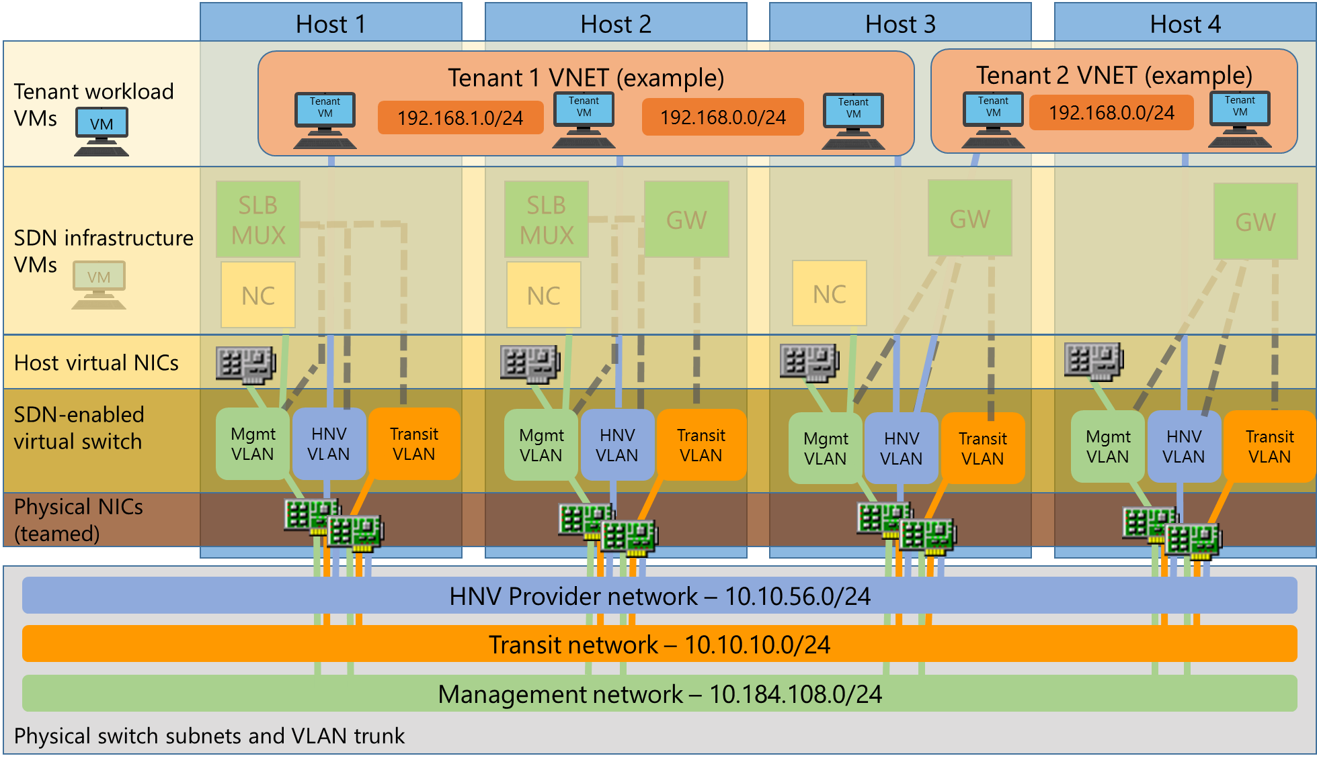
Planning for Software Defined Networking
Notes:
Use this diagram (a copy of which is in the Students Handbook) to discuss Software Defined Networking architecture. The diagram shows four Hyper-V hosts, 1 through 4. Each has teamed NICs, which are connected to the HNV Provider network, the transit network, and the management network indicated by the blue, orange, and green lines respectively. Each host has an SDN-enabled virtual switch, supporting the management VLAN, the HNV VLAN, and the transit VLAN. Virtual NICs are shown, and each represents a host management connection. In the SDN infrastructure layer, virtual machines are shown that support Network Controller (you will discuss Network Controller in the last lesson of this module), gateway, and an SLB multiplexer (MUX). Network Controller is connected (by the green line) to the management network. The SLB MUX and gateway virtual machines are variously connected to the HNV provider, transit, and management networks. The top layer shows the tenant virtual machines, which, where appropriate, span the physical hosts.
For more information on this diagram and other variations of it, refer to “Plan a Software Defined Network Infrastructure” at: http://aka.ms/N4y63g
20743C
8: Implementing Software Defined Networking

Slide 8
Deploying SDN by using scripts
Use the following high-level procedure to deploy SDN:
Install host networking and validate the configuration
Run SDN Express scripts and validate setup
Deploy a sample tenant workload and validate deployment
Notes:
This is a complex topic and might not be applicable to all students. Gauge the experience level in the class before presenting this material.
For more information, refer to “Deploy a Software Defined Networking infrastructure using scripts” at: http://aka.ms/Exuuke
20743C
8: Implementing Software Defined Networking

Slide 9
Lesson 2: Implementing network virtualization
What is network virtualization? Benefits of network virtualization What is Generic Route Encapsulation? What are network virtualization policies?
Notes:
Provide an overview of the lesson.
Question
Does a virtual machine CA change when you move the virtual machine between Hyper-V hosts?
Answer
When you move a virtual machine, its CA stays the same. The only thing that changes is its PA, which is the address of the Hyper-V host on which it is running. You must update the network virtualization configuration on the Hyper-V hosts so that Hyper-V hosts are aware of the move.
Question
Why are network virtualization policies necessary when using network virtualization?
Answer
Network virtualization policies define the Hyper-V host on which the virtual machines are running. Hyper-V consults network virtualization policies when it needs to form an NVGRE–encapsulated packet and send it on a physical network.
20743C
8: Implementing Software Defined Networking

Slide 10

What is network virtualization?
Test virtual machine
Production virtual machine
Test network
Production network
Physical server
Physical network
Server virtualization:
Multiple virtual machines on the same physical server
Each virtual machine is isolated from others
Network virtualization:
Multiple virtual networks on the same physical network
Each virtual network is isolated from others
Notes:
Introduce network virtualization and compare it with server virtualization. Keep the discussion at a high level, and be prepared to talk about implementation details and provide examples in the topics that follow.
20743C
8: Implementing Software Defined Networking

Slide 11
Benefits of network virtualization
Flexible virtual machine placement
Multitenant network isolation without VLANs
IP address reuse
Live migration across subnets
Compatibility with existing network infrastructure
Transparent moving of virtual machines to a shared IaaS cloud
Support for resource metering
Configuration by using Windows PowerShell or by using Virtual Machine Manager
Notes:
Introduce the benefits of network virtualization and spend some time explaining each of them. Mention that you can configure network virtualization by using only Windows PowerShell, but in many scenarios you can use other tools, such as the Microsoft System Center Virtual Machine Manager.
20743C
8: Implementing Software Defined Networking

Slide 12
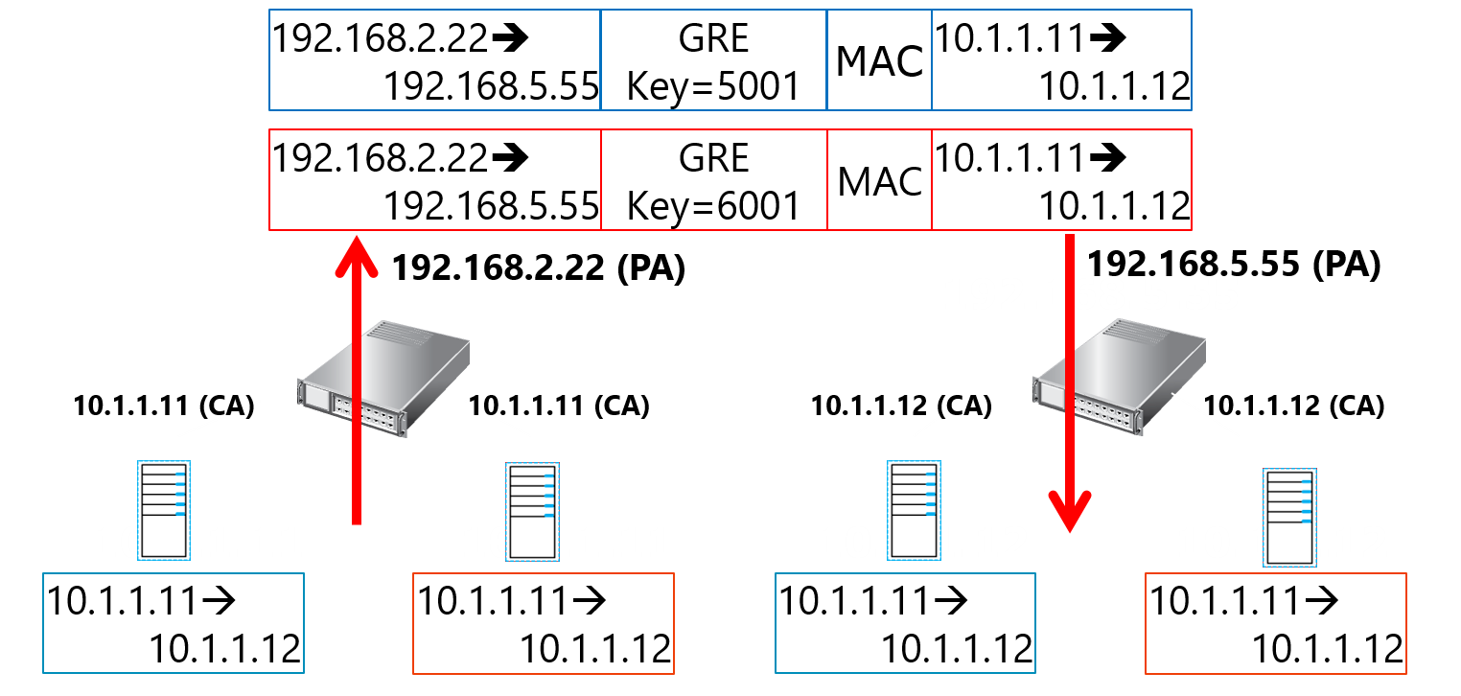
What is Generic Route Encapsulation?
CA space is based on virtual machine configuration
Provider address space is based on physical network and is not visible to the virtual machines
Notes:
This is an animation slide with two clicks. At this point, students are already familiar with network virtualization and its benefits. You can spend some time explaining how Network Virtualization Generic Route Encapsulation (NVGRE) implements network virtualization. You should be aware that IP Rewrite could also implement network virtualization, but NVGRE has several benefits, and Microsoft Hyper-V in Windows Server 2016 uses only NVGRE.
Discuss the customer address (CA) and provider address (PA), and how network virtualization uses both for each virtual machine. Point out that the Hyper-V host can virtualize network traffic for many virtual machines with a single provider address because the Virtual Subnet ID is used to differentiate between them.
20743C
8: Implementing Software Defined Networking

Slide 13
What are network virtualization policies?
Define CA-PA mappings:
Specify the Hyper-V server on which the virtual machines are running
Hyper-V implements policies by translating incoming and outgoing packets
If a virtual machine is moved, policies are modified, but the virtual machine configuration stays the same
Policy settings
PA space
Contoso, Ltd.
CA | PA | VSID
10.1.1.1 | 192.168.1.10 | 5001
10.1.1.2 | 198.168.1.12
SQL | 10.1.1.1
WEB | 10.1.1.2
Datacenter network
192.168.1.10
192.168.1.12
Hyper-V Host 1
Hyper-V Host 2
Woodgrove Bank
CA | PA | VSID
10.1.1.1 | 192.168.1.10 | 6001
10.1.1.2 | 192.168.1.12
SQL | 10.1.1.1
WEB | 10.1.1.2
SQL
SQL
WEB
WEB
10.1.1.1
10.1.1.1
10.1.1.2
10.1.1.2
CA spaces
Notes:
Explain that network virtualization is configured by network virtualization policies, which specify which virtual machine is running on which Hyper-V host―in other words, they specify CA–PA mappings. Based on network virtualization policies, Hyper-V forms NVGRE-encapsulated packets and sends them on the physical network. When it receives NVGRE packets, it decapsulates them and passes them to the appropriate virtual machine. Remind students that when using network virtualization and moving a virtual machine, you do not need to modify its CA, but rather need to modify only its PA. Remind the students that when you use network virtualization only between virtual machines, no additional network hardware is necessary. However, when you want to enable communication between virtual and physical machines, a gateway is necessary.
20743C
8: Implementing Software Defined Networking

Slide 14
Lesson 3: Implementing Network Controller
What is Network Controller? Requirements for deploying Network Controller Demonstration: Preparing to deploy Network Controller The procedure for deploying Network Controller Datacenter Firewall Software Load Balancing RAS Gateway Demonstration: Deploying Network Controller
Notes:
Provide an overview of the lesson.
Question
What does Network Controller use the Northbound and Southbound APIs for?
Answer
Network Controller uses the Southbound API to communicate with network devices, services, and components. With the Southbound API, Network Controller can:
Discover network devices.
Detect service configurations.
Gather all of the information you need about the network.
Send information to the network infrastructure: for example, configuration changes that you have made.
The Network Controller Northbound API enables you to configure, monitor, troubleshoot, and deploy new devices on the network by using:
Windows PowerShell
Representational state transfer (REST) application programming interface (API)
A management application with a GUI, for example, System Center Virtual Machine Manager
20743C
8: Implementing Software Defined Networking

Slide 15
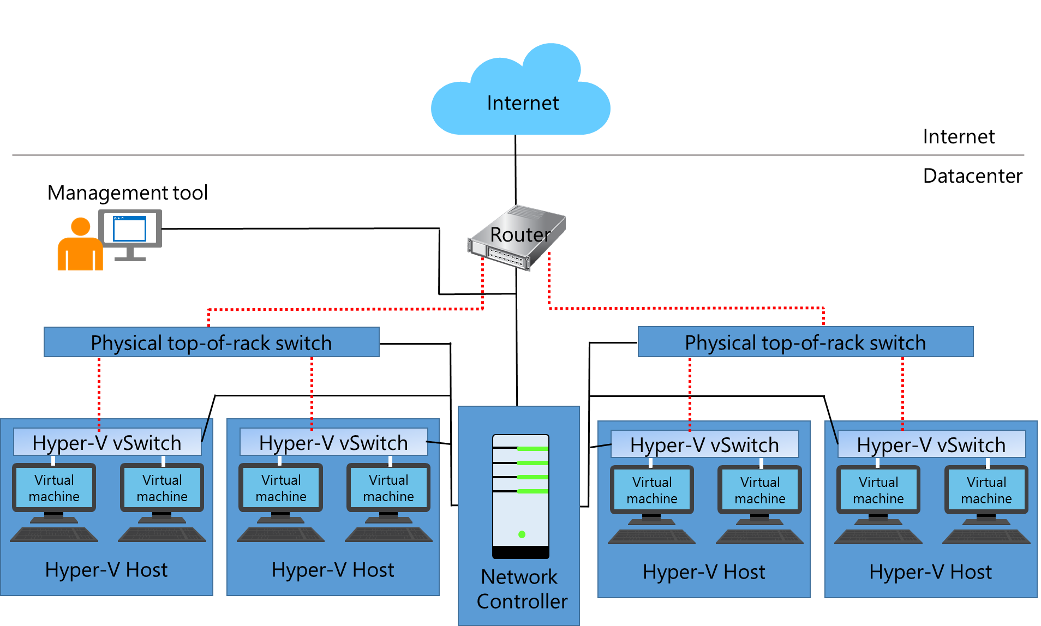
What is Network Controller?
Notes:
Use this topic to provide an introduction to this new Windows Server 2016 feature.
20743C
8: Implementing Software Defined Networking

Slide 16
Requirements for deploying Network Controller
You can deploy Network Controller only to the Windows Server 2016 Datacenter edition
The management client must be running Windows 10, Windows 8.1, or Windows 8
You must configure dynamic DNS registration for Network Controller
If virtual machines running Network Controller are joined to a domain, you must create appropriate Active Directory security groups
If virtual machines running Network Controller are not joined to a domain, you must configure certificate-based authentication
Notes:
Discuss the requirements for installing the Network Controller server role. Before presenting this topic, refer to: “Installation and Preparation Requirements for Deploying Network Controller” at: http://aka.ms/Tn2cxg
20743C
8: Implementing Software Defined Networking

Slide 17
Demonstration: Preparing to deploy Network Controller
In this demonstration, you will see how to:
Create AD DS security groups
Request a certificate
Notes:
After you have completed the demonstration, leave all virtual machines running for the final demonstration.
Preparation Steps
You require the 20743C-LON-DC1 and 20743C-LON-SVR2 virtual machines for this demonstration. Sign in as Adatum\Administrator with the password of Pa55w.rd.
Demonstration Steps
Create Active Directory security groups
Switch to LON-DC1.
In Server Manager, click Tools, and then click Active Directory Users and Computers.
In Active Directory Users and Computers, expand Adatum.com, and then click IT.
Right-click IT, click New, and then click Group.
In the New Object – Group dialog box, in the Group name text box, type Network Controller Admins, and then click OK.
In the details pane, double-click Network Controller Admins.
In the Network Controller Admins Properties dialog box, on the Members tab, click Add.
In the Select Users, Contacts, Computers, Service Accounts, or Groups dialog box, in the Enter the object names to select (examples) text box, type administrator; Beth, and then click OK twice.
Right-click IT, click New, and then click Group.
In the New Object – Group dialog box, in the Group name text box, type Network Controller Ops, and then click OK.
In the details pane, double-click Network Controller Ops.
In the Network Controller Ops Properties dialog box, on the Members tab, click Add.
20743C
8: Implementing Software Defined Networking
(More notes on the next slide)

Slide 18
Notes:
In the Select Users, Contacts, Computers, Service Accounts, or Groups dialog box, in the Enter the object names to select (examples) text box, type administrator; Beth, and then click OK twice.
Close Active Directory Users and Computers.
Request a certificate
Switch to LON-SVR2.
Right-click Start, and then click Run.
In the Run dialog box, type mmc.exe, and then press Enter.
In the Console1 – [Console Root] window, click File, and then click Add/Remove Snap-in.
In the Add or Remove Snap-ins dialog box, in the Snap-in list, double-click Certificates.
Click Computer account, click Next, click Finish, and then click OK.
In the navigation pane, expand Certificates, and then expand Personal.
Right-click Personal, click All Tasks, and then click Request New Certificate.
In the Certificate Enrollment dialog box, on the Before you Begin page, click Next.
On the Select Certificate Enrollment Policy page, click Next.
Select the Computer check box, click Enroll, and then click Finish.
Close the management console, and do not save the changes.
20743C
8: Implementing Software Defined Networking

Slide 19
The procedure for deploying Network Controller
Install the Network Controller server role
Configure the Network Controller cluster
Configure the Network Controller application
Validate the Network Controller deployment
Notes:
You will demonstrate the procedure in the last topic of this lesson. Students will also perform these steps in their lab. Consider combining the theory topic with the following demonstration. For additional guidance, we recommend that you read ”Deploy Network Controller using Windows PowerShell” at: http://aka.ms/rbl4yy
20743C
8: Implementing Software Defined Networking

Slide 20
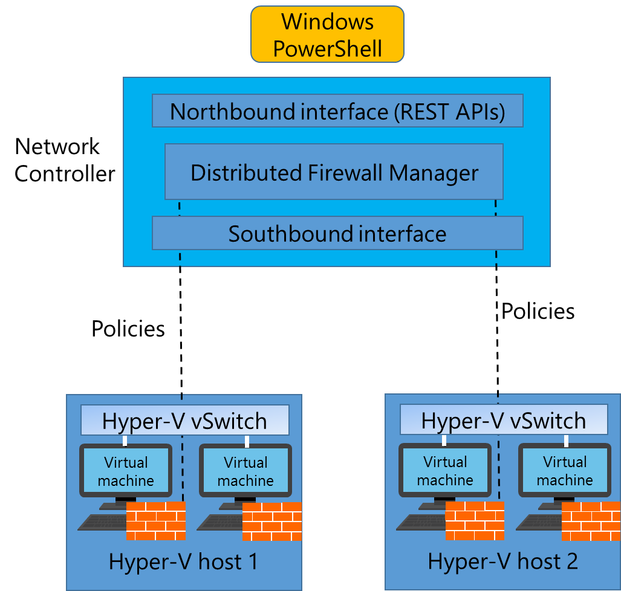
Datacenter Firewall
Notes:
Use this topic to provide an overview of the management benefits of Datacenter Firewall.
20743C
8: Implementing Software Defined Networking

Slide 21
Software Load Balancing
Windows Server SLB provides the following features:
Layer 4 load balancing for both “North-South” and “East-West” TCP/UDP traffic
Public and internal network traffic load balancing
Support for dynamic IP addresses on VLANs and on Hyper-V virtual networks
Support for health probe
Notes:
Note: There are two additional slides for this topic.
Use this topic to describe the features of Software Load Balancing (SLB), and then discuss the potential benefits to the students’ organizations. Use the additional slides when you discuss the SLB infrastructure, and when you summarize the role of Network Controller in SLB.
20743C
8: Implementing Software Defined Networking

Slide 22
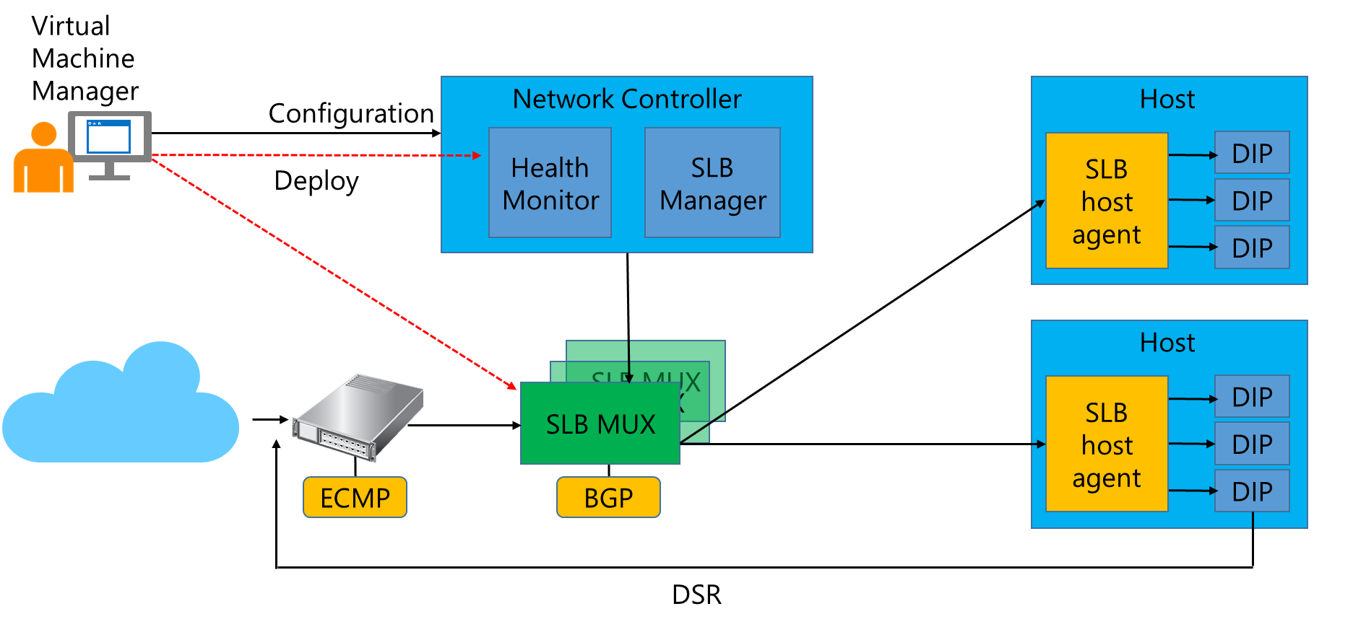
Software Load Balancing
Notes:
Use this slide when you describe the SLB infrastructure. For more information, refer to “Software Load Balancing (SLB) for SDN: Software Load Balancing Infrastructure” at: http://aka.ms/R0mma7
20743C
8: Implementing Software Defined Networking

Slide 23
Software Load Balancing
Network Controller performs the following functions in SLB:
Processes SLB commands that arrive via the Northbound API from a network management application
Calculates policy for distribution to Hyper-V hosts and SLB MUXs
Provides the health status of the SLB infrastructure
Provides each MUX with each VIP
Configures and controls the behavior of the VIP to dynamic IP mapping in the MUX
Notes:
Use this slide to summarize the role of Network Controller in the SLB infrastructure.
20743C
8: Implementing Software Defined Networking

Slide 24
RAS Gateway
RAS Gateway provides the following features:
Site-to-site VPN
Point-to-site VPN
GRE tunneling
Dynamic routing with BGP
Use RAS Gateway in the following scenarios:
Multitenant-aware VPN gateway
Multitenant-aware NAT gateway
Forwarding gateway for internal physical network access
Notes:
This topic has one additional slide.
Use this slide to summarize the functionality and use of RAS Gateway.
20743C
8: Implementing Software Defined Networking

Slide 25
RAS Gateway
Network Controller enables you to automatically deploy VMs running RAS Gateway to support the following features:
Addition and removal of gateway VMs
Site-to-site VPN gateway connectivity by using IPsec
Site-to-site VPN gateway connectivity by using GRE
Point-to-site VPN gateway connectivity
Layer 3 forwarding capability
BGP routing
Notes:
Use this slide to describe the role of Network Controller in managing RAS Gateway.
20743C
8: Implementing Software Defined Networking

Slide 26
Demonstration: Deploying Network Controller
In this demonstration, you will see how to:
Add the Network Controller role
Configure the Network Controller cluster
Configure the Network Controller application
Validate the deployment
Notes:
After you have completed the demonstration, revert all virtual machines.
Preparation Steps
You require the 20743C-LON-DC1 and 20743C-LON-SVR2 virtual machines for this demonstration.
Demonstration Steps
Add the Network Controller role
On LON-SVR2, click Start, and then click Server Manager.
In Server Manager, in the details pane, click Add roles and features.
In the Add Roles and Features Wizard, on the Before you begin page, click Next.
On the Select installation type page, click Next.
On the Select destination server page, click Next.
On the Select server roles page, in the Roles list, select the Network Controller check box.
Click Add Features, and then click Next.
On the Select features page, click Next.
On the Network Controller page, click Next.
On the Confirm installation selections page, click Install.
When the role is installed, click Close.
Right-click Start, point to Shut down or sign out, and then click Restart.
In the Choose a reason that best describes why you want to shut down this computer dialog box, click Continue.
After LON-SVR2 has restarted, sign in as Adatum\administrator with the password Pa55w.rd.
20743C
8: Implementing Software Defined Networking
(More notes on the next slide)

Slide 27
Notes:
Configure the Network Controller cluster
On LON-SVR2, right-click Start, and then click Windows PowerShell (Admin). At the Windows PowerShell (Admin) command prompt, type the following command, and then press Enter:
$node=New-NetworkControllerNodeObject -Name "Node1" -Server "LON-SVR2.Adatum.com" -FaultDomain "fd:/rack1/host1" -RestInterface "Ethernet"
At the command prompt, type the following command, and then press Enter:
$Certificate = Get-Item Cert:\LocalMachine\My | Get-ChildItem | where {$_.Subject -imatch "LON-SVR2" }
At the command prompt, type the following command, and then press Enter:
Install-NetworkControllerCluster -Node $node -ClusterAuthentication Kerberos -ManagementSecurityGroup "Adatum\Network Controller Admins" -CredentialEncryptionCertificate $Certificate
Configure the Network Controller application
At the command prompt, type the following command, and then press Enter:
Install-NetworkController -Node $node -ClientAuthentication Kerberos -ClientSecurityGroup "Adatum\Network Controller Ops" -RestIpAddress "172.16.0.99/24" -ServerCertificate $Certificate
Note: This command can take quite a while to complete.
Validate the deployment
At the command prompt, type the following command, and then press Enter:
$cred=New-Object Microsoft.Windows.Networkcontroller.credentialproperties
At the command prompt, type the following command, and then press Enter:
$cred.type="usernamepassword"
(More notes on the next slide)
20743C
8: Implementing Software Defined Networking

Slide 28
Notes:
At the command prompt, type the following command, and then press Enter:
$cred.username="admin"
At the command prompt, type the following command, and then press Enter:
$cred.value="abcd"
At the command prompt, type the following command, and then press Enter:
New-NetworkControllerCredential -ConnectionUri https://LON-SVR2.Adatum.com -Properties $cred –ResourceId cred1
Press Y, and then press Enter when prompted. If you receive an error, repeat steps 5 and 6.
At the command prompt, type the following command, and then press Enter:
Get-NetworkControllerCredential -ConnectionUri https://LON-SVR2.Adatum.com -ResourceId cred1
20743C
8: Implementing Software Defined Networking

Slide 29
Lab: Deploying Network Controller
Exercise 1: Preparing to deploy Network Controller Exercise 2: Deploying Network Controller
Logon Information
Virtual machines: 20743C-LON-DC1 20743C-LON-SVR2
User name: Adatum\Administrator
Password: Pa55w.rd
Estimated Time: 30 minutes
Notes:
Exercise 1: Preparing to deploy Network Controller
You decide to deploy Network Controller on a single virtual machine called LON-SVR2 by using Server Manager. Beth Burke and the domain administrator account will be responsible for managing both Network Controller and the network using Network Controller. The first stage in your test deployment is to configure the required security groups in AD DS, and to obtain a certificate for encryption on the Network Controller server.
Exercise 2: Deploying Network Controller
After creating the required groups and obtaining the relevant certificate on LON-SVR2, you must now use Windows PowerShell to deploy Network Controller.
20743C
8: Implementing Software Defined Networking

Slide 30
Lab Scenario
Adatum Corporation intends to deploy and use Network Controller to manage network services and devices. You decide to set up a trial of the technology in a test lab.
Notes:
20743C
8: Implementing Software Defined Networking

Slide 31
Lab Review
In the lab, you used Windows PowerShell to manage Network Controller. What other tools could you use? In the lab, you deployed Network Controller in a domain environment. In a non-domain environment, what steps must you take to provide for authentication?
Notes:
Question
In the lab, you used Windows PowerShell to manage Network Controller. What other tools could you use?
Answer
You also could use System Center Virtual Machine Manager and non-Microsoft management tools to manage Network Controller.
Question
In the lab, you deployed Network Controller in a domain environment. In a non-domain environment, what steps must you take to provide for authentication?
Answer
In a non-domain environment, certificates provide authentication. Therefore, you must configure certificate-based authentication by:
Creating a certificate for use on the management client. The Network Controller must trust this certificate.
Creating a certificate on the Network Controller for computer authentication.
20743C
8: Implementing Software Defined Networking

Slide 32
Module Review and Takeaways
Review Questions
Notes:
Review Questions
Question
You decide to deploy Network Controller in your Active Directory domain environment. What steps must you take to prepare for the deployment?
Answer
The deployment requirements in a domain environment are as follows:
You can only deploy Network Controller to the Windows Server 2016 Datacenter edition.
The management client you use must be installed on a computer or virtual machine running Windows 10, Windows 8.1, or Windows 8.
You must configure dynamic DNS registration to enable registration of required Domain Name System (DNS) records for Network Controller.
If the computers or virtual machines running Network Controller or the management client for Network Controller are joined to a domain, you must:
Create a security group that holds all the users that have permission to configure Network Controller.
Create a security group that holds all the users that have permission to configure and manage the network by using Network Controller.
Question
What are the reasons to consider implementing Software Defined Networking with Windows Server 2016?
Answer
SDN provides for network resources that are:
Flexible. You can move traffic from your on-premises infrastructure to your private or public cloud infrastructure.
Efficient. You can abstract the hardware components of your network infrastructure with software components.
Scalable. Your on-premises infrastructure has a finite capacity. Your cloud-based infrastructure has far broader limits enabling you to scale up your infrastructure when necessary.
20743C
8: Implementing Software Defined Networking
(More notes on the next slide)

Slide 33
Notes:
Question
How do you install the Network Controller feature in Windows Server 2016 by using Windows PowerShell?
Answer
To deploy Network Controller with Windows PowerShell, install the feature by running the following cmdlet:
Install-WindowsFeature -Name NetworkController –IncludeManagementTools
20743C
8: Implementing Software Defined Networking

