Slide 1
Data Science DS-SG-04– General Assembly – 8 July 2017 3 Project Proposals
Presenter: Lex
Notes:
This presentation demonstrates the new capabilities of PowerPoint and it is best viewed in Slide Show. These slides are designed to give you great ideas for the presentations you’ll create in PowerPoint 2010!
For more sample templates, click the File tab, and then on the New tab, click Sample Templates.

Slide 2
Project Titles
1
2
3
Stock prices of 4 Tech Giants vs. S&P500 Index
Best month or day to invest in US Stock Market
Apple Versus Google Stock Price
Presenter: Lex

Slide 3
Predict the S&P500 Index using the Stock prices of the 4 Tech Giants Google, Facebook, Amazon and Apple
1
Project Proposal 1: by Lex

Slide 4
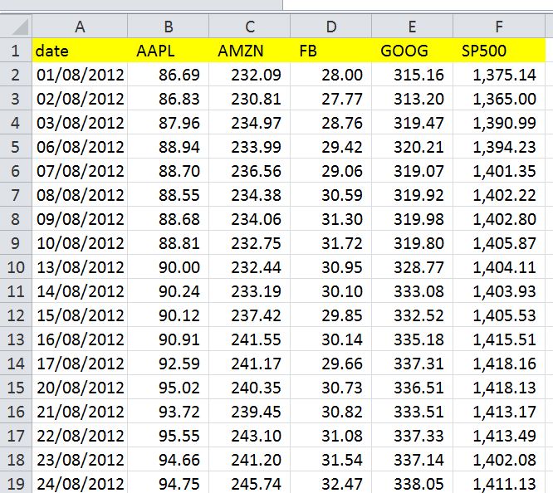
Predict the S&P500 Index
The Problem: What's the background and scope of the project idea?
- Can the overall market (S&P500 Index Price) be predicted by the Stock prices of 4 technology giant’s stocks (Facebook, Apple, Google, Amazon) from 1 Aug 2012 to 1 Aug 2016 (4 years)
What problem are you attempting to address or solve?
- Solve the problem of having to pick stocks. Investors just need to buy the tech giants if there is strong correlation
Who may it matter to?
Investors who buy the 4 tech giants stocks

Slide 5
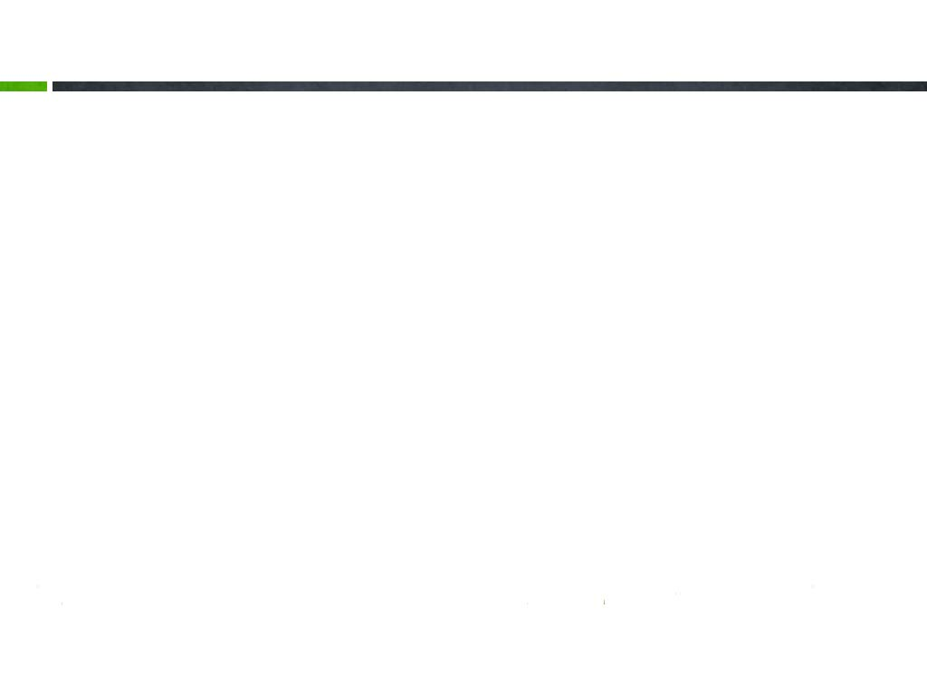
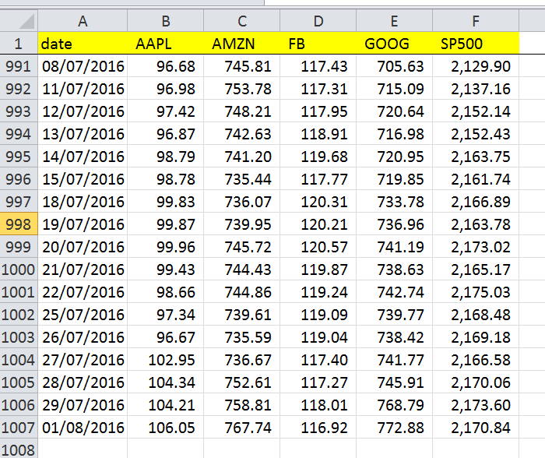
Predict the S&P500 Index
Data: What data exists to help solve this problem?
- S&P Index Price, Stock Prices (close at end of the day) of Facebook, Apple, Google, Amazon
Where is it coming from?
- S&P Official website, Kaggle
What does the data look like?
- 1,007 days from 1/08/2012 to 01/08/2016, with total 6 columns (Date, 4 companies, 1 Index). Total 6,036 data points
What is the observation?
Positive correlation at first glance

Slide 6

Lightning Presentation
Hypotheses: Given the problem and data you're aware of, what do you believe is the solution?
- The S&P500 Index is widely regarded as the best single gauge of large US company stocks, hence it approximates the “overall market”. It includes the 500 leading companies and captures approximately 80% coverage of available market capitalization.
The hypothesis is that the 4 tech giants prices move in the same direction as the overall market.
The solution is that using a combination of all 4 tech giants is the best predictor of the market.
What does success look like?
- Success will show when all 4 tech giants prices, when put into the model together, is the best predictor of the S&P500 market. If individual stocks, such as FB, are even better than all 4 stocks as a predictor of the S&P500, then we also have a new discovery, i.e. that FB alone can better predict the S&P500 than 4 tech giant stocks.
Organize with Sections

Slide 7

Best month or day to invest in US Stock Market
2
Project Proposal 2: by Lex

Slide 8


Which day or month will stocks have the highest prices?
The Problem: What's the background and scope of the project idea?

Slide 9
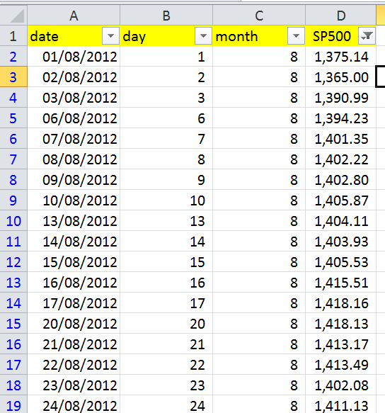
S&P500 Historical Data
What problem are you attempting to address or solve?
- Investors know which day or which month to log in to their trading accounts and buy stocks.
- Is it true there is phenonmenon such as “sell in May and go away”: meaning low prices from May and June
Who may it matter to?
Investors who like to invest in the overall market (S&P500 Index), purely based on the date (e.g. 23rd of the month), or the month itself.

Slide 10
Data: What data exists to help solve this problem? - S&P Index Price Where is it coming from? - S&P Official website What does the data look like? - 4 years of data from 1/08/2012 to 01/08/2016, with total 2 columns (Date, 1 Index). What is the observation? - As the price increases over the 4 years, the data set has to be split into 4 sets, 1 year each (i.e. 2012, 2013, 2014, 2015 onwards)
Exciting insights on stocks

Slide 11

Video Perfect
Lightning Presentation
Hypotheses: Given the problem and data you're aware of, what do you believe is the solution?
The hypothesis is that there are actually no months or days where stock prices are higher than other months.
The solution is it does not matter which month you fit into the model, the price is still not having a large difference
What does success look like?
- Success will show no correlation between month vs. price, or day vs. price.

Slide 12
Can Apple’s stock price predict Google’s stock price?
3
My eyes are hazy! I need more sleep!

Slide 13
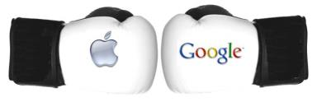
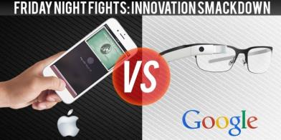
Apple VS Google
The Problem: What's the background and scope of the project idea?
By looking at the Apple’s stock price, can we predict Google’s stock price?
What problem are you attempting to address or solve?
An intellectual curiosity: does the rise of Apple mean a fall in Google? Or do they instead have a symbiotic relationship where when Apple does well, Google also does well.
Who may it matter to?
- People who are curious about business. Google’s businesses such as Adwords, are they helped by Apple’s businesses, such as the iPhone?

Slide 14

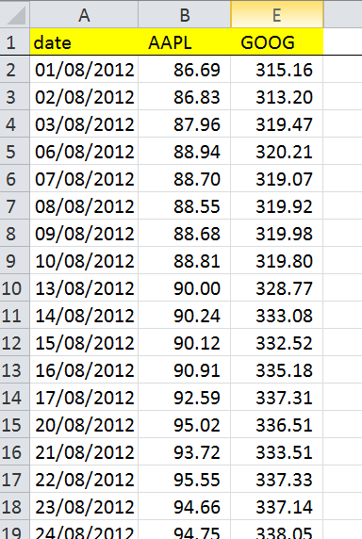
Data analysis
Data: What data exists to help solve this problem?
Stock Prices (close at end of the day) of Apple, Google
Where is it coming from?
- Kaggle
What does the data look like?
1,007 days from 1/08/2012 to 01/08/2016, with total 3 columns (Date, 2 companies)
What is the observation?
- Wildly varying but it seems Google is performing better than Apple and Apple is not a good predictor of Apple’s performance
Price of Apple (AAPL) and Google (GOOGL) across 4 years

Slide 15

Lightning Presentation
Hypotheses: Given the problem and data you're aware of, what do you believe is the solution?
- The hypothesis is that when Apple rises or falls, Google is not affected.
The solution is that Apple prices do not affect Google stock prices.
What does success look like?
- Success will show a low or non-existent correlation between Apple stock prices and Google stock prices.

Slide 16





I hope you enjoyed the presentation
What’s Your Message?

