Slide 1
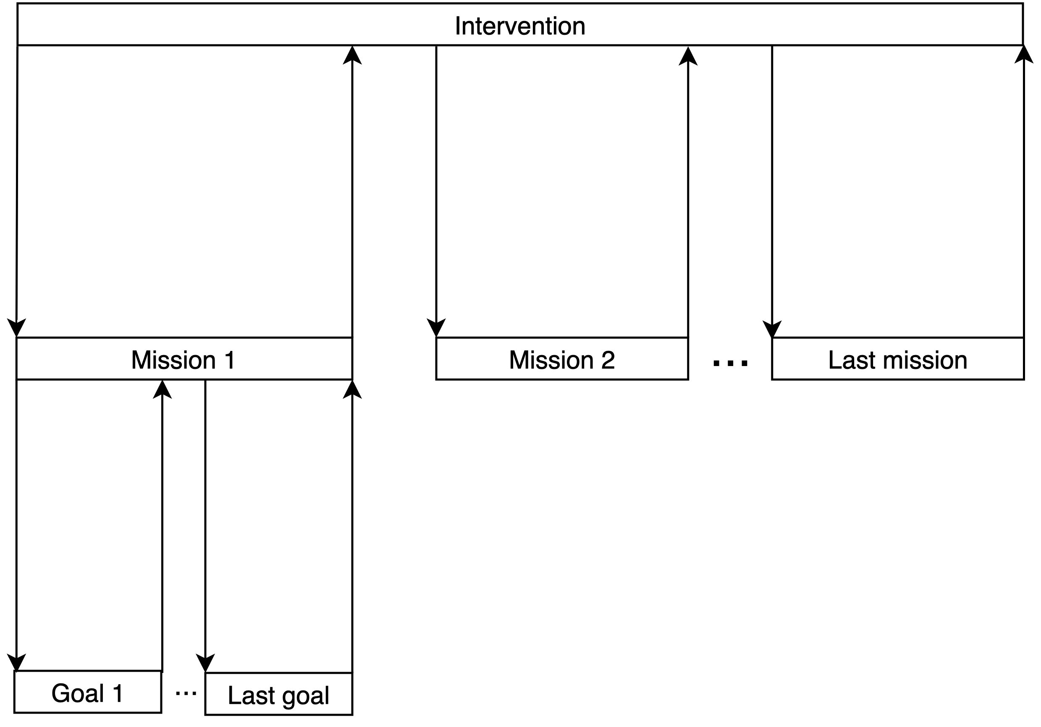
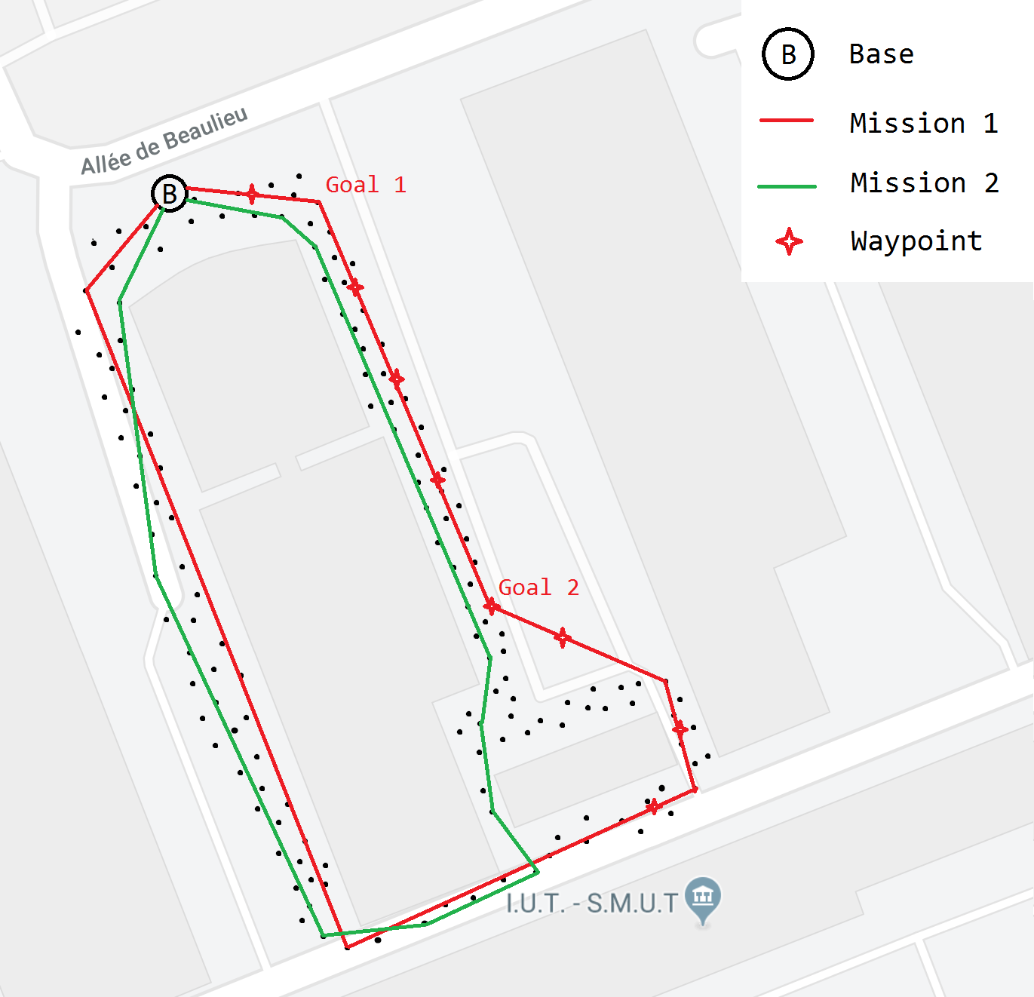
Definitions 1/3
We call intervention any operation in which we use sensors to collect data. It could be a search and rescue operation, like finding skiers burried in avalanches or rescue people stuck in a fire.
During the intervention, the user can give instructions to the drone.
We call this set of instructions a mission.
Then, the planning solver splits the mission into goals, e.g. locations the drone has to reach.
During the execution of the mission, the drone sends its locations to the base. The waypoints summarizes the trajectory of the drone, including when the drone stops itself to collect/send data.
A waypoint could be linked with a goal.

Slide 2
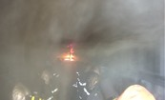
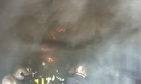

Definitions 2/3
All the videos are stored in the media asset management, and referenced in the associated database.
A frame context gives additional informations about one specific moment of the video, like the location of the sensor or the scale of a thermal picture.
A sequence context extends the notion of frame concept to a continuous set of frames.
In addition to the frame/sequence context, we can add an analysis related to parts of a video. For example, if a person is detected in a specific sequence of the video.
Frame
Sequence
Analysis
Video

Slide 3
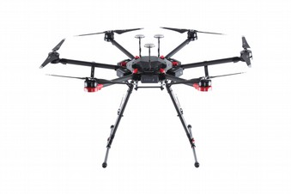
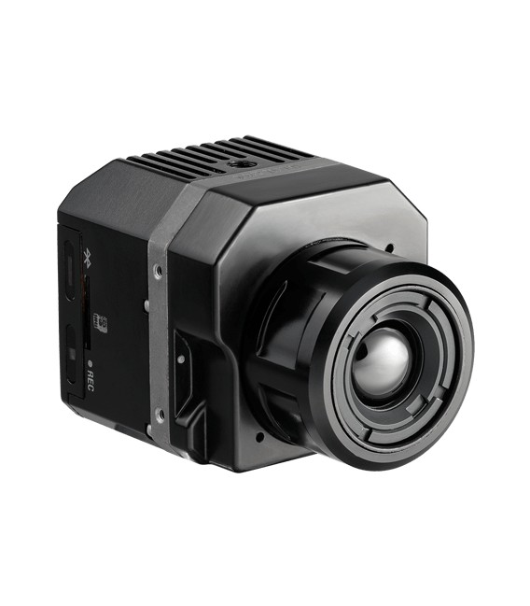
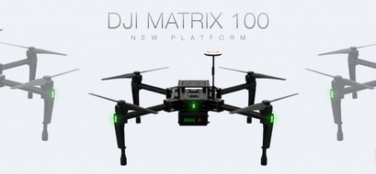
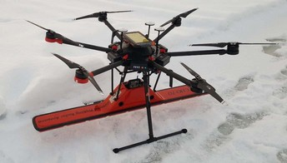
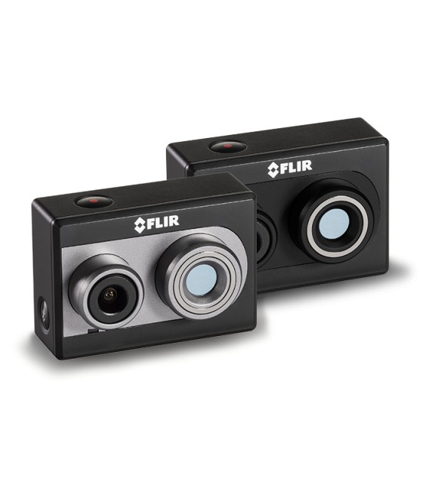
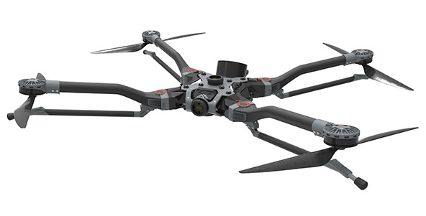
Definitions 3/3
We store data about what we use to collect data, like drones and sensors.
Matrix 600 pro
Flir vue pro r
Tundra
Georadar
Flir vue duo

