Slide 1
In-Sillico Modelling for Non-Invasive Estimation of Static Compliance
Lasse Leuchtmann

Slide 2
Agenda
Problem recap
Solution recap
Report Corrections

Slide 3
Esophageal Pressure
Esophageal Manometry
Transmural Pressures
Pleural Pressure
In-sillico estimation

Slide 4
Static Compliance
Necessity
Breathhold
In-sillico estimation

Slide 5
Problem Statement
How can a model be developed which estimates a patient's C_{rs} without the need for a breathhold?

Slide 6
Hypothesis
Possible to measure C_{rs} at static conditions during mechanical ventilation

Slide 7
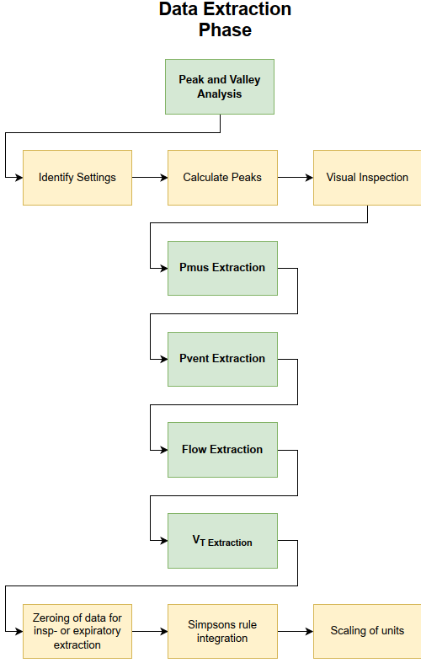
Preprocessing and data extraction

Slide 8
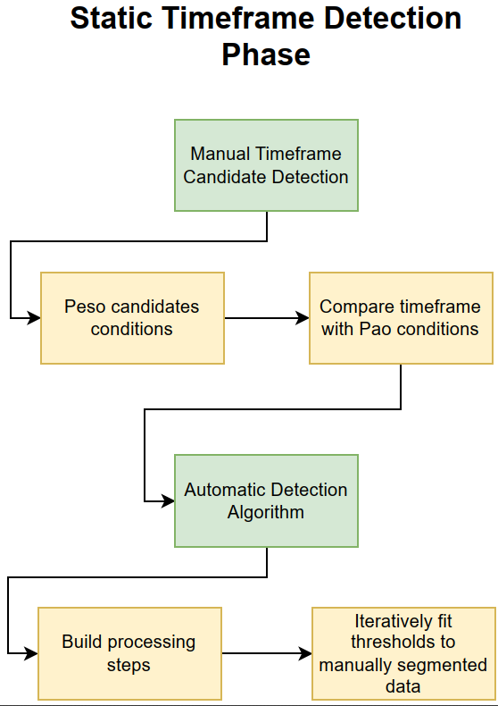
Static Timeframe Detection Phase

Slide 9
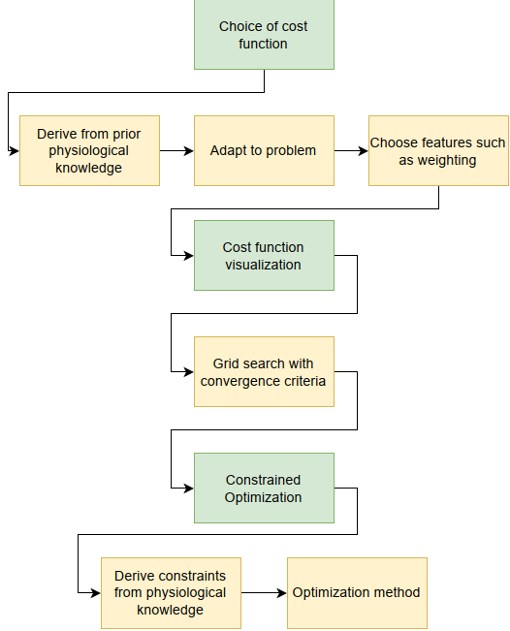
Compliance estimation phase

Slide 10
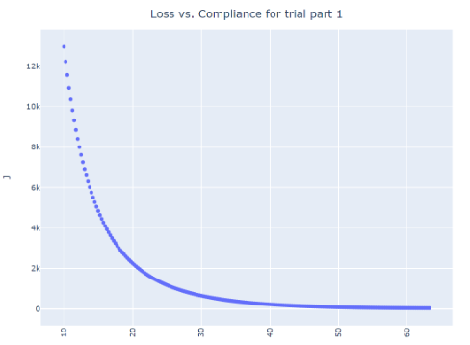
Results

Slide 11
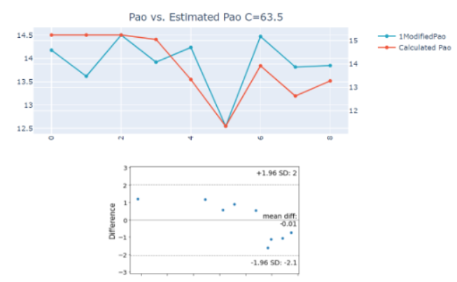
Results

Slide 12
Report Corrections
Figures
Tables
Math Equation

Slide 13
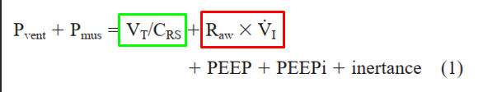



Extended Testing
Variables implemented, testing in progress

