Slide 1
In-Sillico Modelling for Non-Invasive Estimation of Static Compliance
Lasse Leuchtmann

Slide 2
Agenda
Problem recap
Solution recap
Report corrections
Extended testing

Slide 3
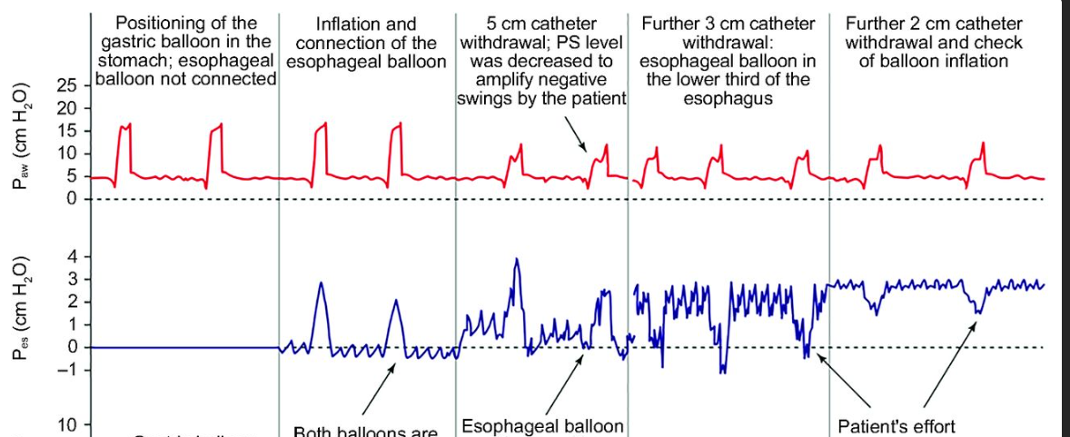
Esophageal Pressure
Transmural Pressures
Pleural Pressure
Esophageal Manometry
In-sillico estimation

Slide 4
Static Compliance
Necessity
Breathhold
In-sillico estimation

Slide 5
Problem Statement
How can a model be developed which estimates a patient's C_{rs} without the need for a breathhold?

Slide 6
Hypothesis
Possible to measure C_{rs} at static conditions during mechanical ventilation

Slide 7
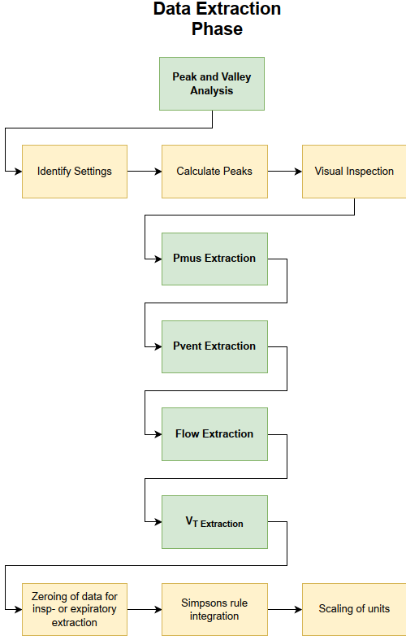
Phase 1 - Preprocessing and data extraction

Slide 8
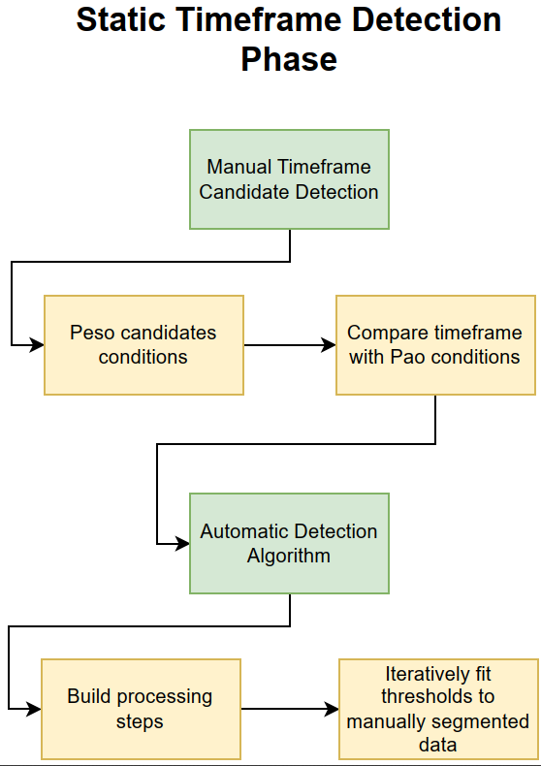
Phase 2 – Static Timeframe Detection

Slide 9
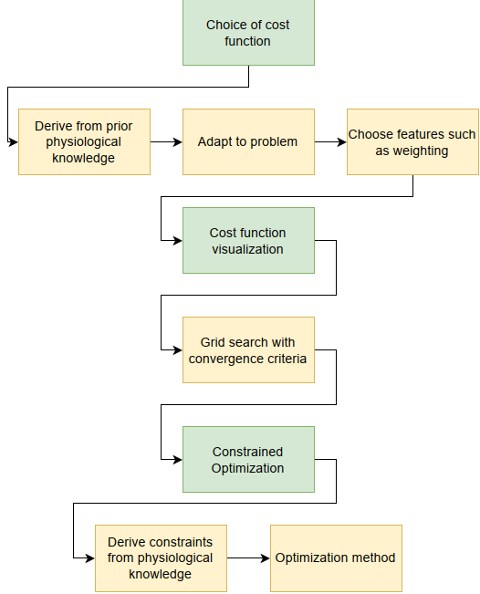
Phase 3- Compliance estimation

Slide 10
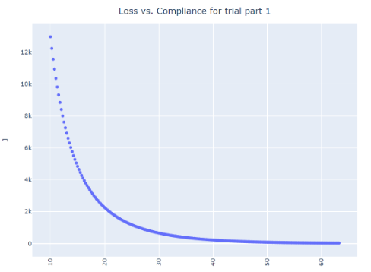
Results

Slide 11
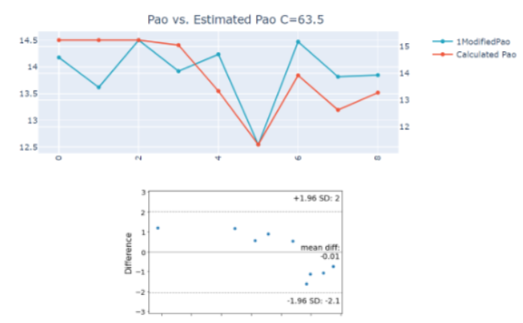
Results

Slide 12
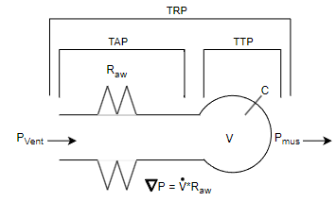
Report Corrections
Misleading figure
Fig. 2.3 P. 5

Slide 13
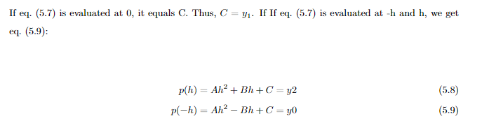
Report Corrections
Wrong statement
Math Equation p. 20
If p(x) is evaluated at..

Slide 14
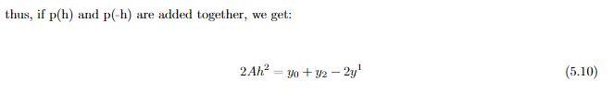

Report Corrections
Wrong statement
Math Equation p. 20-21
The expressions for y₀,y₁ and y₂ are substituted in eq. 5.7,
leading to eq 5.1

Slide 15
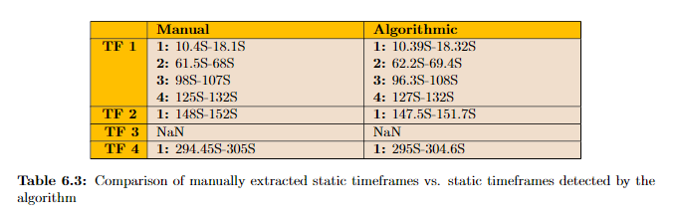
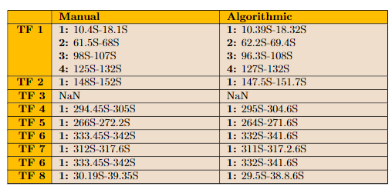
Report Corrections
Missing rows
Table p. 29

Slide 16
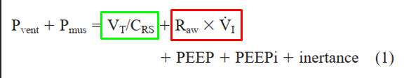



Extended Testing
Implemented using the method developed by [Al-Rawas et. Al., 2013], described in appendix E

Slide 17
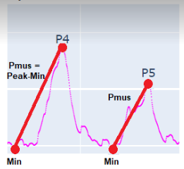
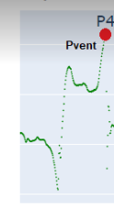
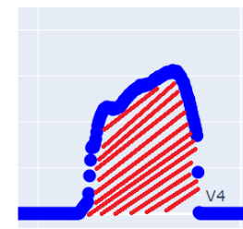
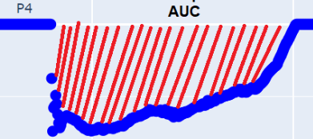
Extended Testing
P_{eso}
P_{ao}
v̇_{exp} + V_{texp}
v̇_{insp} + V_{tinsp}

Slide 18
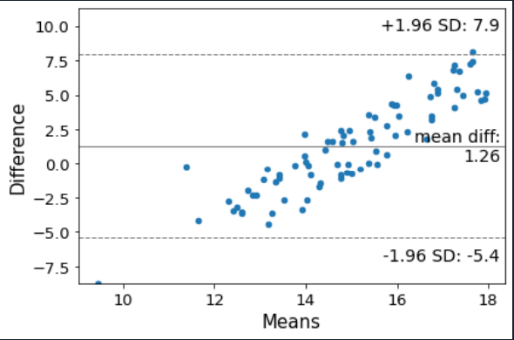
Extended Testing – Trial part 1
Breaths = 79 C=63.5

Slide 19
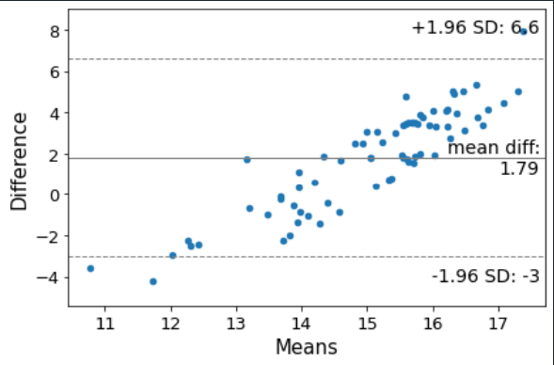
Extended Testing – Trial part 2
Breaths = 70 C=66.5

Slide 20
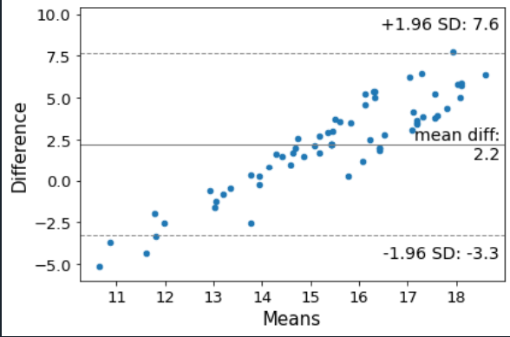
Extended Testing – Trial part 4 (3 is NaN)
Breaths = 66 C=60.5

Slide 21
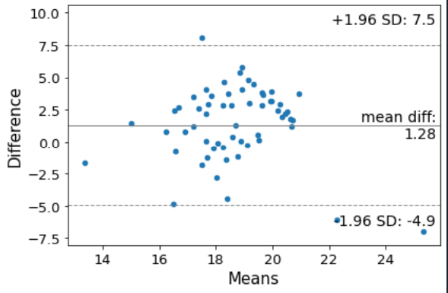
Extended Testing – Trial part 5
Breaths = 67 C=65.3

Slide 22
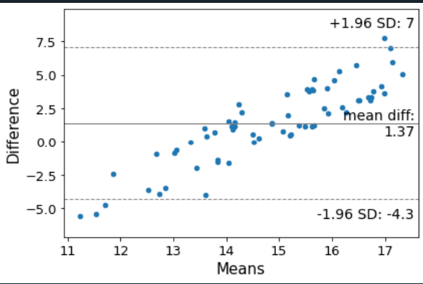
Extended Testing – Trial part 6
Breaths = 67 C=61.7

Slide 23
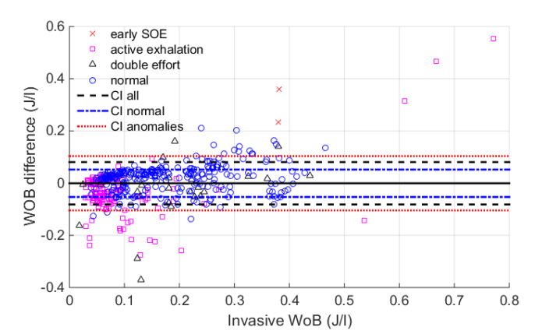
Bland-Altmann Comparison
[Francesco et. Al 2015]

Slide 24
Conclusion
The method proposed by [Al-Rawas et. Al, 2013] provides systematically offset results
Thus, the method provides low accuracy but high precision for the given use case

Slide 25
Conclusion
The report conclusion is not significantly altered
“The models ability to estimate static compliance at no-flow conditions has error rates similar to other non-invasive estimation models. However, larger scale testing on additional test criteria is needed to generalize the study's results to a broader patient population.”

