Slide 1
Vejledermøde 2

Slide 2
Agenda
Model presentation
Overall Framework
Documentation & Implementation of Valve2022 object
Testing
Feedback
Progress with remaining modules
Cardiopulmonary interactions
Bioelectrical Modeling
Preliminary framework
Presentation of milestone
Finish cardiopulmonary module (21/10)
Implement with cardiac model (30/10)
Build parameter optimization framework (7/11)

Slide 3
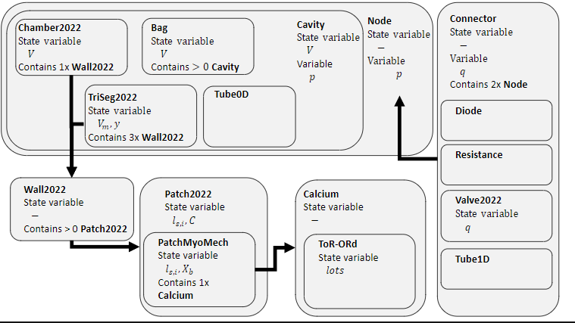
Overall circadapt framework

Slide 4

Valve2022 -> Implementering
Visse antagelser gælder:
Blod er ukomprimerbar, ikke-newtonisk væske
Tyngdekraft kan ignoreres
Kinetisk energi forsvinder væk fra åbningen
Inerti beregnes ud fra:
Hastighed estimeres fra flow over areal
Indgangs tryk- og flow konverteres til kinetisk energi
Udgangs tryk genvindes ikke baseret på turbulens.
Plug flow antages (ens hastighed og retning)

Slide 5


Valve2022 -> Implementering
Bernoulli’s ligning kan benyttes til at beregne trykforskellen over ventilen, hvis laminært og stabilt flow antages:
E_{kin} beregnes som integralet af ½pv² over hele åbningen og dens påvirkningsområde
Antagelsen af at hastighed beregnes som flow over Areal, medfører at:
Antagelsen at inerti beregnes medfører at:

Slide 6

Valve2022 -> Implementering
Den endelige ligning for tryk fratrækker effekten af inerti ganget med ændringen I tid:

Slide 7
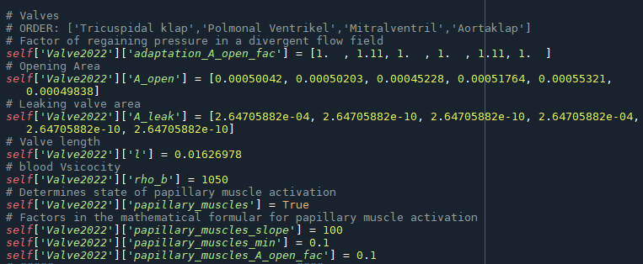
Valve2022 -> Implementering

Slide 8
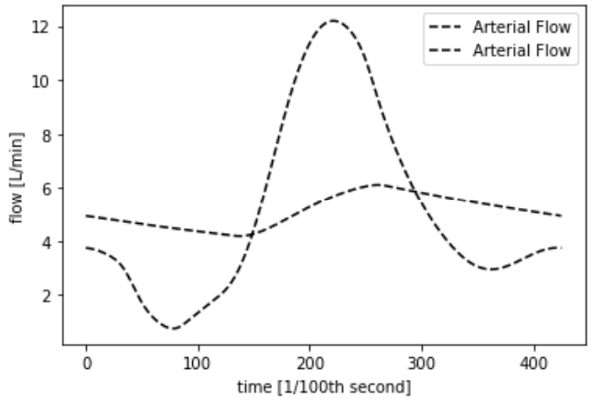
Model Test

Slide 9
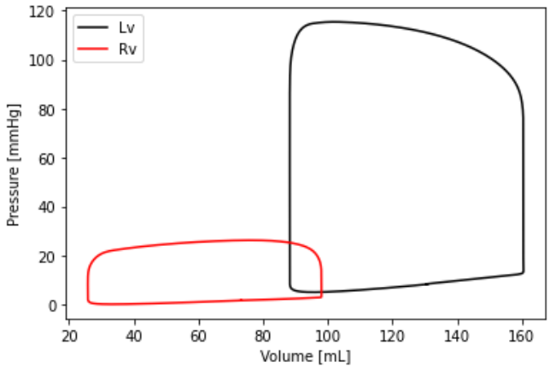
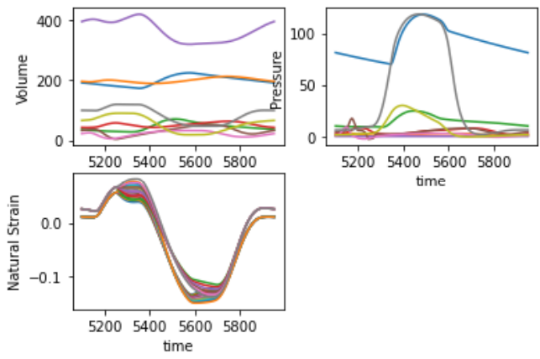

Slide 10
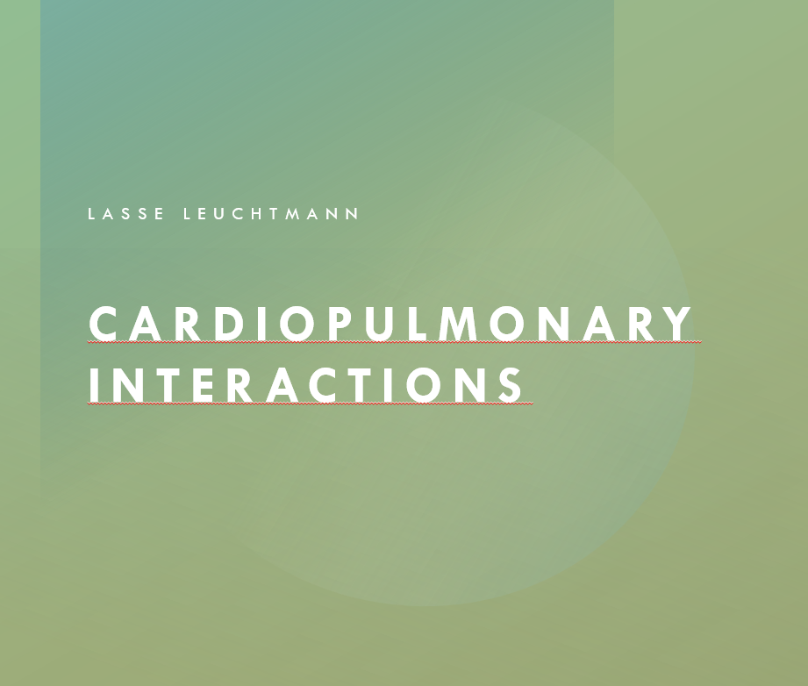
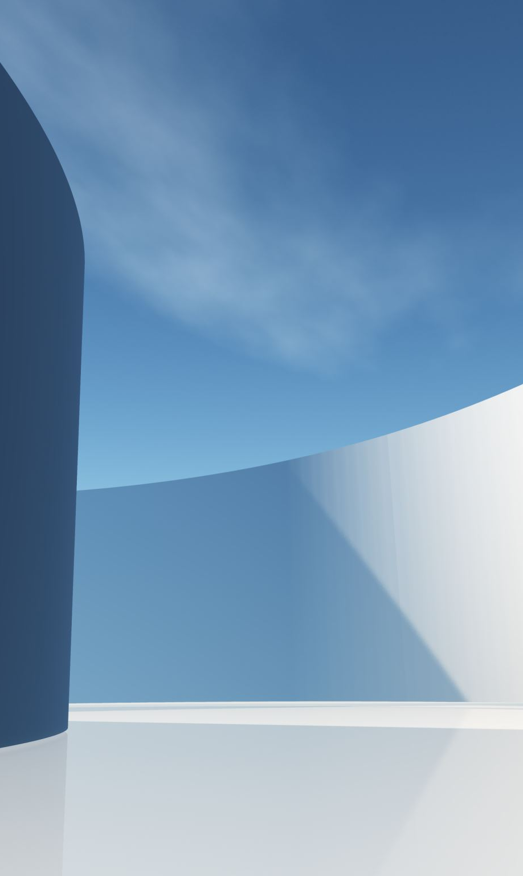
Cardiopulmonary Interactions
Lasse Leuchtmann

Slide 11
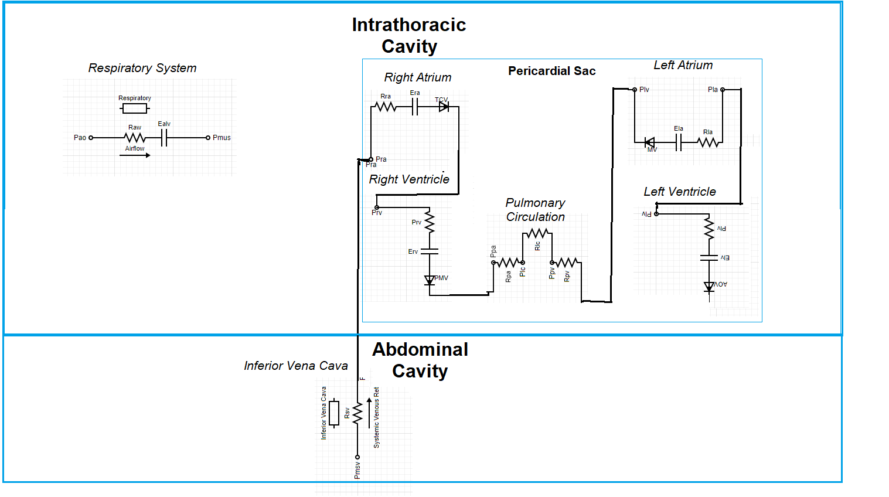
CardioPulmonary System

Slide 12
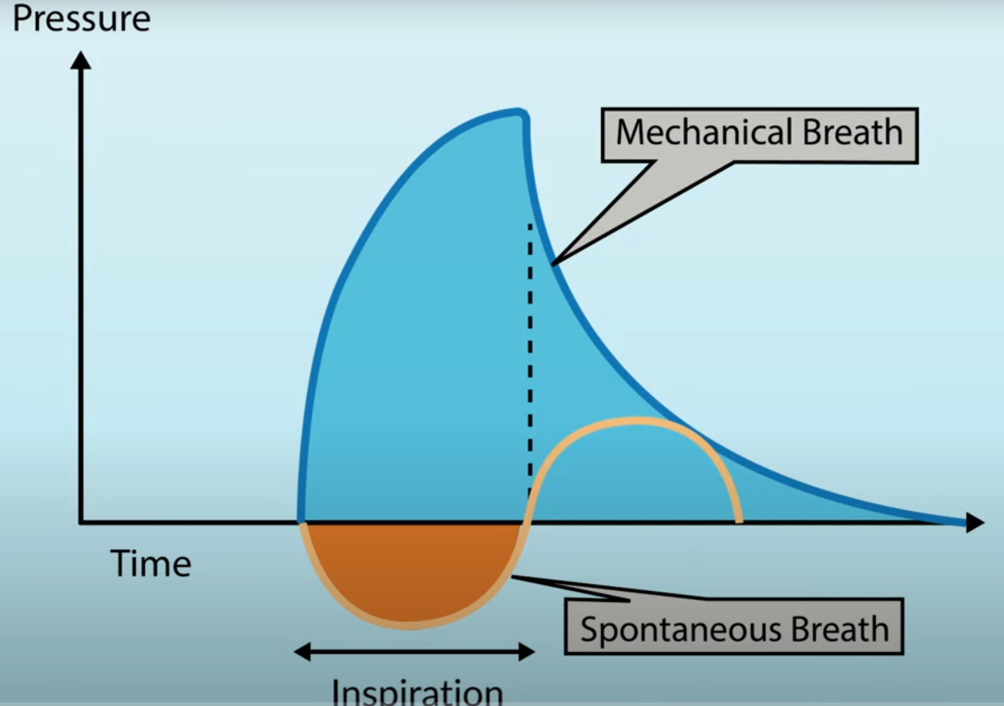
Mechanical Ventilation vs. Spontaneous Breathing

Slide 13
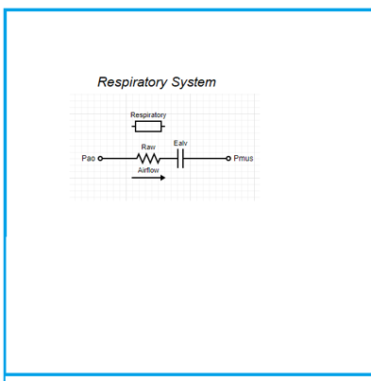
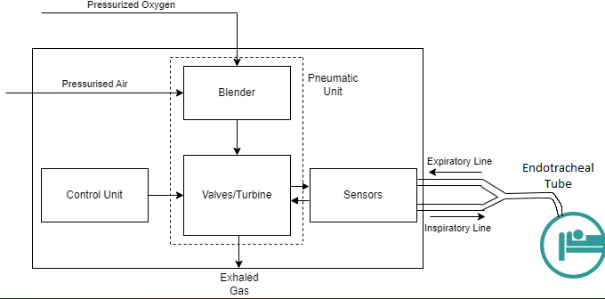
Positive Pressure Ventilation
Intrathoracic Cavity

Slide 14
Positive Pressure Ventilation
Lung volume
Isovolumetric Thoracic Cavity
Boyles law: Ppl
Intrathoracic Cavity

Slide 15
Positive Pressure Ventilation
Ppl
Ppa
Isobaric Pvc

Slide 16
Positive Pressure Ventilation
Right Side
Ppa results in RV afterload
Pra and isobaric Pvc results in systemic venous return (SVR)
SVR results in RV preload
Left Side
RV preload results in LV preload
Ppl results in LV afterload

Slide 17
Negative Pressure Ventilation
Right Side
Ppa results in RV afterload
Pra and isobaric Pvc results in systemic venous return (SVR)
SVR results in RV preload
Left Side
RV preload results in LV preload
Ppl results in LV afterload

Slide 18
Spontaneous Breathing (Inspiration)
Diaphragm contraction increases volume
Ppl decreases
Intraabdominal pressure increases
Pvc increases
SVR increases

Slide 19
Milestones
Finish cardiopulmonary module (21/10)
Implement with cardiac model (30/10)
Build parameter optimization framework (7/11)

