Slide 1
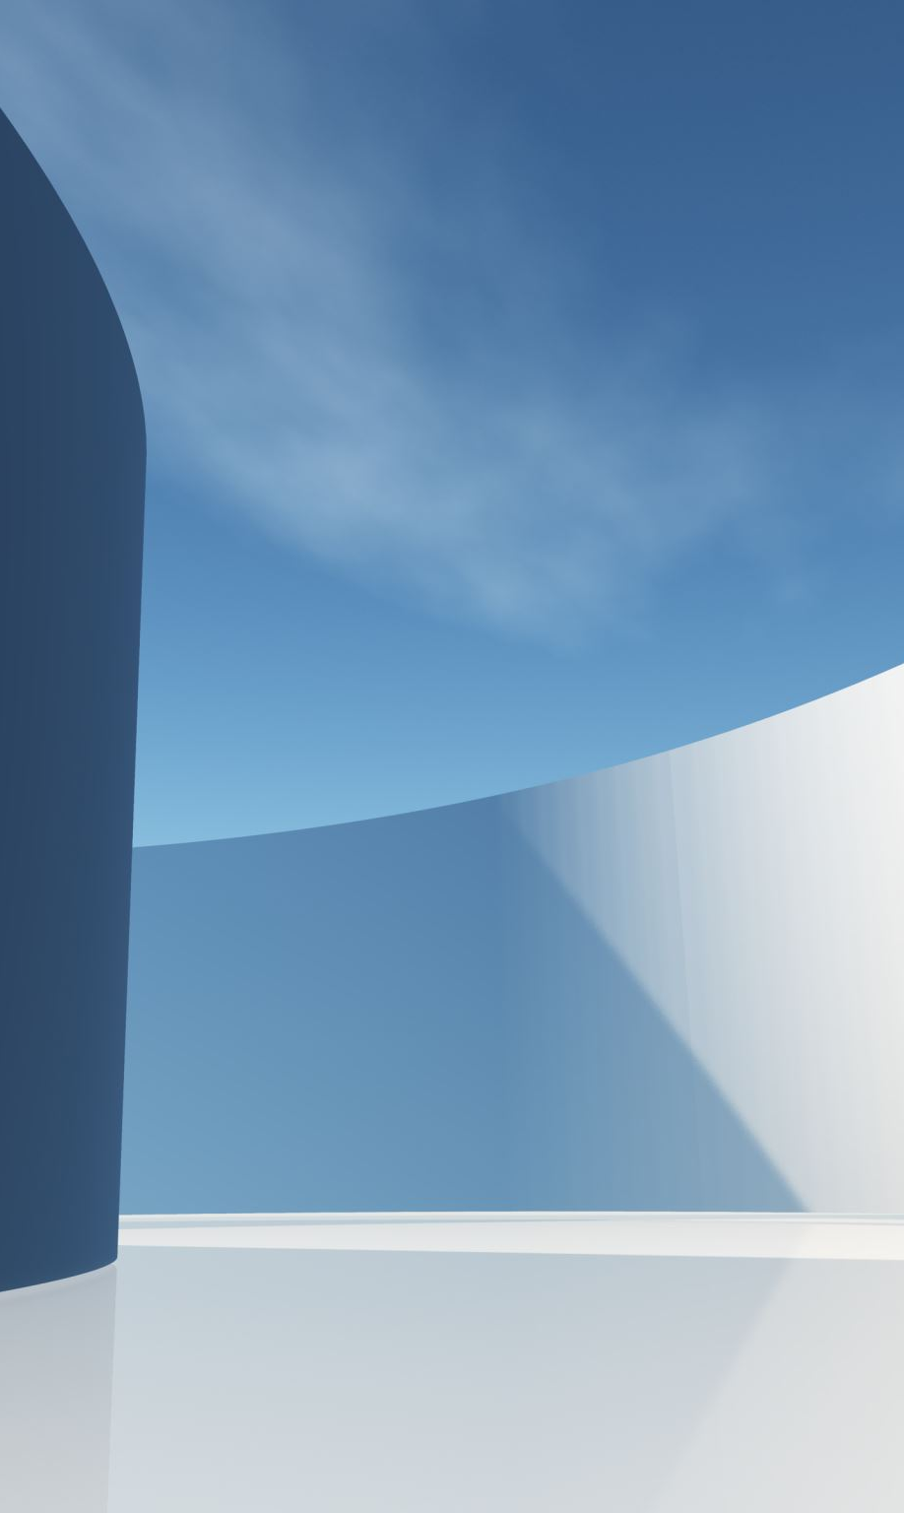
Cardiopulmonary Interactions
Lasse Leuchtmann

Slide 2
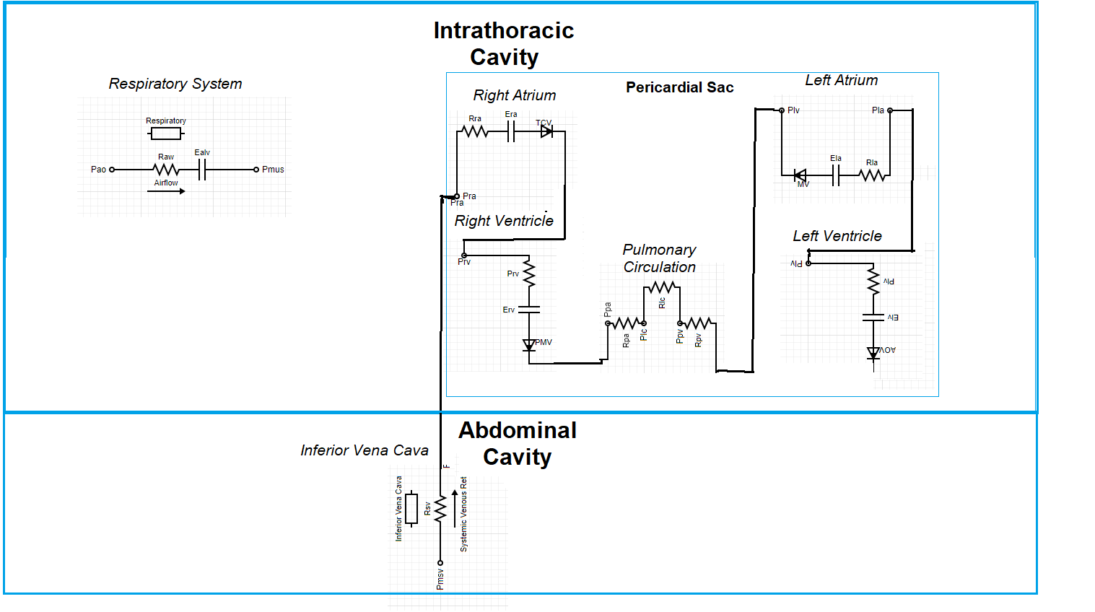
CardioPulmonary System

Slide 3
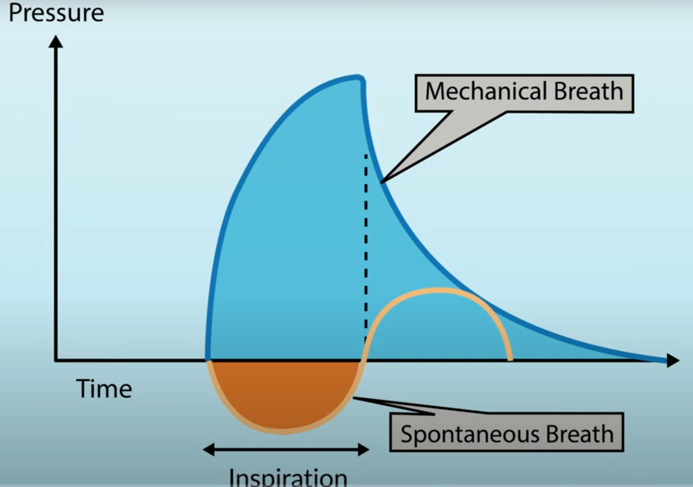
Mechanical Ventilation vs. Spontaneous Breathing

Slide 4
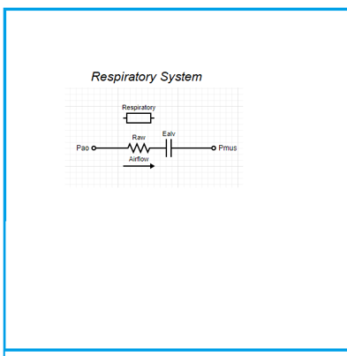
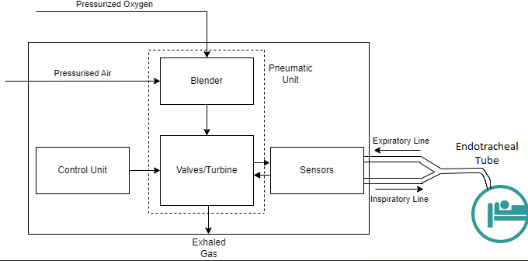
Positive Pressure Ventilation
Intrathoracic Cavity

Slide 5
Positive Pressure Ventilation
Lung volume
Isovolumetric Thoracic Cavity
Boyles law: Ppl
Intrathoracic Cavity

Slide 6
Positive Pressure Ventilation
Ppl
Ppa
Isobaric Pvc

Slide 7
Positive Pressure Ventilation
Right Side
Ppa results in RV afterload
Pra and isobaric Pvc results in systemic venous return (SVR)
SVR results in RV preload
Left Side
RV preload results in LV preload
Ppl results in LV afterload

Slide 8
Negative Pressure Ventilation
Right Side
Ppa results in RV afterload
Pra and isobaric Pvc results in systemic venous return (SVR)
SVR results in RV preload
Left Side
RV preload results in LV preload
Ppl results in LV afterload

Slide 9
Spontaneous Breathing (Inspiration)
Diaphragm contraction increases volume
Ppl decreases
Intraabdominal pressure increases
Pvc increases
SVR increases

