Slide 1
Web Application Development
JAVA 8

Slide 2
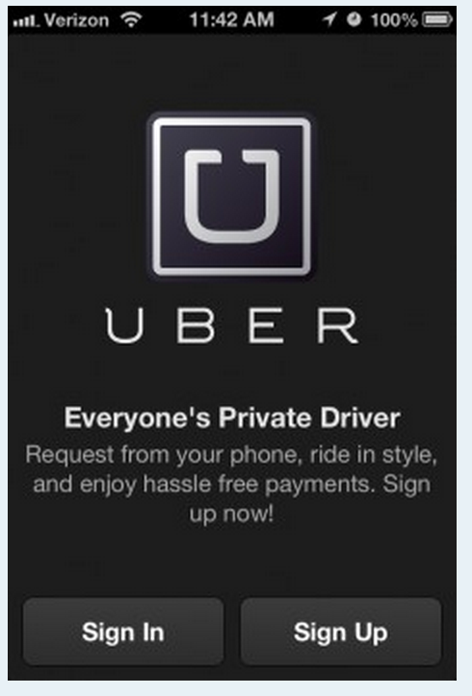
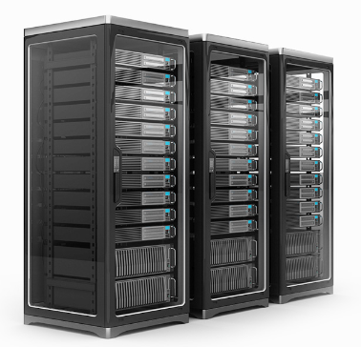
Web Application Architecture
Front End
Servers
Back End
Servers
App
sign in request
authenticate
auth status
Notes:
Describe what happens when they interact with an App on their phone like Uber

Slide 3
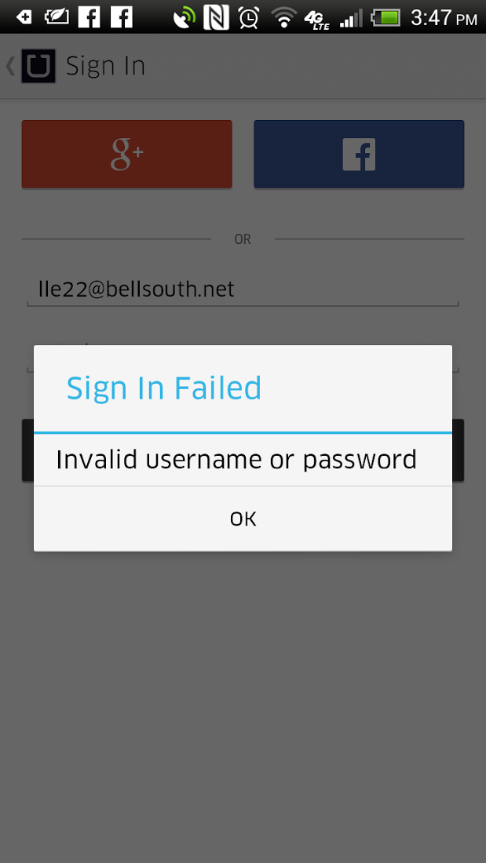
Web Application Architecture
App
Front End
Servers
Back End
Servers
sign in failed
response
auth status :
failure
Notes:
Result of bad login

Slide 4
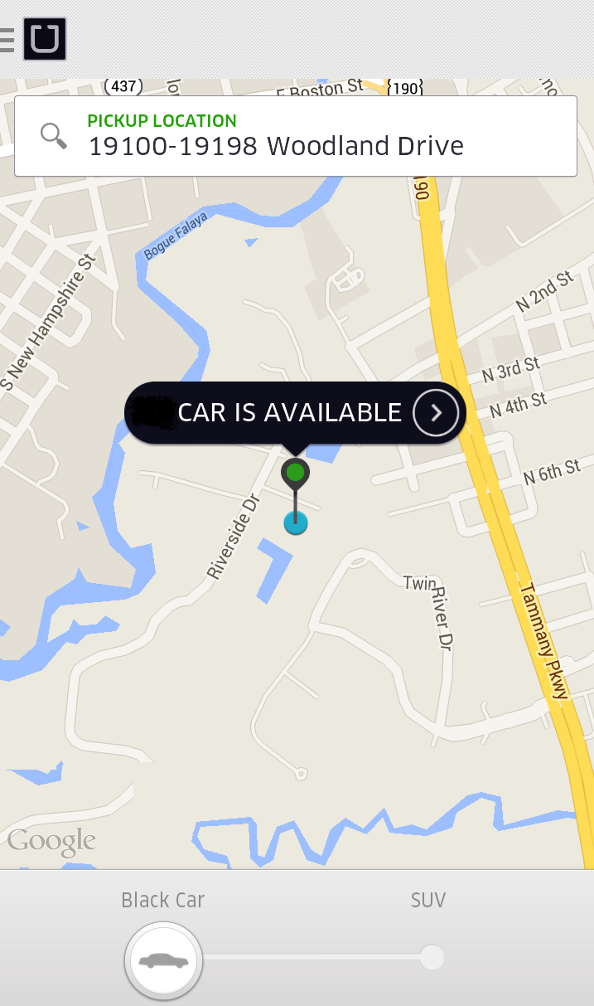
Web Application Architecture
App
Front End
Servers
Back End
Servers
sign in success
avail response
isAvailable?
available
Notes:
Result of successful login

Slide 5
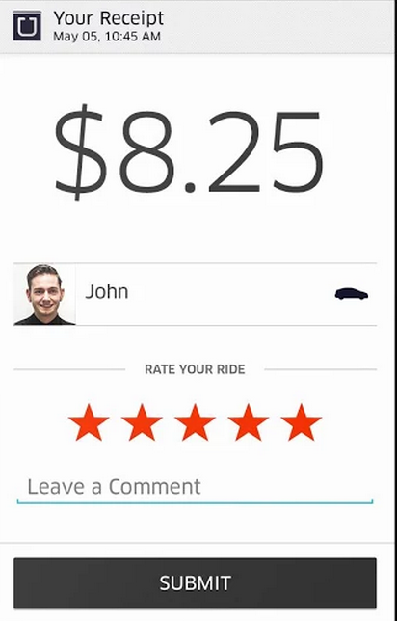
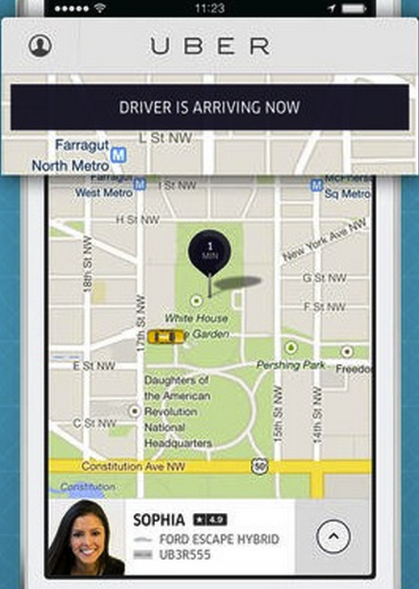
Web Application Architecture
App
Front End
Servers
Back End
Servers
estimate route request
estimate route duration & fee
estimate route response
estimate response
reserve car request
reserve car
car in progress response
reservation *& car status
Notes:
Throughout the app, there can be multiple paths and, as well, multiple types of results sent back to the user

Slide 6
Web Application Architecture
Device
Web Application
APP
Services
Controllers
Content presented to the user
Process
HTTP request
Executes business decisions
Send out HTTP requests
Invoke services
Authenticate
Authorize
Estimate
Plan
Prep & return HTTP response
Receives HTTP response
Notes:
Architecture begins to emerge
Content is dynamic
HTTP requests are sent according to how the user interacts with the App
Reponses are rendered

Slide 7

Model View Controller Pattern
Controller
Model
Populate dynamic user data
Process HTTP requests
Execute Business Logic
View
Decides which view to render
Prep View and Model
User
Content presented to the user
Return HTTP response
Notes:
Abstract away the hardware
A device is a device no matter if it is your phone, laptop or tablet.
Device real-estate will be a concern, but the view’s content will most likely be the same
Introduce the Sweapers to the language that you’ll see when beginning to develop and interact with their team and the source code.

Slide 8
Services
Controller
JPA
Rely on several types of services
Database
REST
Documents Collection
As a developer, you will implement and invoke these services
SOAP
Finance Service
Banking Service
Notes:
Each service may employ a complex algorithm – shortest path first; nearest driver available.
Rules/Interfaces exist as to how to interact with the service.
The service interface is already predefined.
Introduced to new technologies in order to interact with a service -
Database – JPA
Document retrieval – REST
Complex services via web messages - SOAP

Slide 9
Java Persistence API
JPA
Persistence layer exists between your App and the database
Developer defines Interactions with data as services
Database
Example Services:
Modify User Service
Developer won’t need to write SQL
Add User Service
Persistence layer prevents dependence on DB vendor
Get User Service
Delete User Service
SQL is generated at runtime

Slide 10
REST & SOAP Services
REST
Representation State Transfer
Retrieving a document through a URL and ID parameter
Document Repository
Services can be invoked through a URL on an Asset
http://openge.ge.com/nalh/plandocument?id=67844
SOAP
Used to invoke complex services
Finance Service
Construct a message to be sent to a web service to accomplish complex tasks

Slide 11
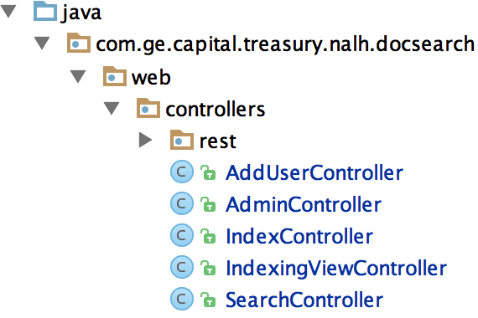
Java Project Structure
Controllers process the user’s requests

Slide 12
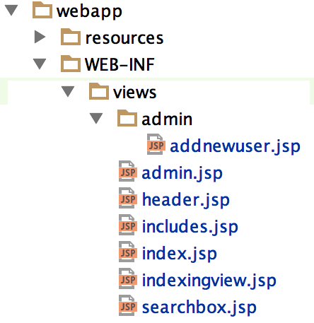
Java Project Structure
Views
are the layout and presentation of a web page

Slide 13
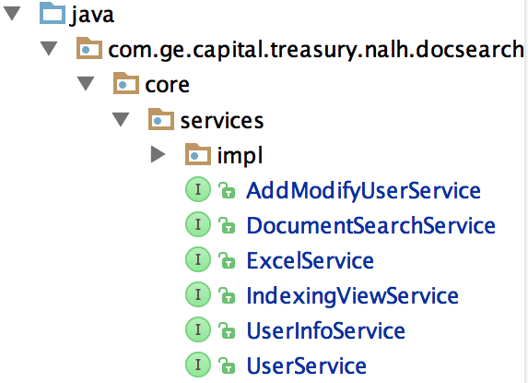
Java Project Structure
Services
are invoked to perform business logic

Slide 14
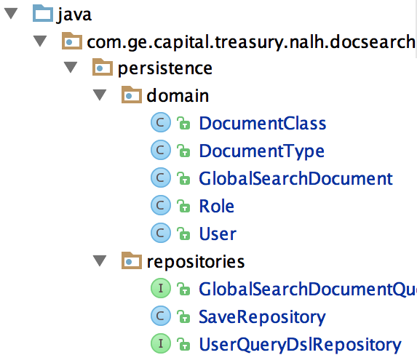
Java Project Structure
A persistence layer is defined to interact with a datasource
In ORM, a tuple in a database table is converted to an object in Java

Slide 15
Java API
In Web App development, a developer will utilize:
Java Interfaces
Collections
Generics
Exception Handling (try/catch)
Regular Expressions to validate data
Date/Time APIs
Good practices
Simple methods
Reusability
Secure coding
Write Tests!

Slide 16
Web App UI
To Develop the Web UI:
Build dynamic page components in JSP
Reference dynamic data from the model
Use JavaScript to access elements on a Web page
Apply jQuery (efficient JavaScript)
Use UI libraries for powerful widgets (BootStrap)
Leverage HTML
Leverage GE IIDX web components

Slide 17
Web Framework
To Run a Web App, a developer will:
Use Annotations to map each URL to a Java method
Use Annotations to define web app behavior
May depend on a framework to instantiate common classes
Depend on a web application server (Tomcat) to host their app

Slide 18
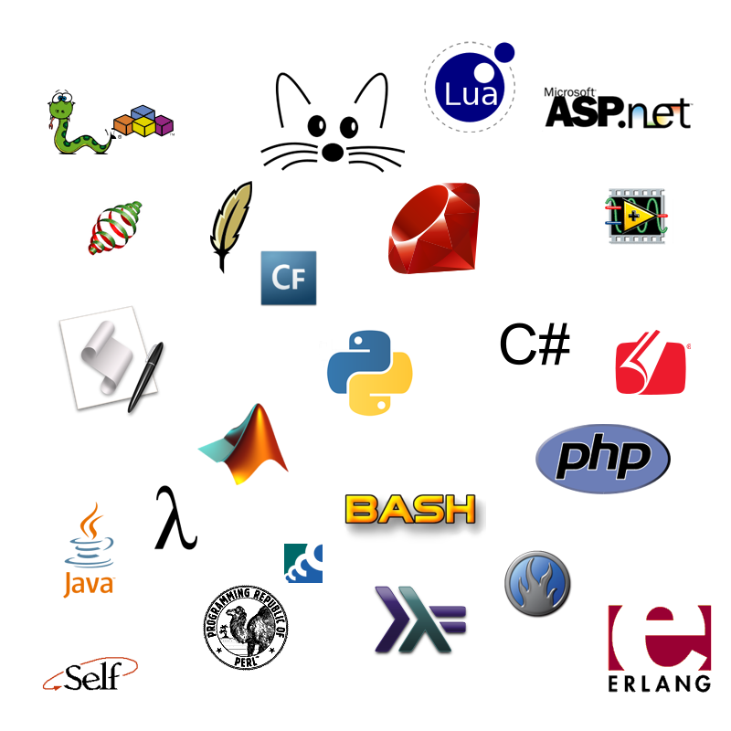

Popular
Programming Languages
Have Fun!!

Slide 19
Software Engineering Concepts
Real World Modeling => Object Oriented Development
Event Handling => Handling User Inputs , Actions
Cloud => Computing functions, assets resides on a shared server privately or publicly
Multi-Threading => Requests are processed synchronously; each handled by a processing “Thread”
Artificial Intelligence => Computing functions begin to make real-world decisions based on past, historical decisions and outcomes

Slide 20
Web Development Concepts
Front End => Handled by CSS, HTML to render the Document Object Model
Front End Frameworks => JavaScripts, Jquery, Angular, React, GO, Node.JS
Document Object Model => All of the elements that make up a Web Page
Back End => Handled by Python, Java, Scala to interact with a Database and perform business calculations

Slide 21
How to Proceed
Tutorials at Computer Science Education Week https://csedweek.org/learn
Choose Grades 9+
Khan Academy : Databases
Robots & Java
Transformation Puzzles
Your First Python Code
Hack Reactor – New Orleans
http://www.hackreactor.com/blog/hack-reactor-pilots-techhire-initiative-with-new-orleans-non-profit-operation-spark

Slide 22
How to Proceed
Delgado Community College – Computer Information Technology
Delgado College - Computer Information Technology
Loyola – New Orleans – Computer Science
Loyola - New Oleans - Computer Science Bulletin
Southeastern – Hammond – Computer Science
SELU - Computer Science
LSU – Computer Science & Engineering
LSU - Electrical & Computer Engineering

Slide 23
Hour Of Code
Coding Track
Have Fun!!

