Slide 1
MyGECapital
Application Refactoring & Development

Slide 2
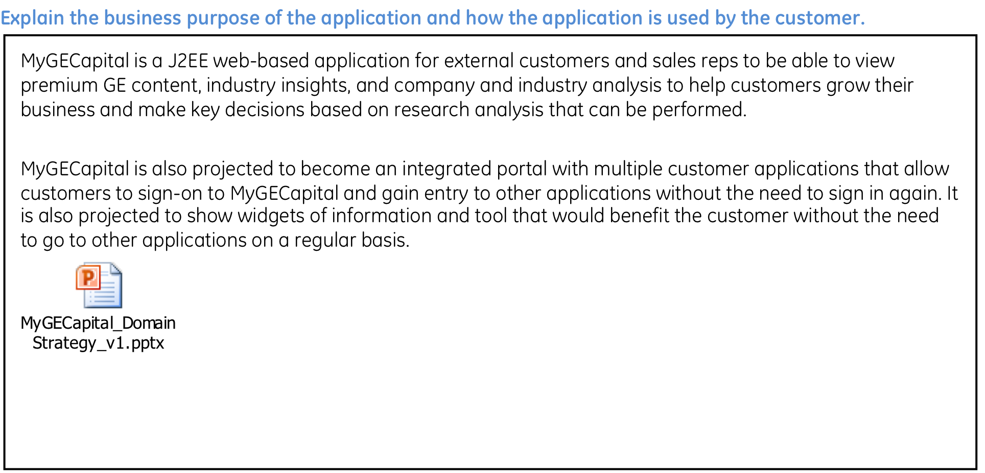
Business Purpose of the Application

Slide 3
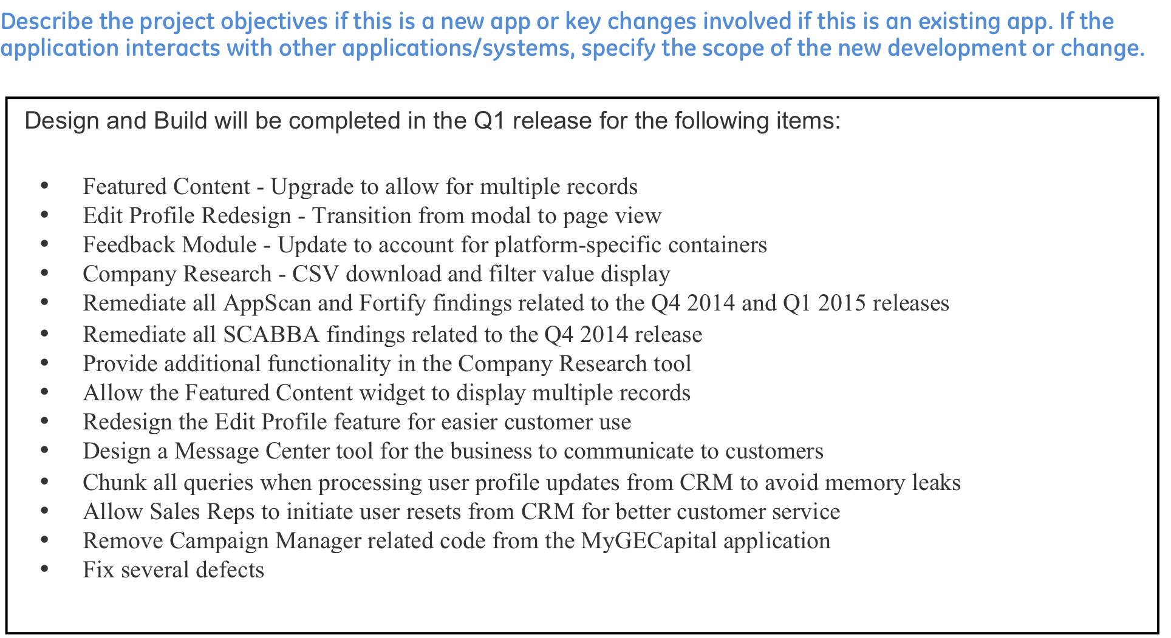
Project/Change Objective

Slide 4
Goals & Objectives and Solution Overview
Goals & Objectives
Provide an integrated customer experience for our customers
Seamless SSO
Provide the foundation to drive differentiation (technology as a competitive advantage):
GPB Box 2 & 3 ideas
Disruptive technology solutions
Make it easy to offer to customers & measure the value of differentiation:
CRM integration
Linking Accounts, Contacts data to digital offerings
Solution Overview
Profile based, configurable IT platform defining a common user experience accommodating all GECA customer types
Seamless SSO integration with transactional customer applications – LS, COMS, MyAccounts, Access GE
Integration with various digital asset types applicable to GECA customers:
Interactive tools
3rd party resources
Integrated GECA Platform
Application | # Users (YE12)
MyAccounts (Loan) | 400
MyAccounts (Lease) | 100,000
Leasing Source | 25,000
COMS 2.0 | 60,000
Access GE (GEC) | 1,000
Access GE (GECA) | 3,000
Seamless SSO
Customer Apps
Other Apps
Leasing Source
COMS
SF CRM
Quoter Tools
Access GE
MyAccounts
Other Tools & Resources
SFE Solutions
Opportunity to Delight 100,000+ Users

Slide 5
Goals & Objectives and Solution Overview
Integrated GECA Platform
Application | # Users (YE12)
MyAccounts (Loan) | 400
MyAccounts (Lease) | 100,000
Leasing Source | 25,000
COMS 2.0 | 60,000
Access GE (GEC) | 1,000
Access GE (GECA) | 3,000
Seamless SSO
Customer Apps
Leasing Source
COMS
Access GE
MyAccounts
Other Tools & Resources
Opportunity to Delight 100,000+ Users

