Slide 1
Careers In Technology
Software Developer
IT Security Specialist
Project Lead
UX Designer
Information Architecture
Technical Writer

Slide 2
IT Careers
Software Developer | Achieve organizations goals with software-based solutions. Professionals design and update existing software or develop new programs to address a specific need or solve a particular problem. Often, they specialize in a particular software package or coding language.
IT Security Specialist | Create and manage safe and secure systems crucial for organizations public and private, large and small. Create, deploy, use, and manage systems that preserve individual and organizational privacy and security.
Project Lead | Plans and executes projects of various sizes and complexity from start up through to completion. Successfully delivers projects to meet budget, schedule and scope to a high standard and the client's satisfaction by applying of quality processes and practices.

Slide 3
IT Careers
UX Designer | Designs, constructs, and evaluates interactive technologies for use by individuals and organizations. This work encompasses user interfaces, accessibility concerns, new design techniques and methods for interactive systems and collaboration.
Information Architect | Designs and builds databases, modeling and organizing structured data. Information architecture is a component of Web sites, software, intranets, and online communities. Architects structure the underlying information and its presentation in a logical and intuitive way so that people can put information to use.
Technical Writer | Creates clear, understandable documentation that translates complicated technical processes to a target audience. Technical writers often work with computer software, translating lines of code into understandable, step-by-step explanations.

Slide 4
Bachelor’s Degrees
Software Developer | B.S. Computer Science, Computer Engineering, Mathematics
Information Architect | B.S. in Informatics, B.S. Mathematics, B.S. Computer Science
Project Lead | B.S. Engineering, B.A. Business
IT Security Specialist | B.S. Security & Risk – Information & Cyber Security
UX Designer | B.S. Psychology, Sociology, Graphic Design – emphasis on Technology, Human/Computer Interaction
Technical Writer | B.S. Journalism, Professional Writing, Creative Writing B.A. Business Administration

Slide 5
Applied Technology
Virtual Classroom at school
White boards
Chats w/ professors, assignments on line
Biological sciences - Model and Analysis
MBA - leverage technology to improve processes
Sales – Design – Brainstorming – Entrepreneurship
Electrical / Mechanical Engineering
Hardware Design, Development –, High Performance Computing, Sensor Networks, IoT
Political Science, International Studies
Impoverished countries – embed IT to handle disease, hunger, safety, water supply

Slide 6



Everyday Technology

Slide 7
Technology Drives Modern Society
IT drive change within a business – since technology and data become so central to a company or organization. IT professionals generate ideas to improve system design or streamline product delivery. They can enhance overall quality of processes and the end-product for a company and enhance customer satisfaction, sales and profits.
Protecting IT assets – information, hardware, applications, web sites - then becomes even more critical.

Slide 8
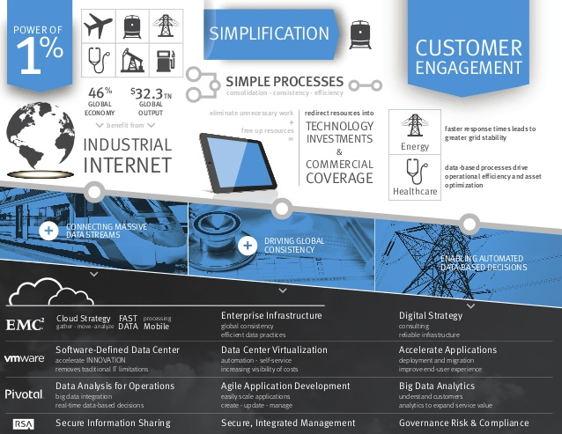

Slide 9
Tools
Software Developer | Java, C++, Smalltalk, Oracle, Linux, OsX, NET – Compilers – Integrated Development Environments
IT Security Specialist | Detection Systems, Monitoring Systems, Hosting & Network Connectivity, Computer Forensics, Security Principles, Risk Assessments
Project Lead | Project Management – Scrum, Agile, Kanban
Information Architect | Conceptual and Logical Data Modeling, RDMS, ERD’s, dimensional modeling - Business Objects, Tableau, Qlikview, Cognos,
UX Designer | Wireframes, Site Maps, Design Tools
Technical Writer | Visual Editors

Slide 10
Titles
IT Security | Applications Security Specialist Network Security Specialist Computer Forensics Specialist Computer System Auditor Intelligence Analyst and Specialist Cyber-Intelligence Analyst Economic Crime Analyst Information Security Analyst
Information Architect | Business intelligence analyst Business process analyst Data Architect Cloud Architect
Project Lead | Program Manager, Product Owner, Scrum Master

