Slide 1
NS2 - Network Simulator 2
Mujibul Islam
Abu Asaduzzaman
COT-6930: Mobile Computing
CSE Dept, FAU, Fall 2003

Slide 2
NS2 - Network Simulator 2
Agenda
Introduction
Installation (Windows, Unix)
Simulation in NS2
  Wired Network
  Wireless Network
Demo Examples
Conclusion
Internet Connectivity for MANet in NS2

Slide 3
Introduction
About NS2
Support networking research and education
  Protocol design, comparison, traffic studies, etc
Provide a collaborative environment
  Freely distributed; share code, protocols, models, etc
  Increase confidence, experts develop models
Used/developed by researchers and universities
Contributions from UCB, CMU, etc and supported by DARPA, NSF, etc

Slide 4
Introduction (Cont’d)
NS2 Components
NS2 - Network Simulator Version 2
Nam - Network Animator (Version 1)
  Visualize NS2 output
Xgraph (Unix), Tracegraph (Windows)
  Graphical representation of the trace files
Pre-processing:
  Traffic and topology generators
Post-processing:
  Simple trace analysis in Awk, Perl, or Tcl

Slide 5
Introduction (Cont’d)
About NAM
NAM provides a visual view of the simulation
  view overall topology - nodes and links
  packets in transmission, queued, and dropped
  can monitor individual nodes, links, or packets
  provides graphical results with xgraph in Unix only

Slide 6
Introduction (Cont’d)
About Xgraph/Tracegraph
Xgraph for Unix/Linux only
Tracegraph for Unix/Windows both
plot graphical results
number of packets transmitted over time, end-to-end delay, etc

Slide 7
Introduction (Cont’d)
Some Functionalities
Wired
  Routing: DV, LS, PIM-SM
  Transportation: TCP, UDP, SRM
  Traffic sources: web, FTP, telnet, CBR, stochastic
  Queuing disciplines: Drop-tail, FQ, SFQ, DRR
Wireless
  Ad hoc routing and mobile IP
  Directed diffusion, sensor-MAC

Slide 8
Introduction (Cont’d)
Other Network Simulation Tools
OPNET Modeler
  Run faster, commercial usages
  Text based, no nice graphics

Slide 9
Introduction (Cont’d)
Conclusion
NS2 supports graphical representations (e.g.,
NAM and Xgraph) that helps to visualize how
protocols work and interact with different
network topologies.
NS2 is a very promising tool for wired and
Wireless network simulation.

Slide 10

Questions?
Questions?
aasaduzz@cse.fau.edu

Slide 11
Installation (Windows)
Install NS2 in Windows
Building NS2 on Cygwin [versions 2.1b9a and 2.26] for Microsoft Windows
  http://csl.ee.iastate.edu/~cpre543/ns2/ns2_howToInstall.htm
Nicolas Christin
  e-mail: nicolas@cs.virginia.edu
  University of Virginia - Dept. of Computer Science
  Last updated on 02/03/2003 or later

Slide 12
Installation (Cont’d)
cygwin-1.3.12 or later with UNIX text type
XFree86 binaries, sources and configuration files
  the XFree86-base, XFree86-bin, XFree86-prog, XFree86-lib, and XFree86-etc packages.
The make and patch utilities
Also, diff, tar, gzip, w32api package
For ns-allinone-2.26
  http://www.isi.edu/nsnam/dist/ns-allinone-2.x.tar.gz
nam-1.9.configure
  http://www.sims.berkeley.edu/~christin/software/nam-1.9.configure

Slide 13
Installation (Cont’d)
ns-allinone-2.x.tar.gz file in Cygwin home directory
nam-1.9.configure file in Cygwin home directory
Launch Cygwin, start an XFree86 server (using startx)
From your Cygwin (bash) prompt run:
  gzip -d -c ns-allinone-2.x.tar.gz | tar xvf -
  mv nam-1.9.configure ns-allinone-2.26/nam-1.9/configure
Now install everything by doing:
  cd ns-allinone-2.x
  ./install

Slide 14
Installation (Cont’d)
Update ENV variables (~/.bashrc)
  point to the right PATH
  export NS_HOME=/home/XXX/ns-allinone-2.x/
  …
Run the validation tests
  cd ns-2.x; ./validate
  Or,
  /home/XXX/ns-allinone-2.x/ns-2.x/validate

Slide 15
Installation (Unix)
Install NS2 in Unix
Linux Style: Network Simulator 2: a Simulation Tool for Linux
  Posted on Monday, October 21, 2002 by Ibrahim F. Haddad and David Gordon
  http://www.linuxjournal.com/article.php?sid=5929

Slide 16
Installation (Cont’d)
Download all-in-one pkg from the NS2 home page
  http://www.isi.edu/nsnam/ns/
  into /usr/src
Extract it as follows,
  cd /usr/src
  tar xzvf ns-allinone-2.x.tar.gz
  cd ns-allinone-2.x
Now install,
  /usr/src/ns-allinone-2.1b8/install

Slide 17
Installation (Cont’d)
Update ENV variables (/etc/profile)
  point to the right PATH
  source /etc/profile
  …
Run the validation tests
  cd ns-2.x; ./validate
  Or,
  /usr/src/ns-allinone-2.x/ns-2.x/validate

Slide 18
Installation (Problems)
General Problems
I can't download ns from this web site
command not found
"apply a patch file“ – ftp.gnu.org
Validation under Windows does not work
NS (or otcl or tclcl) gets link errors
  manually add the dll to ns's Makefile
set DISPLAY to machine:0.0 (setenv/export)

Slide 19
Installation (Cont’d)
Some Other Problems
NS 2.26 - all-in-one/Get-by-pieces
  an old file crept its way into the release
Nam - "configure" script has a typo
  edit nam-1.9/configure, ZLIB_VERS=1.1.4 (not 3)
Cannot open display - set DISPLAY
Tclcl/Otcl – include header files
Intel Linux doesn't use IEEE arithmetic

Slide 20
Installation (Cont’d)
Bug Report
Report goes to the ns-users-list and ns-developers
  http://www.isi.edu/cgi-bin/nsnam/reportbug.cgi
Contact Information (name, e-mail)
Environment (Pkg, Pkg-Ver#, OS, env)
Description (Category, Sub, Desc)

Slide 21
Questions?
Questions?
aasaduzz@cse.fau.edu

Slide 22
Simulation in NS2
NS Communication Model
Nodes
  Hosts, Routers
1
2
UDP
Links
  Queues
CBR
3
Agents
  Protocol
4
5
Applications
  CBR
UDP Sink

Slide 23
Simulation in NS2 (Cont’d)
A (Mobile)
Port Classifier
Node
Protocol/Agent
Addr Classifier
Entry
Routing/Agent
LL - Link Layer
IFQ - Interface queue
MAC – Mac object
PHY – Net interface
CHANNEL

Slide 24
Simulation in NS2 (Cont’d)
Link
n0
n1
duplex link
Link n0-to-n1
Head
Tail
enqH
queue
deqT
n0 entry
n1 entry

Slide 25
Simulation in NS2 (Cont’d)
The Drop-Tail Queue
  - implements FIFO scheduling
  - drop-on-overflow
  - typical buffer management of Internet routers
The SFQ Queue
  - stochastic fair queue

Slide 26
Simulation in NS2 (Cont’d)
Agents
n0
n1
Port Classifier
dst_=1.0
Port Classifier
Agent/UDP
Agent/UDPSink
Addr Classifier
0
Addr Classifier
0
0
1
entry
1
Link n0-n1
0
entry
Link n1-n0

Slide 27
Simulation in NS2 (Cont’d)
Application
n0
n1
App/Traffic/CBR
Port Classifier
dst_=1.0
Port Classifier
Agent/UDP
Agent/UDPSink
Addr Classifier
0
Addr Classifier
0
0
1
entry
1
Link n0-n1
entry
0
Link n1-n0

Slide 28
Simulation in NS2 (Cont’d)
Packet Flow
n0
n1
App/Traffic/CBR
Port Classifier
Port Classifier
dst_=1.0
Addr Classifier
0
Agent/UDP
Addr Classifier
0
Agent/UDPSink
0
1
entry
1
Link n0-n1
0
entry
Link n1-n0

Slide 29
Simulation in NS2 (Cont’d)
Things to Remember
  Topology (nodes), agents, Applications
  Connect the agents
  Start/Stop the sources
  Proc “finish”
  “$ns run” – last line

Slide 30
Simulation in NS2 (Cont’d)
Running Wired Simulation in NS2
Create the event scheduler
Turn on tracing
Create network
Create transport connection
Create traffic
Setup routing

Slide 31
Simulation in NS2 (Cont’d)
Running Wireless Simulation in NS2
Create an instance of the simulator
Setup trace support
Create a topology object
Create the object GOD
Create mobile nodes
Create agent and traffic
Setup Event
Define components and options of mobile nodes

Slide 32
Simulation in NS2 (Cont’d)
OTcl Script
n0
n1
Network Topology
Traffic Generation
set ns [new Simulator]
set n0 [$ns node]
set n1 [$ns node]
set ftp [new Application/FTP]
$ftp attach-agent $tcp
$ns at 0.2 "$ftp start"
$ns at 1.2 ”exit"
$ns duplex-link $n0 $n1 1.5Mb 10ms DropTail
Run Simulation
$ns run
Transport Protocol
set tcp [$ns create-connection TCP $n0 TCPSink $n1 0]

Slide 33
Questions?
Questions?
aasaduzz@cse.fau.edu

Slide 34
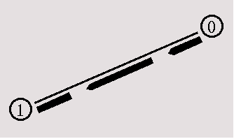
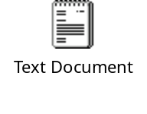
Demo - Wired Network
Example_1: n0 sends data packets to n1
$ns duplex-link $n0 $n1 1Mb 10ms DropTail
Source code

Slide 35
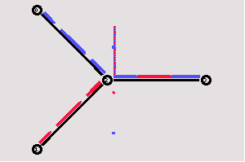
Demo - Wired Network
Example_2: packets drop from queue
$ns duplex-link-op $n0 $n2 orient right-down
$ns duplex-link $n3 $n2 1Mb 10ms SFQ
$udp0 set class_ 1 ; $ns color 1 Blue
$ns duplex-link-op $n2 $n3 queuePos 0.5
Source code

Slide 36
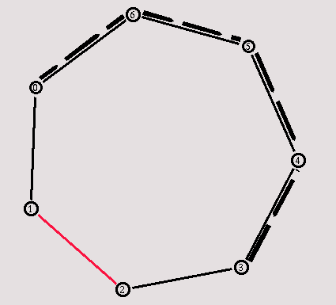
Demo - Wired Network
Example_3: Network Dynamics
$ns rtmodel-at 1.0 down $n(1) $n(2)
$ns rtmodel-at 2.0 up $n(1) $n(2)
$ns rtproto DV
Source code

Slide 37
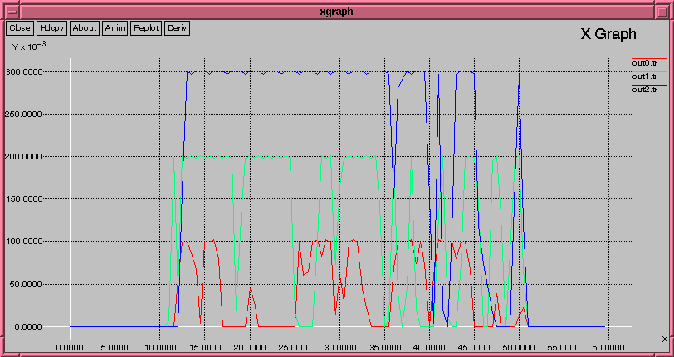
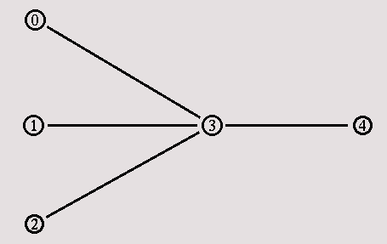
Demo - Wired Network
Example_4: Xgraph
puts $f0 "$now [expr $bw0/$time*8/1000000]"
puts $f1 "$now [expr $bw1/$time*8/1000000]"
puts $f2 "$now [expr $bw2/$time*8/1000000]"
Source code

Slide 38
Demo – Our Simulation
Simulation Assumptions
10 nodes
Bandwidth 1MB
n0 – n9 (red), pick rate 400KB
n1 – n6 (green), pick rate 400KB
n2 - n8 (blue), pick rate 400KB
Expecting packet drop in n3 – n4
Source code

Slide 39
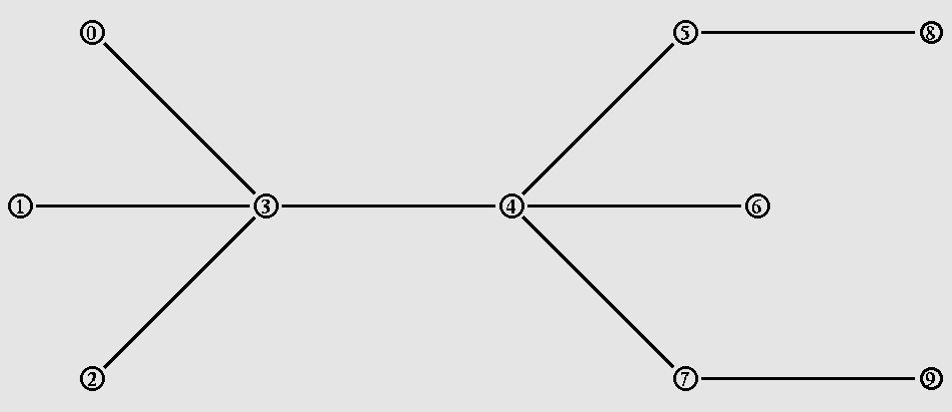
Demo – Our Simulation
Simulation Model

Slide 40
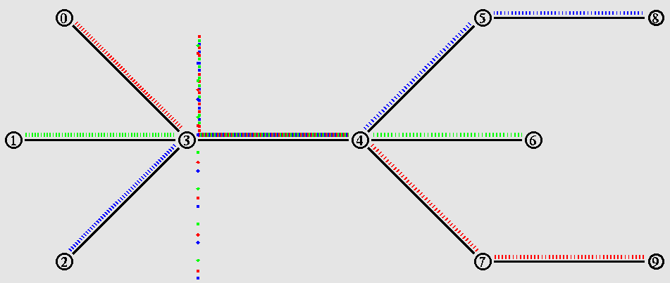
Demo – Our Simulation
NAM

Slide 41
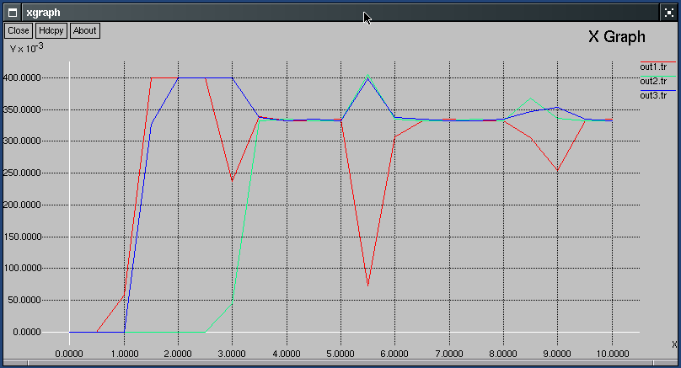
Demo – Our Simulation
Xgraph

Slide 42
Demo - Wireless Network
# =======================================================
# Define options
# =======================================================
set val(chan) Channel/WirelessChannel ;# channel type
set val(ll) LL ;# Link layer type
set val(ifq) Queue/DropTail/PriQueue ;# Interface queue type
set val(ifqlen) 50 ;# max packet in ifq
set val(netif) Phy/WirelessPhy ;# network interface type
set val(mac) Mac/802_11 ;# MAC type
set val(rp) AODV ;# ad-hoc routing protocol
set val(nn) 2 ;# number of mobilenodes
set val(cp) “./cbr-3-test” ;# random traffic pattern
set val(sc) “./scen-3-test” ;# node movement

Slide 43
Demo - Wireless Network
Creating random traffic-pattern
ns cbrgen.tcl -type cbr -nn 10 -seed 1.0 -mc 8 -rate 4.0 > cbr-10-test
CBR connection file between 10 nodes, having maximum of 8 connections,
with a seed value of 1.0 and a rate of 4.0
Creating node-movements
./setdest -n 20 -p 2.0 -s 10.0 -t 200 -x 500 -y 500 > scen-20-test
Node-movement scenario for 20 nodes moving with maximum speed of
10.0m/s with an average pause between movement being 2s.
The simulation stops after 200s and the topology boundary is defined
as 500 X 500

Slide 44
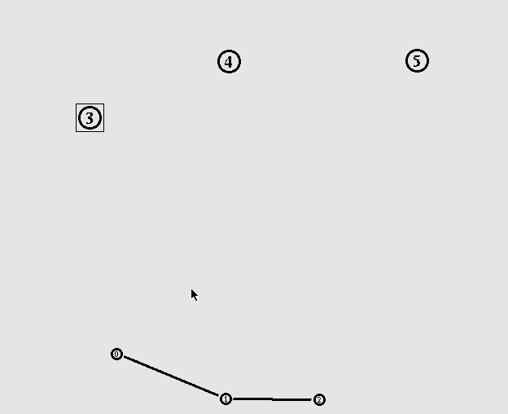
Demo - Wireless Network
NAM
Source code
Node movement file

Slide 45
Questions?
Questions?
aasaduzz@cse.fau.edu

Slide 46
Conclusion
Installed NS2 in Windows and Unix
Ran Simulation for both wired and wireless networks in NS2
Very promising simulation tool for both wired and wireless networks

Slide 47
Future Directions
Can be used to implement current connectivity models for both wired and wireless networks
Can be used to evaluate new/proposed connectivity models for both wired and wireless networks
Can be use to simulate satellite networks

Slide 48
Thank you
Questions?
aasaduzz@cse.fau.edu
mislam1@cse.fau.edu

