Slide 1
Efficacy of Nabiximols in Reducing Frequency of Cannabis Use 3 months After Treatment Cessation: Results from a Randomised Controlled Trial.
Presented by
Llewellyn Mills
Discipline of Addiction Medicine, Central Clinical School, University of Sydney
South Eastern Sydney Local Health District, Drug and Alcohol Treatment Services
llew.mills@sydney.edu.au

Slide 2

Disclosures
Nick Lintzeris has received funding for research unrelated to this topic from Indivior, Munidpharma, Braeburn Pharmaceuticals and Camurus.
Funding for the study from Division of Addiction Medicine, and South East Sydney Local Health District, NSW Health.
Social media advertisements paid by Lambert Initiative, University Sydney.
Iain McGregor reports grants from NHMRC and grants from Lambert Initiative for Cannabinoid Therapeutics during the conduct of the study
Iain McGregor has a patents to WO2018107216A1, WO2017004674A1, and WO2011038451A1 issued and licensed, and patents to AU2017904438, AU2017904072, and AU2018901971 pending.

Slide 3
Background
One of the most effective ways to treat dependence on an addictive agent is to replace that agent with an agonist that mimics the pharmacological profile of the original drug but is…
Cheaper
Safer
Allows patient to:
establish new routines,
remove themselves from using milieu
extinguish conditioned cues associated with the original addictive agent
… all in the absence of intense withdrawal
Methadone/buprenorphine (SOP for heroin addiction)
Lisdexamfetamine (slow release amphetamine agonist, currently being tested as a amphetamine replacement)

Slide 4
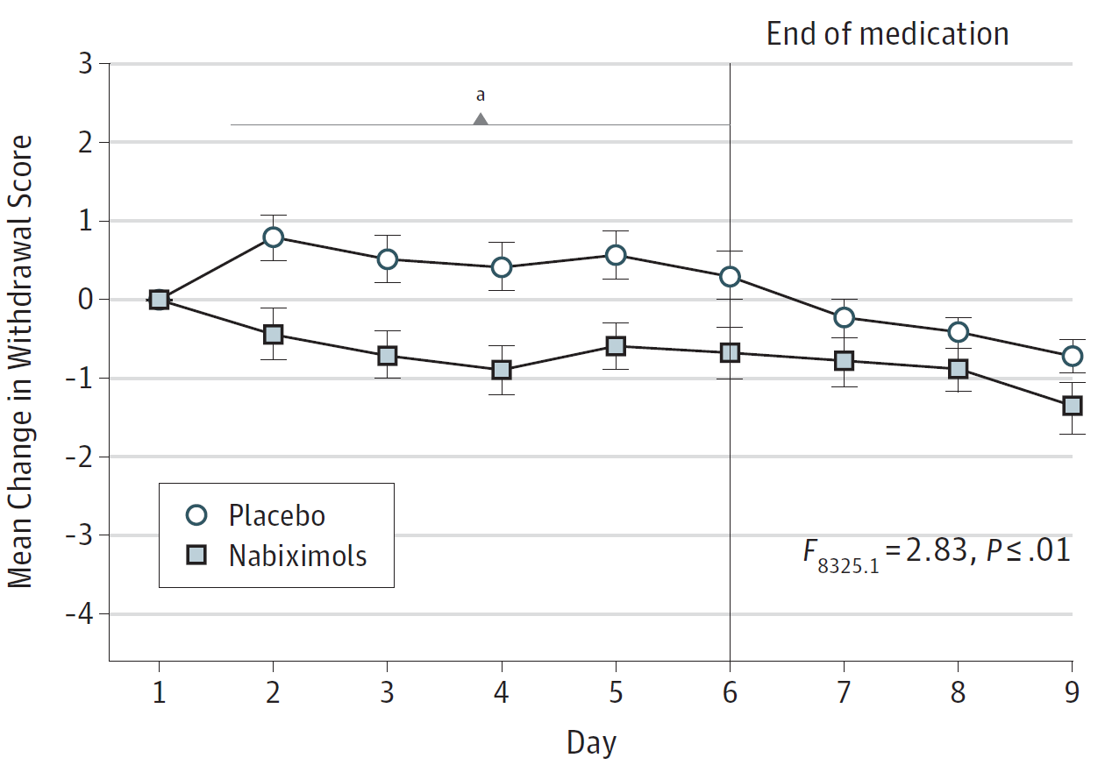
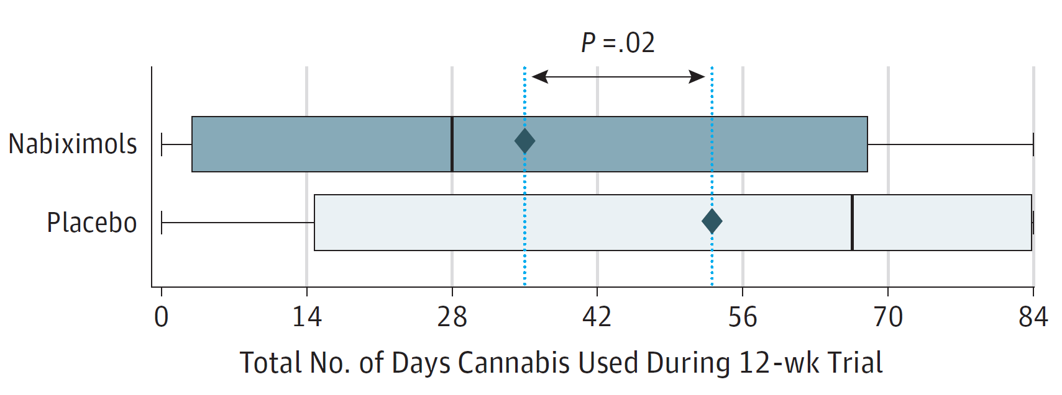
Background
Increasing evidence shows use of cannabis agonist medications may be effective at treating cannabis use disorder.
Dronabinol: THC
Nabilone: Synthetic THC
Nabiximols: THC and CBD
Short 9-day Inpatient Withdrawal
12-week
Outpatient
Withdrawal
P = 35 days
N = 19 days

Slide 5
Background
Most cannabis agonist studies test differences during medication phase only
Allsop and colleagues, 2014 examined outcomes 1-month post-treatment (not shown on graph)
N.S. difference in relapse one month after medication
phase

Slide 6
Background
Short-term withdrawal management limited in efficacy
Longer-term cannabis agonist treatment more effective?
12-week outpatient randomised, placebo-controlled trial
Less use days during trial period but n.s. difference in abstinence
Do reduced rates of cannabis use persist after treatment ends?
?
12-week
Outpatient
Withdrawal
P = 35 days
N = 19 days

Slide 7
Background
Do reduced rates of cannabis use persist after treatment ends?
Why is this question important?

Slide 8
Why is this Important?
What model of care do we use for cannabis agonist treatment?
Short-to-Medium Term
Nicotine Replacement Therapy
Several weeks treatment
Then stop
Maintenance Model
Methadone/Buprenorphine
Indefinite
No post-treatment benefit over placebo in reduced days used or abstinence rates would suggest latter model

Slide 9
Research Question
During 12-week Trial
Days Used of Illicit Cannabis in previous 28 days measured at 28-day intervals for 12 weeks during trial period
But also at a post-treatment interview, 3 months after treatment ended
Was the incremental improvement in frequency of cannabis use due to nabiximols over and above standard treatment (case management + voluntary counselling) plus placebo preserved 3 months after agonist treatment ended?
Tested group differences in frequency of days used at each point during the trial and at 3-month post-treatment follow-up (MMRM), then simple effects of group at each time point
Group difference in odds of abstinence at 3-month follow-up

Slide 10
Results
Difference between groups in days used at each time point compared to difference at baseline
β=0.2
p=.89
n=128
End of Treatment
β=3.5
p=.062
n=104
β=6.5
p=.006
n=75
β=4.1
p=.062
n=78
β=6.1
p=.018
n=54
Adjusted for multiple comparisons using the Benjamini-Hochberg method , error bars = standard error

Slide 11
Results
Backwards Difference Coding: Testing group difference at each timepoint relative to previous timepoint
End of Treatment
β=-6.2
p<.001
β=1.1
p=.482
β=-2.5
p=.070
β=-2.9
p=.090
Overall cannabis use drops a bit more from end of treatment
But the group difference at end of treatment is preserved
β=-3.5
p=.051
β=-2.7
p=.029
β=0.4
p=.861
β=-0.6
p=.782
β=-2.4
p=.267
β=0.4
p=.861
Adjusted for multiple comparisons using the Benjamini-Hochberg method, error bars = standard error

Slide 12
Results
Abstinence at week 24
abstinent:
6/29 (21%)
14/26 (54%)

Slide 13
Results
Urinalysis validating self-reported abstinence at week 24
Self Reported abstinence in previous 28 days
Compared to abstinence criteria of < 50 ng/ml THCCOOH
10/33 (30%) reported abstinence, 23/33 (70%) non-abstinence
91% agreement, 9% disagreement were low SR use/UR abs
To a great extent people told the truth about their abstinence
Confusion Matrix |  |  |  |  | Receiver Operating Characteristics
Self-Reported Cannabis Useª | THC-COOH^{b} |  |  |  | TPR^{c} | TNR^{d} | Correctly Classified | PLR^{e} | NLR^{f} | AUC^{g}
 |  | 0 | 1
 | 0 | 10 | 0 | 10 | 87% | 100% | 91% | 3.78 | 0.00 | 0.88
 | 1 | 3 | 20 | 23
 |  | 13 | 20 | 33
a: 0 = Zero self-reported cannabis use days in previous 28 days; 1 = one day or more of self-reported illicit cannabis use in previous 28 days. b: 0 = THC-COOH levels < 50 ng/ml; 1 = THC-COOH levels ≥25% of levels at previous measurement and ≥ 200 ng/ml. c: TPR = True Positive Rate = Sensitivity. d:TNR = True Negative Rate = Specificity. e: PLR = Positive Likelihood Ratio = True Positive Rate/False Positive Rate. f: NLR = Negative Likelihood Ratio = False Negative Rate/True Negative Rate. g: AUC = Area Under the Curve.

Slide 14
Discussion
Benefits of nabiximols maintained 3 months after treatment cessation
Compared with Allsop et al (2014) where nabiximols was associated with no post-treatment benefit over placebo
Longer period of treatment more successful in achieving sustained reductions in cannabis use
Which persist beyond the cessation of treatment
Suggests that model of care of cannabis agonist treatment may resemble nicotine replacement therapy (time-limited model) rather than opioid replacement therapy (maintenance model).
Medication used to manage withdrawal, reduce cravings and change behavioural patterns in short-term which then may translate to benefits that persist after stopping medication

Slide 15
Limitations
43% follow-up rates
Exactly the same rates in both groups but
Might be an unobserved interaction effect whereby more lost to follow-up due to relapse (i.e. rather than simply being uninterested in participating) in the Nabiximols group
3-month follow-up, longer duration needed
These limitations, and the fact that 60% were not abstinent indicate merits of stepped care approach

Slide 16
Discussion
Stepped Care Approach for Cannabis Treatment
Client reduces Cannabis
use
Counselling
+
Supportive
Case
Management
Client presents for Treatment
8 to 12
weeks of
nabiximols
+ counselling
Client reduces Cannabis
use
Client continues to use Cannabis
Long Term
nabiximols
+
counselling
Client continues to use Cannabis

Slide 17

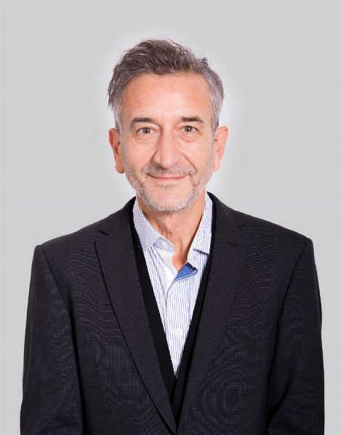





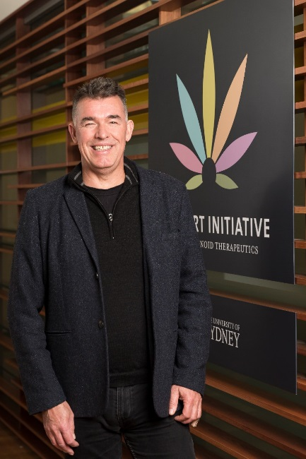
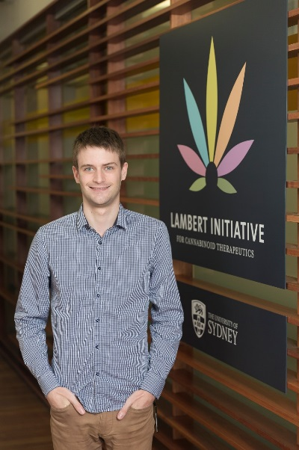
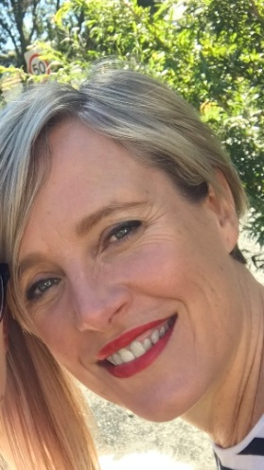

The Team
The ARC-D Study Group

