Slide 1

Medicinal Cannabis Use in Australia, Circa 2018: The Cannabis As Medicine Survey (CAMS-18)
Presented by
Llewellyn Mills
Discipline of Addiction Medicine, Central Clinical School, University of Sydney
South Eastern Sydney Local Health District, Drug and Alcohol Treatment Services
llew.mills@sydney.edu.au

Slide 2
Disclosure
Nick Lintzeris has received funding for research unrelated to this topic from Indivior, Mundipharma, Braeburn Pharmaceuticals and Camurus.
Funding for the study from Division of Addiction Medicine, and South East Sydney Local Health District, NSW Health.
Social media advertisements paid by Lambert Initiative, University Sydney.
Iain McGregor reports grants from NHMRC and grants from Lambert Initiative for Cannabinoid Therapeutics during the conduct of the study
Iain McGregor has a patents to WO2018107216A1, WO2017004674A1, and WO2011038451A1 issued and licensed, and patents to AU2017904438, AU2017904072, and AU2018901971 pending.

Slide 3
Terminology
Medical Cannabis
“Any legal or illegal cannabis-based product (including plant matter) used to treat or alleviate the symptoms of a self-identified health condition, and does not imply that the cannabis product was indicated or prescribed by a health professional.”

Slide 4
Medical Cannabis: Background
November, 2016
Narcotic Drugs Amendment Act
Through Special Access Scheme (SAS) medical practitioners can apply to become ‘Authorised Prescribers’ of unregistered medicines (i.e. cannabis)
Commercial sector has entered the medicinal cannabis marketplace
Now estimated of 10-20% of patients with chronic pain or in palliative care use medical cannabis
Yet c2016 didn’t know much about medical cannabis users experiences, attitudes, comorbidities, patterns of use etc

Slide 5
CAMS-16
Snapshot of Medical Cannabis landscape circa 2016
Cannabis As Medicine Survey, 2016 (CAMS-16)
Online Consumer Survey
Australian adults
Used Cannabis (either legally or illegally) to manage a health condition in the previous 12 months
Results: Medical Cannabis mostly
Sourced illegally
Smoked
Used to treat Mental Health, Chronic Pain, Sleep conditions

Slide 6
CAMS-18
Allows us to track the changes since the 2016 Survey
Once again Australians ≥ 18 yo, used cannabis for therapeutic reasons in last year
Survey live from Sept 2018 – Feb 2019

Slide 7
CAMS-18: Results
Recruitment
1804 started survey
416 excluded (e.g. ineligible, did not consent, 0% medical use)
Leaving 1388 for analysis (numbers vary per question)
Sources of recruitment: mostly social media, mostly Twitter
Source | CAMS-16 (n=1744) | CAMS-18 (n=1388)
Facebook groups | 1437 (82.2%) | 336 (24.2%)
Twitter | 13 (0.7%) | 825 (59.5%)
Friends | 66 (3.8%) | 65 (4.7%)
Online Forum (Reddit etc.) | 65 (3.7%) | 13 (0.9%)
Lambert Initiative website | 35 (2.0%) | 23 (1.7%)
Medical Cannabis Providers | 20 (1.1%) | 25 (1.8%)
Consumer support groups | 18 (1.0%) | 13 (0.9%)
Doctor / Cannabis Clinic | 2 (0.1%) | 14 (1.0%)

Slide 8
CAMS-18: Results
Demographics
Variable | CAMS-16 (n=1744) | CAMS-18 (n=1388)
Age, Mean ± SD | 37.9 ± 13.4 | 43.4 ± 14.0
Gender, n (%) Female | 545 (31.2%) | 560 (40.4%)
Current Relationship Status Single (includes separated, widowed) Married/domestic partnership | 968 (56.2%) 757 (43.9%) | 526 (37.9%) 861 (62.1%)
Aboriginal status, n (%) Aboriginal/Torres Straight Islander | 95 (5.4%) | 56 (4.0%)
Highest Education Level, n (%) Primary Secondary/High School Trade or vocational training University degree | 20 (1.1%) 652 (37.3%) 672 (38.4%) 348 (19.9%) | 14 (1.0%) 278 (20.0%) 461 (33.2%) 631 (45.5%)
Employment Status Full-time work Part-time work Home duties Student Unemployed/Disability Pension/Retired | 559 (32.0%) 316 (18.1%) 113 (6.5%) 102 (5.8%) 555 (31.7%) | 633 (45.6%) 188 (13.6%) 78 (5.6%) 77 (5.6%) 411 (29.6%)
More women
More married
More grads
More f/t

Slide 9
CAMS-18: Results
Main Conditions Treated with Cannabis
 |  | Main Reason
Category | # | CAMS-16 | CAMS-18
Pain CAMS-16: 36.4% CAMS-18: 36.4% | 1 2 3 4 | Back (15%) Arthritis (7%) Neuropathy (5%) Migraine (3%) | Back (10%) Arthritis (6%) Neuropathy (6%) Fibromyalgia (3%)
Mental Health CAMS-16: 36.3% CAMS-18: 32.8% | 1 2 3 4 | Anxiety (15%) Depression (11%) PTSD (5%) ADHD (3%) | Anxiety (13%) Depression (9%) PTSD (6%) Addiction (1%)
Sleep CAMS-16: 6.6% CAMS-18: 9.2% | 1 2 3 |  | Insomnia (7%) Circadian (1%) Movement (1%)
Neurological CAMS-16: 7.5% CAMS-18: 5.2% | 1 2 3 | Epilepsy (5%) MS (1%) Autism (<1%) | Epilepsy (2%) Autism (1%) MS (1%)
Other CAMS-16: 13.2% CAMS-18: 9.5% | 1 2 3 | Gastro (4%) Cancer (4%) Respiratory (1%) | Immune (3%) Gyna (2%) Infectious (1%)
Cancer = 4%, Gastrointestinal = 3%

Slide 10
CAMS-18: Results
Patterns of Medical Cannabis Use
 | CAMS-16 | CAMS-18
Age First Used Cannabis (any reason) | 18.6 ± 8.9 | 20.5 ± 11.6
Age First Used Cannabis Regularly (any reason) | 23.7 ± 11.0 | 25.8 ± 16.3
Age First Used Cannabis Regularly (Medical Reasons) | 29.2 ± 12.8 | 32.6 ± 17.5
Days Used Cannabis/28 (Medical Reasons) | 19.9 ± 10.0, median=26 | 17.3 ± 10.9 median = 18
Days Used Cannabis/28 (Any Reason) | 20.9 ± 9.4, median=28 | 15.8 ± 11.2 median = 28
% Total Cannabis Use for Medical Reasons | 81 ± 20 | 83 ± 21
Usual Number of Times Using Cannabis Each Day | 5.0 ± 4.9, median=3 | 3.3 ± 3.7 median = 2
Weekly Cost of Cannabis (whole sample) | $69 ± $85 | $61 ± $94
Weekly Cost of Cannabis (among those who paid) | $95 ± $87 | $82 ± $101

Slide 11
CAMS-18: Results
Routes of Administration

Slide 12
CAMS-18: Results
How did people decide to use Medical Cannabis for their condition?
Which most informed your decision to use medical cannabis? | %
Discovered benefits on my own (i.e. using cannabis & noticed symptoms improved) | 52%
Internet-based media (e.g. facebook, Reddit) | 11%
Friend or Family member | 10%
Medical cannabis advocacy group (e.g. united in compassion, hemp embassy) | 7%
Consumer group focused on a single condition (e.g. epilepsy, chronic pain) | 6%
Conventional healthcare provider | 5%
Conventional media (e.g. TV, radio, newspaper, magazine) | 3%
Alternative healthcare provider | 3%

Slide 13
CAMS-18: Results
Main Source of Medicinal Cannabis (n=1044)
Traditional Sources
Emerging Sources
3%
0.2% in CAMS-16

Slide 14
CAMS-18: Results
Less than 3% (n = 25) of respondents accessed
medical cannabis through legal channels

Slide 15
CAMS-18: Results
Why?

Slide 16
CAMS-18: Results
Why did the other 97% not access it legally when
the apparatus existed for them to do so?

Slide 17
CAMS-18: Results
Why did the other 97% not access it legally when the apparatus exists for them to do so?

Slide 18
CAMS-18: Results
What conditions were the 2.4% prescribed for?
Condition | n
Fibromyalgia | 3
MS | 3
Neuropathy | 3
Other non-cancer pain | 3
Back pain | 2
Epilepsy | 2
PTSD | 1
Dementia | 1
Mesothelioma | 1
Other | 5

Slide 19
CAMS-18: Conclusions
What has changed in 2 years?
Compared with CAMS16: the CAMS-18 sample were:
Older
More educated
Had more women
Used less cannabis
Smoked less and used oral sources more
Difference in sample or change?

Slide 20
CAMS-18: Conclusions
What is the same?
Similar range of conditions for which MC used:
Pain
Mental Health
Sleep problems
Similar source of MC: largely from illicit dealers
Similar perspectives re: effectiveness, side effects of MC
Little uptake of legal MC

Slide 21
CAMS-18: Conclusions
Little Uptake of Medical Cannabis
Barriers to Access
Finding a Dr willing to prescribe
Knowledge that cannabis can be prescribed legally
Cost
Concern about stigma and confidentiality
Perception that system is not user friendly

Slide 22
CAMS-18: Conclusions
Category-B SAS approvals of medical cannabis over time
Close of CAMS-18
n=2916
12,075 approvals in 6 months since CAMS-18 closed!
n=1042
n=339
Compared to 3,840 in 6 months prior
Private medicine stepping in
https://www.tga.gov.au/access-medicinal-cannabis-products-1

Slide 23
CAMS-20
CAMS-20

Slide 24
CAMS-18: Limitations
Low numbers of prescribed medicinal cannabis users
Were these ‘legitimate’ medical cannabis users?
80% had used cannabis recreationally prior to using it medicinally
45% said there was no gap between using it recreationally and using it medicinally
97% used without the guidance of a Doctor
A large number used cannabis to treat conditions for which there is no substantial evidence of efficacy (e.g. Anxiety, Depression)
May not be able to get legal access even if they tried to
The symptoms they are treating with cannabis might simply be cannabis withdrawal symptoms
Raises questions about whether cannabis would be the best treatment for their complaint
Reducing the barriers to accessing cannabis for medicinal purposes will make sure that people who use it to treat symptoms do so within medical system.

Slide 25
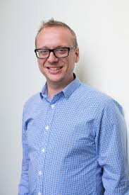
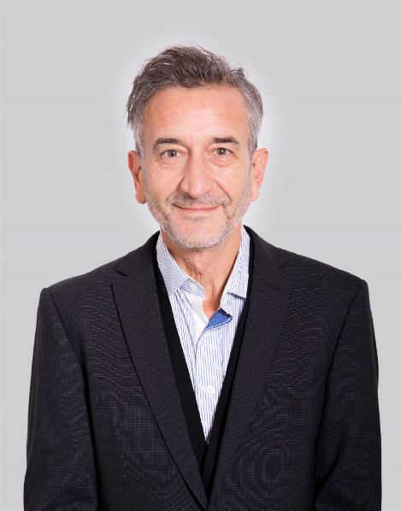
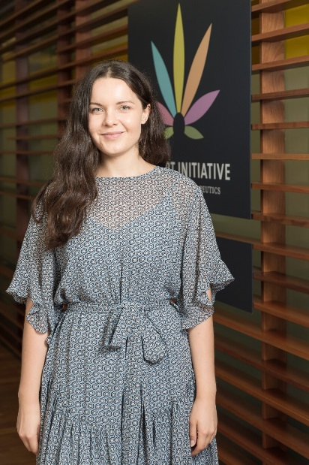
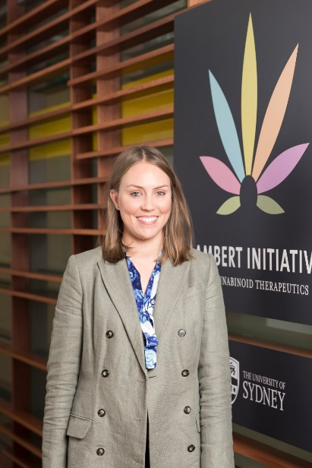
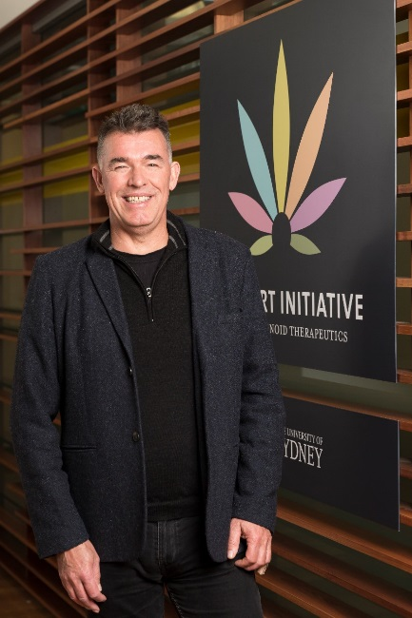
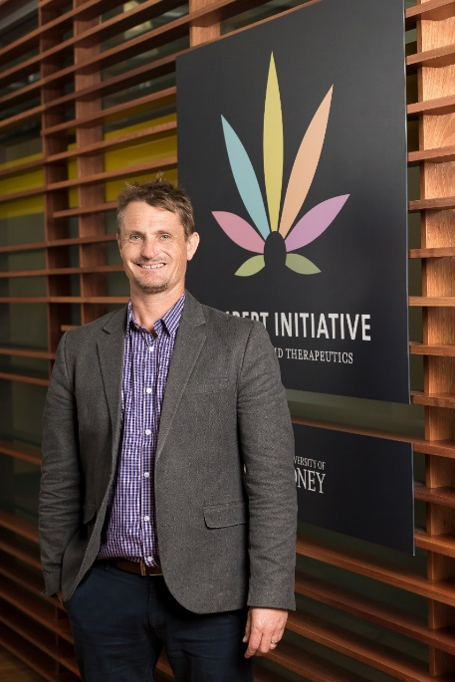

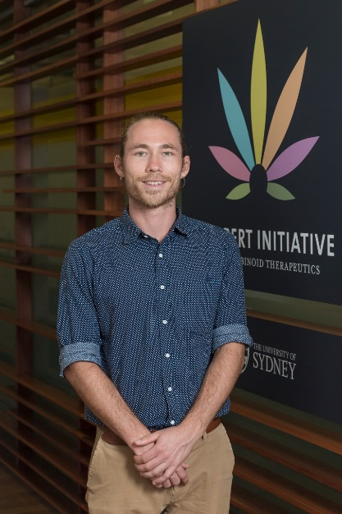
The C Team

