Slide 1

Abtractive Text Summarization on Vietnamese news
Group 10
20520805 - Nguyễn Viết Tiến
20520829 – Nguyễn Thanh Thanh Trúc
DS201.O11
Lecturer : Đỗ Trọng Hợp
1

Slide 2


CONTENT
01
INTRODUCTION
02
DATASET
03
EDA
04
MODEL
05
RESULT AND EVALUATION
06
CONCLUSION
2

Slide 3

1.INTRODUCTION
Input : a vietnamese text includes many sentences
Output : a summary sentence covers the content of the text
Two types of summarization :
Extractive : get important sentences in paragraph
Abtractive : generate sentences from paragraph
3

Slide 4
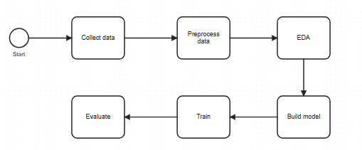
2.DATASET
a) General Process
4

Slide 5
b) Collecting data
Source : Vietnamese newspaper such as Bao dan tri, vnexpress ...
Shape : 23248 x 4
Codebook
No. | Name | Description | Range
1 | topic | descibe a topic of news | 16 topic
2 | title | header of news | text
3 | text | full content of news | text
4 | summary | brief content of news | text
5

Slide 6
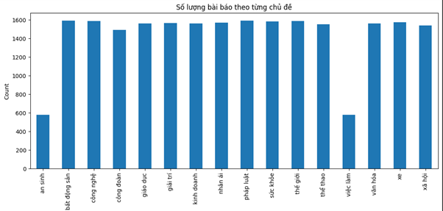
Distribution of topic
6

Slide 7
c) Preprocessing data
On dataset :
+ delete null, duplicated rows
+ delete rows < 200 words
On each cell :
+ standardize punctuation (convert some case to dot, delete all remain)
+ delete extra whitespace
+ delete extra infomation in parenthesis
-> In the end, the shape of dataset is 20792 x 2
7

Slide 8
3. EDA
Maximum word text : 9647
Minimum word text : 48
Maximum word summary : 140
Minimum word summary : 9
80% text length : < 811
80% summary length : < 47
8

Slide 9
4.MODEL
Train - Validation - Test (8 : 1 : 1)
Model : ViT5, BARTpho, mT5
Metric : ROUGE (ROUGE-1, ROUGE-2, ROUGE-L)
Hyperparameter :
+ epoch : 3
+ per_device_train_batch_size : 2
+ per_device_test_batch_size : 2
+ learning_rate : 1e - 4
9

Slide 10
5. RESULT AND EVALUATION
Model | ROUGE-1 | ROUGE-2 | ROUGE-L
mT5 | 0.507 | 0.193 | 0.336
BARTpho | 0.575 | 0.258 | 0.370
ViT5 | 0.587 | 0.282 | 0.389
10

Slide 11
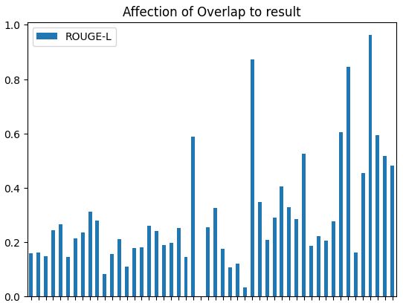
Error Analyst
Higher overlap, the better model performance
11

Slide 12
6. CONCLUSION
Advantage :
+ Build a dataset for the problem
+ Fine-tune model on the dataset
+ Understand some knowledge in text summarization field
Limitation :
+ train on small epoch - due to lack of facilities and time
Development :
+ update more data
+ increase epoch for training
12

Slide 13



THANK YOU FOR WATCHING
13

