Slide 1

Topic:
DETECT TOXIC COMMENT USING MACHINE LEARNING
- Subject: Statistical Machine Learning – DS102.N21
- Lectures: PhD. Nguyen Luu Thuy Ngan
PhD. Duong Ngoc Hao
- Students:
Nguyen Viet Tien – 20520805
Doan Phuong Khanh – 20521443

Slide 2
CONTENTS
Introdution
01
02
Method
03
Results
Problem
Dataset
Metrics
Result
Evaluation
04
Conclusion &
Development
Feature Extraction
Models

Slide 3
01
INTRODUCTION

Slide 4
1.1 Problem
0
(non-toxic)
1
Bạn chơi hay quá!
1
1
(toxic)
2
Chơi gì ngu vậy!
2
0
(non-toxic)
3
haha
3
Input
Output

Slide 5
1.2. Dataset
Step 01
Crawling data & Preprocessing
Collecting from many sources: in games, in the livestreams,…
Step 02
Labeling data
Content | Label | Distribution
toxic comment | 1 | 1183 labels
non-toxic comment | 0 | 1947 labels
Step 03
Evaluating dataset
2 annotator, the agreement is 0.95 using Cohen’s Kappa

Slide 6
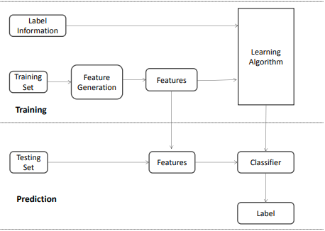
02
METHOD
2.1
Work Flow

Slide 7


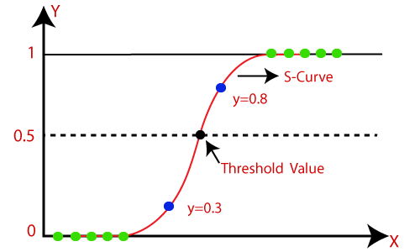
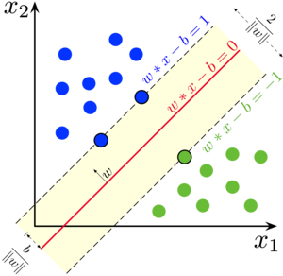


2.2 Feature Extraction
TF-IDF
2.3 Models
Logistic Regression
SVM

Slide 8
03
RESULTS
3.1 Metrics
F1 Score
3.2 Result
Normal | Using GridSeachCV
Models | Valid | Test
Logistic Regression | 0.882 | 0.769
SVM | 0.947 | 0.769
Models | Valid | Test
Logistic Regression | 0.952 | 0.814
SVM | 0.952 | 0.814
3.3 Evaluation
Model may be overfitting
Solution: adding more data,focus on choosing sentences with commonly used acronyms

Slide 9
CONCLUSION & DEVELOPMENT
04
Conclution
Delelopment
Built a dataset including Vietnamese comments.
Applied LR & SVM to build classification model.
Optimized hyperparameter to improve precision.
Try to make model better by adding more data to dataset and expand into many fields.
Experiment with Deep Learning

Slide 10
Thanks for listening!

