Slide 1


Movie ticket booking system
Kokumova Aidana
Bekten uly Mukhammed
Rahmatova Leyla

Slide 2

Introduction
Overview: A system to manage movie bookings, reviews, showtimes, and cinema details.
Purpose: Simplify the process of managing movie tickets for customers and cinema managers.
Key Features:
Movie and showtime management.
Booking and seat allocation.
User reviews and ratings.

Slide 3

Team Roles:
Kokumova Aidana - UI development
Rahmatova Leyla - Database handling
Bekten uly Mukhammed - Business logic creation

Slide 4
Application design
Technologies Used:
Frontend: JavaFX for GUI design.
Backend: Java with PostgreSQL database.
Key Functionalities:
Dropdowns to select movies and showtimes.
Input fields for user details and seat count.
Buttons for booking, adding reviews.

Slide 5

Database Design
Tables Overview:
Movies: Stores movie details like title, genre, and price.
Bookings: Records customer bookings with user details and seat count.
Reviews: Stores user reviews and ratings for movies.
Showtimes: Manages show dates and times for movies.
Cinema: Contains cinema details like name, type, and capacity.

Slide 6

Relationships
Movies ↔ Bookings: One movie can have many bookings (One-to-Many).
Movies ↔ Reviews: One movie can have many reviews (One-to-Many).
Cinema ↔ Showtimes: One cinema can have multiple showtimes (One-to-Many).

Slide 7
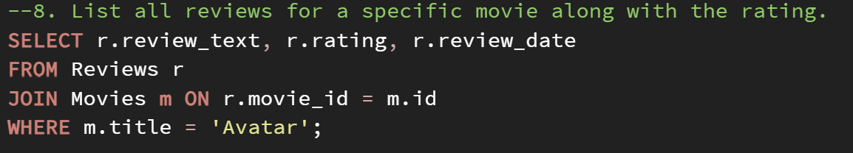
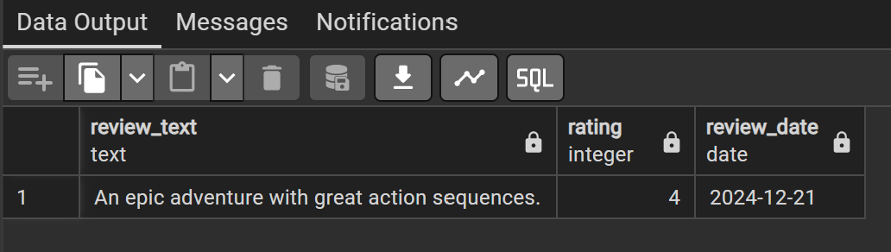
Example SQL QUERIES
Calculate total revenue for a movie based on the ticket price and seat count.
List available showtimes for a specific movie.
List customers who made more than one booking.
Query Examples:

Slide 8

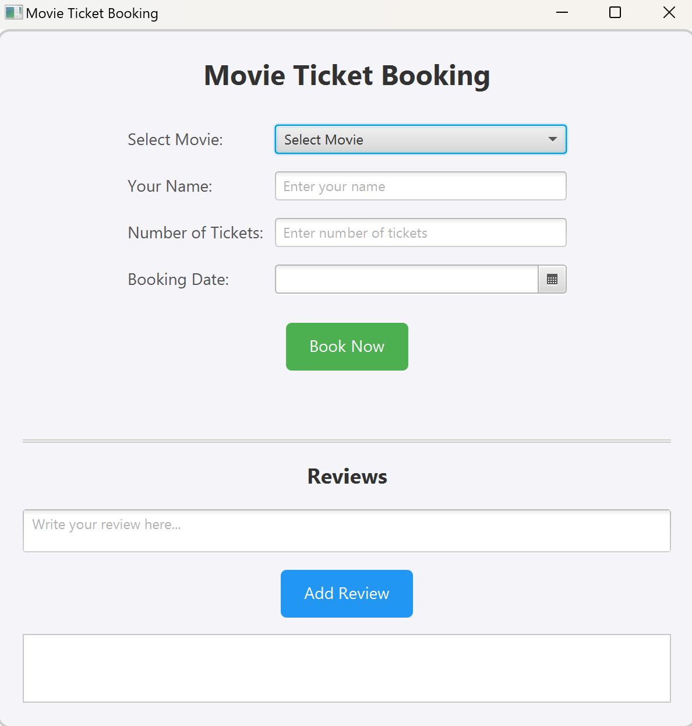
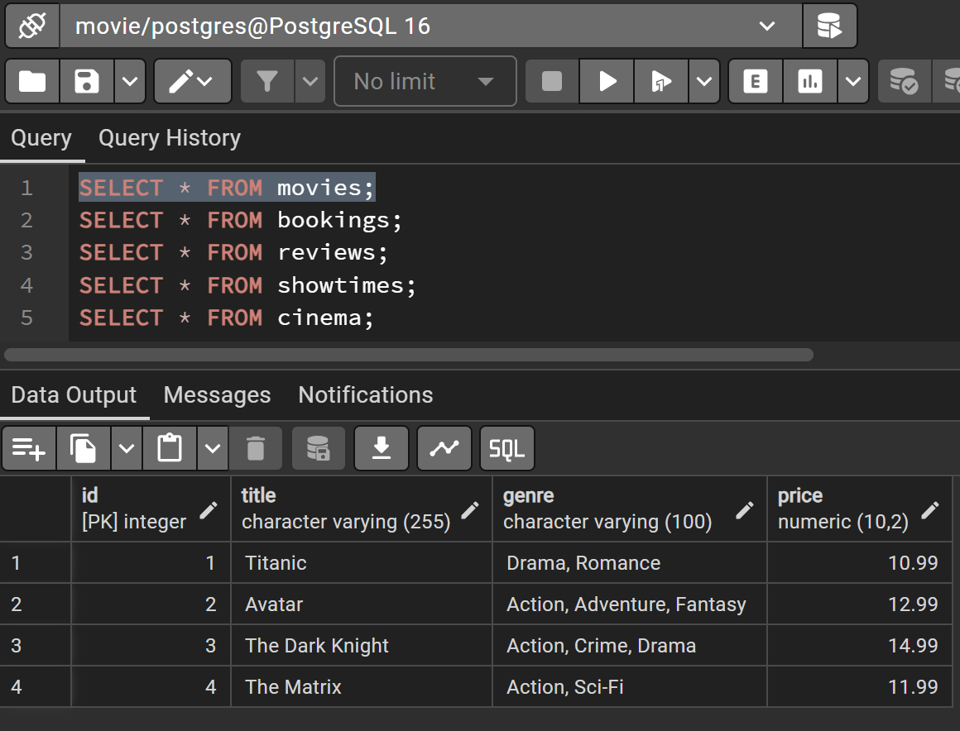
Demonstration
Making a booking.
List of movies.

Slide 9
Project Improvement
Enhanced Features:
Add user authentication for secure bookings and reviews.
Introduce ticket pricing based on seat type (Standard, VIP).
Real-time seat availability updates.
Scalability:
Optimize queries for faster performance with large datasets.
Add support for multiple cinemas with detailed layouts.
UI/UX Enhancements:
Mobile app integration.
Interactive seat selection in the booking interface.

Slide 10
conclusion
Key Takeaways:
Successfully implemented a functional movie booking system.
Learned about database relationships, JavaFX, and SQL operations.
Acknowledgments:
Mentors, team members, and resources used.

