Slide 1
PCA Plots for Small Sine Perturbations in PCA Space Using SVM Trained on 16 Static Currents
Lawson F. 3/20/20

Slide 2
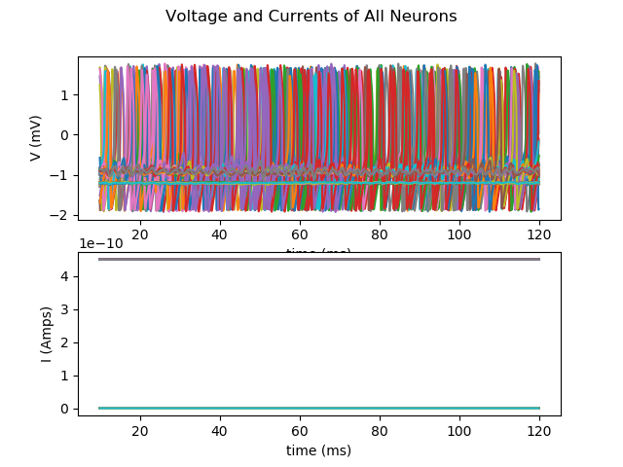
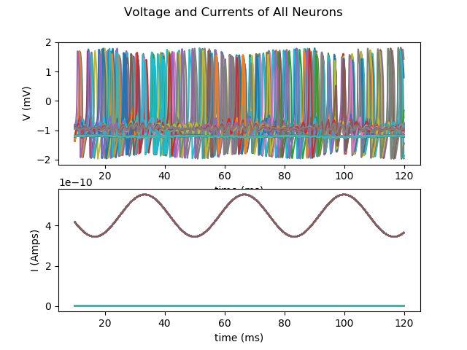
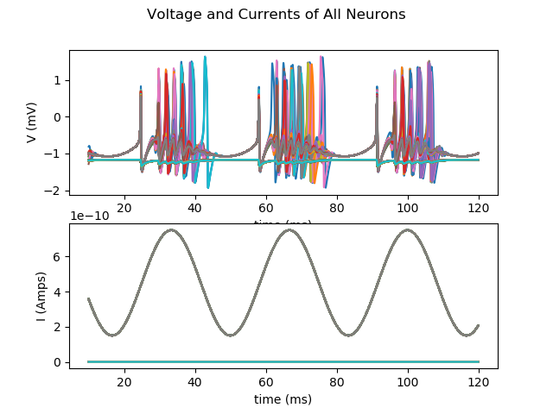
Static vs Perturbed
800 Neurons, 120 ms
Amplitude of base current are 0.45 nA
Base currents are time-independent
Sine perturbations have frequency 30 Hz
For small perturbation: Total driving current always above threshold 0.35 needed for some neuron to be spiking at all times (internal driving voltage = 0.05mV).
(Perturbations have amplitude 0.105 nA)
(Perturbations have amplitude 0.3 nA)

Slide 3
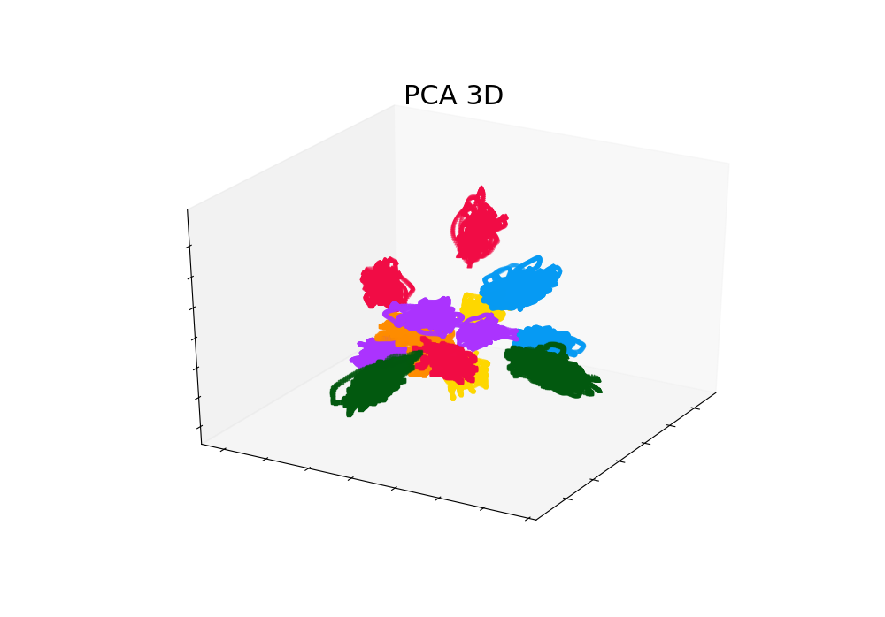
PCA Result with Only Static Currents
SVM trained on time-independent currents
PCA axes determined using all points from all static odors
Projecting perturbed currents onto static current’s PCA basis.
From 6000 time points of 120 ms, using last 5000 (100s)
Sometimes 1 false classification (93.75% acc), sometimes none

Slide 4
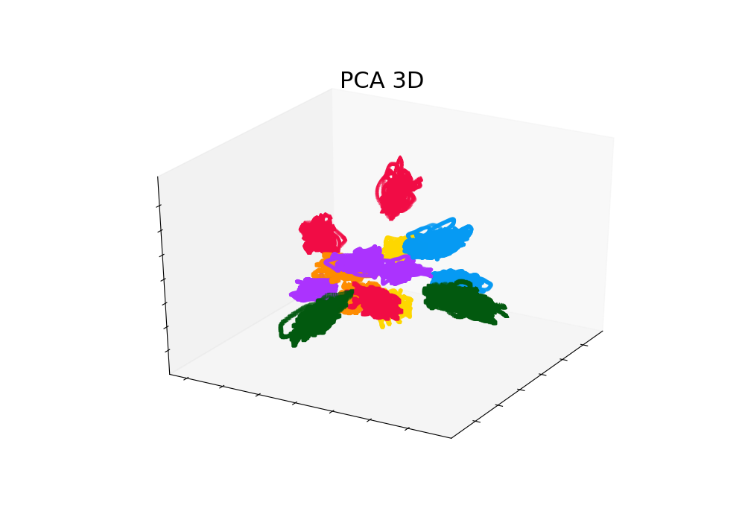
PCA Result with Small (0.105 nA) Sine Perturbation
SVM trained on time-independent currents
PCA axes determined using all points from all static odors
Projecting perturbed currents onto static current’s PCA basis.
From 6000 time points of 120 ms, using last 5000 (100s)
No false classifications

Slide 5
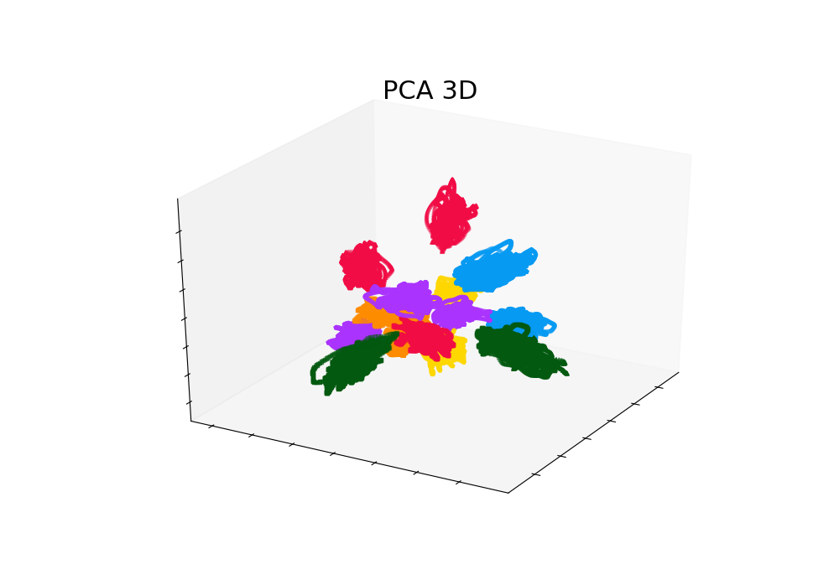
PCA Result with Large (0.3 nA) Sine Perturbation
SVM trained on time-independent currents
PCA axes determined using all points from all static odors
Projecting perturbed currents onto static current’s PCA basis.
From 6000 time points of 120 ms, using last 5000 (100s)
“Transients” from troughs of sine stimulus still included
~ 87.5 – 93.75 correct classification rate

Slide 6
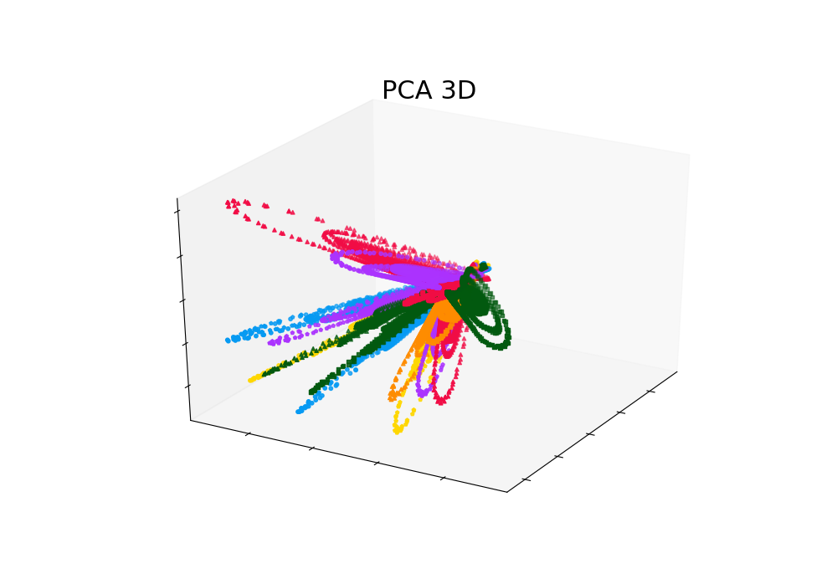
PCA Result with Large (0.3 nA) Sine Perturbation
SVM trained on large sine perturbation currents
PCA axes determined using all points from all large sine perturbation odors
Projecting perturbed currents onto large sine perturbation current’s PCA basis.
From 6000 time points of 120 ms, using last 5000 (100s)
“Transients” from troughs of sine stimulus still included
~ 0.5625-0.625 correct classification rate

