Slide 1
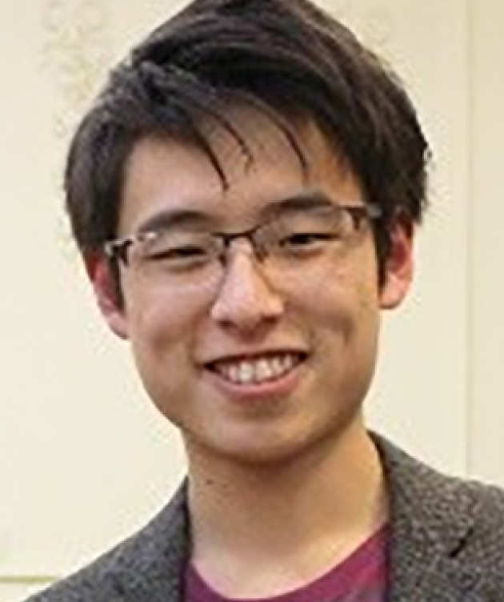
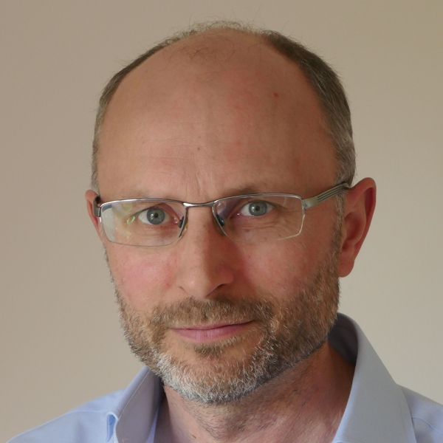
Bayesian Inversion and Data Assimilation using PPL
NFFDy SP2
Leeds
Lloyd Fung Research Fellow, Cambridge
Research Associate, Alan Turing Institute
L. Fung
Cambridge
M. Juniper
Cambridge
This work is supported by Peterhouse Research Fellowship and the Alan Turing Institute.

Slide 2
Bayes’ Inversion
Forward Problem
Parameters
Model
Data
Solver
Inverse Problem
Bayesian Inversion
likelihood
prior
$P\left(ξ | D,ℋ_{i}\right)=\frac{P\left(D | ξ,ℋ_{i}\right)P\left(ξ∨ℋ_{i}\right)}{P\left(D∨ℋ_{i}\right)}$
posterior
evidence

Slide 3
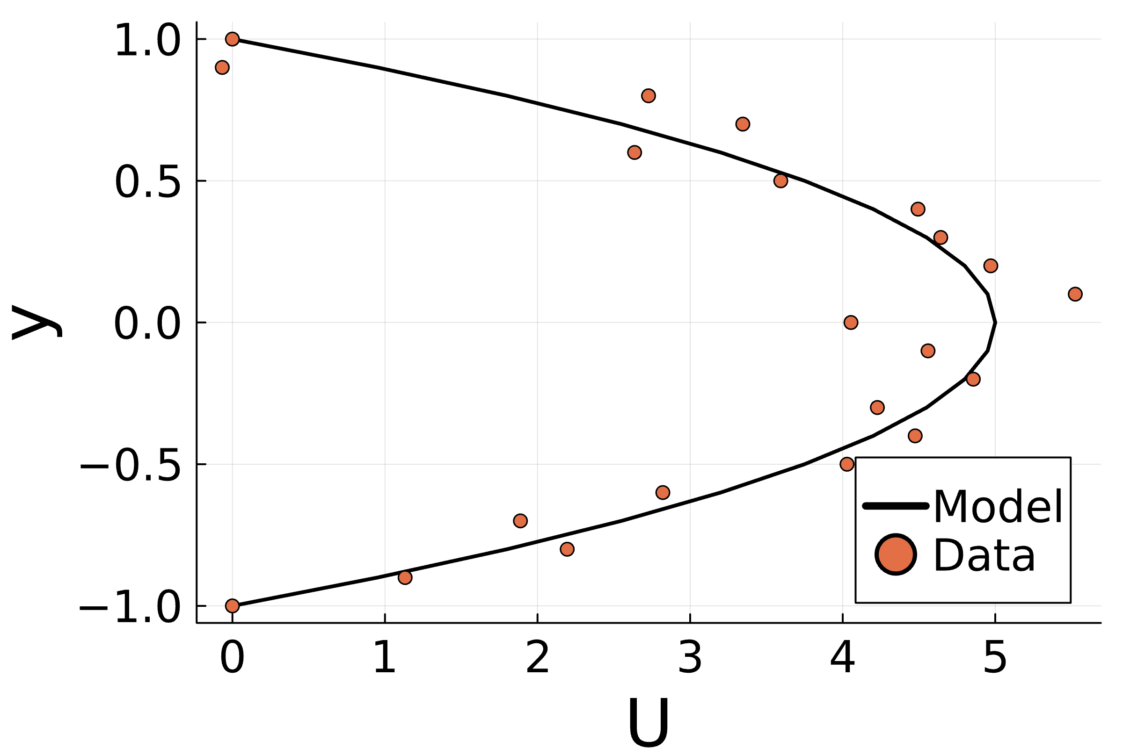
Example: assimilating pressure gradient in channel flow
$y$
$U\left(y\right)$
$x$
$\frac{∂p}{∂x}$
Model Equation:
B.C. :
$0=−Re\frac{∂p}{∂x}+\frac{∂^{2}U}{∂y^{2}}$
$Re\frac{∂p}{∂x}?$
$U\left(±H\right)=0$
Notes:
There’re a few ways we can assimilate the data to get an estimate of the pressure gradient.
We can, e.g.
Take a finite difference of dU/dy from the data, but that would be too noisy
Analytically work out the analytical solution for given pressure gradient, and fit the parabolic flow profile.
Optimise numerical solution that fulfil the model equation while minimising error (a constrained optimisation)
Sampling

Slide 4
Example: assimilating pressure gradient in channel flow
Directly est. from the data.
Data might be too noisy or not sampled regularly enough
Work out the analytical solution for given pressure gradient and fit the parabolic flow profile.
Analytical solution may not always possible
Optimise numerical solution that fulfil the model equation while minimising error ➔ a constrained optimisation
Sampling multiple values to find the one that fits the best ➔ MCMC / HMC sampling
$0=−Re\frac{∂p}{∂x}+\frac{∂^{2}U}{∂y^{2}}$
Accelerated if
gradient is also calculated.
$Re\frac{∂p}{∂x}?$
Notes:
There’re a few ways we can assimilate the data to get an estimate of the pressure gradient.
We can, e.g.
Take a finite difference of dU/dy from the data, but that would be too noisy
Analytically work out the analytical solution for given pressure gradient, and fit the parabolic flow profile.
Optimise numerical solution that fulfil the model equation while minimising error (a constrained optimisation)
Sampling

Slide 5
(To tutorial Cheb_Channel1D_Pressured.jl)
Notes:
Guide through the exercise

Slide 6
Note on hyperprior – Why InverseGamma?
The hyperprior here defines the prior knowledge on the scale of the parameter
Need to be as ”uninformative” as possible (Maximise entropy)
InverseGamma is
time elapse before occurrences of randomly occurring event following a Poisson/Exponential process with average rate
Higher = Stronger prior; = scaling or prior mean for
Conjugate prior of Gaussian
Nice closed form
Allow further data assimilation -> Karman Filter
Maximum entropy distribution for given and
Normal-InverseGamma is a commonly used hierarchical prior, but this is not the only option!
(Refer back to Hong’s talk)!

Slide 7
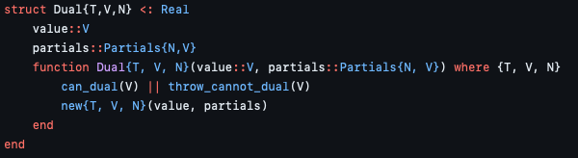
Automatic Differentiation: FowardDiff.jl
$g\left(x_{0}+ε\right)=g\left(x_{0}\right)+{\left.\frac{∂g}{∂x}\right|}_{x=x_{0}}⋅ε$
Dual Number

Slide 8
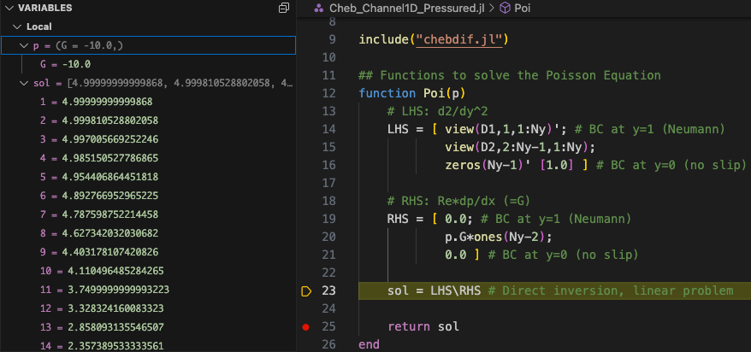
Why JULIA?
Automatic Differentiation for FREE!
The power of composable language with multi-dispatch:
Write once, AD comes automatically!

Slide 9
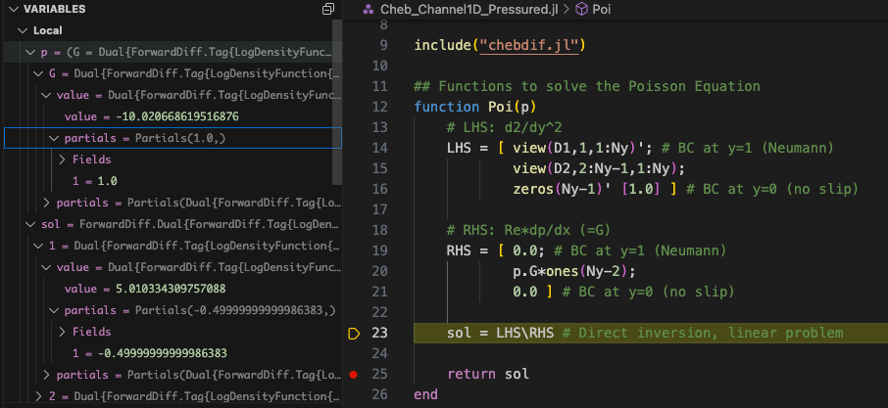
Why JULIA?
Automatic Differentiation for FREE!
The power of composable language with multi-dispatch:
Write once, AD comes automatically!

Slide 10
Example: assimilating arbitrary forcing in channel flow
Model Equation:
$\frac{∂^{2}U}{∂y^{2}}=f\left(y\right)$
$y$
$U\left(y\right)$
$x$
where is some unknown arbitrary forcing, with
B.C. :
$U\left(±H\right)=0$
Can we assimilate the data of to estimate ?
Notes:
Let them try

Slide 11
(Exercise Cheb_Channel1D_Forced.jl)

Slide 12

Example: Turbulence modelling in channel flow
Model Equation:
$0=−Re\frac{∂\overline{p}}{∂x}+\frac{∂^{2}\overline{U}}{∂y^{2}}+\left\langle u^{′}v′\right\rangle$
$y$
$\overline{U}\left(y\right)$
$x$
where is given by some turbulence model that can be a function of the local shear
B.C. :
$\overline{U}\left(±H\right)=0$
Can we assimilate the data of to find the parameters of a given model for ?

Slide 13
(Exercise Cheb_TurbChan_RANS.jl)

