Slide 1
Graph-Based Privacy-Preserving Data Publication
Xiang-Yang Li†, Chunhong Zhang§,
Taeho Jung∳, Jianwei Qian∳, Linlin Chen∳
† University of Science and Technology of China
§ Beijing University of Posts and Telecommunications
∳ Illinois Institute of Technology
IEEE International Conference on Computer Communications (INFOCOM2016), April, 2016

Slide 2
Outline
Background
Framework
Experiment
Conclusion

Slide 3
Outline
Background
Framework
Experiment
Conclusion

Slide 4





Privacy issue of Big Data
Data collection by
governments/ corporations
Data publication by mutual
benefits or regulations
What do we want to do?
Designing Privacy-Preserving Data Publishing framework for the data publisher with strong privacy protection guarantee.
Privacy is breached
Teddy Bear is sick!
Attack on published data

Slide 5



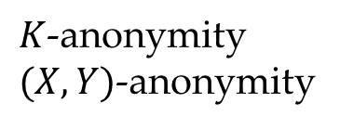
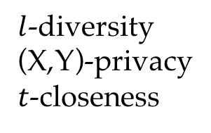
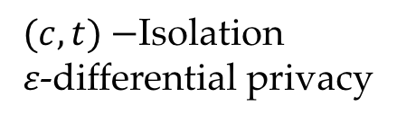
Related work
Record linkage
$K$-anonymity
$(X,Y)$-anonymity
Attribute linkage
$l$-diversity
(X,Y)-privacy
$t$-closeness
Generalization
Suppression
Permutation
Perturbation
Bucketization
……
Table linkage
𝛿-presence
Probabilistic attack
$(c,t)−$Isolation
𝜀-differential privacy

Slide 6
Limitations of Previous Work
Methods Dependency
Limited to apply in particular data types and have low generalization ability to other kinds of data.
Criteria Dependency
Privacy and utility criteria are dependent on the anonymity approach.
Difficulty to compare different anonymity approaches.

Slide 7
Our objective: a general framework
Motivation
Propose a general model incorporating with existing approach
Uniformly define and assess privacy and utility.
Challenge
Utility metric independent of specified anonymity approaches
Capacity of representing a variety of data types
Compare different anonymity approaches in our model.
Model of attacker’s background knowledge

Slide 8
Outline
Background
Framework
Experiment
Conclusion

Slide 9
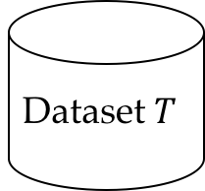

Framework F
Graph Generator
Graph Partition
Anonymization
Modules:
Data Graph Generation
Attack Graph Generation
Graph Partition
Anonymization
Privacy & Utility Evaluation
Published Data Generation
Privacy Risk Evaluation
Published Dataset Generator
Attack Background Knowledge Bases
Attack Graph Generator
Utility Evaluation
Dataset $T$
Published
Dataset $T^{∗}$

Slide 10
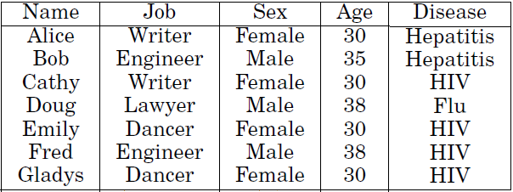
Data Graph
User Vertex: Identification of Object (IoB)
Attribute Vertex: Attribute of Object (AoB)
Secret Vertex: Secret of Object (SoB)
Graph nodes:
Identification of Object (IoB)
Secret of Object (SoB)
Attribute of Object (AoB)
Table from paper: Privacy-Preserving Data Publishing: A Survey of Recent Developments, Fung, et al, 2010

Slide 11
Data Graph
Correlated edge (same record)
Semantic edge (same attribute)
Graph edges
Correlated edge (user-attribute)
Semantic edge (attribute -attribute)

Slide 12
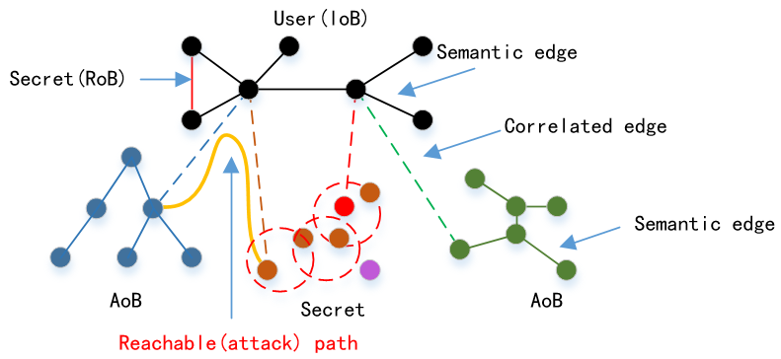
Data Graph

Slide 13









Attack Graph
Attacker’s background knowledge
Common sense
BK1：The prevalence of lung cancer is higher for Male than Female
<50%
30%
50%
50%
2. Extract from original dataset or external knowledge base
BK2：Alice, a 30 female dancer, has HIV with 30% percent
High likely
3. Reasonable inference or assumptions
BK3 : Alice has college education, so Bob is likely to also has college education since they are college-mates
The assumption for Attack Graph captures the capability of attacker

Slide 14
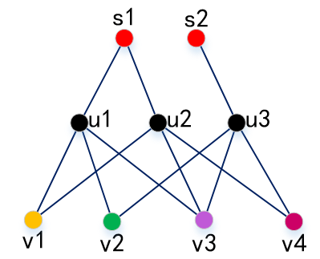
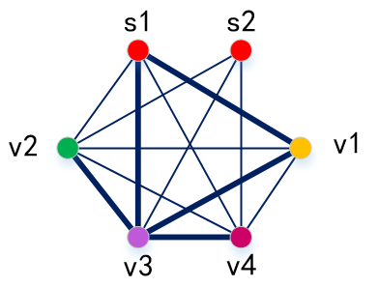

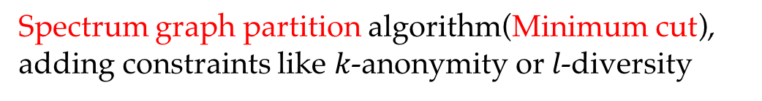
Graph Partition
Objective: Find subgraphs consisting of similar users
A user can be anonymized to be indiscriminative with others in the same subgraph
Step 1: Project original data graph $G$ to attribute graph $G_{Σ}$
Step 2: Dividing graph into two balanced subgraphs
Graph Project
Spectrum graph partition algorithm(Minimum cut), adding constraints like $k$-anonymity or $l$-diversity
Data Graph
Projected Attribute Graph
Step 3: Assigning users to each subgraph (recover data graph from attribute graph)

Slide 15
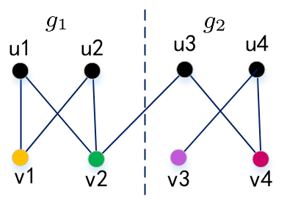
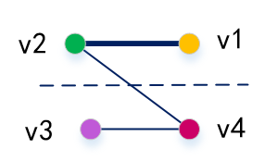
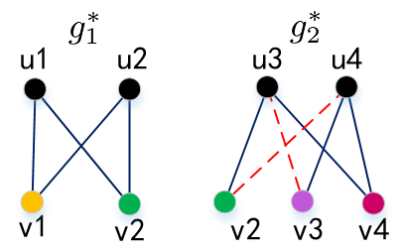
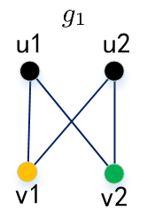
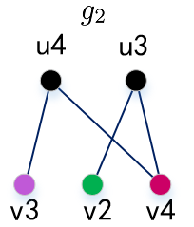
Graph Partition
Data Graph
Projected Attribute Graph
Minimum cut
A user is assigned to a subgraph if all his attributes are cut to the same subset
A user is assigned to a subgraph which contains the majority of his attributes
Anonymity Graph

Slide 16
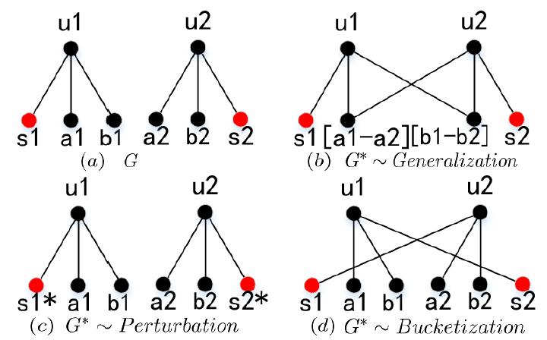
Graph Anonymity Operator
Vertex perturbation
Generalization, Randomization
Aggregation, Permutation
Edge perturbation
Changing, Modification
Aggregation, division
The Anonymity Graph is produced by a sequence of vertex/edge addition/deletion on Data Graph

Slide 17


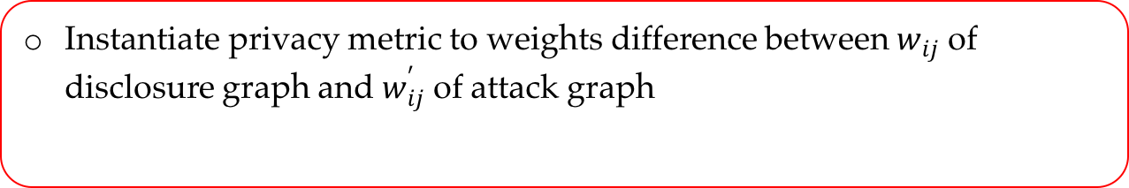
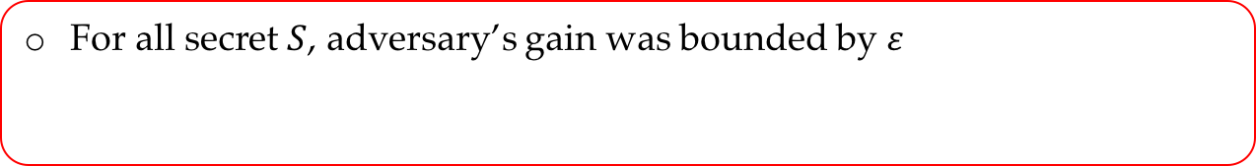

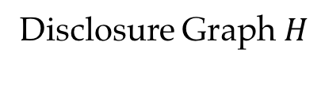
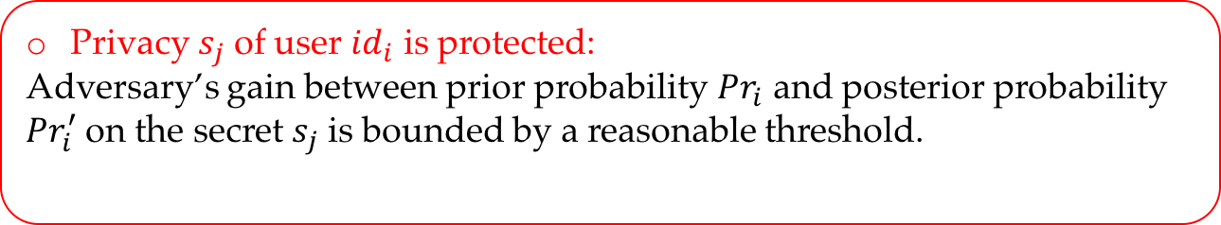
Privacy Metric
Privacy $s_{j}$ of user ${id}_{i}$ is protected:
Adversary’s gain between prior probability ${Pr}_{i}$ and posterior probability ${Pr}_{i}^{′}$ on the secret $s_{j}$ is bounded by a reasonable threshold.
Privacy
Difference
Attack Graph $G_{A}$
Disclosure Graph $H$
Instantiate privacy metric to weights difference between $w_{ij}$ of disclosure graph and $w_{ij}^{′}$ of attack graph
For all secret $S$, adversary’s gain was bounded by $ε$

Slide 18

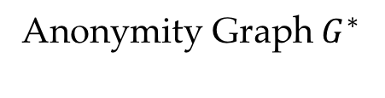
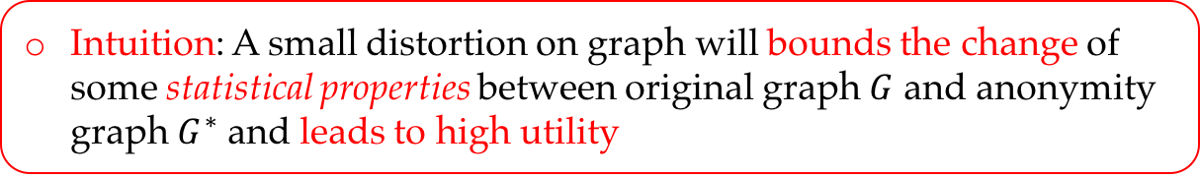
Utility Metric
Intuition: A small distortion on graph will bounds the change of some statistical properties between original graph $G$ and anonymity graph $G^{∗}$ and leads to high utility
Utility
Statistical properties
Difference
Original Graph $G$
Anonymity Graph $G^{∗}$
Same attribute
Different attributes
Expectation
Correlation

Slide 19

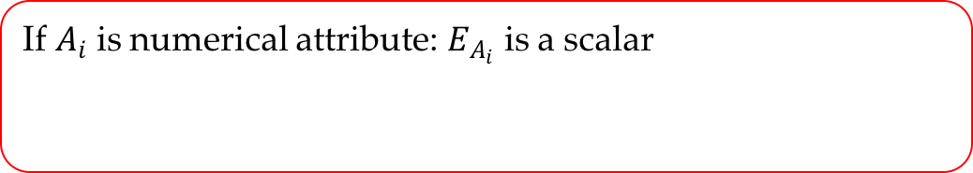
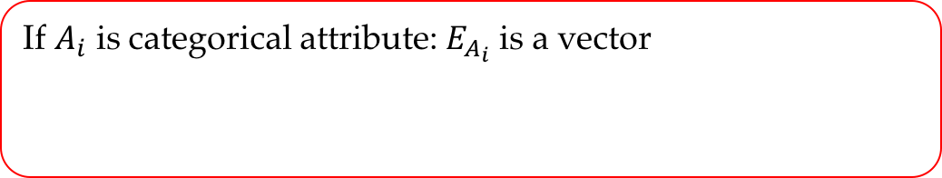


Utility Metric: expectation
$E_{A_{i}}$ : expectation for the attribute $A_{i}$
If $A_{i}$ is numerical attribute: $E_{A_{i}}$ is a scalar
If $A_{i}$ is categorical attribute: $E_{A_{i}}$ is a vector
The expectation $E_{G}$ of graph $G$:

Slide 20
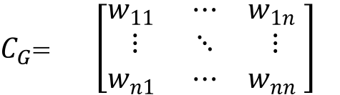




Utility Metric: correlation
Project Data Graph $G$& Anonymity Graph $G^{∗}$ into Attribute Graph $G_{Σ}$
$$A_{1}$$
$$A_{n}$$
Graph Project
$$A_{1}$$
Adjacent matrix
$C_{G}$= $\left[\begin{matrix}w_{11} & ⋯ & w_{1n} \\ ⋮ & ⋱ & ⋮ \\ w_{n1} & ⋯ & w_{nn} \end{matrix}\right]$
$$A_{n}$$
Data Graph/Anonymity Graph
Projected Attribute Graph

Slide 21
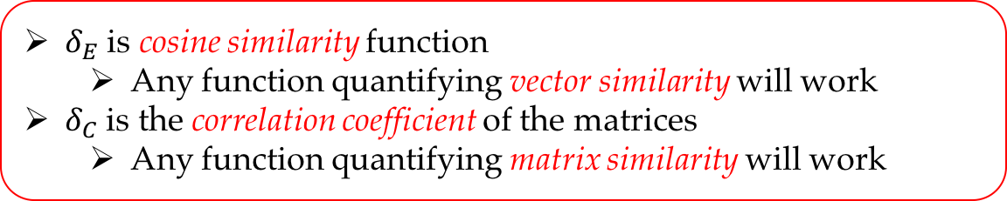
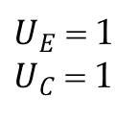
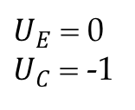
Utility Measurement
Data utility is calculated based on the difference of statistical properties
$δ_{E}$ is cosine similarity function
Any function quantifying vector similarity will work
$δ_{C}$ is the correlation coefficient of the matrices
Any function quantifying matrix similarity will work
Maximal utility
Minimal utility
$U_{E}$ = 1
$U_{C}$ = 1
$U_{E}$ = 0
$U_{C}$ = -1

Slide 22
Outline
Background
Framework
Experiment
Conclusion

Slide 23
Experiment
Dataset:
Adult (Census Table, Secret: Salary)
30,162 users with 9 attributes (Age, Workclass, Education, Marital-status, Occupation, Salary, Race, Sex, Native-country)
Facebook (Social Network, Secret: User ID)
4039 user nodes and 88234 edges within 10 ego networks, where each user has 6 attributes (Birthday, Education degree, Education type, Education with gender, Location, Work with)
Brightkite ( Temporal and spatial data, Secret: User ID)
4,491,151 check-in records which consists of times and GPS locations

Slide 24
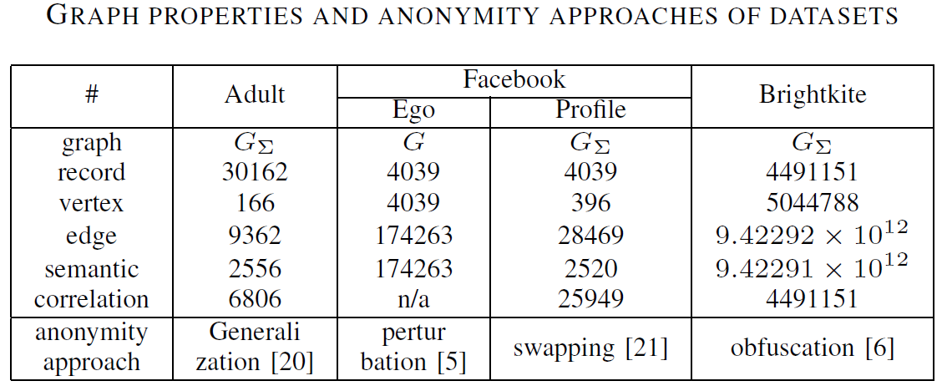
Experiment
Attacker’s Background Knowledge:
Assumed uniformly distributed over all secret nodes of Attack Graph for simplicity.

Slide 25
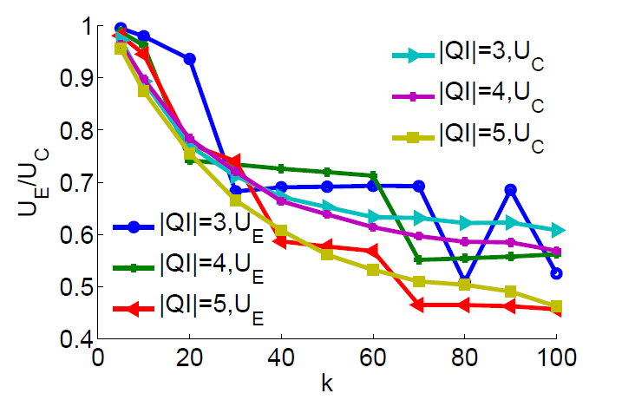
Utility on Table
The 5-anonymity graph utility of Adult dataset with 3/4/5 attributes
The utility is relative high when the anonymity group k is small

Slide 26
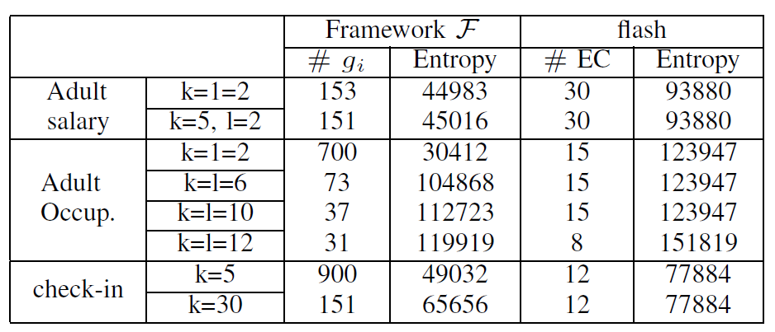
Utility Comparison
Compare the utility of graph anonymity and ARX(implemented by flash)
Our framework can reach better utility within the same privacy constraints

Slide 27
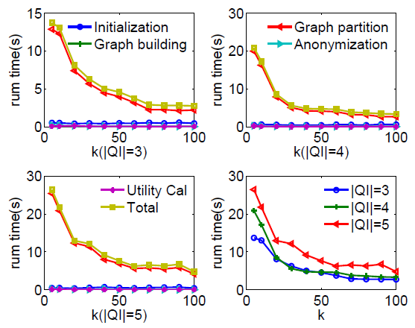

Computation Complexity
The graph partition contributes most of the run time of the framework
Computation Complexity:

Slide 28
Outline
Background
Framework
Experiment
Conclusion

Slide 29
Summary
Propose a graph-based privacy preserving data publishing scheme
Incorporate with most of privacy protection approaches
Define graph-based privacy criterion and utility metric and provably efficient

Slide 30
Thanks!

