Slide 1







$$d_{ubm}$$
$$d_{rep1}$$
$$t_{ubm}$$
UBM
$$d_{del}$$
$$h_{ball}$$
Solder bump
Cu pad
$$t_{pad}$$
$$d_{pad}$$

Slide 2
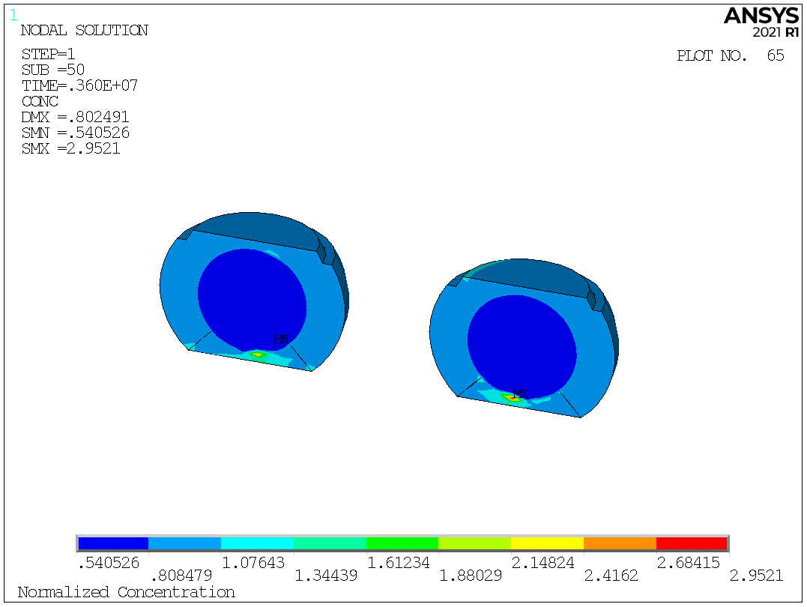
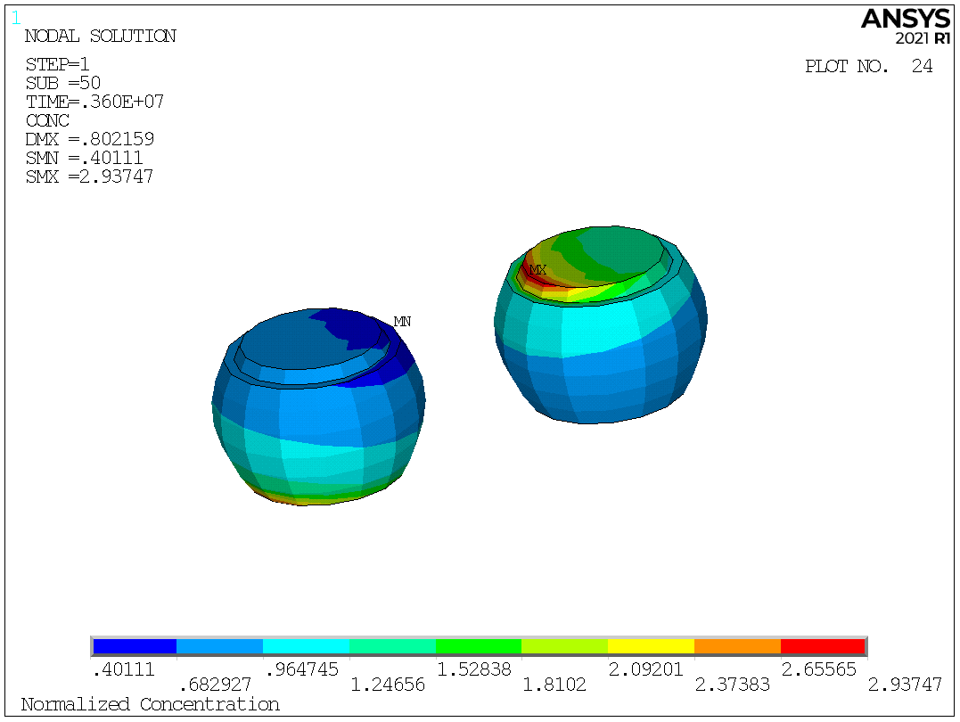
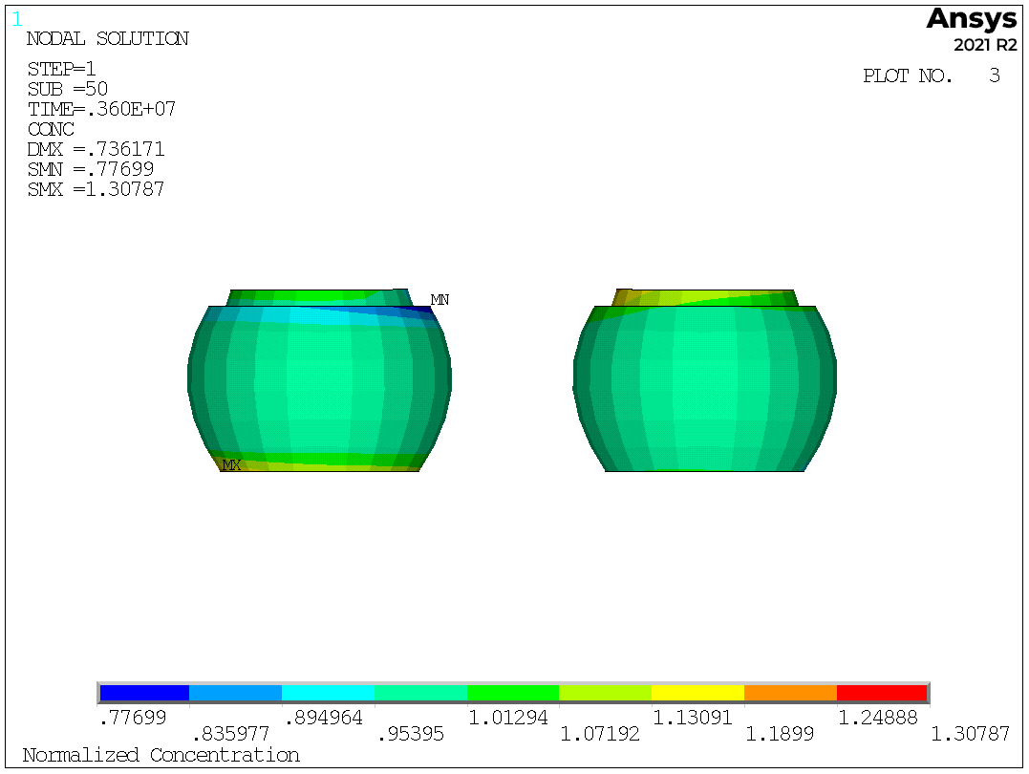

Slide 3
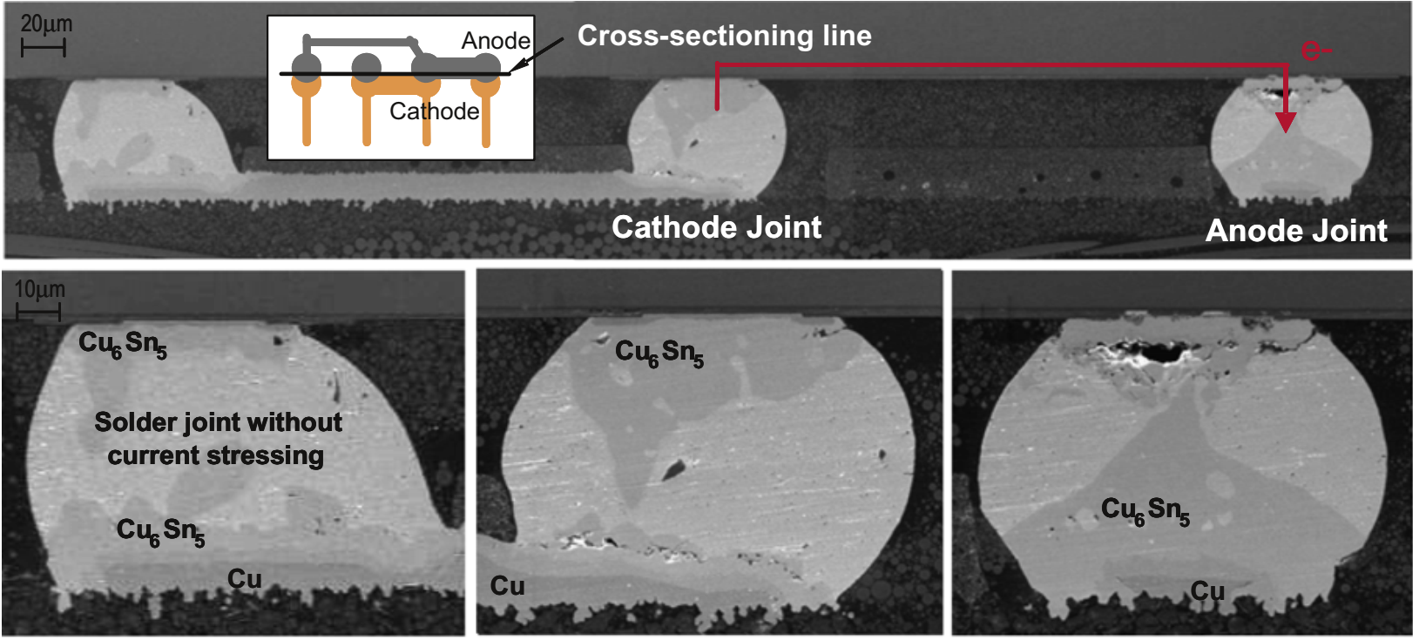

Slide 4
