Slide 1



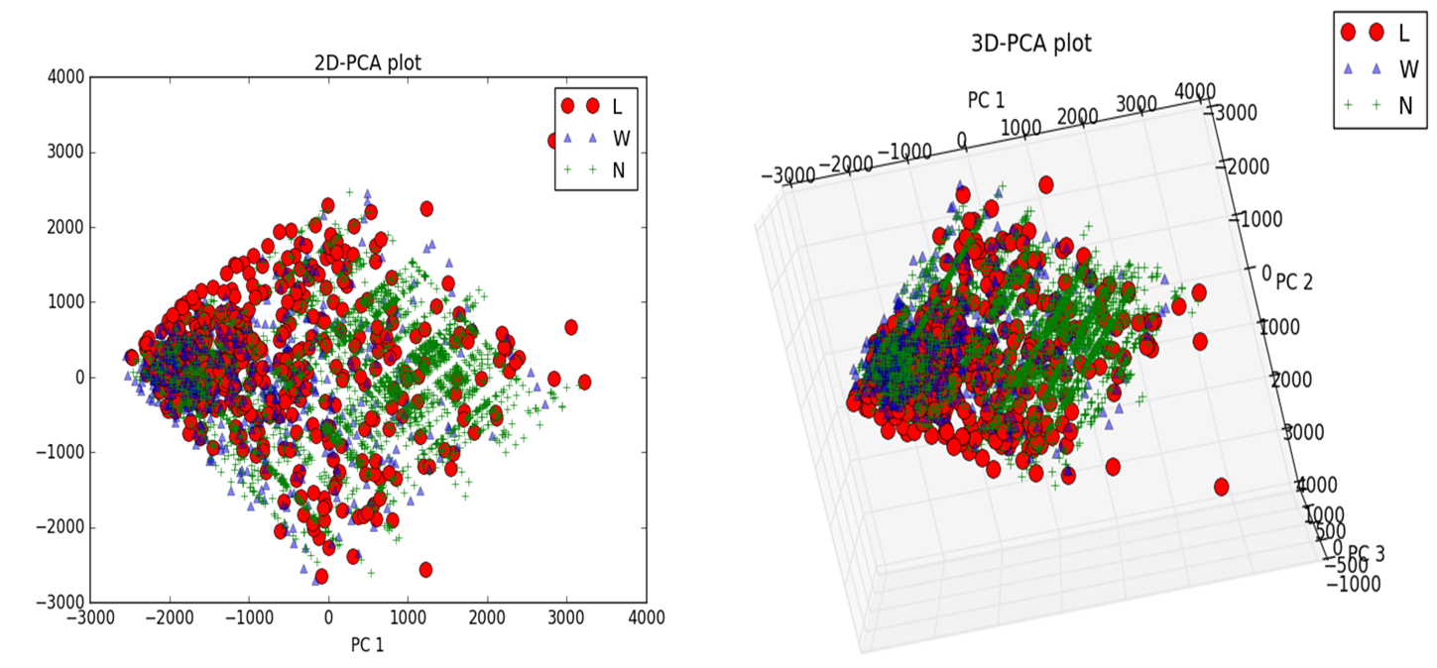
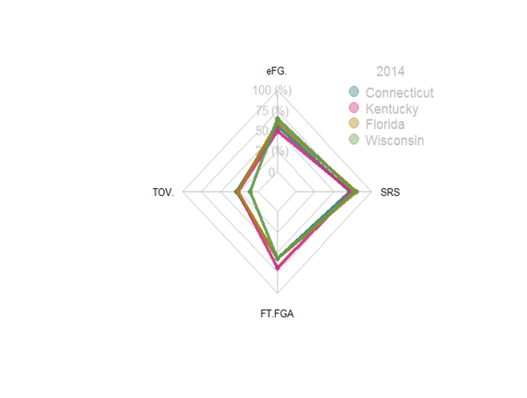

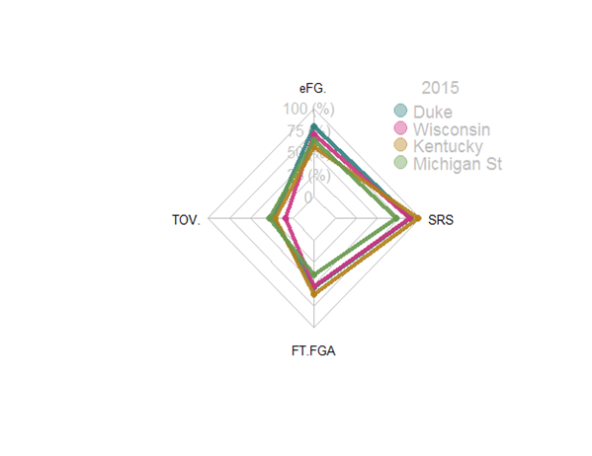
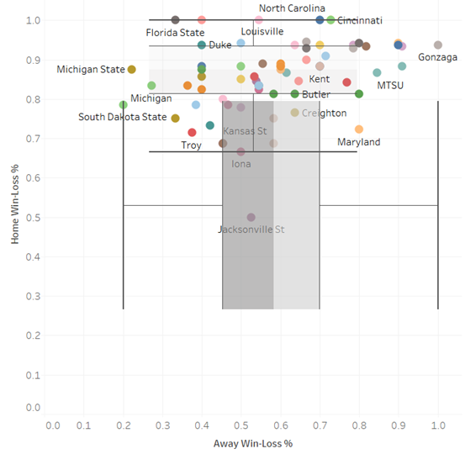
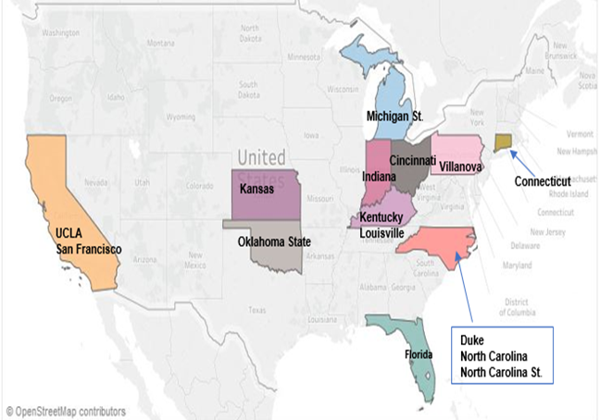


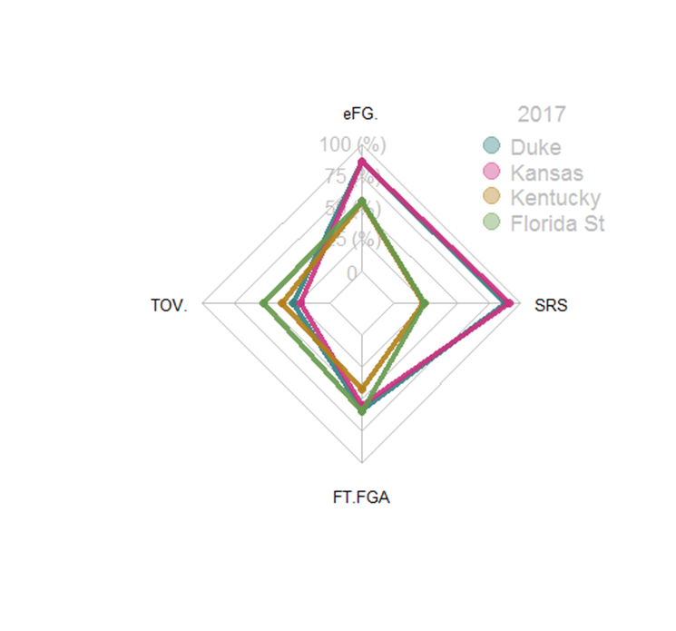
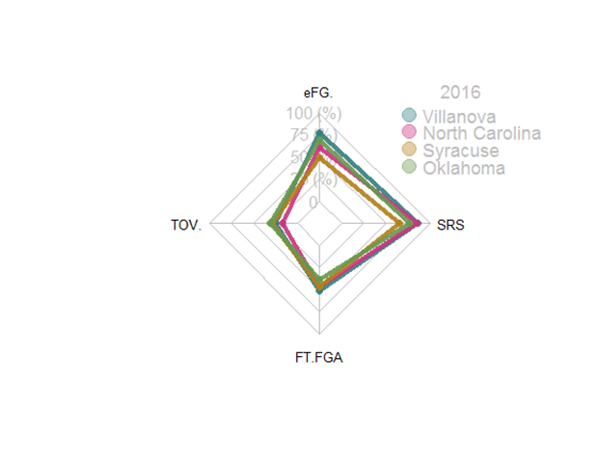

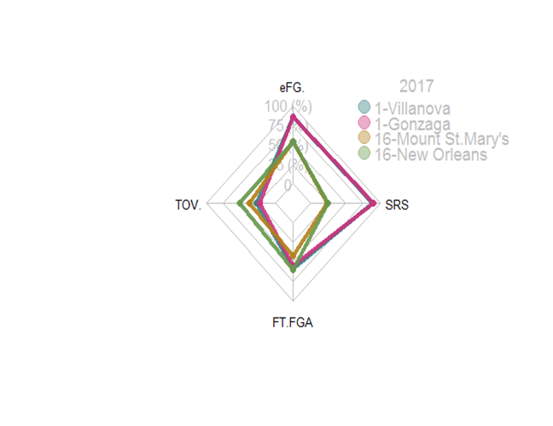
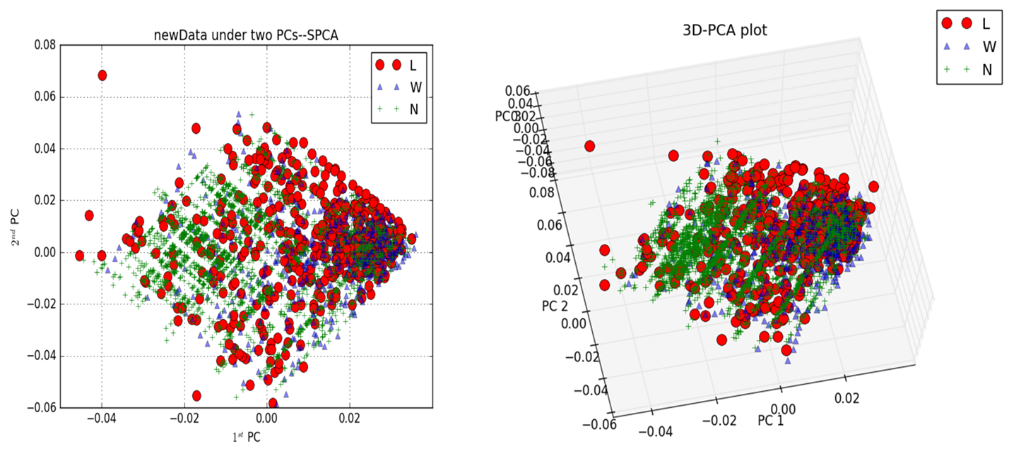
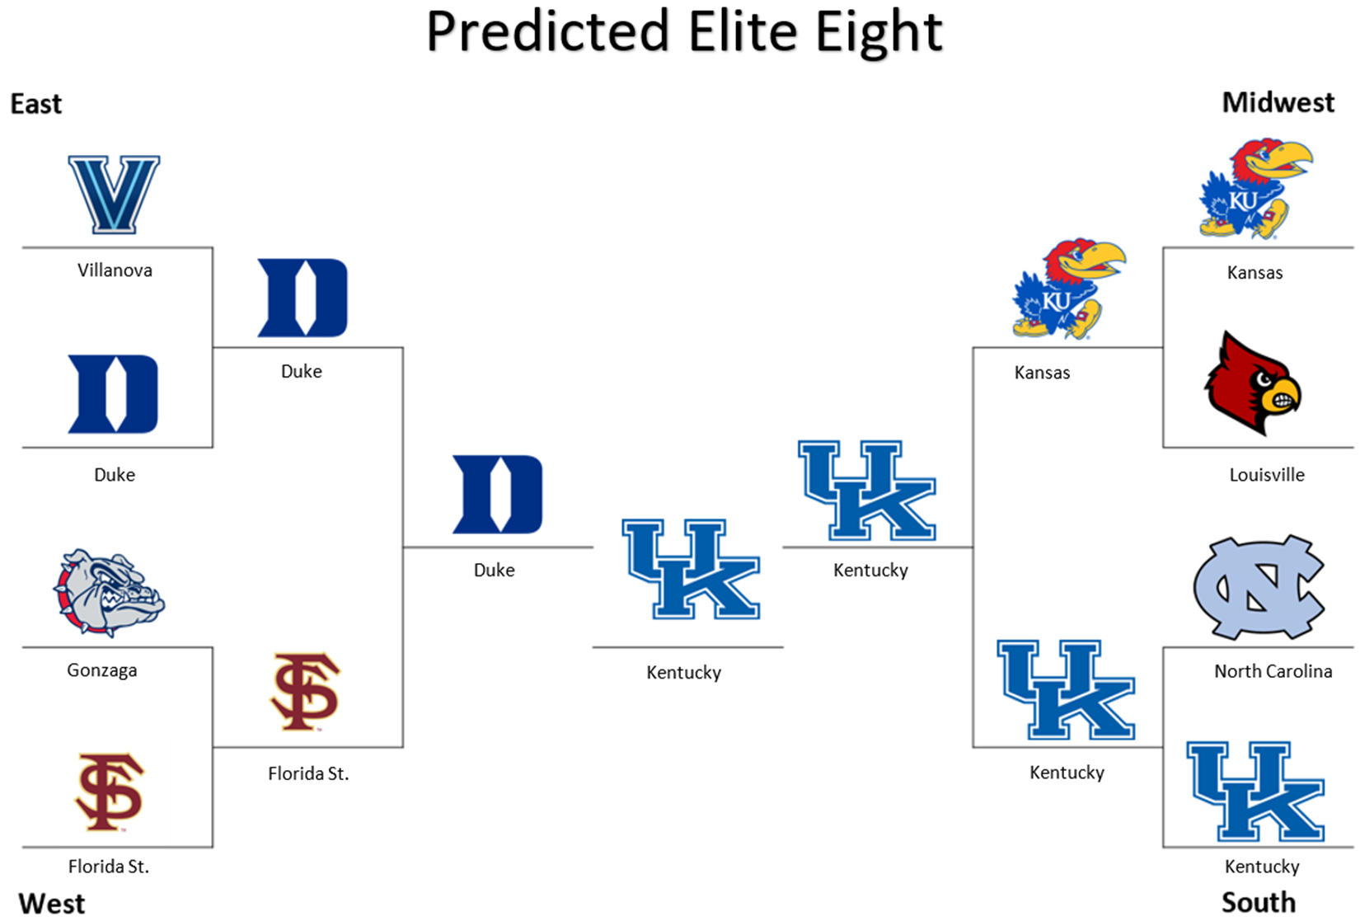
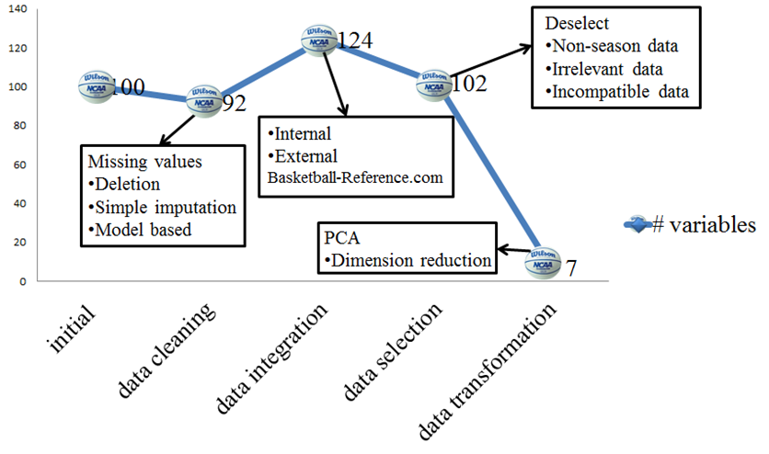
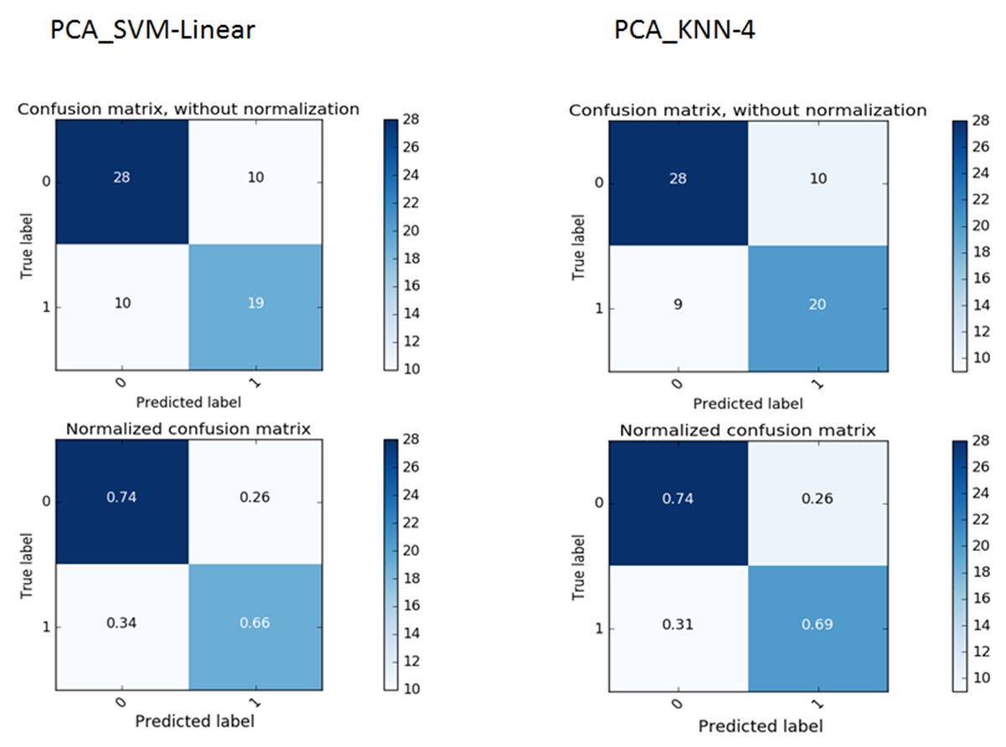
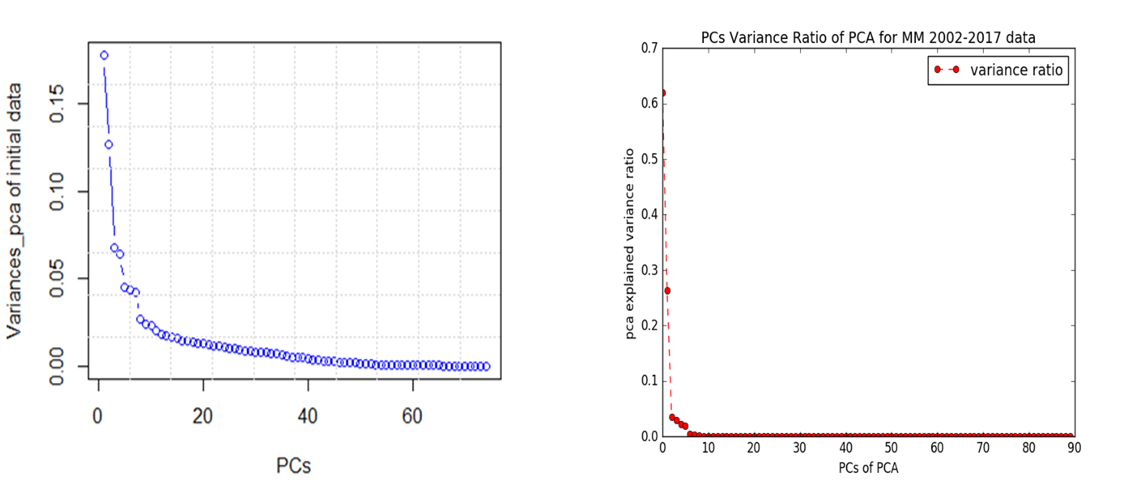
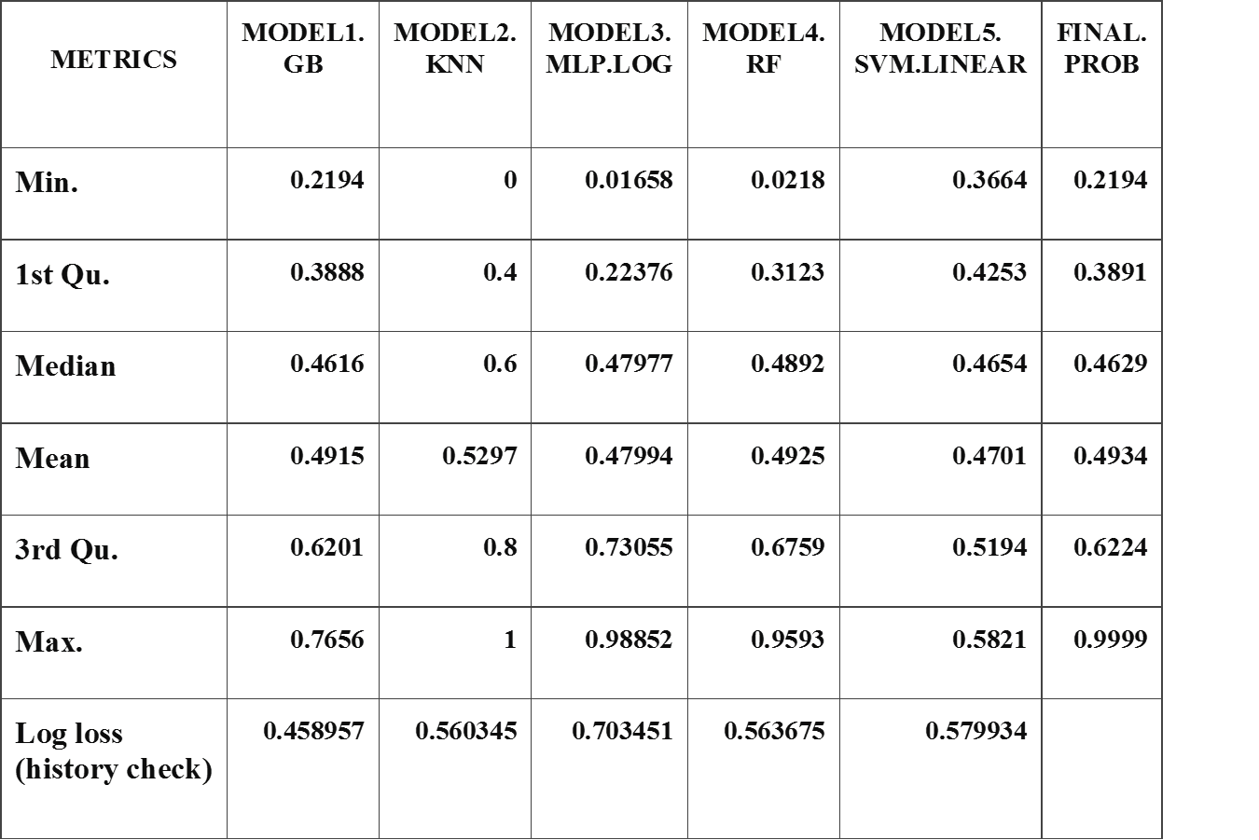
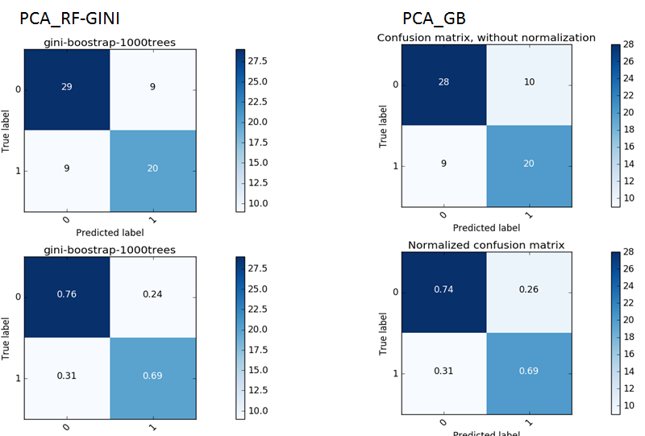

Liyi Li
Huizhen Xu
Michael Friscia
Ayaz Ghesani
New Data PCA 2D Plot
New Data PCA 2D Plot
2017 Home & Away Win-Loss Percentage
Map of Teams with More than One Championship
Results from SPCA:
Similar patterns as PCA
Natural clustering
Outliers
Red shows the historical loss records
Blue shows the historical winning records
Green shows the 2017 records
New Data SPCA 2D Plot
New Data SPCA 3D Plot
Number of Variables in Dataset during Data Processing
Confusion Matrix for Train 2002-2015 & Test 2016
Variables Added to Original Dataset
PC Variances of Initial Dataset
PC Variances of Updated Dataset
Prediction Probability Summary Table for 2017 Tournament
Confusion Matrix for Train 2002-2015 & Test 2016
Keep >= 90% Data Variances
But need 31 variables
Keep >= 99% Data Variances
But only 7 variables

