Slide 1
NLP classification of Women’s Clothing Reviews
By Larissa Lieberson

Slide 2
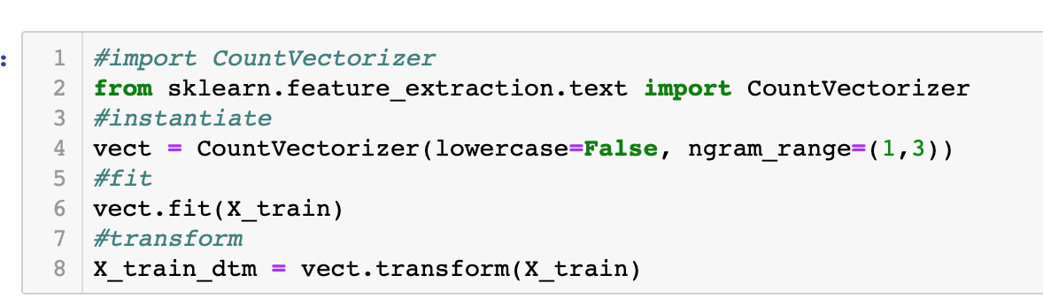
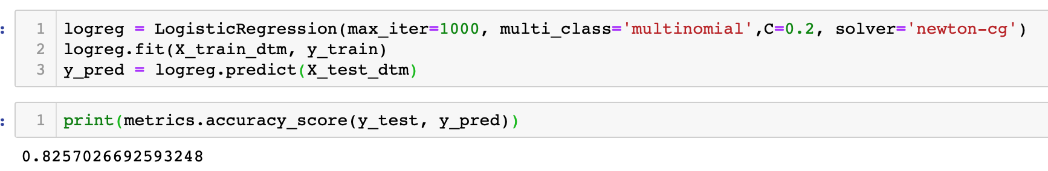
Final model
For the final model, I kept all star reviews in the dataset. Upon exploring various mappings, I achieved the highest accuracy when mapping 1 and 2 to 0, 3 to 1, and 4 and 5 to 2.
Surprisingly, count vectorizer outperformed Tfidf on this algorithm, and many parameters were tested. In the best performing version, lowercase is set to false, meaning that the vectorization considers uppercase words different from lowercase. I also changed the n_gram range, to account for patterns within strings of text of various length
In order for the model to predict more than two classes, I had to set multi_class to multinomial. Furthermore, the solver had to be changed. I changed the solver to newton-cg, which handles L2 regularization at no penalty. However, it does handle L1 with a penalty and does not support elasticnet penalty. I could have also used saga, sag, but they are better for larger algorithms. Also, saga was not available in my version of Python. Newton-cg uses a quadratic loss function.
Using the results of grid search, I set the max_iter to be 1000, meaning that the solver will converge at that point. I also set C=0.2, supporting stronger regularization on the data.
The model accuracy was 5 percentage points higher than the null accuracy, at 83% accurate versus 77% accurate.

Slide 3
relevance and implementation
This model can be used to help businesses identify customer sentiment in relation to their products. Since the only input is a text review, the company could further gauge their customers feelings from comments; for example, on social media pages, blogs, and more in which star ratings are not readily available.

Slide 4
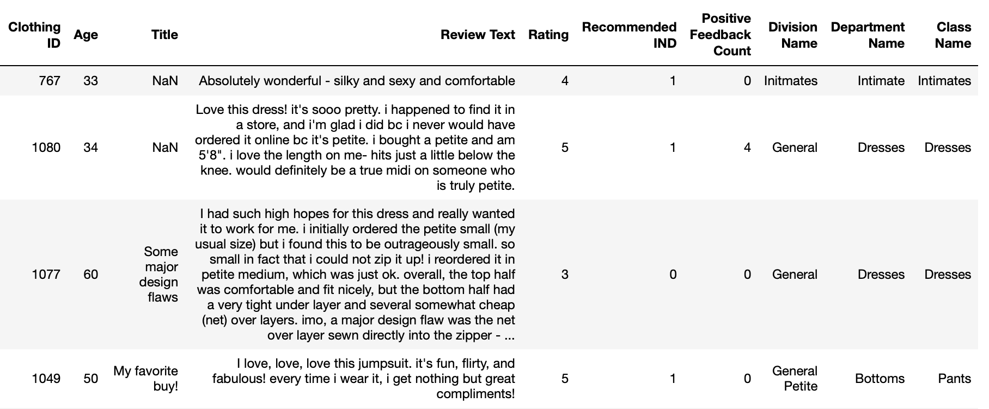
dataset
Dataset: https://www.kaggle.com/nicapotato/womens-ecommerce-clothing-reviews

Slide 5
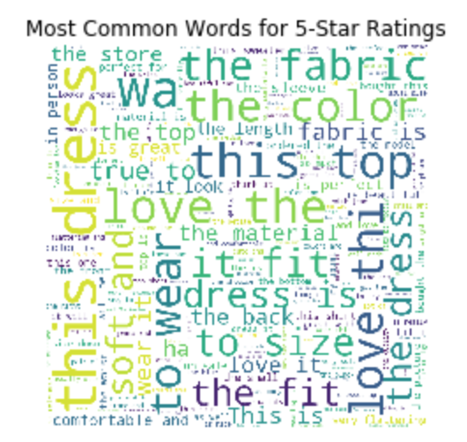
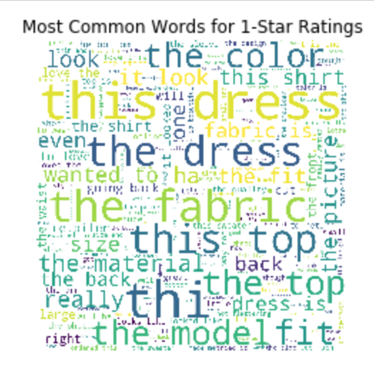
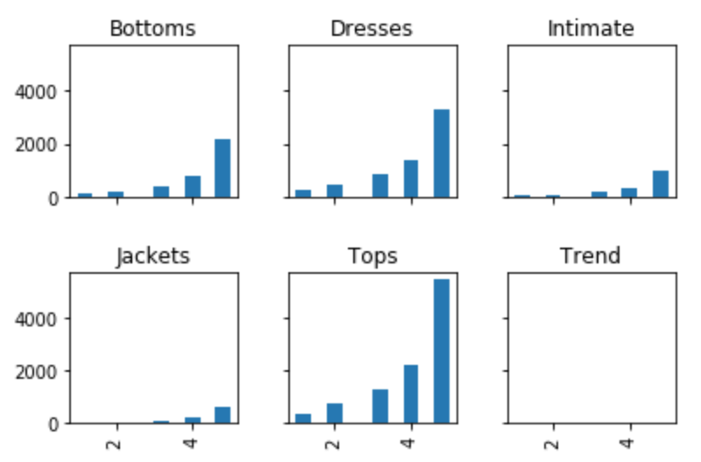
EDA
Rating by Department

Slide 6
Base vectorizers & models
To begin with, I dropped all rows that contained 2, 3, or 4-star reviews in order to use a dataset containing only extreme sentiments.
Multinomial NB Reason: this algorithm is commonly used in text-classification problems because it is intuitive and considers conditional probability. However, the independence assumption is difficult to realistically assume in the case of the English language. Results: this simple algorithm performed extremely well in all regards; however, logistic regression was slightly better except for recall. Metrics for accuracy, precision, and recall were all above .96—3 percentage points higher than null accuracy. | Logistic Regression Reason: this algorithm is less prone to overfitting, especially in smaller datasets, such as this one. It is also simple to understand. Results: using grid search, the best algorithm has max iterations of 10, and fit_intercept set to false. This was the highest-performing algorithm in terms of accuracy and precision. Metrics for accuracy, precision, and recall were all above .96—3 percentage points higher than null accuracy. | Count Vectorizer Reason: base-line to transform the data into a format that can be analyzed in machine learning algorithms. Results: surprisingly, in all instances, count vectorizer performed better than Tdfidf. Furthermore, the baseline vectorizer performed best on the binary dataset. | Tfidf Reason: this transformation method is typically best practice because it gives a better sense of the importance of words across the documents Results: in base models, we saw this perform worse than count vectorizer | NLTK sentiment analysis Reason: this package has been trained with thousands of documents and gives a value between -1 and 1 of polarity in a text blob Results: this was the lowest performing algorithm at a base level. The comparison came from mapping negative predictions to 0 and positive predictions to 1

Slide 7
Next steps
See if a multi-class Naïve Bayes is possible
1
Deploy the model using Flask
2
Deploy the model using an EC2 instance on AWS
3

Slide 8
Pitfalls & surprises
The data is extremely skewed right, with few 1 and 2 star ratings. Therefore, there was a high probability of false positives, since there were less training points for low ranking reviews
I was happy to see that my models performed better than the NLTK polarity models; however, it should be noted that with more fine-tuning and tuning, this may not be the case
I still have some confusion surrounding the best way to assess models both against each other, and against the baseline, especially when using multi-class classification

