Slide 1
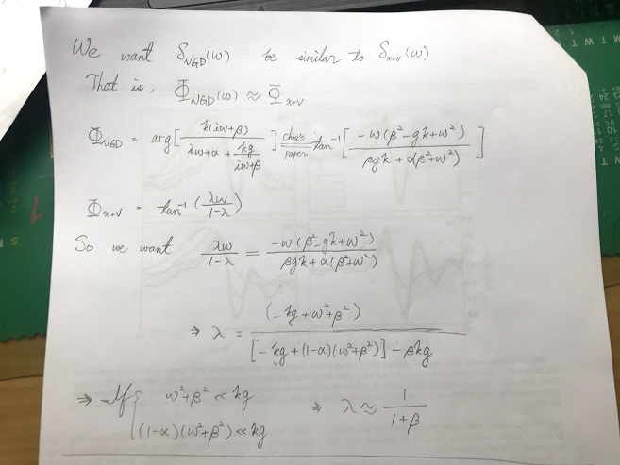

Slide 2
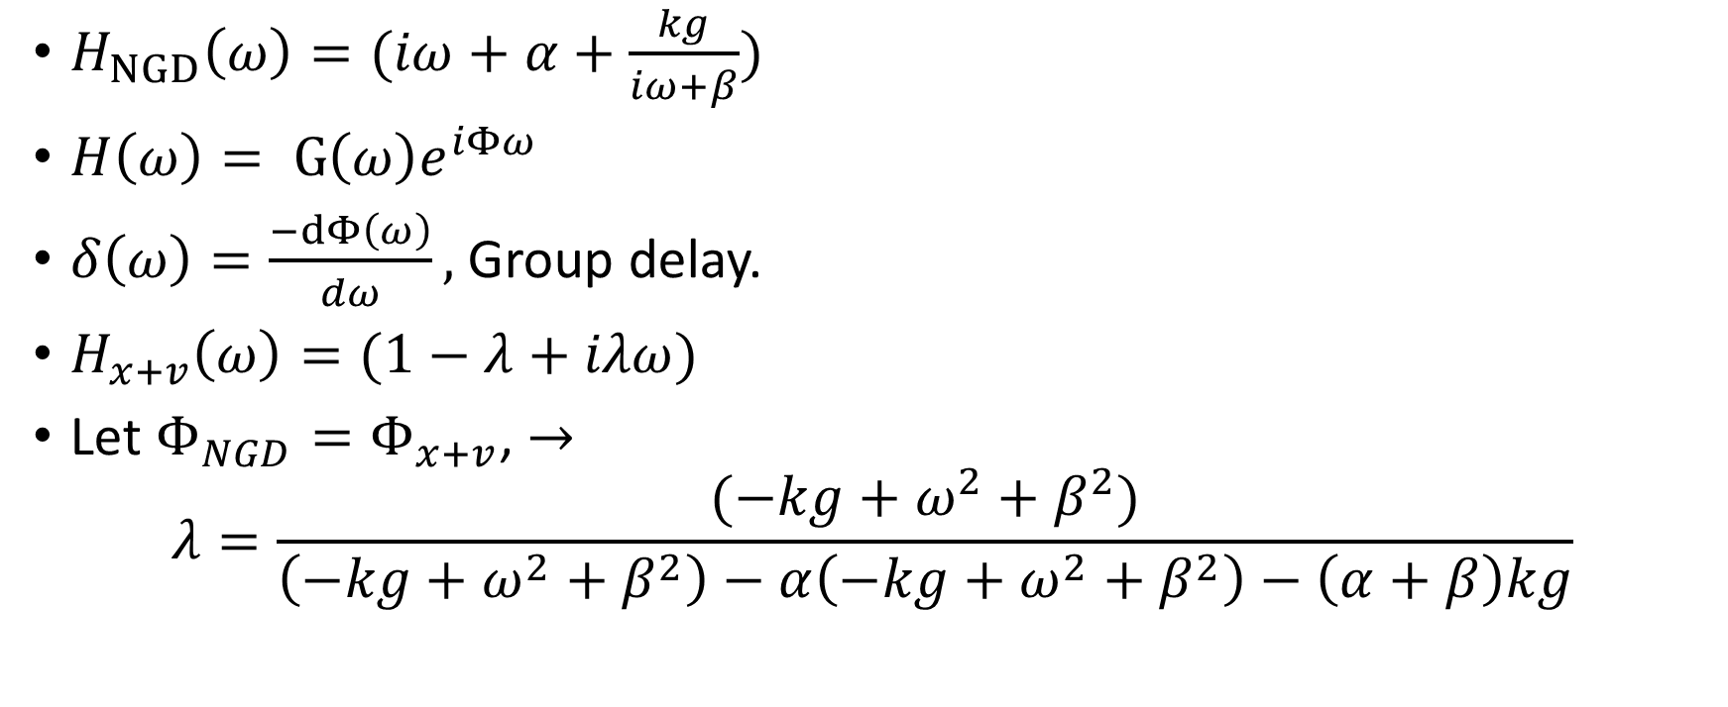

$$Y\left(ω\right)=H\left(ω\right)X\left(ω\right)$$
$H_{NGD}\left(ω\right)=(iω+α+\frac{kg}{iω+β})$
$H\left(ω\right)= G\left(ω\right)e^{iΦω}$
$δ\left(ω\right)=\frac{−dΦ\left(ω\right)}{dω},$ Group delay.
$H_{x+v}\left(ω\right)=(1−λ+iλω)$
Let $Φ_{NGD}=Φ_{x+v}$, $→$ $λ=\frac{(−kg+ω^{2}+β^{2})}{\left(−kg+ω^{2}+β^{2}\right)−α\left(−kg+ω^{2}+β^{2}\right)−\left(α+β\right)kg}$

Slide 3
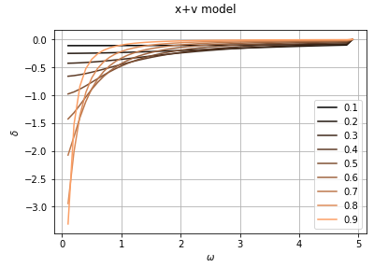
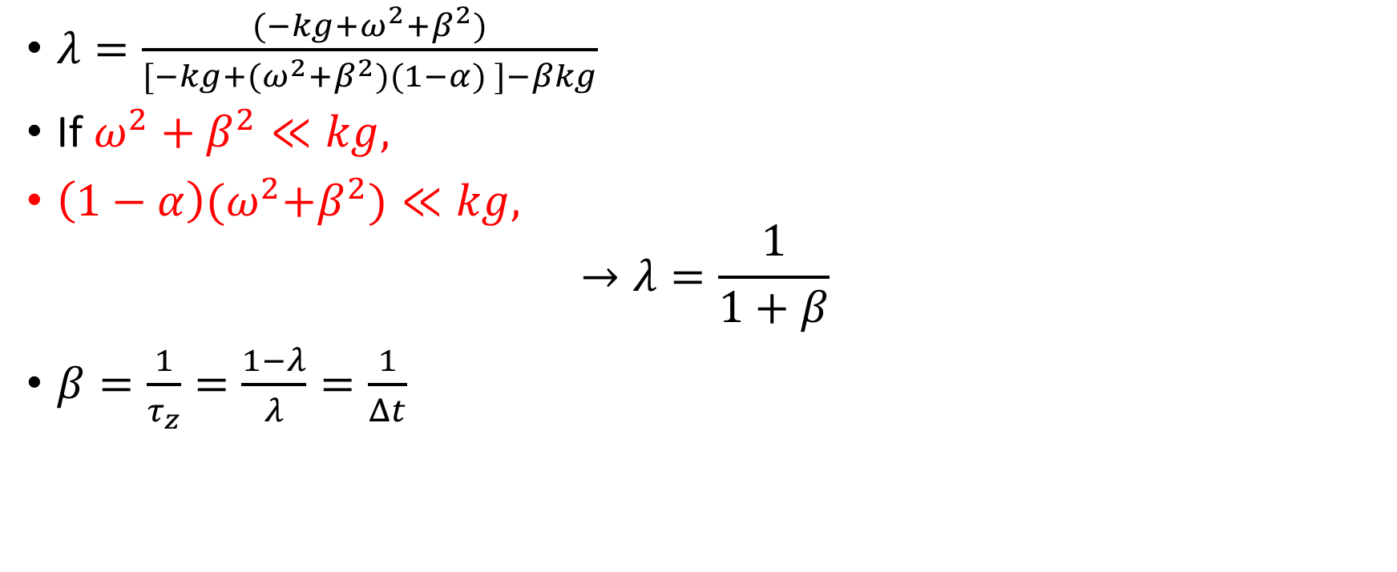
$λ=\frac{(−kg+ω^{2}+β^{2})}{[−kg+(ω^{2}+β^{2})(1−α) ]−βkg}$
If $ω^{2}+β^{2}≪kg,$
$\left(1−α\right){(ω}^{2}+β^{2})≪kg,$
$$→λ=\frac{1}{1+β}$$
$β=\frac{1}{τ_{z}}=\frac{1−λ}{λ}=\frac{1}{Δt}$

Slide 4
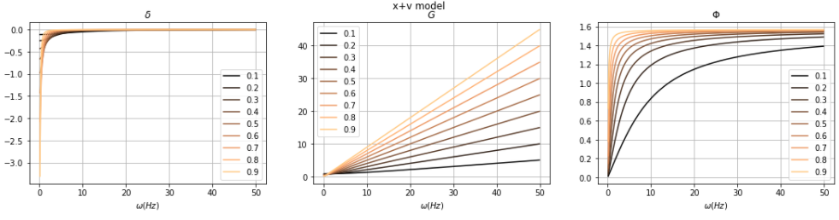

X+v model, Different $λ$

Slide 5
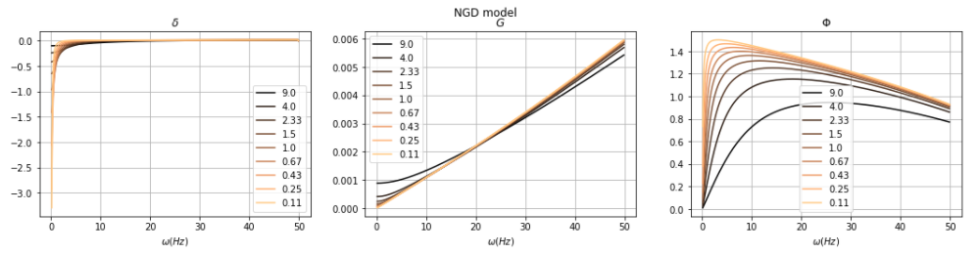


NGD model, different $β$
$α$ = 100,
Kg = 9200.

Slide 6
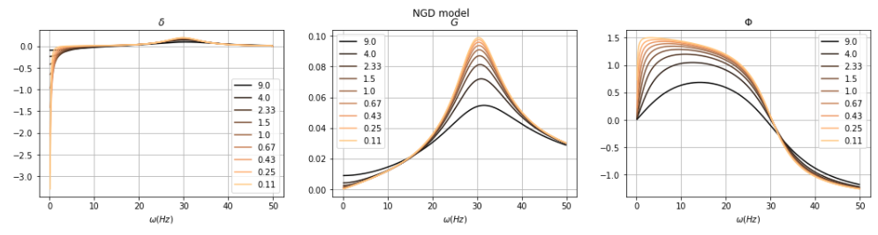
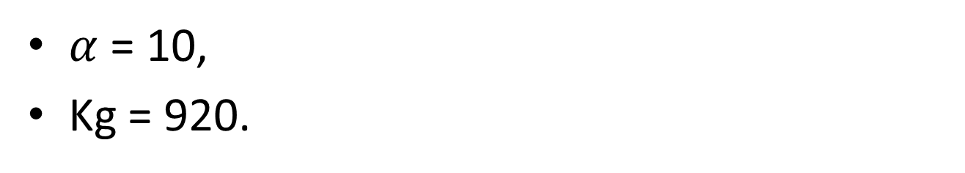

NGD model, different $β$
$α$ = 10,
Kg = 920.
$$α$$
Kg

