Slide 1
Setup matlab search path

Slide 2
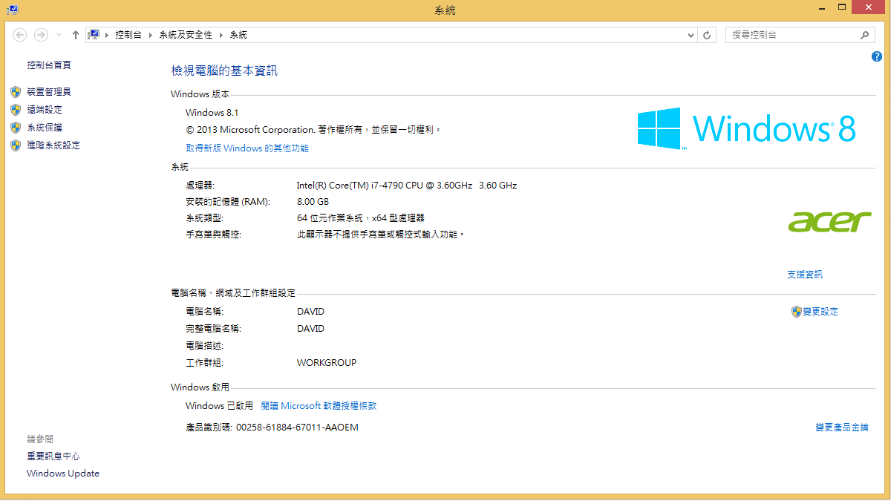

Slide 3
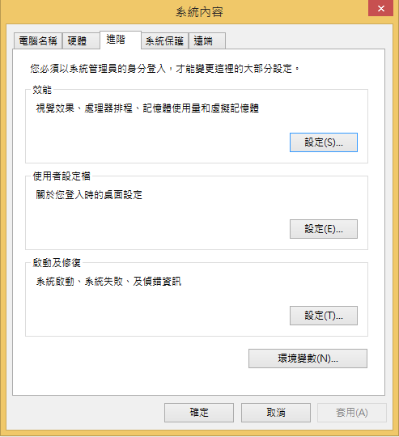

Slide 4
