Slide 1
misinformation · digital literacy · generational gaps
Can people reliably distinguish AI-generated images from real photographs?
Who's better at it — and does self-reported AI exposure help?
Ordered probit analysis · N = 508 · Lulu, Maddy and Seamus

Slide 2
02 · Study Design
Study Design
THE SURVEY
WHAT WE COLLECTED
Qualtrics survey distributed at Bowdoin. Each respondent classified 10 images (5 AI-generated, 5 real) as AI or Real. Two attention checks embedded. Raw n = 508.
· Demographics — age/class, gender, race · Device type used · AI familiarity & weekly usage · Social media time · Per-question confidence (0–10) · Per-question response times
Every respondent faced the same task — 10 images, binary choice, confidence rating.

Slide 3
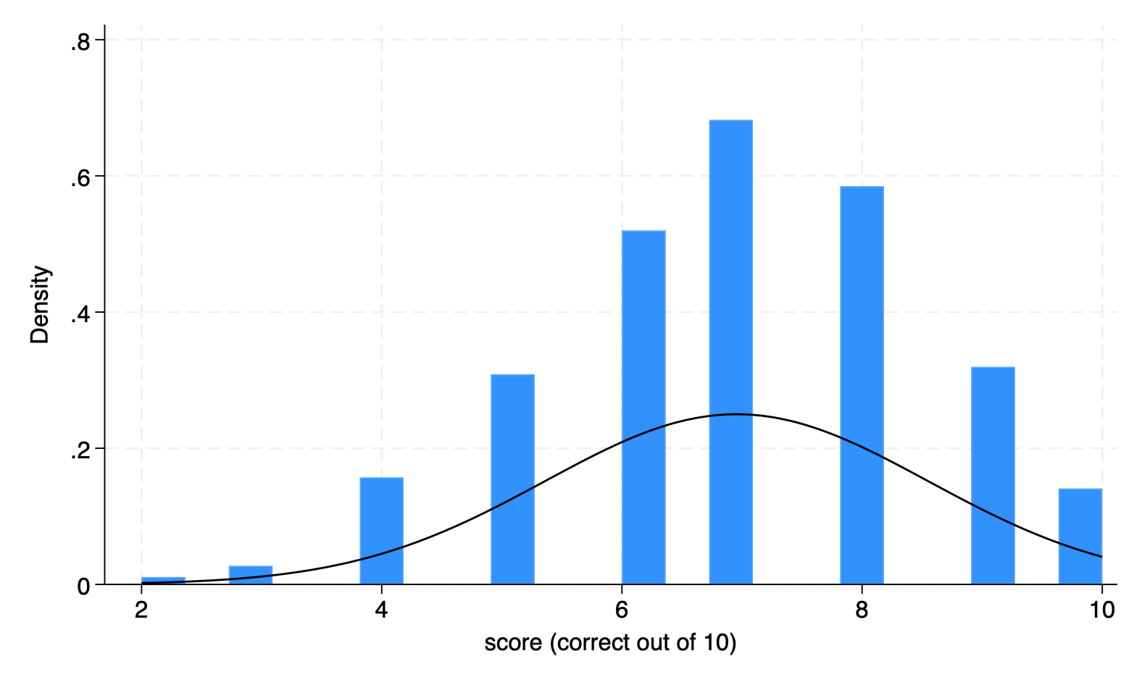
03 · Dependent Variable
Y = detection score
SUMMARY STATISTICS
n = 508 Mean = 6.95 SD = 1.60 Median = 7 Range = 2 – 10 Ordinal, 11 levels
Normal distribution
Score = count of correct classifications (TP + TN) out of 10. Roughly symmetric, modal at 7.

Slide 4
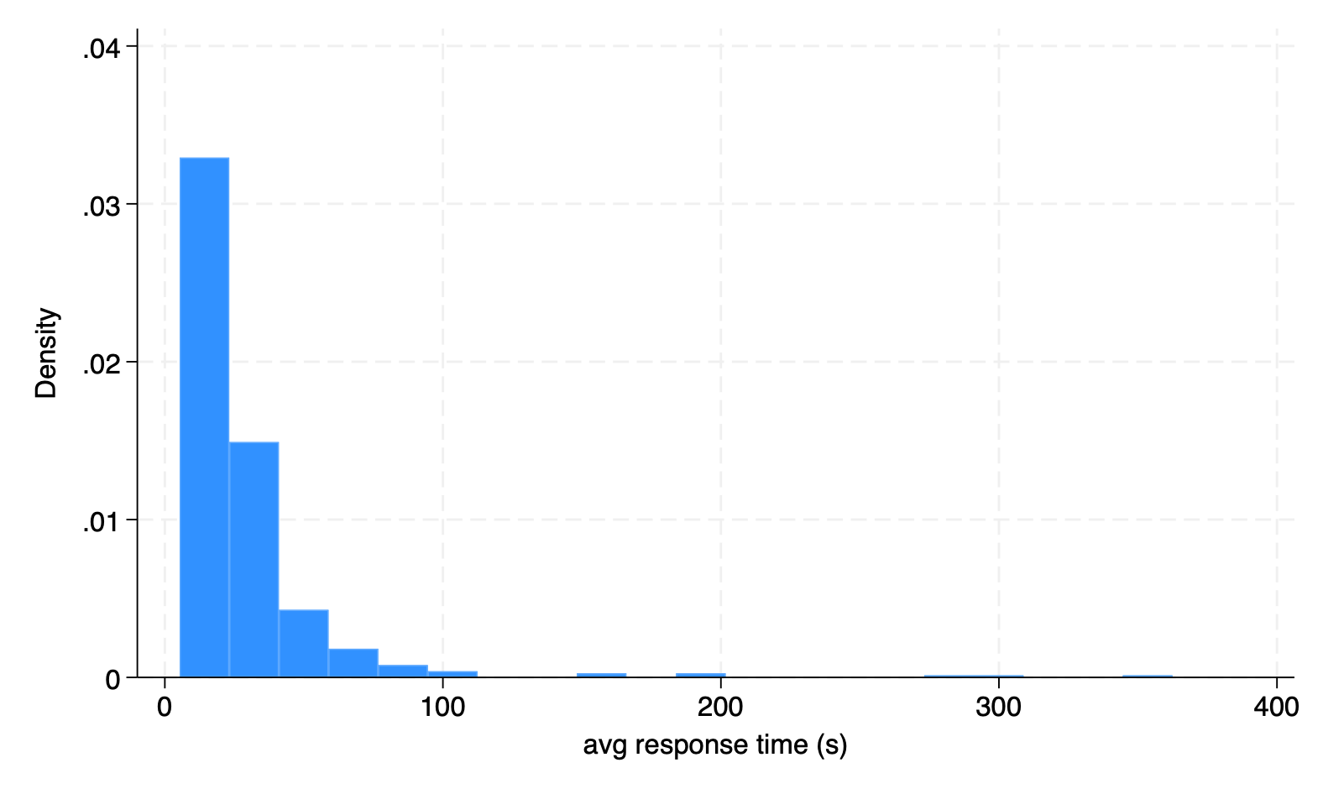
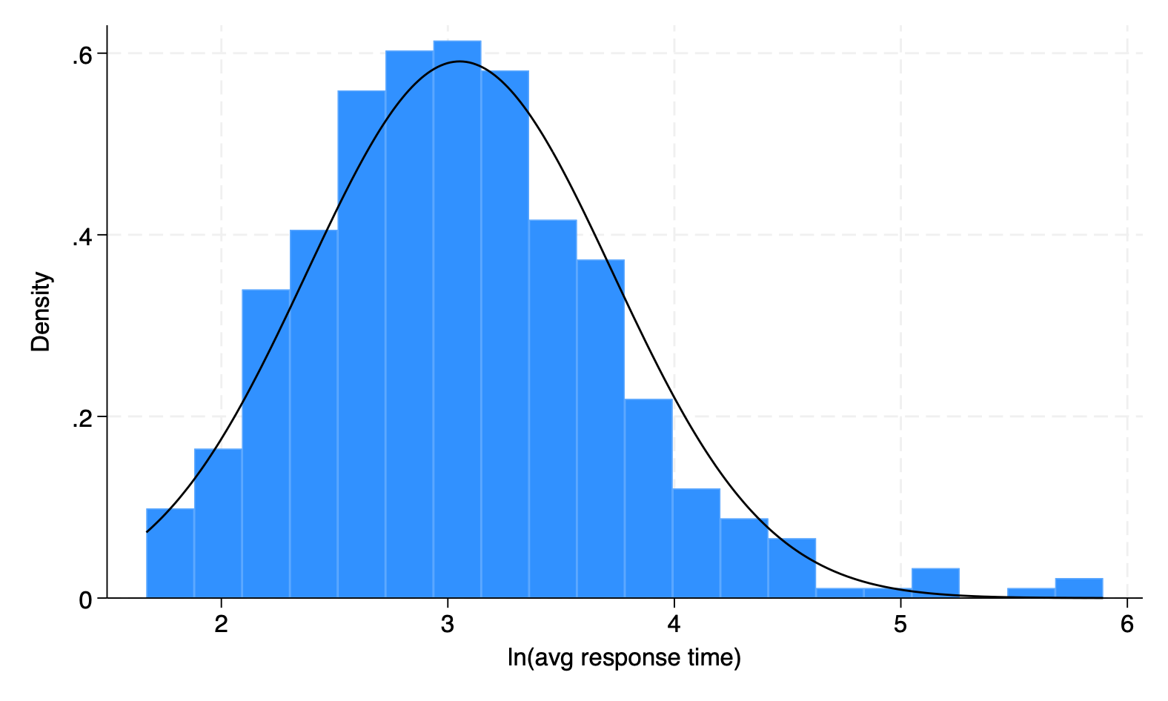
06 · RESPONSE TIME
Timing Filter
RAW — avg seconds per image
LOG — ln(avg seconds)
Mean 34.3s Max 2,766s (45 min) → remove anything more than 5 minutes? (outlier/unrealistic?) Skew +11.2
After log(x): approximately normal — usable as a linear predictor.
The raw distribution is heavily right-skewed; the log transform makes it symmetric enough to use in the regression.

Slide 5
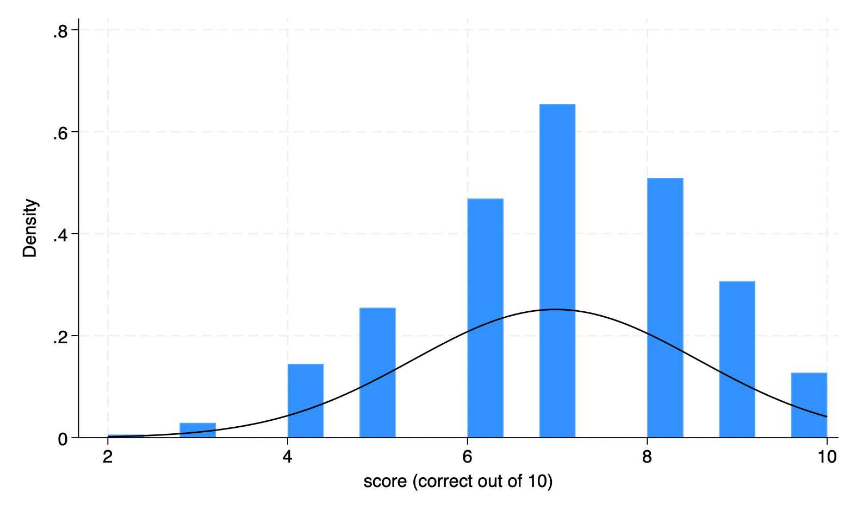
04 · DATA CLEANING
Attention Filter
508
Starting sample
BEFORE — N = 508
AFTER — N = 432
−54
Failed Attn-Check 1
−22
Failed Attn-Check 2
432
Analytic sample
Score mean 6.95 → 6.98 SD 1.60 → 1.59 (distribution unchanged)
15% dropped — attention-check failures plus implausibly fast responses. Score distribution barely moved.

Slide 6
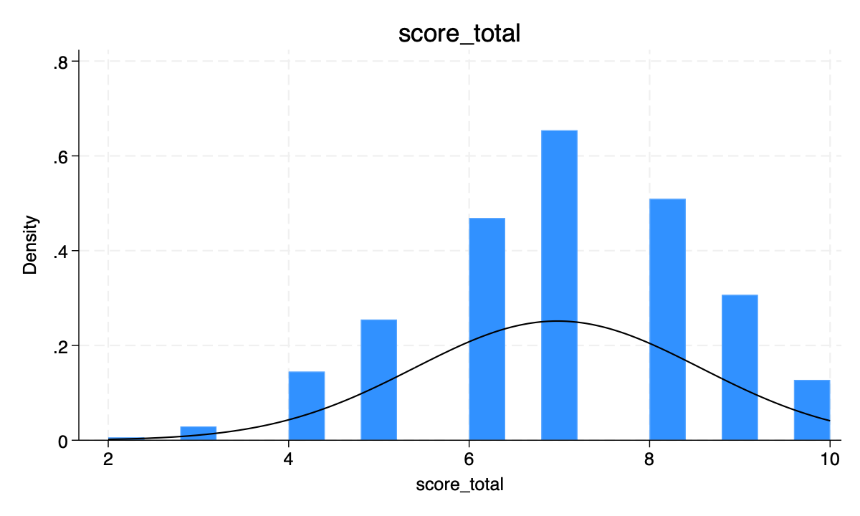
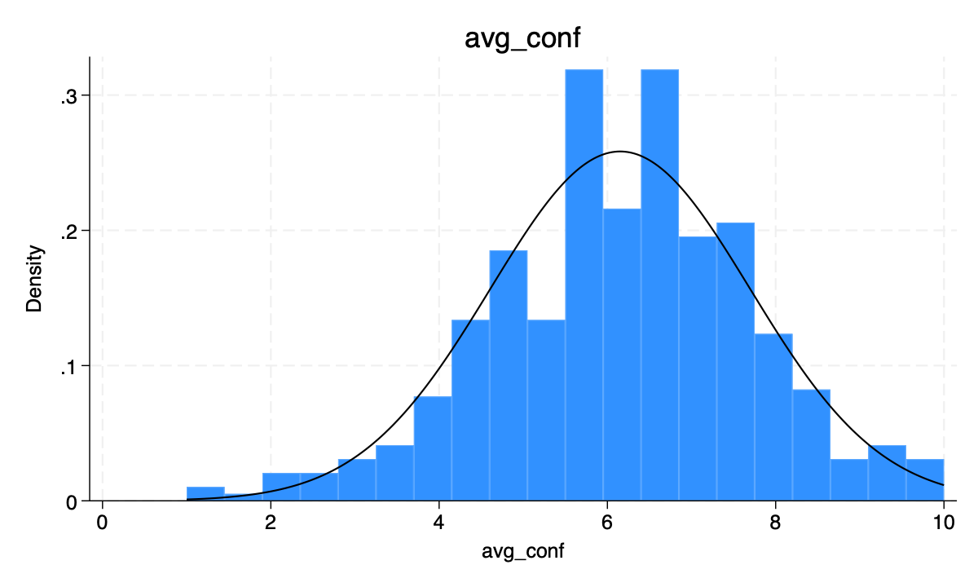
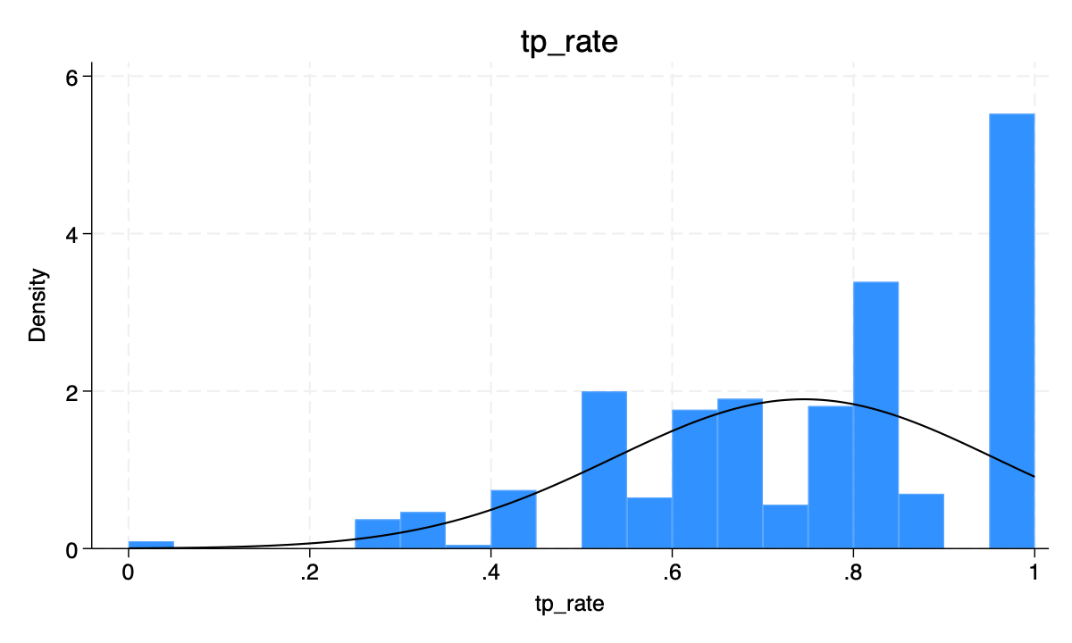
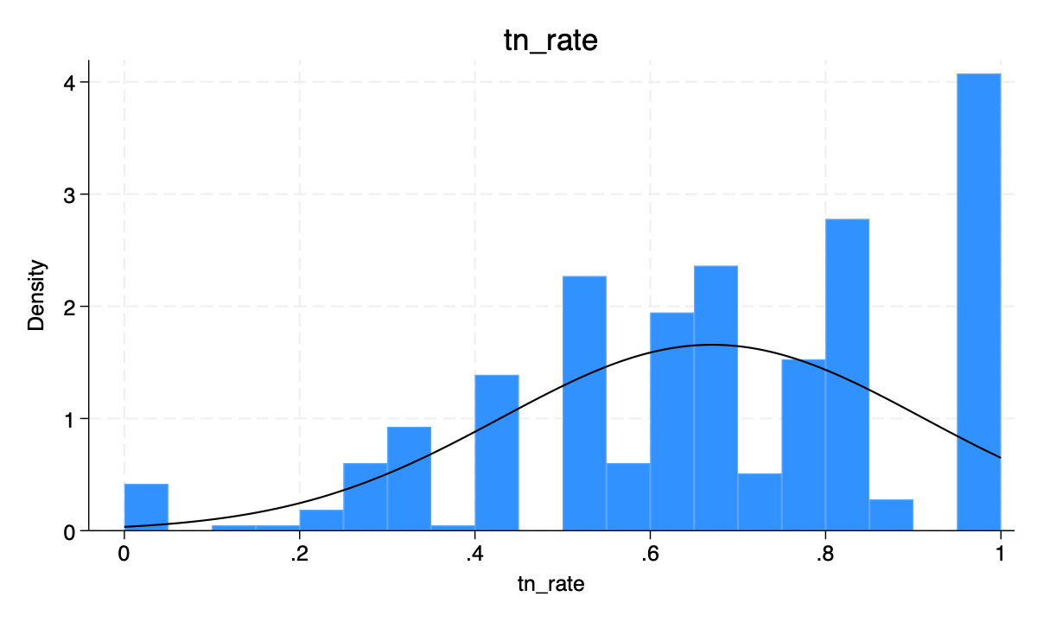
05 · DESCRIPTIVE OUTCOMES
Four views of performance
TOTAL SCORE (0–10)
AVG CONFIDENCE (0–10)
HIT RATE (AI correct / AI seen)
CORRECT-REJECTION RATE (Real correct / Real seen)
People score ~7/10 overall. Hit rate (AI) and correct-rejection rate (Real) are roughly symmetric, both spiking at 1.

Slide 7
07 · METHOD
Why ordered probit?
01
02
03
The outcome is ordered, not continuous
…and not binary
Ordered probit fits the latent structure
Score is 0–10 integers. Distances between 6 and 7 need not equal 7 to 8. OLS would assume they do.
Dichotomizing (e.g. ≥7 vs <7) discards information. Logit/probit would force an arbitrary threshold.
Assumes a latent 'detection ability' with cutpoints between score levels. Probit link (vs logit) is standard for normally-distributed latents.
Score is ordinal (0–10). Ordered probit respects that — OLS would impose equal spacing, binary logit would throw away levels.

Slide 8
08 · MODEL SELECTION
Eight ordered-probit specifications, ranked by fit
Source: Stata estimates stats m1 m2 m3a m3b m3c m4 m5 m6
Model
Specification
N
Log-lik
AIC
BIC
m5: LOWEST AIC
m1
Affiliation only
431
-794.9
1613.7
1662.5
1603.4
m2
+ Device
430
-789.3
1606.5
1663.4
Best bias–variance trade-off of the 8 specs.
m3a
+ AI familiarity
429
-786.8
1603.6
1664.5
m3b
+ AI use time
429
-786.9
1603.9
1664.8
m5
+ Fam × Use + SocMedia + Age≥25
429
-786.7
1603.4
1664.3
m1: lowest BIC
1662.5
m6
m5 + ln(response time)
429
-786.4
1604.7
1669.7
BIC penalizes params harder — but m5 is only 1.8 BIC higher.
m3c
m5 without SocMedia
429
-785.6
1605.3
1674.3
m4
Full (all predictors)
429
-785.1
1606.2
1679.3
Takeaway ·
AIC selects m5 (interaction + age + social media). We carry it forward.

Slide 9
09 · Sensitivity Check
Sensitivity Check
THE DECISION RULE
ROBUSTNESS CHECK
Class rule for counts: var ≈ mean → Poisson var >> mean → Negative Binomial Observed for score: mean = 6.95, var = 2.55 var << mean → under-dispersion. Neither is the textbook fit.
Ran Poisson and NB anyway. Signs and significance line up with the ordered probit: over_25 and mobile remain negative and significant; AI familiarity and usage remain n.s. Findings don't hinge on model family.
Score behaves like a bounded ordinal variable — oprobit is the right tool, count models agree.

Slide 10
10 · Diagnostics
Diagnostics
PARALLEL REGRESSION ASSUMPTION
MULTICOLLINEARITY (VIF)
Brant-style test on bucketed score
computed on parallel OLS of m5
CUTOFF
p-VALUE
STATISTIC
VALUE
cutoff 1
0.365
mean VIF
1.27
cutoff 2
0.302
max VIF
1.62
cutoff 3
0.341
rule of thumb
< 5
cutoff 4
0.318
No collinearity concern ✓
cutoff 5
0.372
All p > 0.30 → assumption holds ✓
Model assumptions hold — m5 is safe to interpret as an ordered probit.

Slide 11
11 · Findings
Who detects AI images?
ORDERED PROBIT — MODEL m5 (N = 432)
PREDICTOR
β
SE
p
Faculty/Staff (vs. Student)
−0.341
0.167
0.041*
significant
Mobile phone (vs. Laptop)
−0.247
0.112
0.028*
significant
AI familiarity
+0.042
0.088
0.634
n.s.
AI weekly usage
+0.019
0.074
0.798
n.s.
AI familiarity × usage
−0.011
0.036
0.760
n.s.
Social media time
+0.028
0.051
0.589
n.s.
* p < 0.05. Cutpoints and model fit suppressed. Full table: see appendix.
Two things predict score: being a student, and using a laptop. AI exposure does not.

Slide 12
13 · Limitations
Limitations & next steps
LIMITATIONS
NEXT STEPS
—
Broaden sample
→
Broaden the sample
Bowdoin = convenience sample
Not generalizable to the broader public
Qualtrics
—
Only 10 images
→
More images, varied hardness
Small per-person n
Floor and ceiling effects at the tails of the score distribution
30+ items with calibrated difficulty
Separates skill from luck
—
Device confound
→
Objective AI literacy
Can't separate device physics from the kind of person who uses a phone.
Replace self-report with a short quiz on AI-image tells (hands, text, reflections).
—
Self-reported AI
→
Unpack the device effect
An objective AI-literacy test would be cleaner.
Isolate screen size from user type
Random Control Trial:
1/2 take survey on mobile (laptop) first, then laptop (mobile)
Signal is real, but narrow. Replication with broader sampling and objective measures is the obvious next move.

