Slide 1
Real time cross model validation for hurricane supplement effort (Ling Liu)
Ingest high resolution ocean observations in JEDI (NOS-IOOS, NCEP-EMC)
Build observation operators in JEDI for Gliders and HF-Radar
Test use of real-time and historical high resolution ocean observations using Marine JEDI

Slide 2
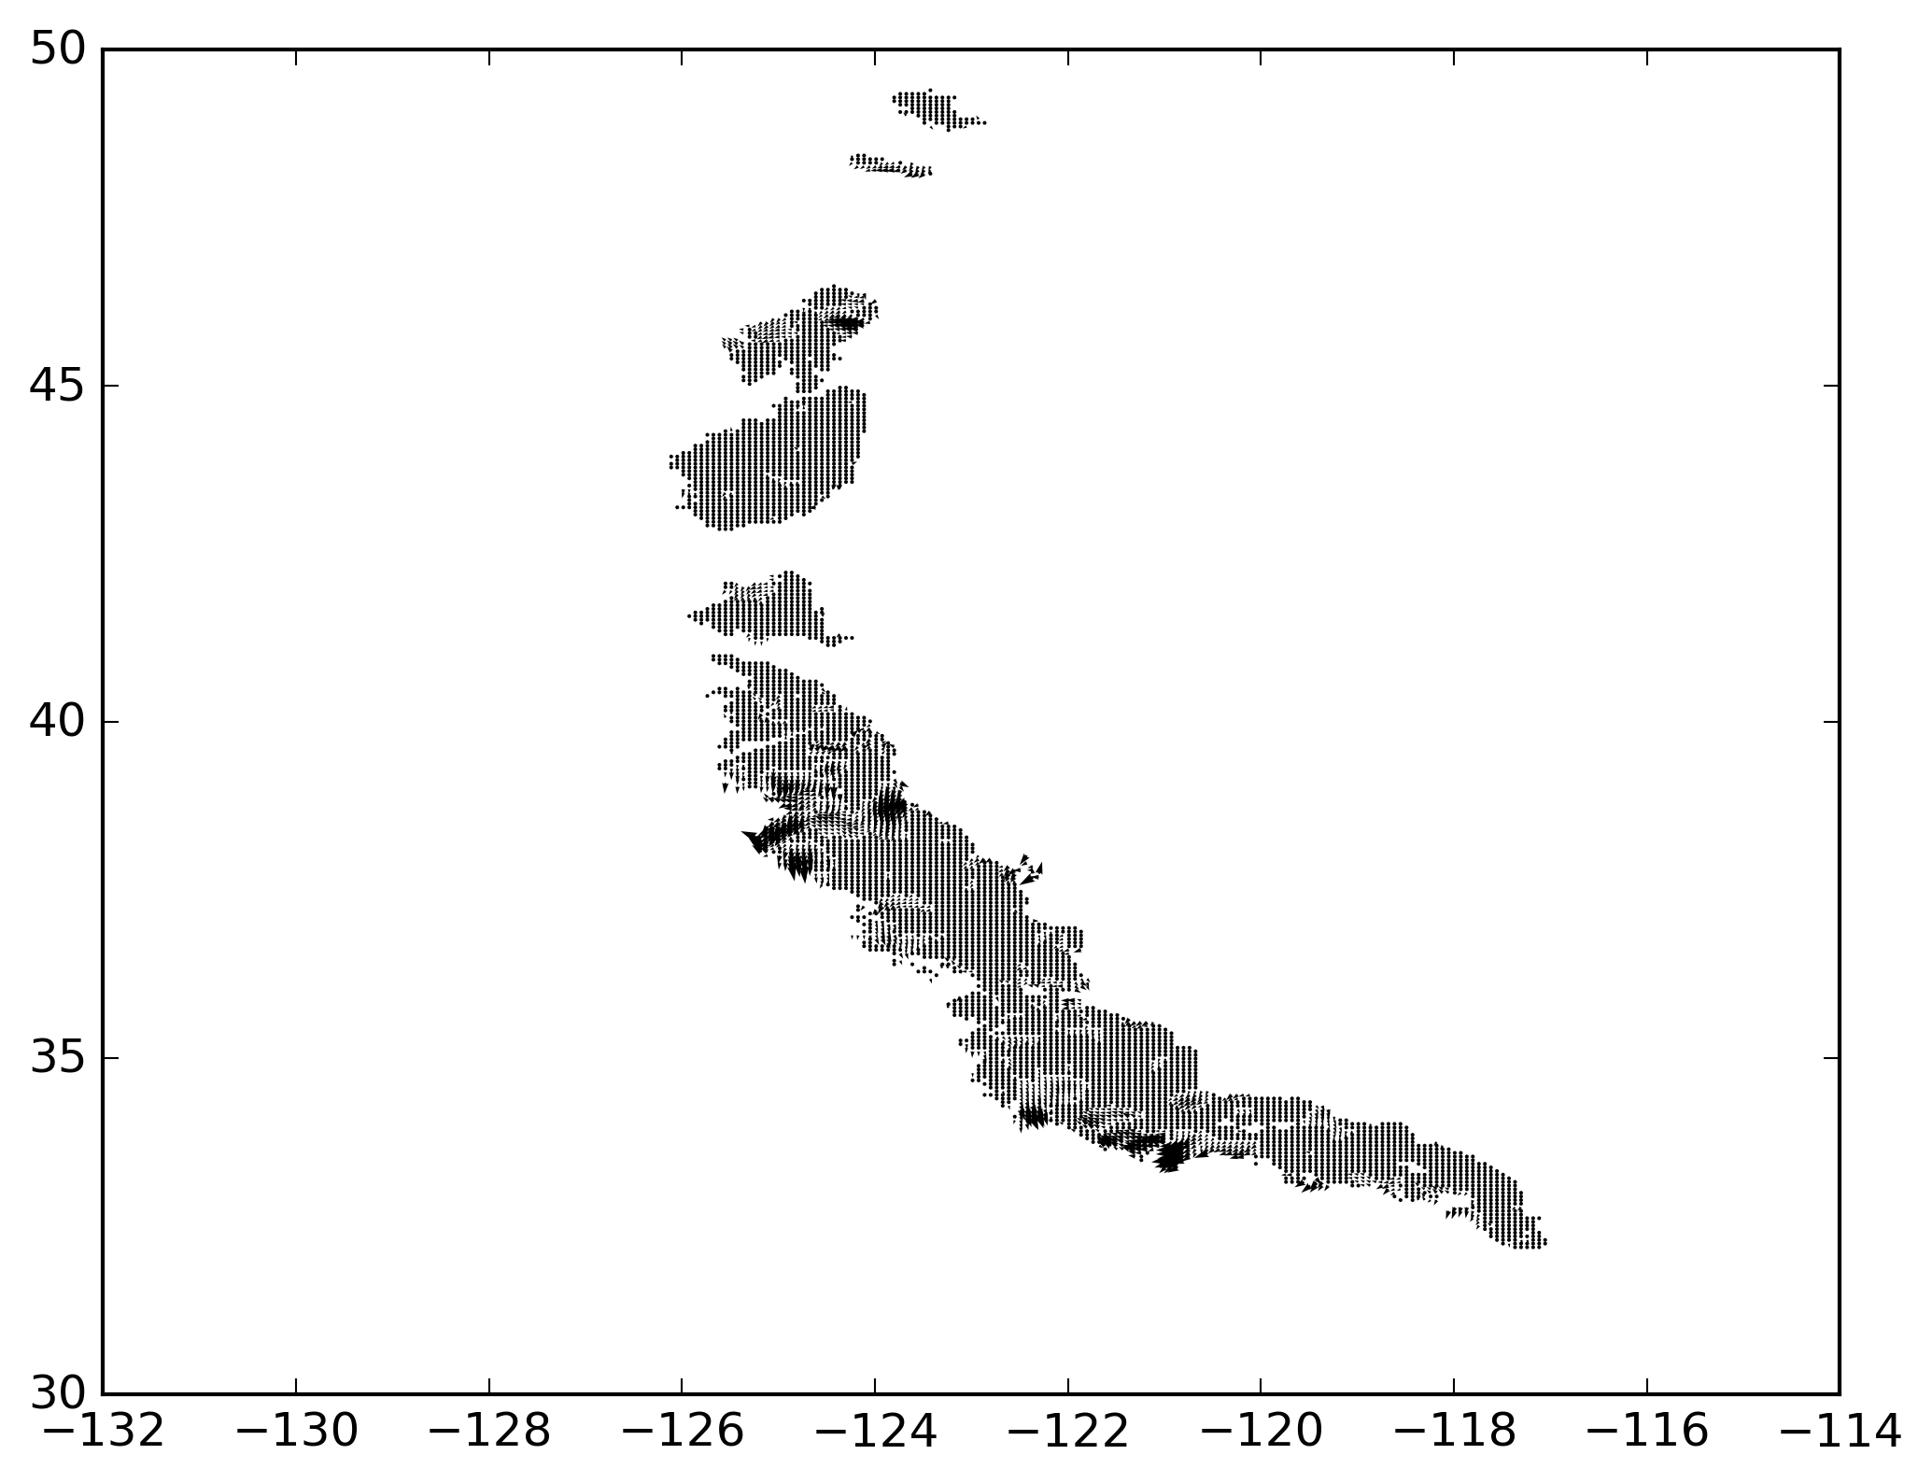
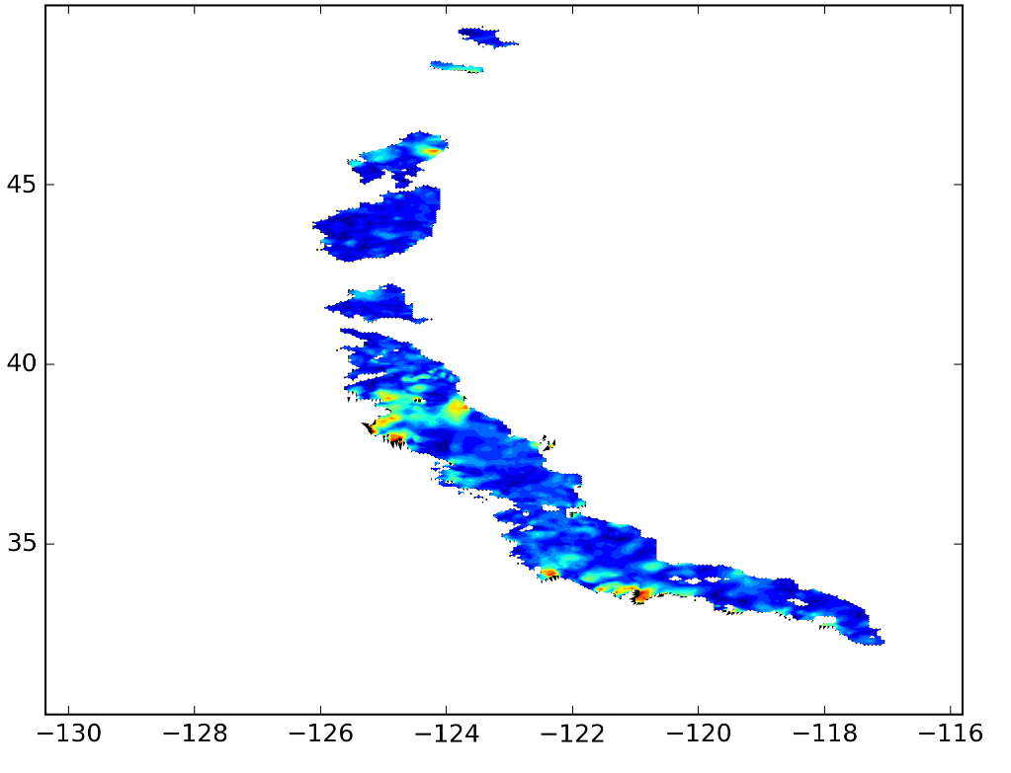
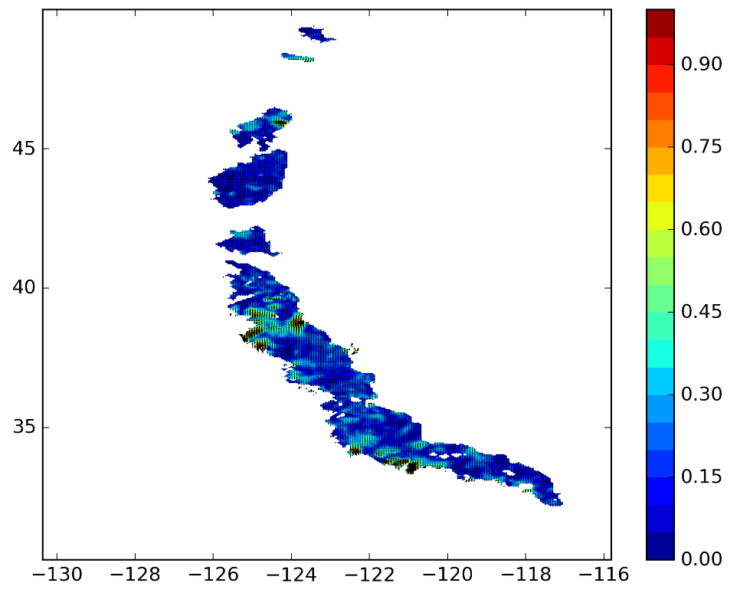
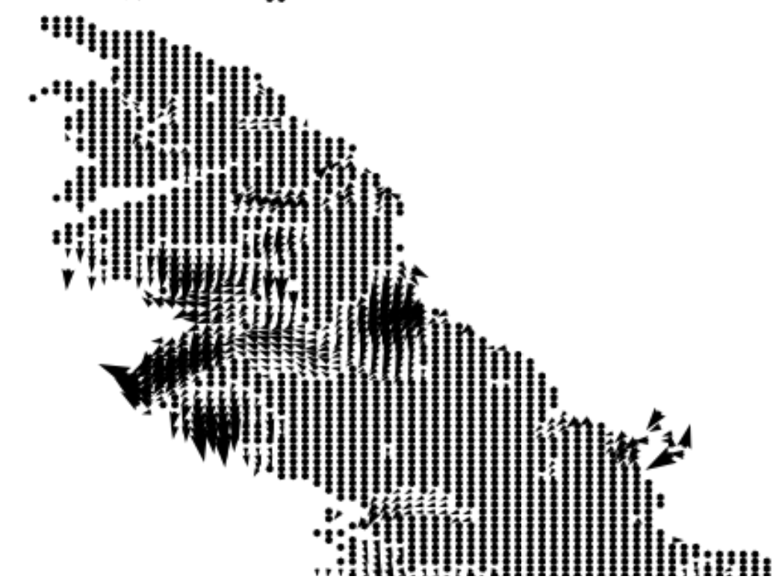
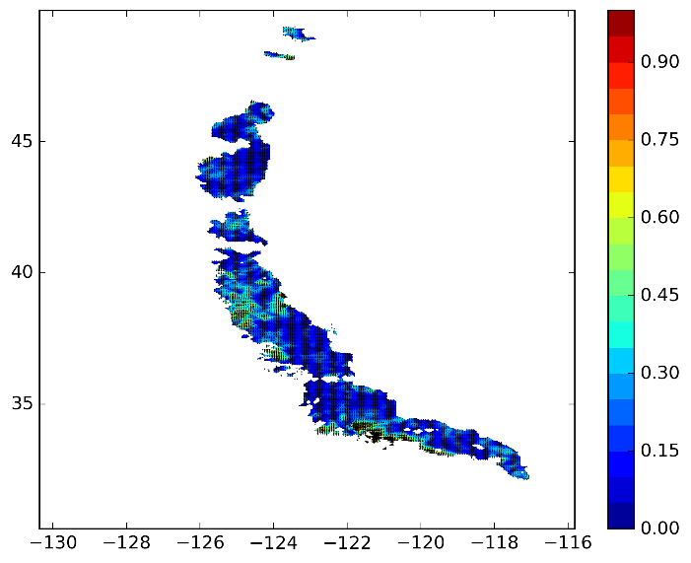
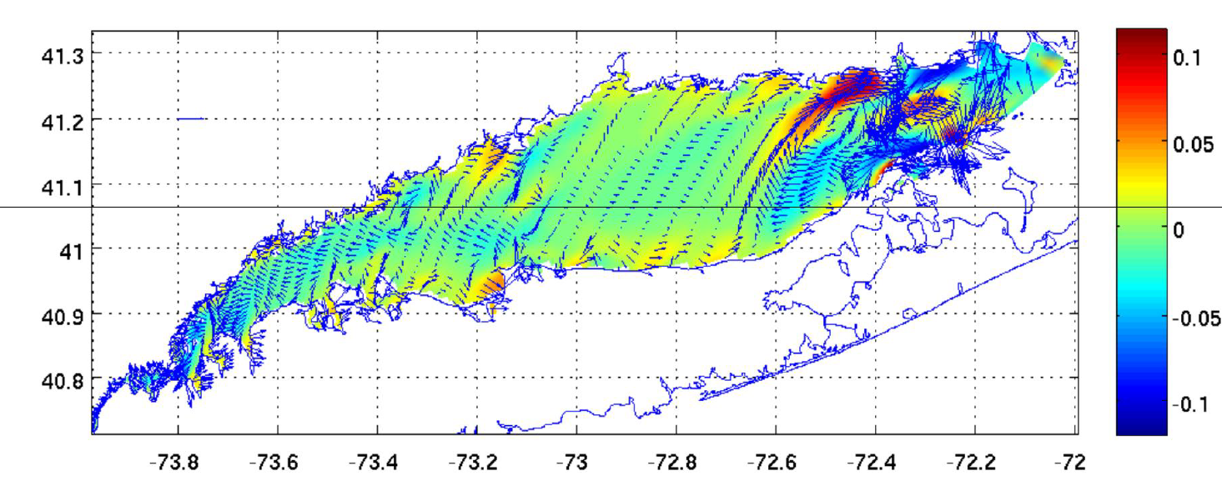
HF-radar data, off west coast 6 km resolution, hourly, 202009120700
Before detide ~ 0.9 m/s
m/s
Hour: 07
Hour: 01
For comparison, Residual current ~ 0.1 m/s

Slide 3
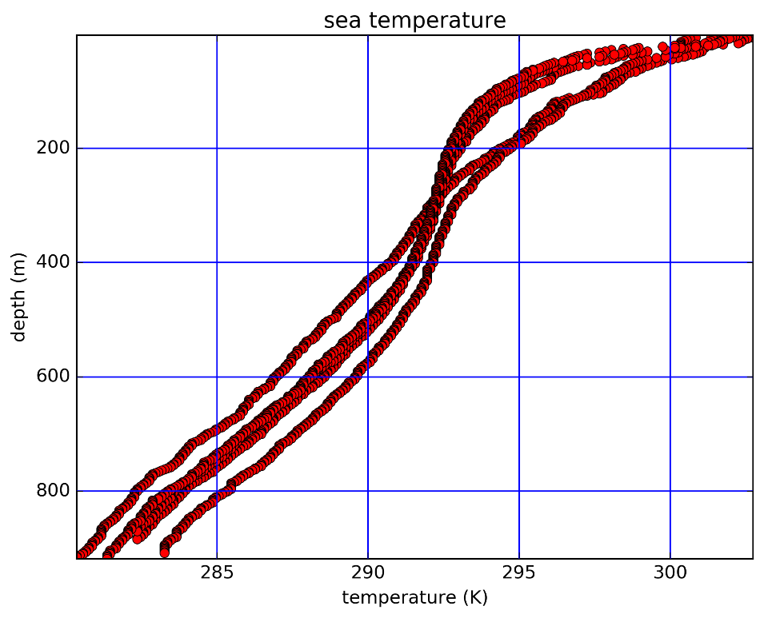
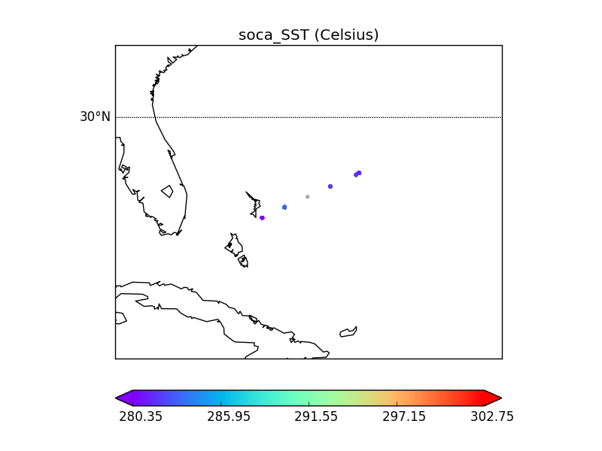
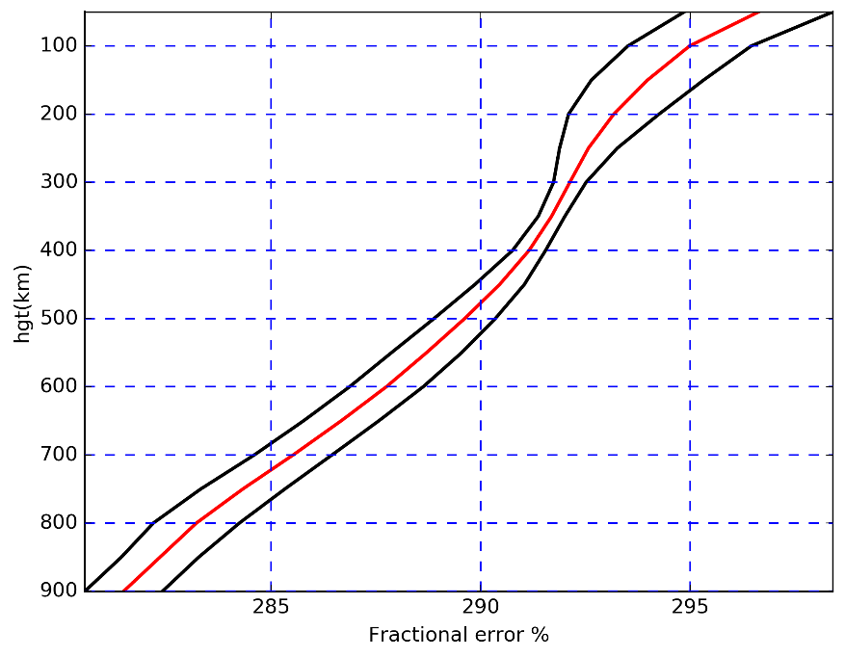
Marine glider data: Ioda bufr marine profile, yaml nc031001
Time span: 2020, 0709, Hour: 02, 06, 10, 14, 18, 21
Vertical resolution: 2 meter vertical resolution with Florida strait focus
Batch converter for more marine profiles and surface glider data
To do: Marine profile data validation & cross validation
Mean and standard deviation

Slide 4
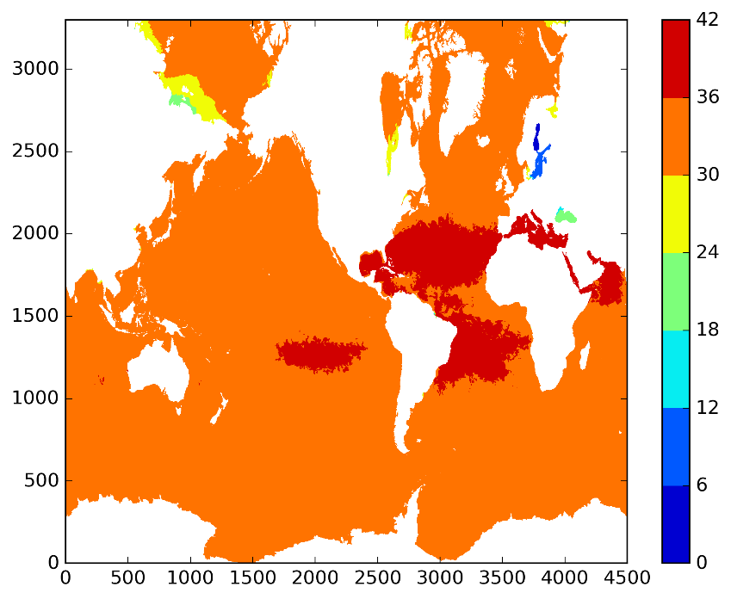
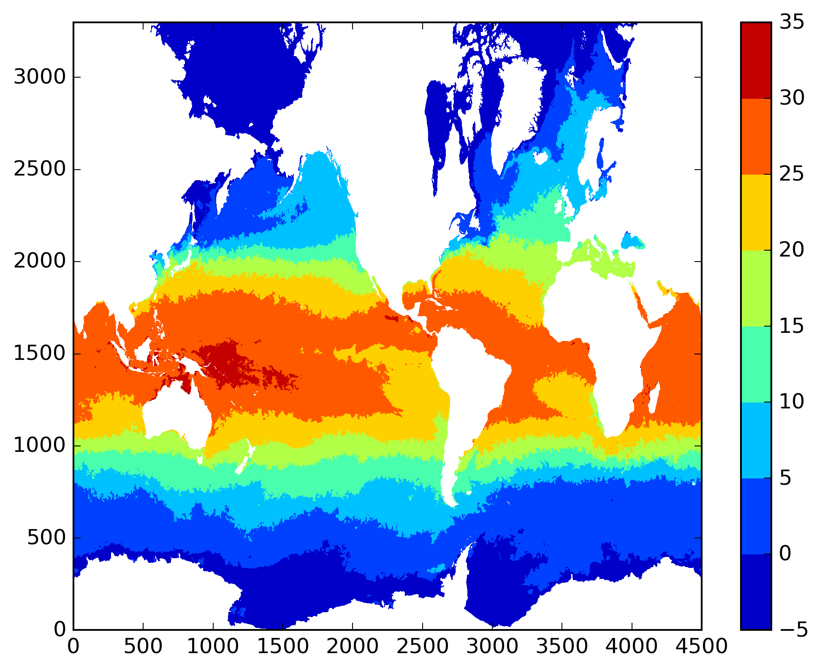
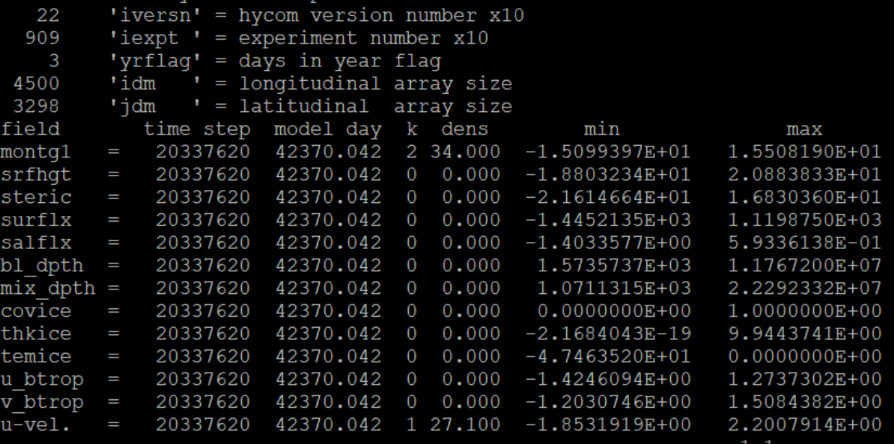
Exploring HYCOM_tool: 2D/3D
salinity
Hycom_depth ../Data/rtofs_glo.t00z.f01.archv.a
2D temperature
rtofs_glo.t00z.f01.archv.b

Slide 5
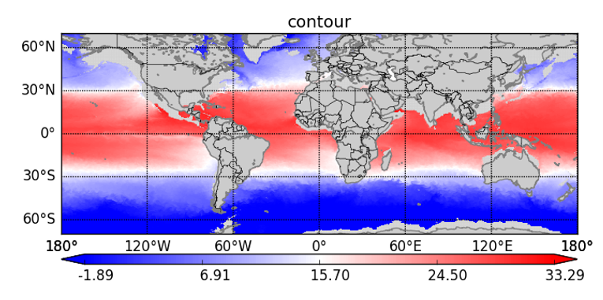
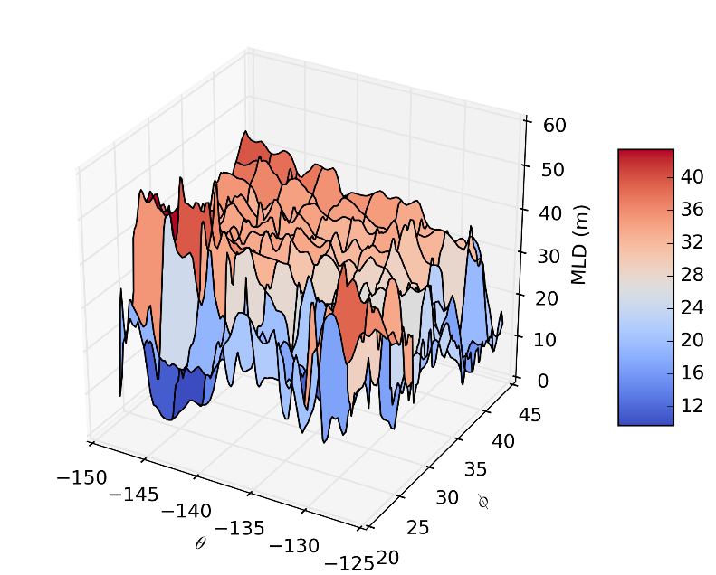
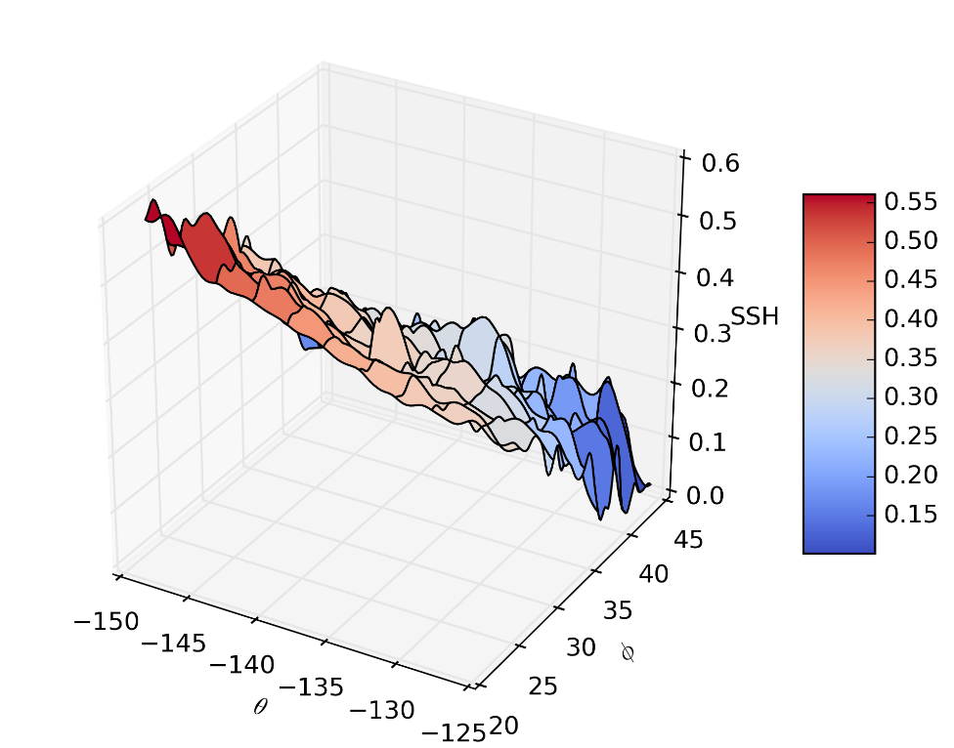
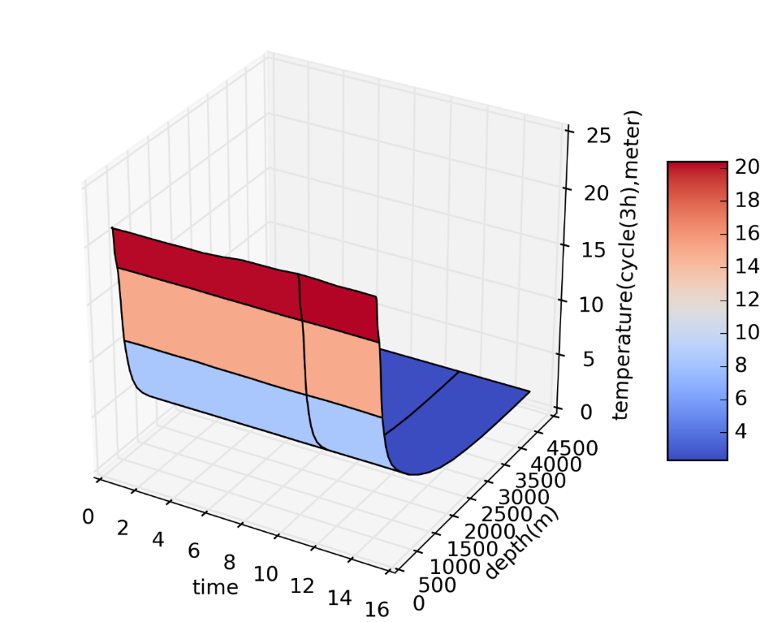
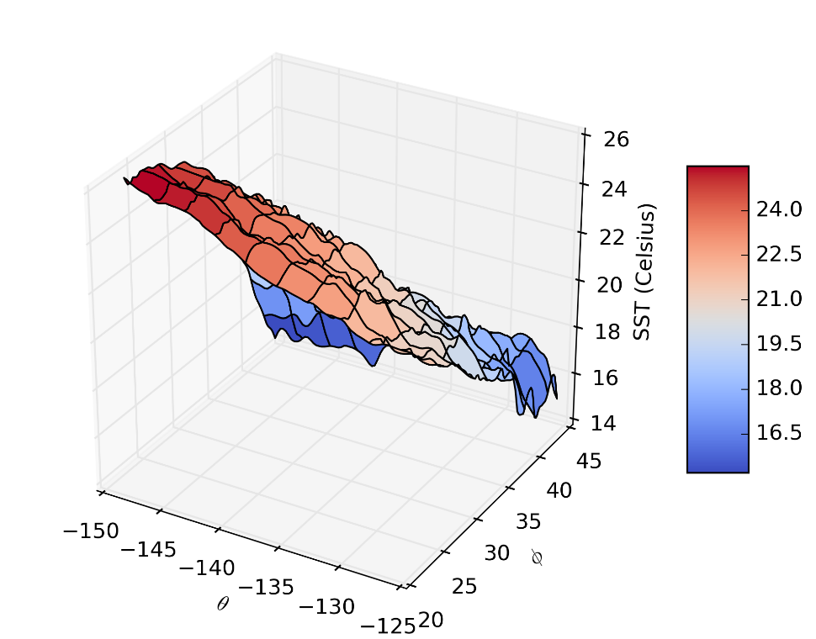
1-15 day workflow thermocline variation 0.25 degree ufs: -- a regional view with a global setup

Slide 6
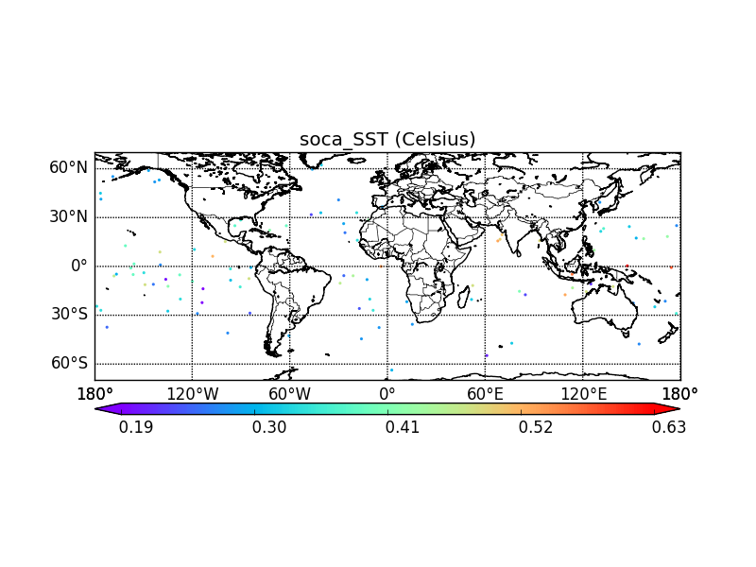
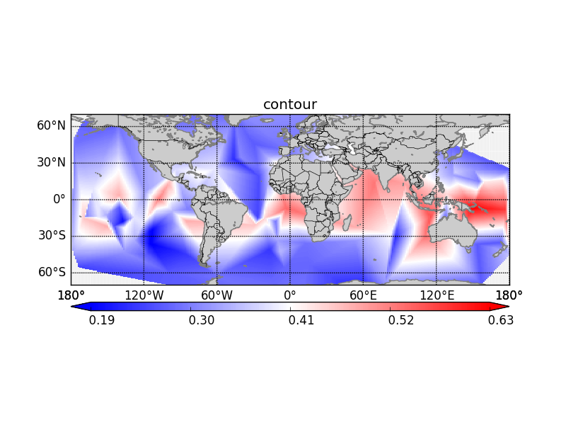
3dvar_soca test case: Sea_surface_temperature@obs_error

