Slide 1
STAT 8060
MWF 10:20 – 11:10
Sanford Hall 312
Fall 2021

Slide 2
Numerical Computing
Calculating mathematical functions: pi, irrational numbers, matrix inverse
Numerical differentiation
Numerical integration
Numerical optimization

Slide 3

How to calculate $\sqrt{2}$?
Bisection algorithm
Newton-Raphson algorithm
Speed versus Accuracy
Jupyter notebook: https://lliu1871.github.io/stat8060/STAT8060.html
0 2

Slide 4


How to find $π$ and $e$?
Infinite sequence: $e=\lim_{n→∞}{{\left(1+\frac{1}{n}\right)}^{n}}$
Leibniz sequence: $\frac{π}{4}=1−\frac{1}{3}+\frac{1}{5}−\frac{1}{7}+\frac{1}{9}−…$

Slide 5

How to calculate derivative
$f^{′}\left(x_{0}\right)=\lim_{Δx→0}{\frac{f\left(x_{0}+Δx\right)−f(x_{0})}{Δx}}$
$f^{′}\left(x_{0}\right)≈\frac{f\left(x_{0}+Δx\right)−f(x_{0})}{Δx}$

Slide 6


How to calculate integral
Approximation: $\int_{a}^{b}{f\left(x\right)dx}≈\sum_{k=1}^{n}{f\left(a+kΔx\right)Δx}$
a b
$$Δx$$

Slide 7
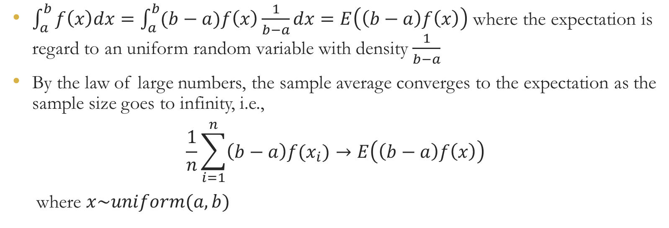
Monte Carlo Simulation
$\int_{a}^{b}{f\left(x\right)dx}=\int_{a}^{b}{(b−a)f\left(x\right)\frac{1}{b−a}dx}=E\left(\left(b−a\right)f\left(x\right)\right)$ where the expectation is regard to an uniform random variable with density $\frac{1}{b−a}$
By the law of large numbers, the sample average converges to the expectation as the sample size goes to infinity, i.e.,
$$\frac{1}{n}\sum_{i=1}^{n}{\left(b−a\right)f(x_{i})}→E\left(\left(b−a\right)f\left(x\right)\right)$$
where $x\sim uniform(a,b)$

Slide 8
Optimization problems
Maximizing the likelihood function
Minimizing the least squared error
Newton-Raphson algorithm, EM (expectation and maximization), simulated annealing, genetic algorithm, etc.

Slide 9

Newton-Raphson algorithm
$f′\left(x^{∗}\right)=0$
$f^{′′}\left(x\right)≈\frac{f^{′}\left(x\right)−f^{′}\left(x^{∗}\right)}{x−x^{∗}}=\frac{f^{′}\left(x\right)−f^{′}\left(x^{∗}\right)}{x−x^{∗}}⇒x^{∗}=x−\frac{f^{′}\left(x\right)}{f^{′′}\left(x\right)}$
$x_{n+1}=x_{n}−\frac{f^{′}\left(x_{n}\right)}{f^{′′}\left(x_{n}\right)}$

Slide 10
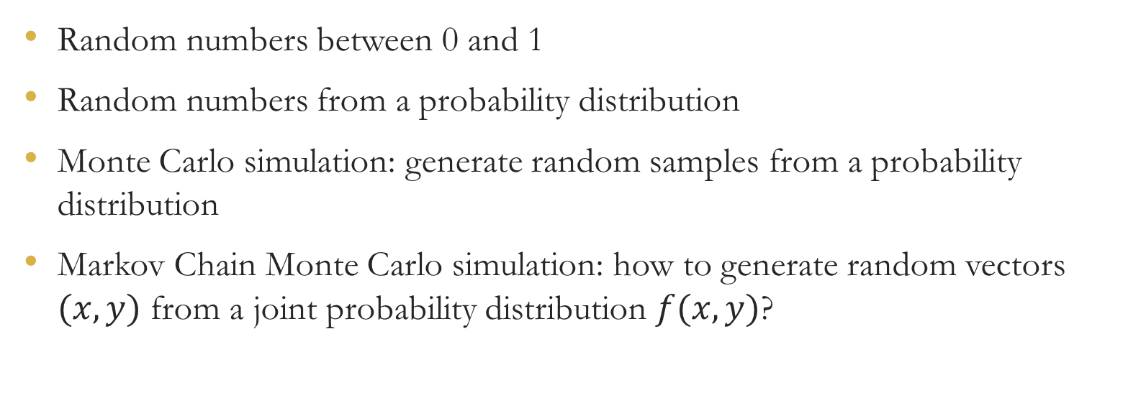
Simulation
Random numbers between 0 and 1
Random numbers from a probability distribution
Monte Carlo simulation: generate random samples from a probability distribution
Markov Chain Monte Carlo simulation: how to generate random vectors $(x,y)$ from a joint probability distribution $f(x,y)$?

Slide 11
Numerical linear algebra
Matrix inverse
Eigenvalue and eigenvector
Discrete Fourier transformation (DFT)

Slide 12
How to write efficient programs
Divide and conquer
Dynamic programming
Speed versus Memory space
Parallel programming: multiple threads, MPI (multicore), GPU (cuda)

Slide 13
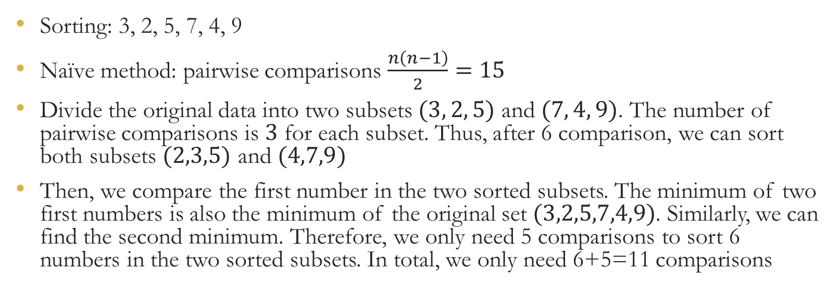
Divide and Conquer
Sorting: 3, 2, 5, 7, 4, 9
Naïve method: pairwise comparisons $\frac{n\left(n−1\right)}{2}=15$
Divide the original data into two subsets $(3, 2, 5)$ and $(7, 4, 9)$. The number of pairwise comparisons is $3$ for each subset. Thus, after 6 comparison, we can sort both subsets $(2,3,5)$ and $(4,7,9)$
Then, we compare the first number in the two sorted subsets. The minimum of two first numbers is also the minimum of the original set $(3,2,5,7,4,9)$. Similarly, we can find the second minimum. Therefore, we only need 5 comparisons to sort 6 numbers in the two sorted subsets. In total, we only need 6+5=11 comparisons

Slide 14
Dynamic programming
Dynamic programming breaks a problem down into simpler overlapping sub-problems in a recursive manner (from https://en.wikipedia.org/wiki/Dynamic_programming )
In contrast, divide and conquer breaks a problem into non-overlapping sub-problems

Slide 15
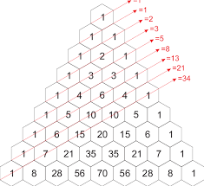
Dynamic programming example
Fibonacci sequence
Naïve implementation based on the mathematical definition
If we call fib(4), it will calculate fib(2) twice
Leading to exponential time
function fib(n)
if n <= 1 return n
return fib(n − 1) + fib(n − 2)

Slide 16
Cont.
Memorization: save the intermediate results
Linear time
function fib(n)
if key n is not in map m
m[n] := fib(n − 1) + fib(n − 2)
return m[n]

Slide 17
Parallel programming
R and Python (easy coding but slow) versus C, C++ (fast but difficult coding). Julia is a scripting language (easy coding) with high performance (as fast as C)
MPI (message passing library)
GPU

