Slide 1
STAT 8060
MWF 10:20 – 11:10
Sanford Hall 312
Fall 2021

Slide 2
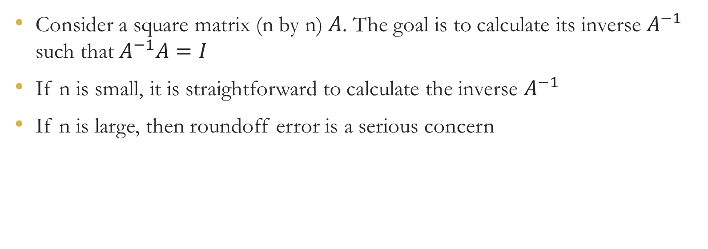
Matrix inverse
Consider a square matrix (n by n) $A$. The goal is to calculate its inverse $A^{−1}$ such that $A^{−1}A=I$
If n is small, it is straightforward to calculate the inverse $A^{−1}$
If n is large, then roundoff error is a serious concern

Slide 3



Gaussian Elimination with Backward Substitution
Systems of equations => Augmented matrix => Upper-triangular matrix
Backward substitution: solve for $β$ working from the bottom up but using the row manipulations from above to accomplish that

Slide 4
Example
equations augmented matrix Gaussian elimination backward substitution
solution: x = 0, y = 3, z = -1
If there were not a unique solution, then the row reduction would have arrived at
zeros in one row, with the rest determining the set of solutions.
If row reduction gives us a row with elements on the left all zero, but a non-zero
element on the right, then that means there is no solution.

Slide 5
Pivoting
The pivot element is the element on diagonal. This is also the element that you'd divide the row by to achieve a 1 in the diagonal element
If the pivot element is 0, just swap that row with one of the rows that has a better potential pivot element. This sort of swapping rows is called partial pivoting
Partial pivoting is also necessary when the pivot element is very small (i.e., large roundoff error)
Fully pivoting is when we swap columns and also rows

Slide 6
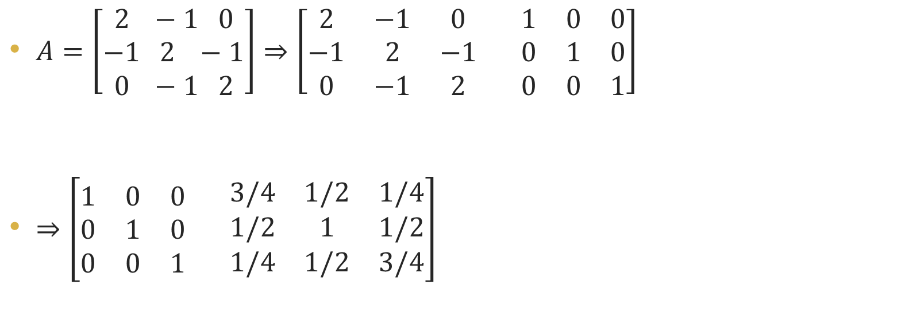
Applications for matrix inverse
$A=\left[\begin{aligned}2 −1 0 \\ −1 2 −1 \\ 0 −1 2\end{aligned}\right]⇒\left[\begin{matrix}2 & −1 & 0 \\ −1 & 2 & −1 \\ 0 & −1 & 2\end{matrix} \begin{matrix}1 & 0 & 0 \\ 0 & 1 & 0 \\ 0 & 0 & 1\end{matrix}\right]$
$⇒\left[\begin{matrix}1 & 0 & 0 \\ 0 & 1 & 0 \\ 0 & 0 & 1\end{matrix} \begin{matrix}3/4 & 1/2 & 1/4 \\ 1/2 & 1 & 1/2 \\ 1/4 & 1/2 & 3/4\end{matrix}\right]$

Slide 7
Gauss-Jordan elimination
Gauss-Jordan elimination differs slightly from Gaussian elimination with backward substitution.
In Gauss-Jordan, the pivot element is used to zero out all elements in that column, rather than just those elements below the diagonal.
Gaussian elimination with backward substitution is faster and more stable than Gauss-Jordan.

Slide 8
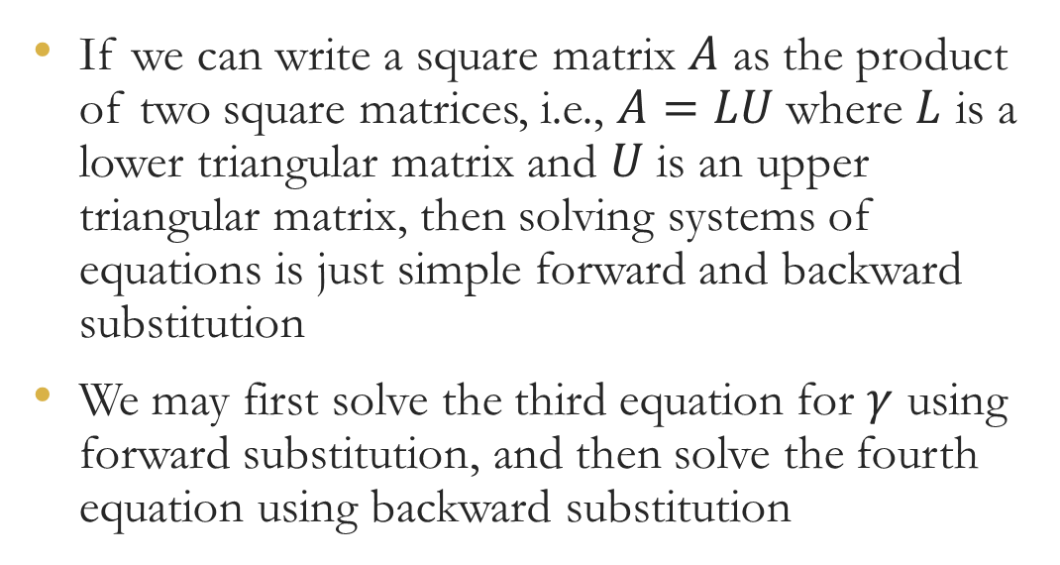
L-U Decomposition
If we can write a square matrix $A$ as the product of two square matrices, i.e., $A=LU$ where $L$ is a lower triangular matrix and $U$ is an upper triangular matrix, then solving systems of equations is just simple forward and backward substitution
We may first solve the third equation for $γ$ using forward substitution, and then solve the fourth equation using backward substitution

Slide 9

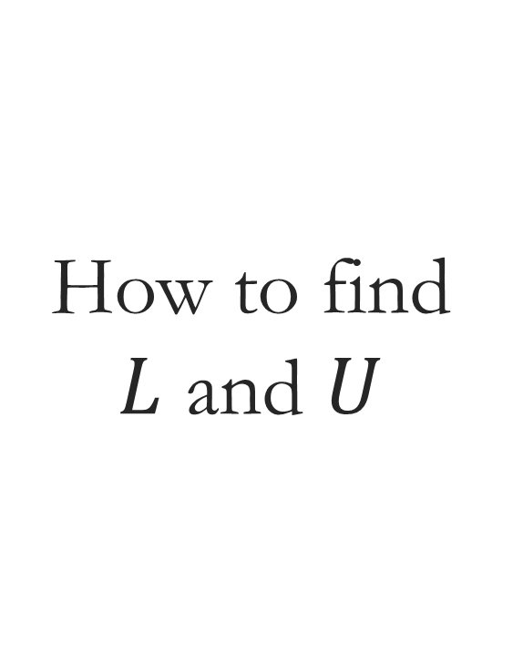
How to find $L$ and $U$
$A=LU$ where $A$ is an $m×m$ matrix and $L$ is a lower triangular matrix and $U$ is an upper triangular matrix
There are $m^{2}$ linear equations in $A=LU$ and $m^{2}+m$ unknown parameters in $L$ and $U$
Restrictions on $L$: $l_{ii}=1$ for $i=1,…,m$

Slide 10
Crout’s algorithm

Slide 11
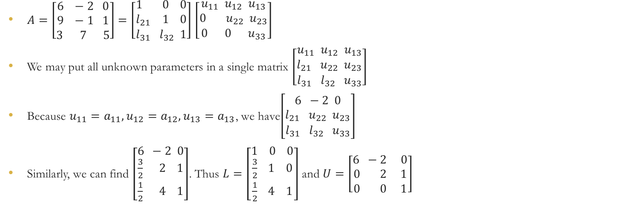
Example
$A=\left[\begin{aligned}6 −2 0 \\ 9 −1 1 \\ 3 7 5\end{aligned}\right]=\left[\begin{aligned}1 0 0 \\ l_{21} 1 0 \\ l_{31} l_{32} 1\end{aligned}\right]$ $\left[\begin{aligned}u_{11} u_{12} u_{13} \\ 0 u_{22} u_{23} \\ 0 0 u_{33}\end{aligned}\right]$
We may put all unknown parameters in a single matrix $\left[\begin{aligned}u_{11} u_{12} u_{13} \\ l_{21} u_{22} u_{23} \\ l_{31} l_{32} u_{33}\end{aligned}\right]$
Because $u_{11}=a_{11},u_{12}=a_{12},u_{13}=a_{13}$, we have$\left[\begin{aligned}6 −2 0 \\ l_{21} u_{22} u_{23} \\ l_{31} l_{32} u_{33}\end{aligned}\right]$
Similarly, we can find $\left[\begin{aligned}6 −2 0 \\ \frac{3}{2} 2 1 \\ \frac{1}{2} 4 1\end{aligned}\right]$. Thus $L=\left[\begin{aligned}1 0 0 \\ \frac{3}{2} 1 0 \\ \frac{1}{2} 4 1\end{aligned}\right]$ and $U=\left[\begin{aligned}6 −2 0 \\ 0 2 1 \\ 0 0 1\end{aligned}\right]$

Slide 12
LU decomposition solving a system of linear equations

Slide 13
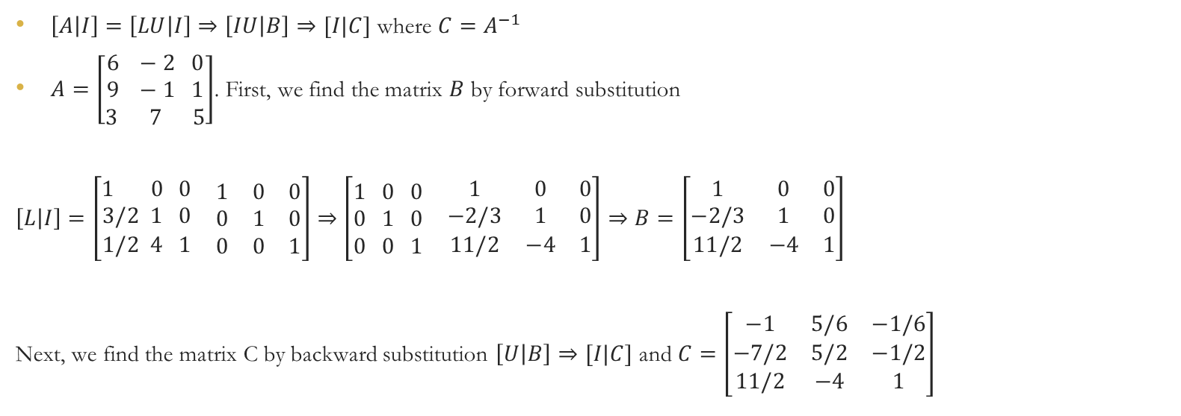
Using LU decomposition to find matrix inverse
$\left[A | I\right]=\left[LU | I\right]⇒\left[IU | B\right]⇒[I|C]$ where $C=A^{−1}$
$A=\left[\begin{aligned}6 −2 0 \\ 9 −1 1 \\ 3 7 5\end{aligned}\right]$. First, we find the matrix $B$ by forward substitution
$\left[L | I\right]=\left[\begin{aligned}1 0 0 \\ 3/2 1 0 \\ 1/2 4 1\end{aligned} \begin{matrix}1 & 0 & 0 \\ 0 & 1 & 0 \\ 0 & 0 & 1\end{matrix}\right]⇒$ $\left[\begin{aligned}1 0 0 \\ 0 1 0 \\ 0 0 1\end{aligned} \begin{matrix}1 & 0 & 0 \\ −2/3 & 1 & 0 \\ 11/2 & −4 & 1\end{matrix}\right]⇒B=\left[\begin{matrix}1 & 0 & 0 \\ −2/3 & 1 & 0 \\ 11/2 & −4 & 1\end{matrix}\right]$
Next, we find the matrix C by backward substitution $\left[U | B\right]⇒[I|C]$ and $C=\left[\begin{matrix}−1 & 5/6 & −1/6 \\ −7/2 & 5/2 & −1/2 \\ 11/2 & −4 & 1\end{matrix}\right]$

Slide 14
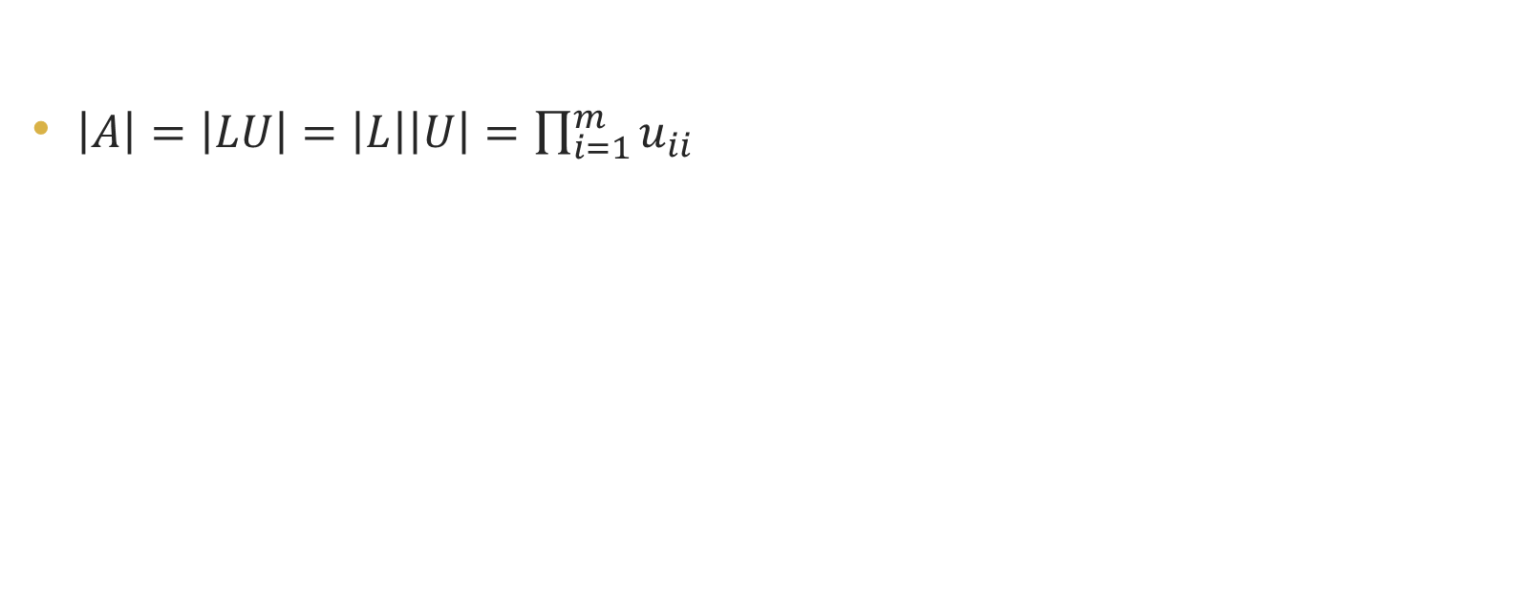
Using LU to find the determinant
$\left|A\right|=\left|LU\right|=\left|L\right|\left|U\right|=\prod_{i=1}^{m}{u_{ii}}$

Slide 15

Cholesky Decomposition
A square matrix $A$ is symmetric $(A^{′}=A)$ and positive definite $(i.e., x^{′}Ax>0 ∀x∈R^{m})$
Cholesky decomposition: $A=LL′$

Slide 16

Cholesky decomposition
There are $\frac{n^{2}+n}{2}$ linear equations in $A=LL′$, and there are $\frac{n^{2}+n}{2}$ unknown parameters in $L$
Cholesky decomposition is about twice as fast as the $LU$ decomposit

Slide 17
Cholesky algorithm
Solving a system of linear equations
Matrix inverse
Determinant

Slide 18
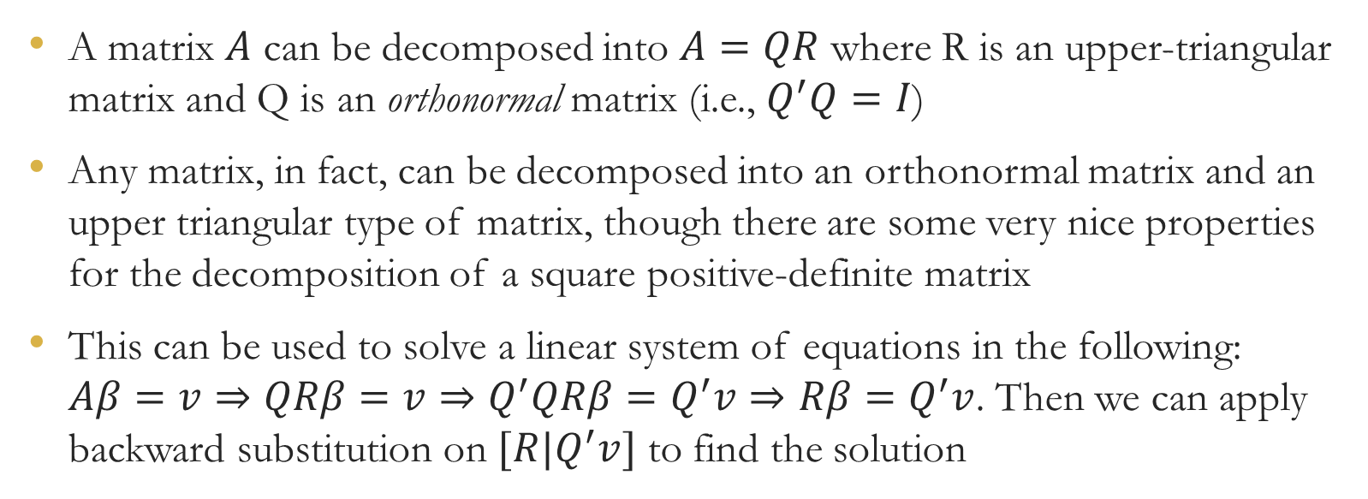
QR decomposition
A matrix $A$ can be decomposed into $A=QR$ where R is an upper-triangular matrix and Q is an orthonormal matrix (i.e., $Q^{′}Q=I$)
Any matrix, in fact, can be decomposed into an orthonormal matrix and an upper triangular type of matrix, though there are some very nice properties for the decomposition of a square positive-definite matrix
This can be used to solve a linear system of equations in the following: $Aβ=v⇒QRβ=v⇒Q^{′}QRβ=Q^{′}v⇒Rβ=Q^{′}v$. Then we can apply backward substitution on $[R|Q^{′}v]$ to find the solution

Slide 19

The Gram-Schmidt Orthogonalization Process
Two vectors $a$ and $b$ are orthogonal if $a⋅b=0$
Let $\left\{x_{1},…,x_{m}\right\}$ be a basis for a subspace of $R^{n}$. Then we rotate the vectors until they are mutually orthogonal, forming the new orthogonal basis $\{v_{1},…,v_{m}\}$
The projection of $x_{2}$ onto $x_{1}$ is given by $\frac{x_{2}⋅x_{1}}{x_{1}⋅x_{1}}x_{1}$. If we subtract this projection from $x_{2}$, then the result is orthogonal to $x_{1}$:

Slide 20

The Gram-Schmidt Orthogonalization Process
The Gram-Schmidt orthogonalization procedure is successive projections onto vectors already orthogonalized
Then $\{v_{1},…,v_{m}\}$ is an orthogonal basis for the space expanded by $\{x_{1},…,x_{m}\}$.
You make the orthogonal basis an orthonormal basis simply by normalizing (length = 1) all of the elements of the basis.

Slide 21

Example
How do we find the orthonormal matrix $Q$ for $A=\left[\begin{aligned}\begin{matrix}1 & 0 & 0 \\ 1 & 1 & 0\end{matrix} \\ \begin{matrix}1 & 1 & 1 \\ 1 & 1 & 1\end{matrix}\end{aligned}\right]$?
$Q=\left[\begin{aligned}\begin{matrix}1/2 & −3/2\sqrt{3} & 0 \\ 1/2 & 1/2\sqrt{3} & −2/2\sqrt{6}\end{matrix} \\ \begin{matrix}1/2 & 1/2\sqrt{3} & 1/2\sqrt{6} \\ 1/2 & 1/2\sqrt{3} & 1/2\sqrt{6}\end{matrix}\end{aligned}\right]$
We can check $Q^{′}Q=I$

Slide 22


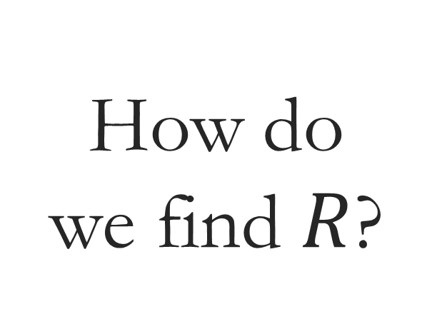
How do we find $R$?
$$A=QR⇒Q^{′}A=Q^{′}QR⇒R=Q^{′}A$$

Slide 23
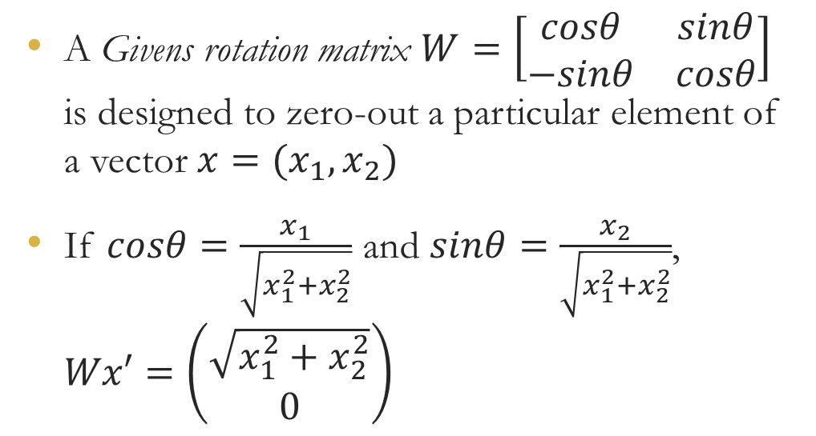
A rotation method for QR decomposition
A Givens rotation matrix $W=\left[\begin{matrix}cosθ & sinθ \\ −sinθ & cosθ\end{matrix}\right]$ is designed to zero-out a particular element of a vector $x=(x_{1},x_{2})$
If $cosθ=\frac{x_{1}}{\sqrt{x_{1}^{2}+x_{2}^{2}}}$ and $sinθ=\frac{x_{2}}{\sqrt{x_{1}^{2}+x_{2}^{2}}}$, $Wx′=\left(\begin{aligned}\sqrt{x_{1}^{2}+x_{2}^{2}} \\ 0\end{aligned}\right)$

Slide 24

A rotation method
So, we can insert this $2×2$ matrix into a larger $n×n$ identity matrix to zero-out a chosen element below the diagonal of any $n×m$ matrix. And that matrix is orthonormal

Slide 25

Example
Transform $X=\left[\begin{aligned}\begin{matrix}1 & 0 & 0 \\ 1 & 1 & 0\end{matrix} \\ \begin{matrix}1 & 1 & 1 \\ 1 & 1 & 1\end{matrix}\end{aligned}\right]$ into an upper triangular matrix
Zero-out the (4,1) element using a rotation matrix
Zero-out the (3,1) element using a rotation matrix
Zero-out the (2,1) element using a rotation matrix

Slide 26
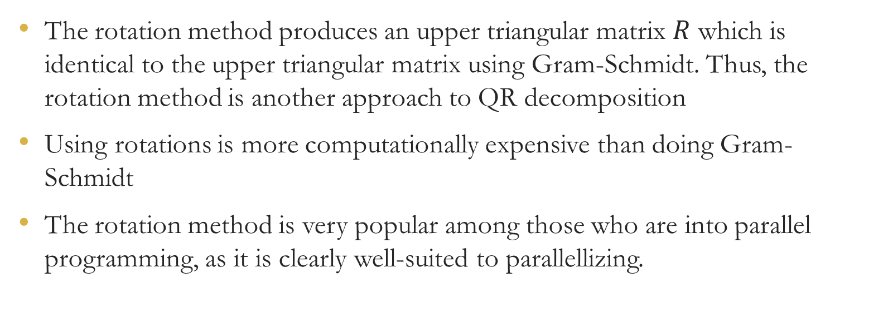
A rotation method
The rotation method produces an upper triangular matrix $R$ which is identical to the upper triangular matrix using Gram-Schmidt. Thus, the rotation method is another approach to QR decomposition
Using rotations is more computationally expensive than doing Gram-Schmidt
The rotation method is very popular among those who are into parallel programming, as it is clearly well-suited to parallellizing.

Slide 27
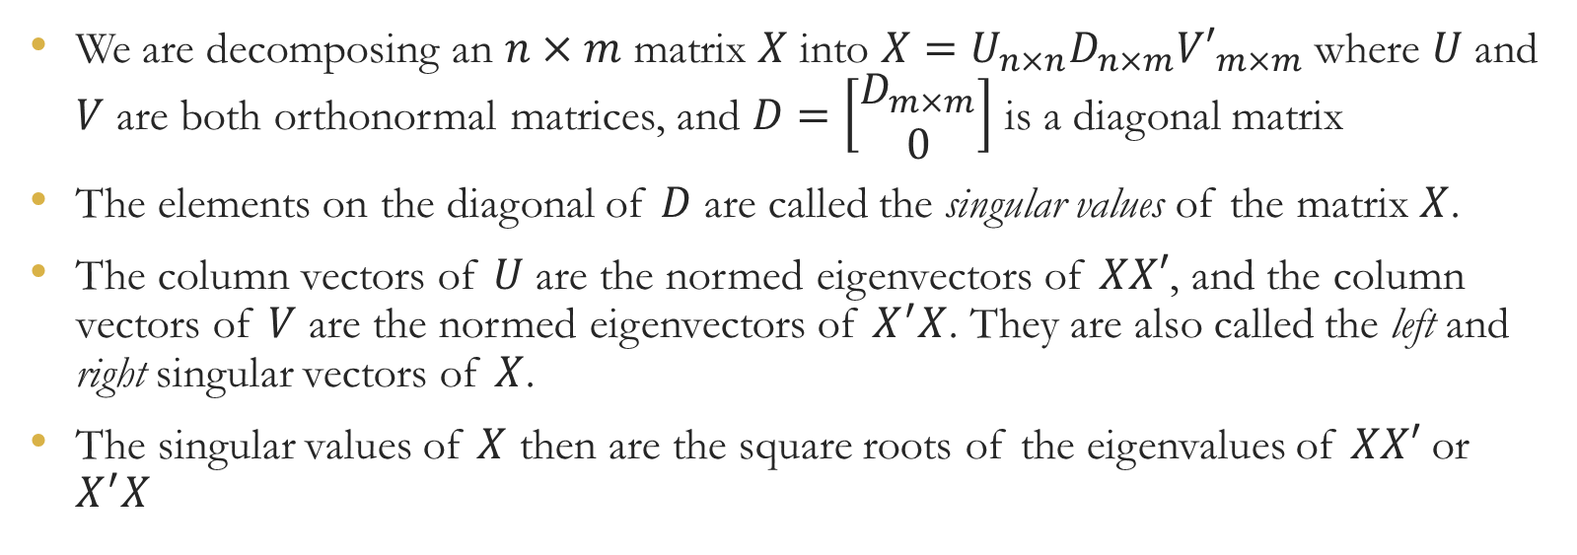
Singular-Value Decomposition (SVD)
We are decomposing an $n×m$ matrix $X$ into $X=U_{n×n}D_{n×m}{V′}_{m×m}$ where $U$ and $V$ are both orthonormal matrices, and $D=\left[\begin{aligned}D_{m×m} \\ 0\end{aligned}\right]$ is a diagonal matrix
The elements on the diagonal of $D$ are called the singular values of the matrix $X$.
The column vectors of $U$ are the normed eigenvectors of $XX′$, and the column vectors of $V$ are the normed eigenvectors of $X^{′}X$. They are also called the left and right singular vectors of $X$.
The singular values of $X$ then are the square roots of the eigenvalues of $XX′$ or $X^{′}X$

Slide 28
Algorithm for SVD

Slide 29
Jacobi rotations
Jacobi rotations can zero-out a particular element of the matrix
Jacobi rotations are specifically for square symmetric matrix
Successive applications of the Jacobi rotations will converge to a diagonal matrix
To find eigenvalues, we may do a series of Jacobi rotations

Slide 30
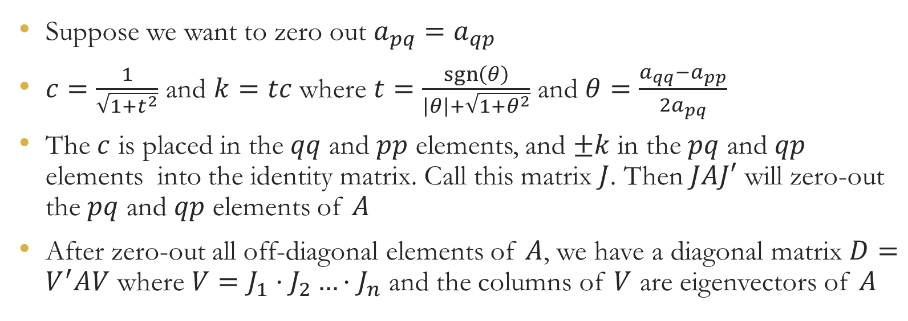
Jacobi rotations
Suppose we want to zero out $a_{pq}=a_{qp}$
$c=\frac{1}{\sqrt{1+t^{2}}}$ and $k=tc$ where $t=\frac{\operatorname{sgn}\left(θ\right)}{\left|θ\right|+\sqrt{1+θ^{2}}}$ and $θ=\frac{a_{qq}−a_{pp}}{2a_{pq}}$
The $c$ is placed in the $qq$ and $pp$ elements, and $±k$ in the $pq$ and $qp$ elements into the identity matrix. Call this matrix $J$. Then $JAJ′$ will zero-out the $pq$ and $qp$ elements of $A$
After zero-out all off-diagonal elements of $A$, we have a diagonal matrix $D=V^{′}AV$ where $V=J_{1}⋅J_{2}…⋅J_{n}$ and the columns of $V$ are eigenvectors of $A$

Slide 31

Example
Find the eigenvalues and eigenvectors of $X^{′}X=\left[\begin{matrix}4 & 3 & 2 \\ 3 & 3 & 2 \\ 2 & 2 & 2\end{matrix}\right]$ when $X=\left[\begin{aligned}\begin{matrix}1 & 0 & 0 \\ 1 & 1 & 0\end{matrix} \\ \begin{matrix}1 & 1 & 1 \\ 1 & 1 & 1\end{matrix}\end{aligned}\right]$
To zero-out the elements $(2,1)$ and $(1,2)$, i.e., $p=1$ and $q=2$
$J_{1}=\left[\begin{matrix}c & k & 0 \\ −k & 1 & 0 \\ 0 & 0 & 1\end{matrix}\right]$
$D_{1}=J_{1}\left(X^{′}X\right)J_{1}′$

Slide 32

Continue
Consider $p=1$ and $q=3$
$J_{2}=\left[\begin{matrix}c & 0 & k \\ 0 & 1 & 0 \\ −k & 0 & c\end{matrix}\right]$
$D_{2}=J_{2}D_{1}J_{2}′$
Eventually, we have the diagonal matrix (eigenvalues) $D^{∗}=$ $\left[\begin{matrix}7.8916 & 0 & 0 \\ 0 & 0.7859 & 0 \\ 0 & 0 & 0.3225\end{matrix}\right]$ and the eigenvectors $V^{∗}=$ $\left[\begin{matrix}0.6793 & −0.6312 & 0.3744 \\ 0.5932 & 0.1720 & −0.7864 \\ 0.4320 & 0.7563 & 0.4913\end{matrix}\right]$

Slide 33
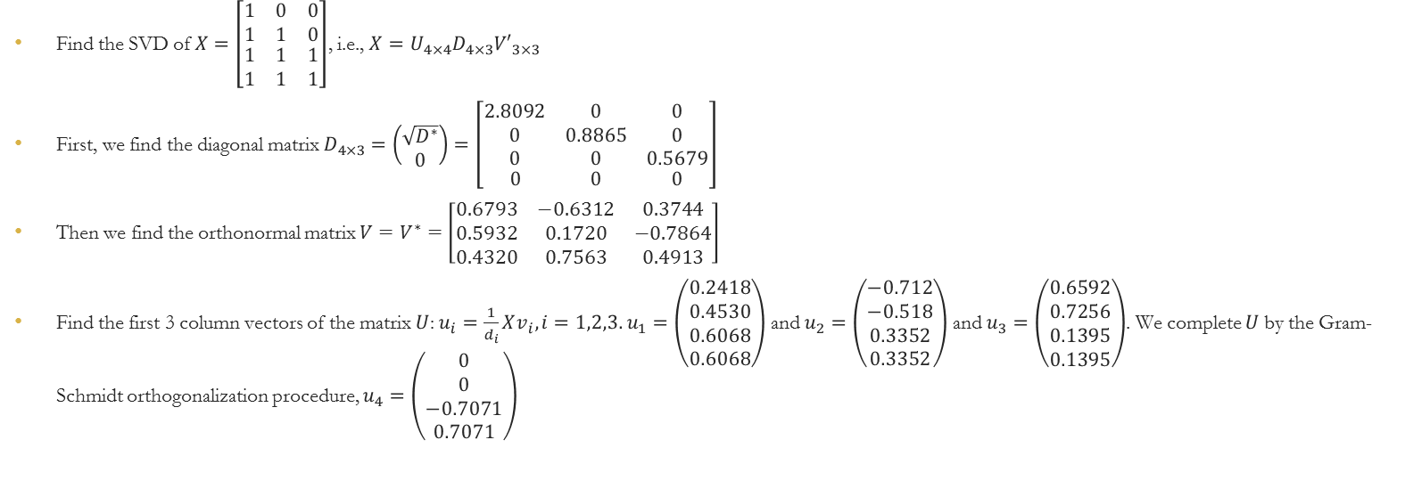
Example for SVD
Find the SVD of $X=\left[\begin{aligned}\begin{matrix}1 & 0 & 0 \\ 1 & 1 & 0\end{matrix} \\ \begin{matrix}1 & 1 & 1 \\ 1 & 1 & 1\end{matrix}\end{aligned}\right]$, i.e., $X=U_{4×4}D_{4×3}{V′}_{3×3}$
First, we find the diagonal matrix $D_{4×3}=\left(\begin{aligned}\sqrt{D^{∗}} \\ 0\end{aligned}\right)=\left[\begin{aligned}\begin{matrix}2.8092 & 0 & 0 \\ 0 & 0.8865 & 0 \\ 0 & 0 & 0.5679\end{matrix} \\ \begin{matrix}0 & 0 & 0\end{matrix}\end{aligned}\right]$
Then we find the orthonormal matrix $V=V^{∗}=$ $\left[\begin{matrix}0.6793 & −0.6312 & 0.3744 \\ 0.5932 & 0.1720 & −0.7864 \\ 0.4320 & 0.7563 & 0.4913\end{matrix}\right]$
Find the first 3 column vectors of the matrix $U$: $u_{i}=\frac{1}{d_{i}}Xv_{i}, i=1,2,3.$ $u_{1}=\left(\begin{aligned}0.2418 \\ 0.4530 \\ 0.6068 \\ 0.6068\end{aligned}\right)$ and $u_{2}=\left(\begin{aligned}−0.712 \\ −0.518 \\ 0.3352 \\ 0.3352\end{aligned}\right)$ and $u_{3}=\left(\begin{aligned}0.6592 \\ 0.7256 \\ 0.1395 \\ 0.1395\end{aligned}\right)$. We complete $U$by the Gram-Schmidt orthogonalization procedure, $u_{4}=\left(\begin{aligned}0 \\ 0 \\ −0.7071 \\ 0.7071\end{aligned}\right)$

Slide 34
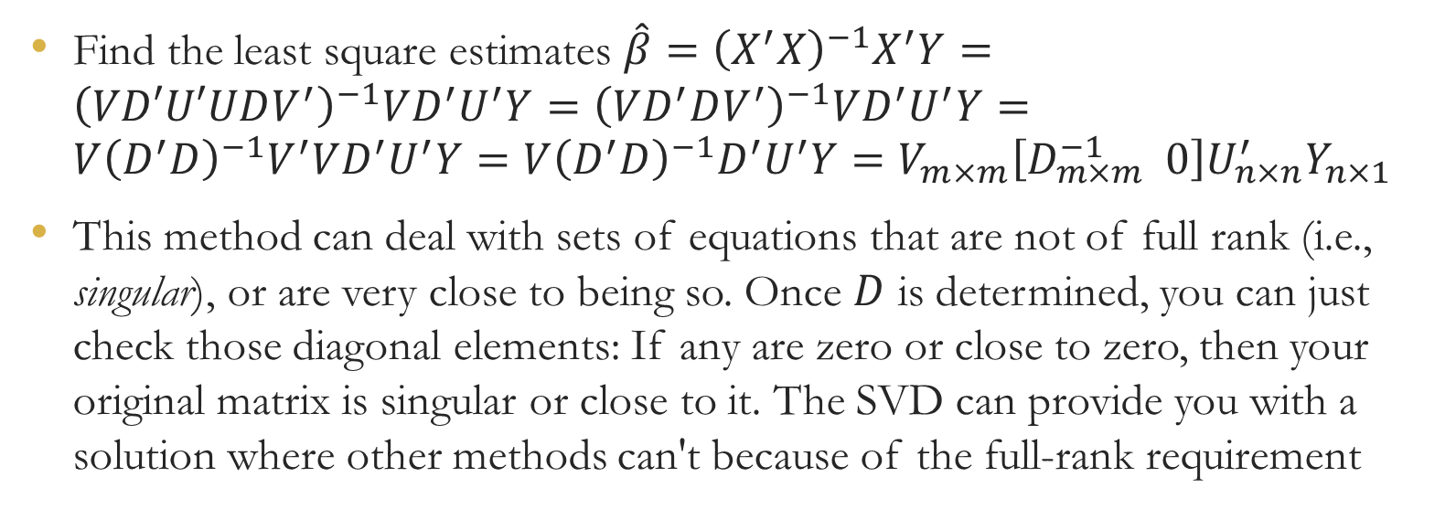
Applications of SVD
Find the least square estimates $\hat{β}={\left(X^{′}X\right)}^{−1}X^{′}Y={\left(VD′U′UDV^{′}\right)}^{−1}VD^{′}U^{′}Y={\left(VD^{′}DV^{′}\right)}^{−1}VD^{′}U^{′}Y=V{\left(D^{′}D\right)}^{−1}V^{′}VD^{′}U^{′}Y=V{\left(D^{′}D\right)}^{−1}D^{′}U^{′}Y=V_{m×m}\left[D_{m×m}^{−1} 0\right]U_{n×n}^{′}Y_{n×1}$
This method can deal with sets of equations that are not of full rank (i.e., singular), or are very close to being so. Once $D$ is determined, you can just check those diagonal elements: If any are zero or close to zero, then your original matrix is singular or close to it. The SVD can provide you with a solution where other methods can't because of the full-rank requirement

Slide 35
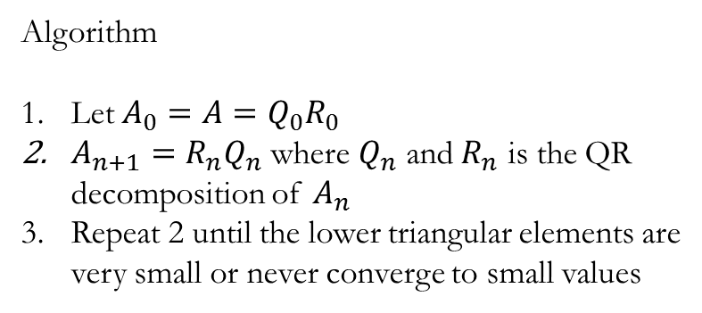
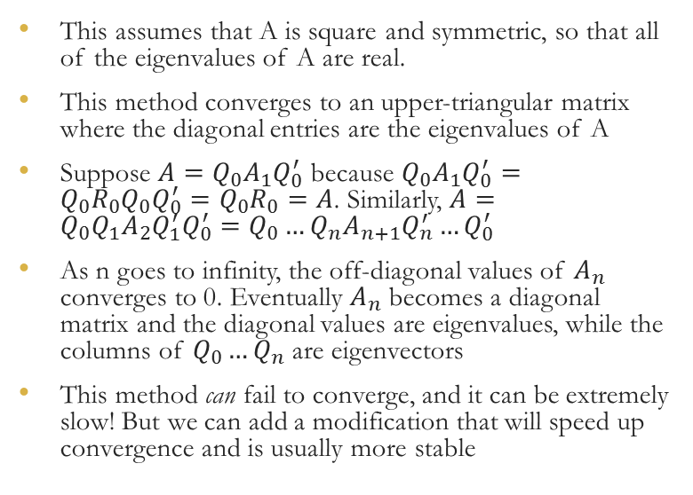
QR Method for Finding Eigensystems
This assumes that A is square and symmetric, so that all of the eigenvalues of A are real.
This method converges to an upper-triangular matrix where the diagonal entries are the eigenvalues of A
Suppose $A=Q_{0}A_{1}Q_{0}^{′}$ because $Q_{0}A_{1}Q_{0}^{′}=Q_{0}R_{0}Q_{0}Q_{0}^{′}=Q_{0}R_{0}=A$. Similarly, $A=Q_{0}Q_{1}A_{2}Q_{1}^{′}Q_{0}^{′}=Q_{0}…Q_{n}A_{n+1}Q_{n}^{′}…Q_{0}^{′}$
As n goes to infinity, the off-diagonal values of $A_{n}$ converges to 0. Eventually $A_{n}$ becomes a diagonal matrix and the diagonal values are eigenvalues, while the columns of $Q_{0}…Q_{n}$ are eigenvectors
This method can fail to converge, and it can be extremely slow! But we can add a modification that will speed up convergence and is usually more stable
Algorithm
Let $A_{0}=A=Q_{0}R_{0}$
$A_{n+1}=R_{n}Q_{n}$ where $Q_{n}$ and $R_{n}$ is the QR decomposition of $A_{n}$
Repeat 2 until the lower triangular elements are very small or never converge to small values

Slide 36
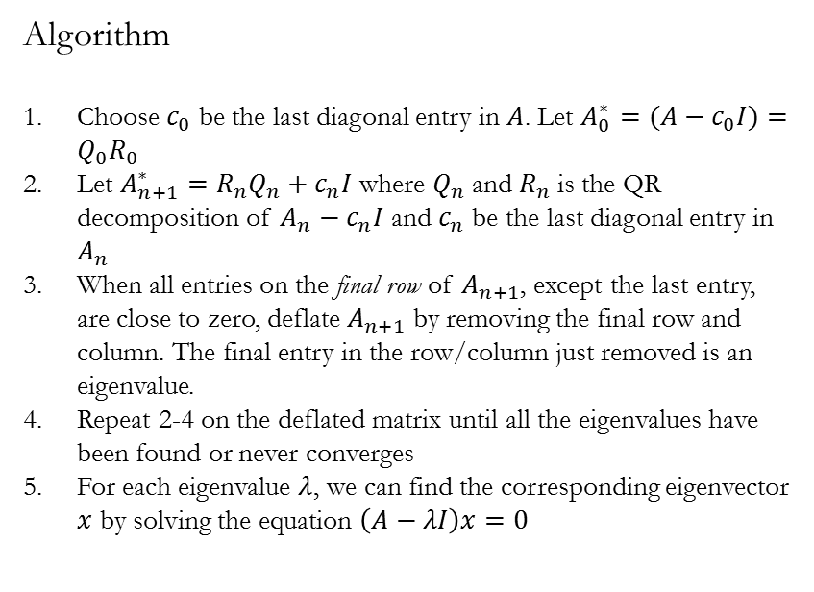
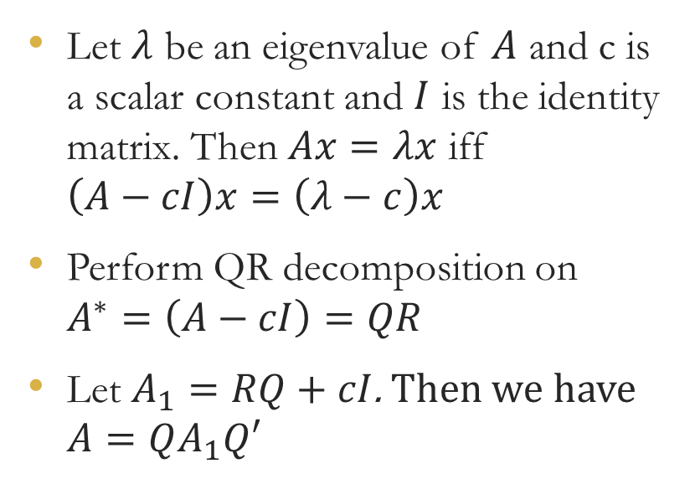
Modification
Let $λ$ be an eigenvalue of $A$ and c is a scalar constant and $I$ is the identity matrix. Then $Ax=λx$ iff $\left(A−cI\right)x=\left(λ−c\right)x$
Perform QR decomposition on $A^{∗}=\left(A−cI\right)=QR$
Let $A_{1}=RQ+cI$. Then we have $A=QA_{1}Q′$
Algorithm
Choose $c_{0}$ be the last diagonal entry in $A$. Let $A_{0}^{∗}=(A−c_{0}I)=Q_{0}R_{0}$
Let $A_{n+1}^{∗}=R_{n}Q_{n}+c_{n}I$ where $Q_{n}$ and $R_{n}$ is the QR decomposition of $A_{n}−c_{n}I$ and $c_{n}$ be the last diagonal entry in $A_{n}$
When all entries on the final row of $A_{n+1}$, except the last entry, are close to zero, deflate $A_{n+1}$ by removing the final row and column. The final entry in the row/column just removed is an eigenvalue.
Repeat 2-4 on the deflated matrix until all the eigenvalues have been found or never converges
For each eigenvalue $λ$, we can find the corresponding eigenvector $x$ by solving the equation $\left(A−λI\right)x=0$

