Slide 1

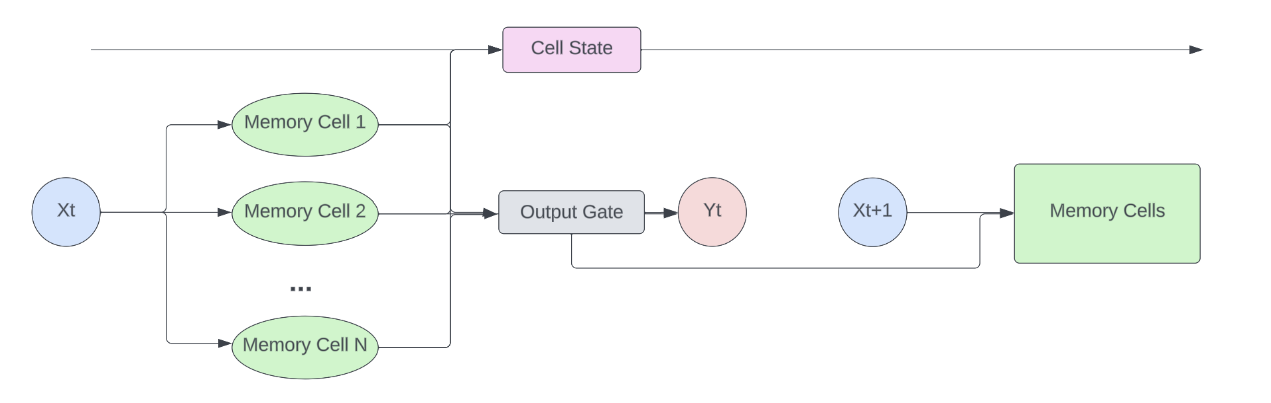
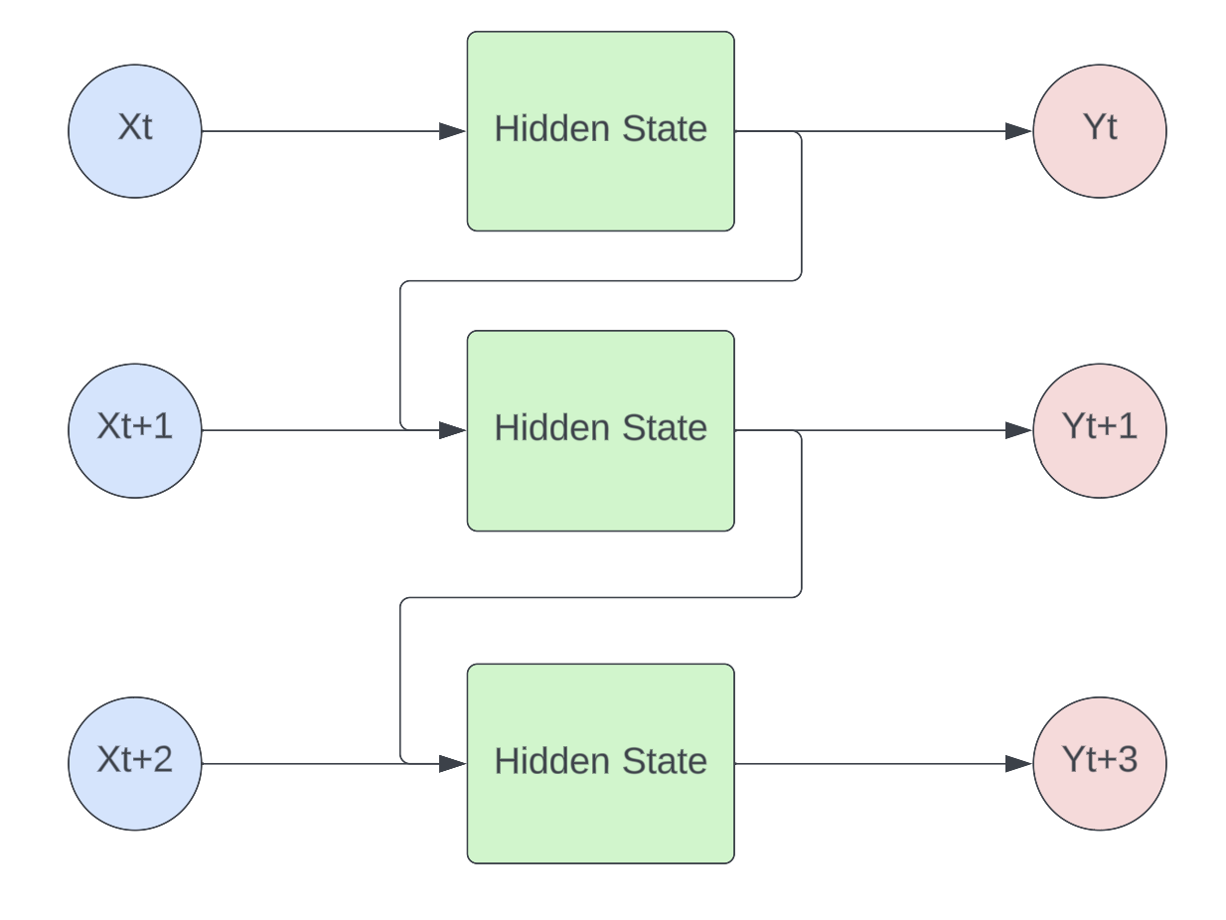
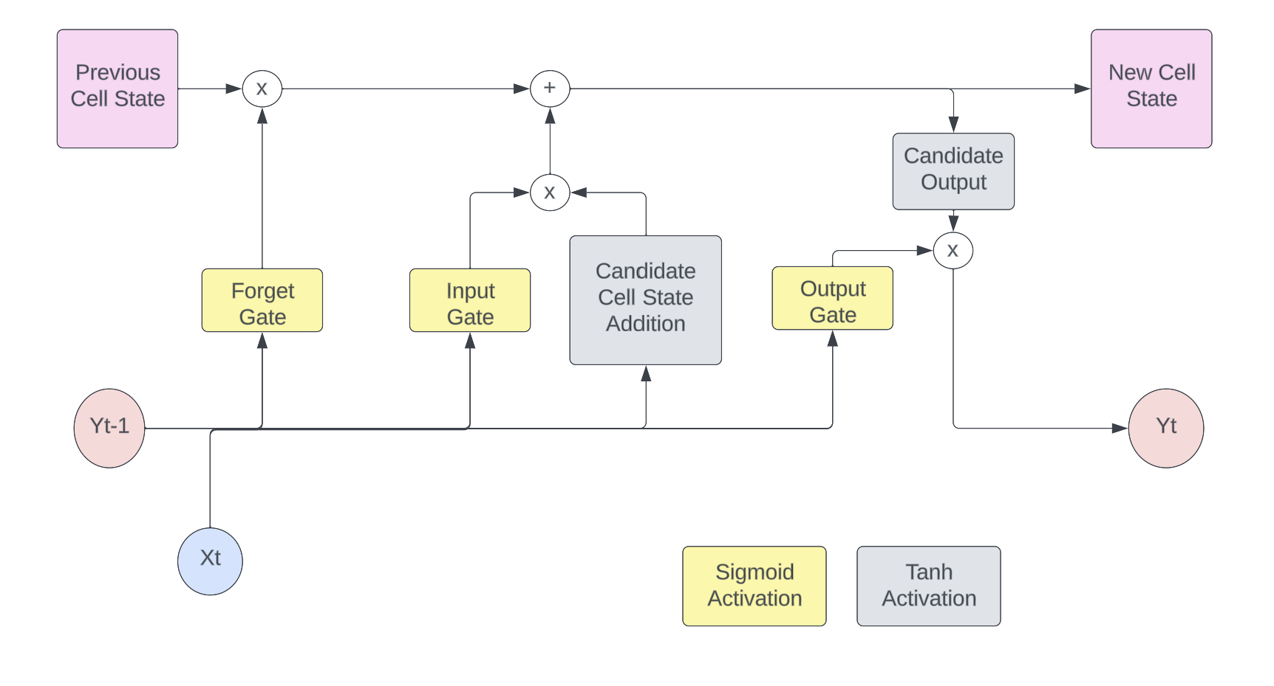



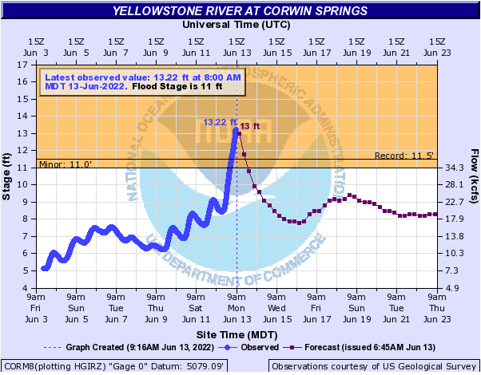
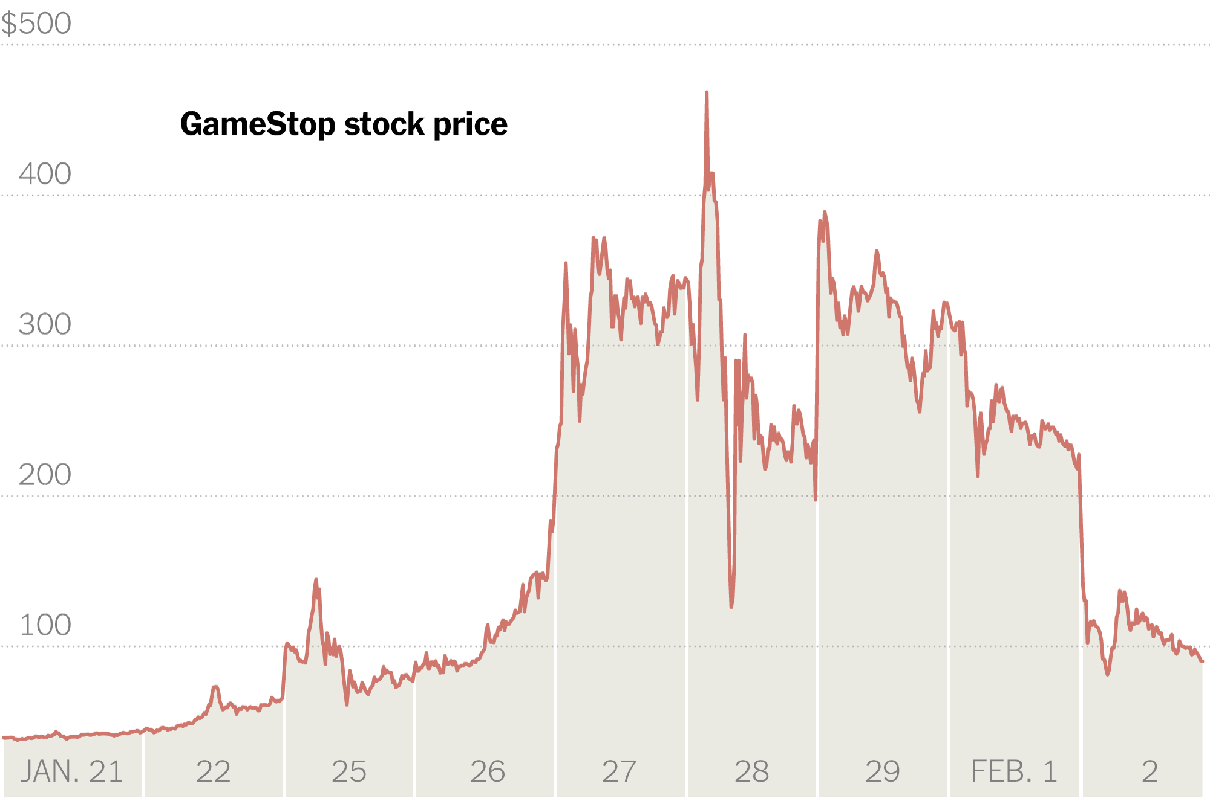




Long Short-Term Memory Networks for Time-Series Forecasting
Eliot Liucci
Dr. John Smith
Long Short-Term
Memory Networks
ideas for peer review processes in the context of mentoring students as statistical consultants and collaborators.
Recurrent Neural Networks
k
Description
Research Questions
Time-series data are collected in almost every field
Time-series data are data collected at regular intervals where an observation depends on previous observations
Dependence on previous data points can make handling these data difficult
Autoregressive Integrated Moving Average (ARIMA) models take into account;
How many time points back to incorporate (AR)
How many orders of differencing were done (Integrated)
Where the average value is at the current time point (MA)
Forecasting is the process of predicting into future values given observed values
Forecasting can help stakeholders make informed decisions
How do traditional methods such as ARIMA models perform in comparison to LSTM networks?
What is the ideal structure that allows for the most accurate forecasts?
What methods can be applied to obtain a level of uncertainty about predictions?
Figure 2. RNN Structure
Figure 3. LSTM Structure
Figure 4. Memory Cells
Methods
Water elevation data in Everglades National Park collected from 1995 to 2023 were used for the comparison
Training: 1995 - 2020
Testing: 2020 - Present
Used a robust scaler on Train data
Centered at Median
IQR of 1
LSTM built in Keras framework through Python
Trained on scaled data
Tested on scaled testing set
ARIMA was fit using an auto ARIMA function within Python
Fit on scaled train data
1st order autoregressive
1st order differencing
4th order moving average
Sigma represents sigmoid activation
Only 5 parameters to be tuned
Notice that w3 ends up being multiplied by itself for each additional time point included in predictions
Time point 1 is more influential than time point 2, etc.
Can cause exploding/vanishing gradient problem
Gradient descent is used to find optimal weights and biases
Forget Gate
Input Gate
New Candidate Values
New Cell State
Output Gate
Output Value
Figure 1. Example Time-Series
https://www.kbzk.com/weather/historic-flooding-on-the-yellowstone
https://www.nytimes.com/2021/02/02/business/gamestop-investors-plunging-shares.html
Notes:
Description -> RNN -> LSTM -> RQ -> Data -> Imputation -> Preliminary Results -> Future Work/References

Slide 2
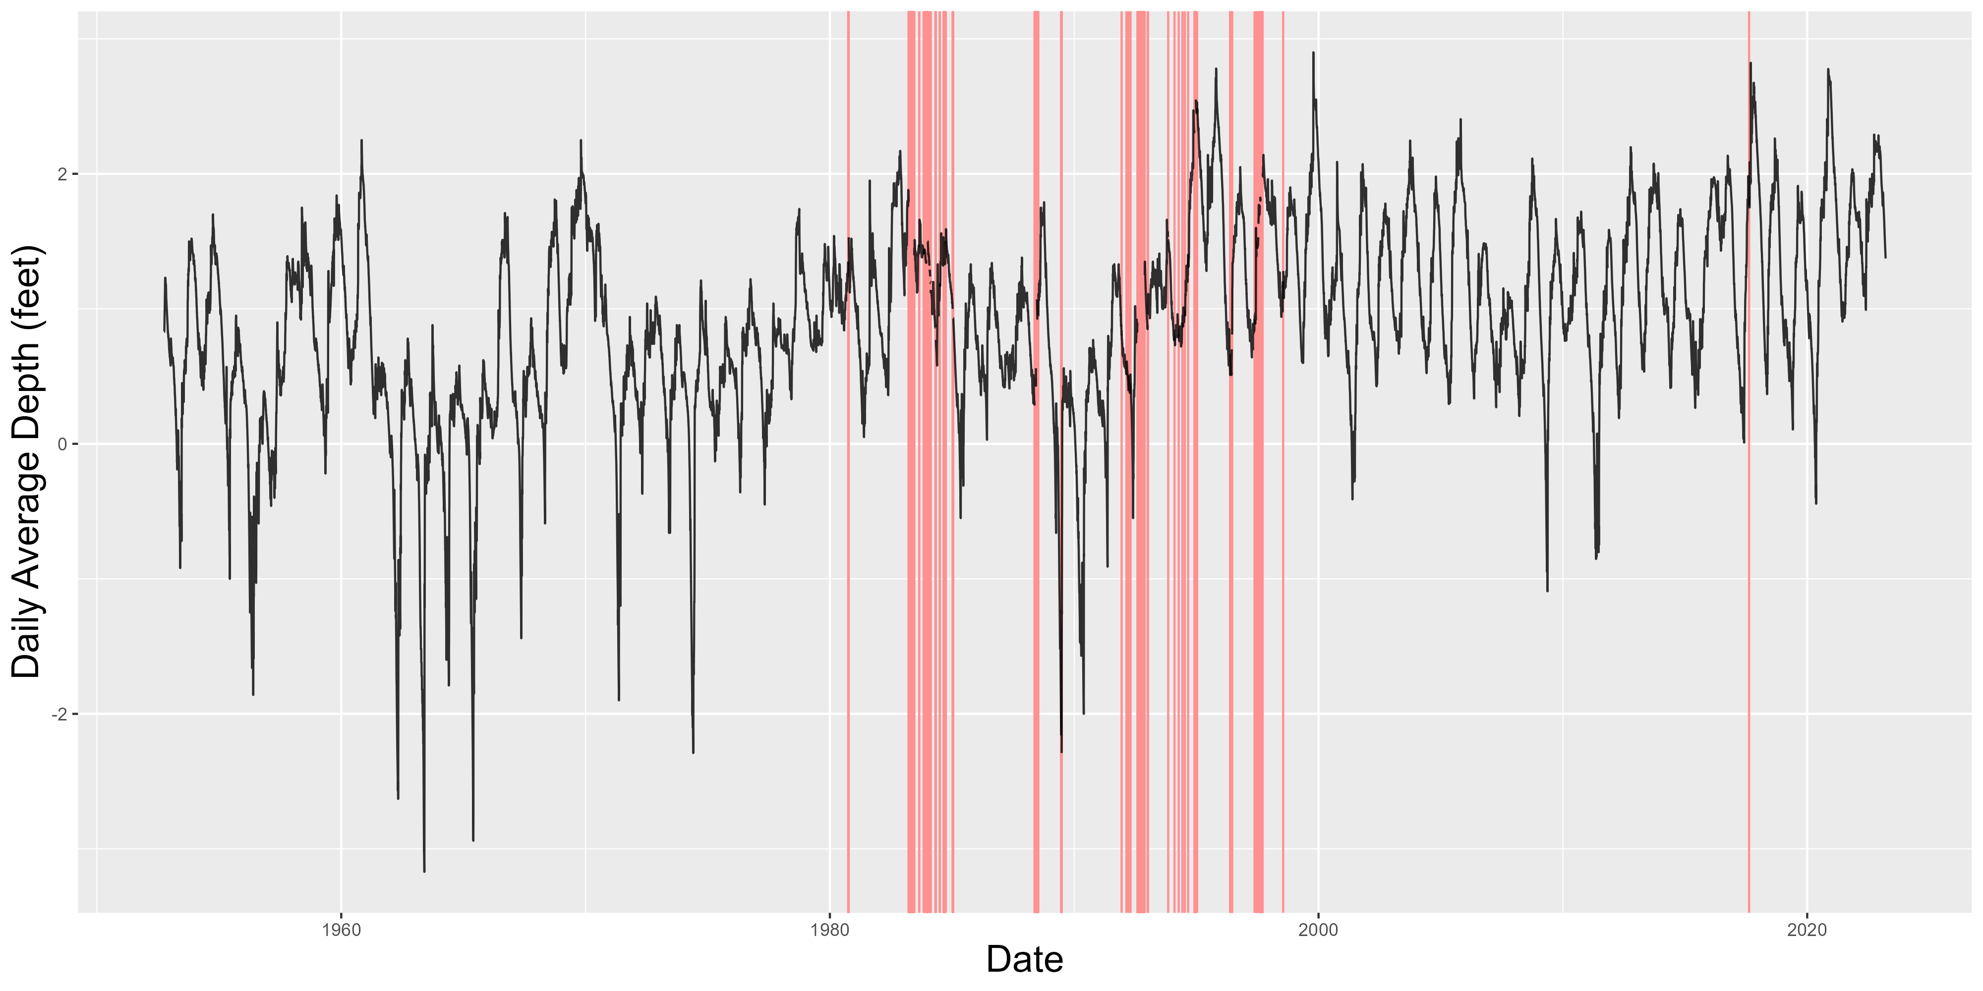
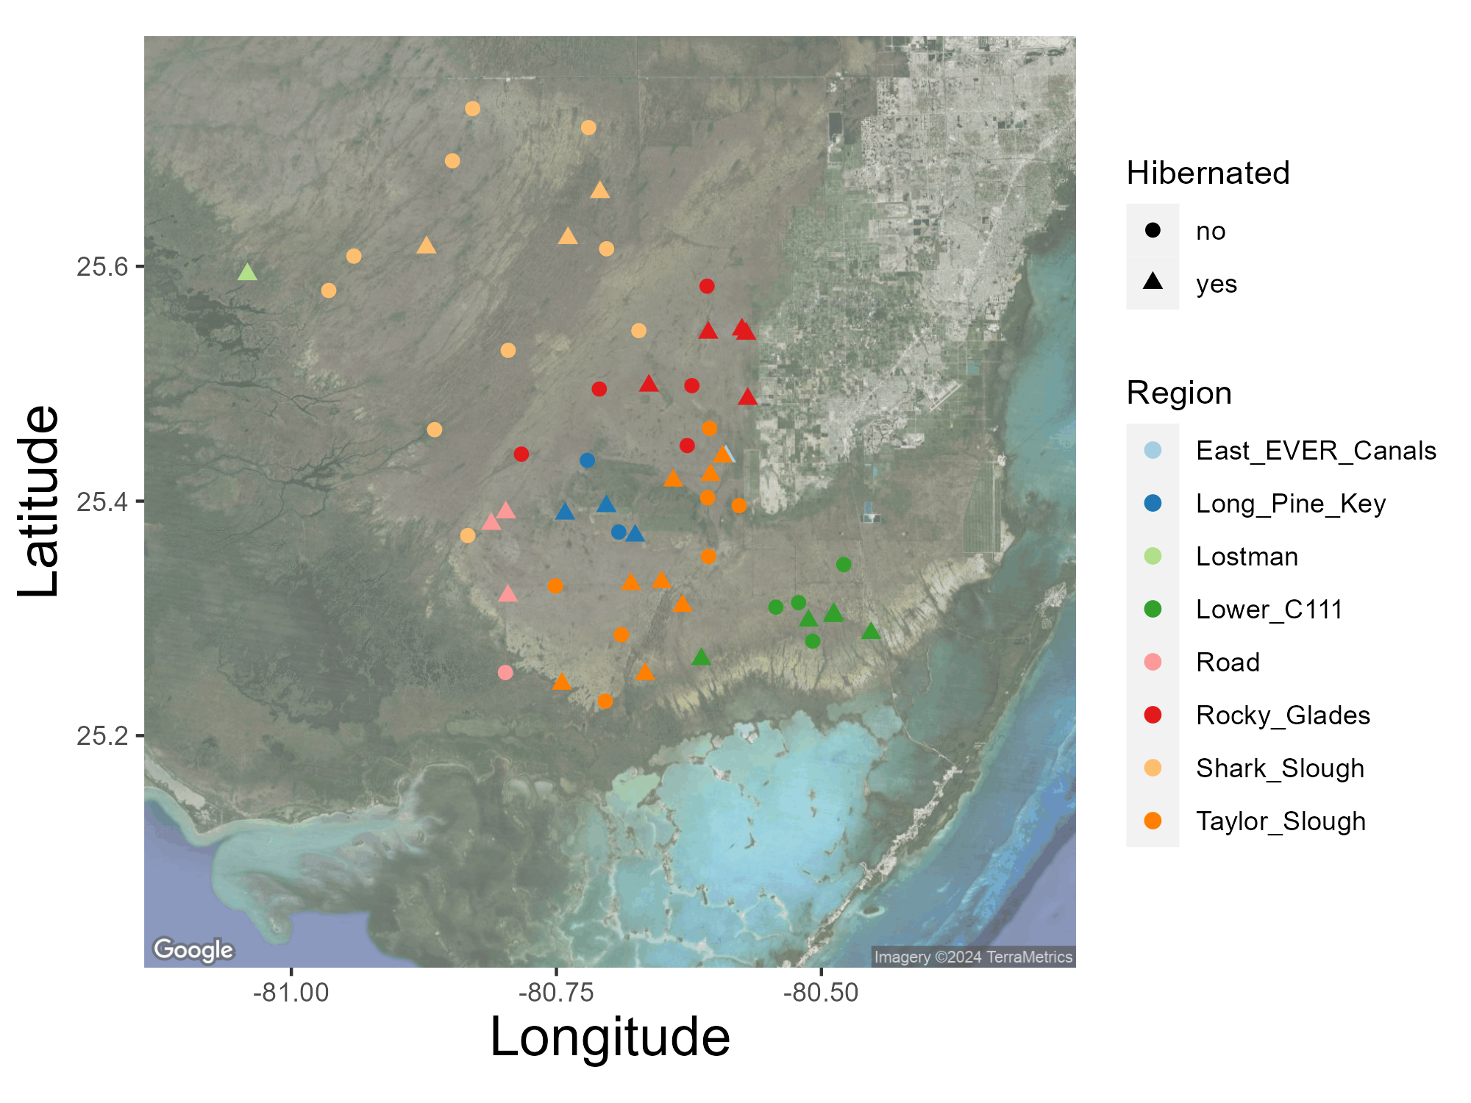
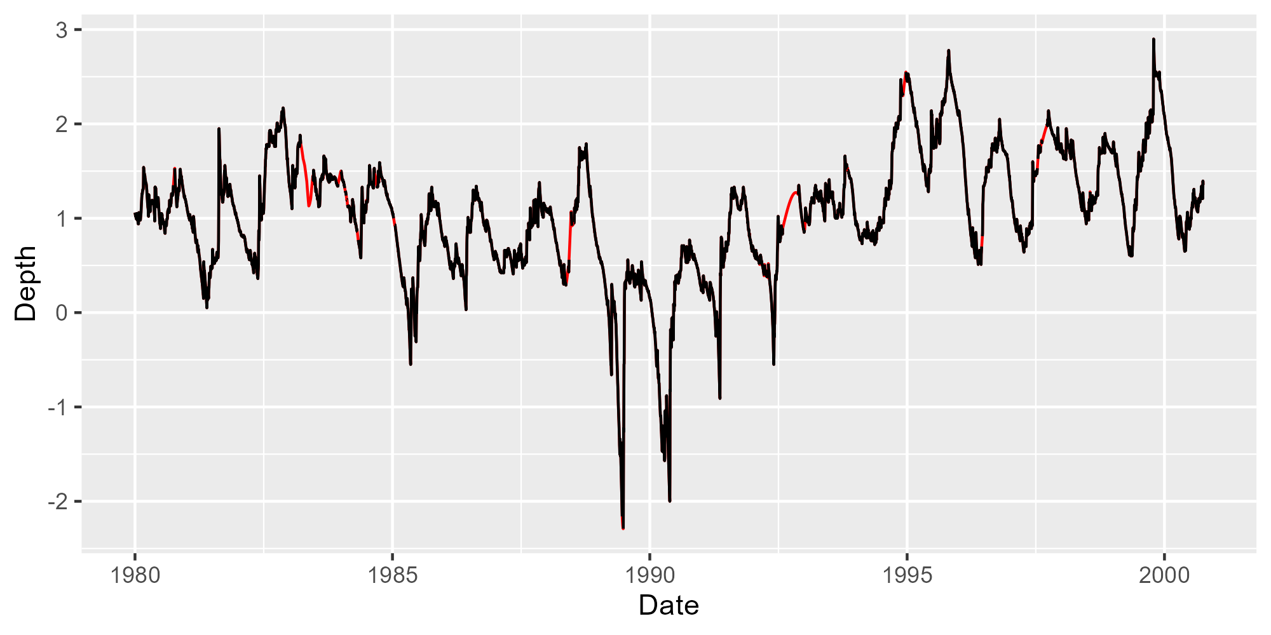
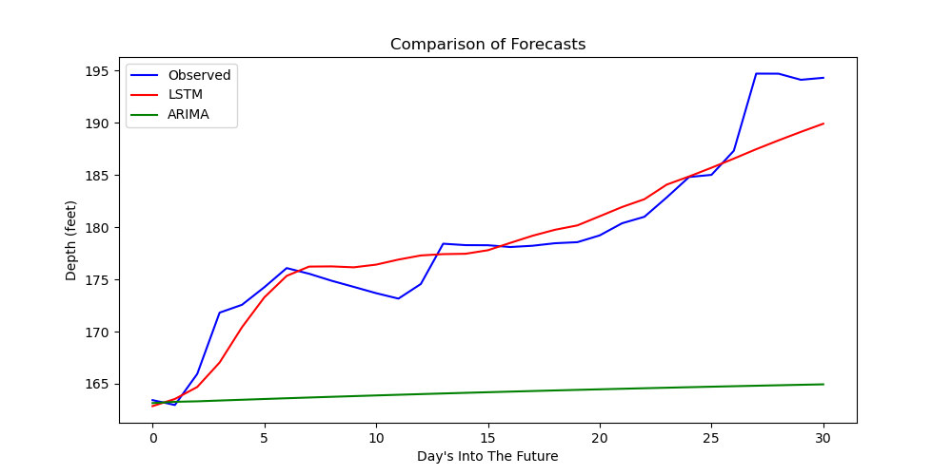
Long Short-Term Memory Networks for Time-Series Forecasting
Eliot Liucci
Dr. John Smith
ideas for peer review processes in the context of mentoring students as statistical consultants and collaborators.
k
Everglades Data Set
Imputation Methods
Preliminary Results
Future Work
Missingness present has been assumed to be missing at random
Device malfunctions, random outages, etc.
Used a Kalman Filter to impute missing values
LSTM Structure
All layers utilized
L1 kernel regularization (0.1%)
L2 activity regularization (0.1%)
Dropout (30%)
128 LSTM nodes
64 LSTM nodes
32 LSTM nodes
10 Dense nodes
Output
Results
Predicting 31 days ahead using last batch of training data (31 days)
Compared on MSE
LSTM: 7.2
ARIMA: 270.3
Bayesian Optimization for hyperparameter tuning
Expository paper by Snoek, Larochelle, and Adams (2012)
Compare to other methods
Holt-Winters
Exponential Smoothing
Obtain uncertainty intervals for LSTM predictions
Bootstrap from training sample
Bootstrap
Retrain Network
Obtain Predictions
Repeat
58 hydrology stations measure water stage (elevation from sea level) multiple times per day
For each day, the daily average is recorded
Stage was transformed to depth by subtracting the elevation of the station itself
Time-series go as far back as 1952
Missingness present in each time-series ranges from 0.5% to >50%
Figure 6. Missingness Present in P33
Figure 5. EVER Stations
References
Ruiz, P. (2019). ML approaches for time series. Medium.
Medsker, L. and Jain, L. C. (1999). Recurrent neural networks: design and applications. CRC press.
Lim, B. and Zohren, S. (2021). Time-series forecasting with deep learning: a survey. Philosophical Transactions of the Royal Society A, 379(2194):20200209.
Hebbar, N. (2021). Time series forecasting with rnn(lstm)— complete python tutorial—.
Snoek, J., Larochelle, H., and Adams, R. P. (2012). Practical bayesian optimizationof machine learning algorithms. In Pereira, F., Burges, C., Bottou, L., andWeinberger, K., editors, Advances in Neural Information Processing Systems,volume 25. Curran Associates, Inc.
Figure 7. Imputed Data
Figure 8. Forecast Comparison

