Slide 1
Long Short-Term Memory Networks for Time-Series Predictions
Eliot Liucci
Dr. John Smith

Slide 2
Special Thanks
Project Advisor
John Smith
Committee Members
Samidha Shetty
Scott McCalla
Katharine Banner

Slide 3
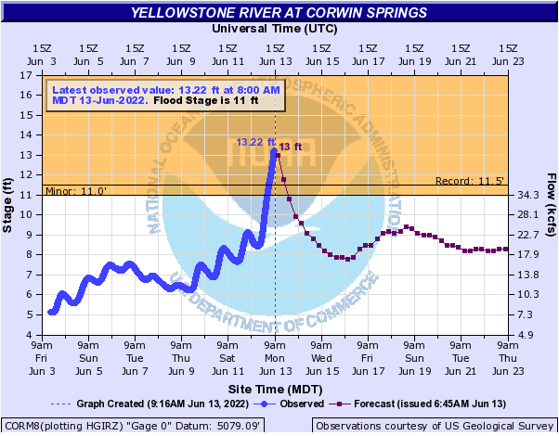
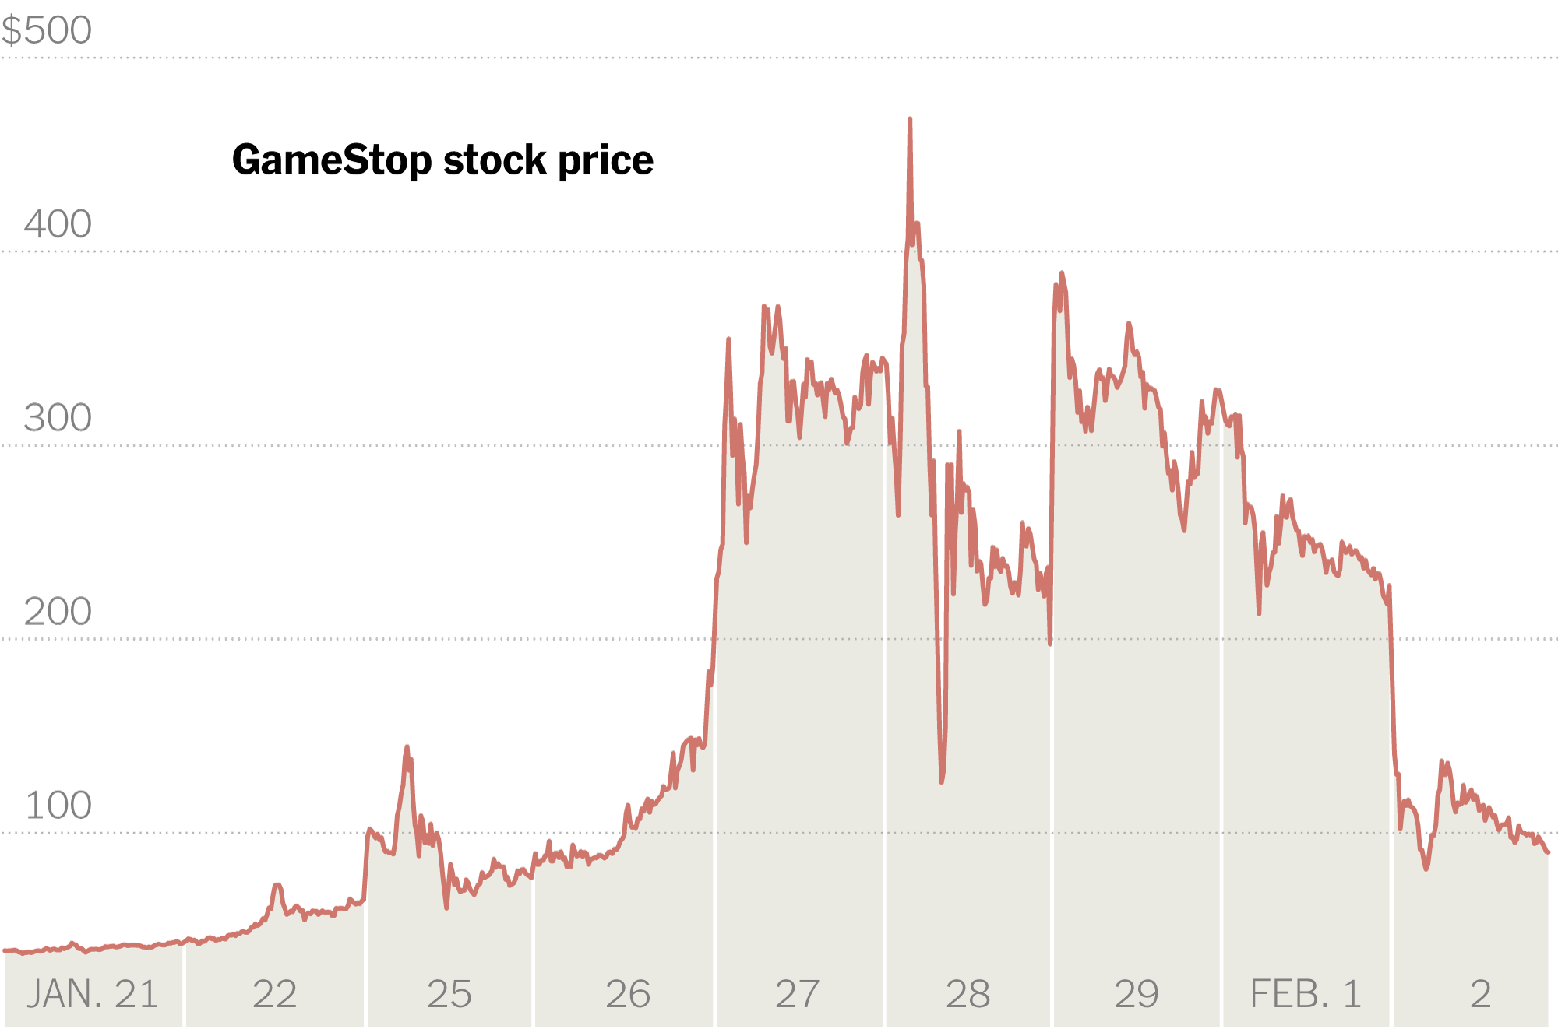
Time-Series Data
Used in almost every field
Predictions are frequently used in stakeholder decisions
https://www.kbzk.com/weather/historic-flooding-on-the-yellowstone
https://www.nytimes.com/2021/02/02/business/gamestop-investors-plunging-shares.html

Slide 4
Recurrent Neural Networks
Allow for multiple dependent inputs
Forecasts can be made based on batches of inputs
Too many inputs -> Exploding gradient
Long Short-Term Memory Networks provide a solution
Hidden State -> Memory Cells

Slide 5
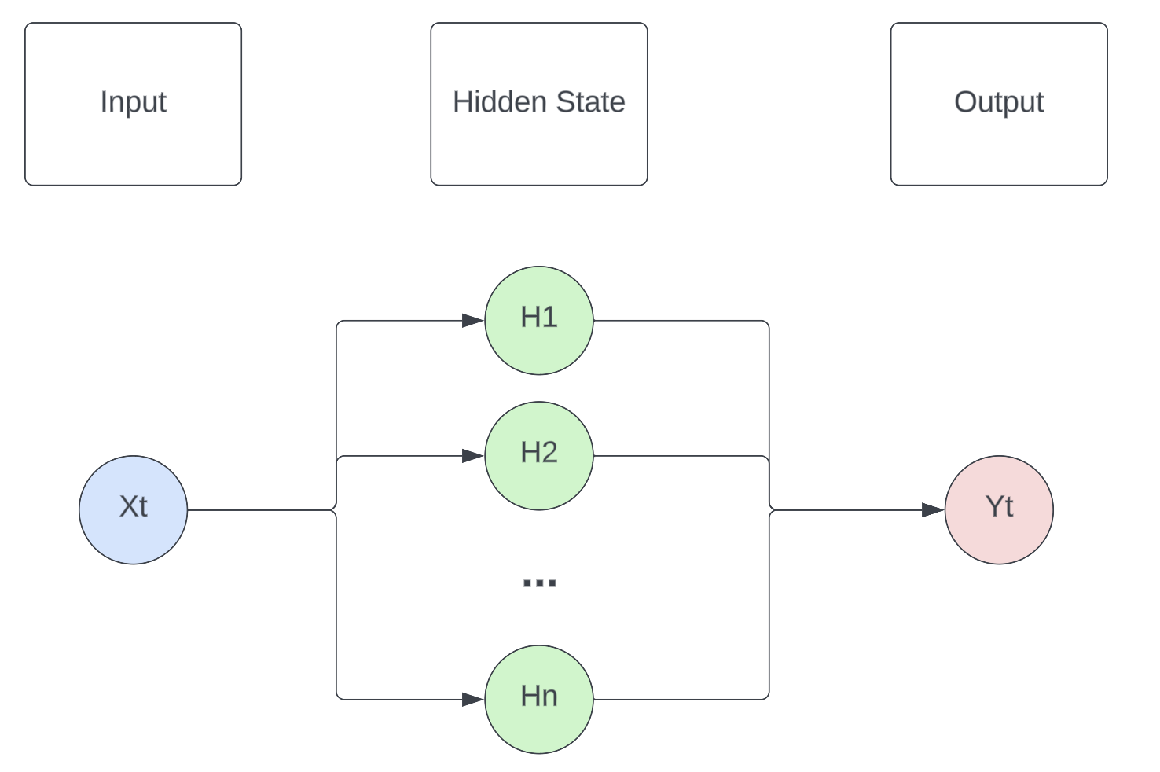
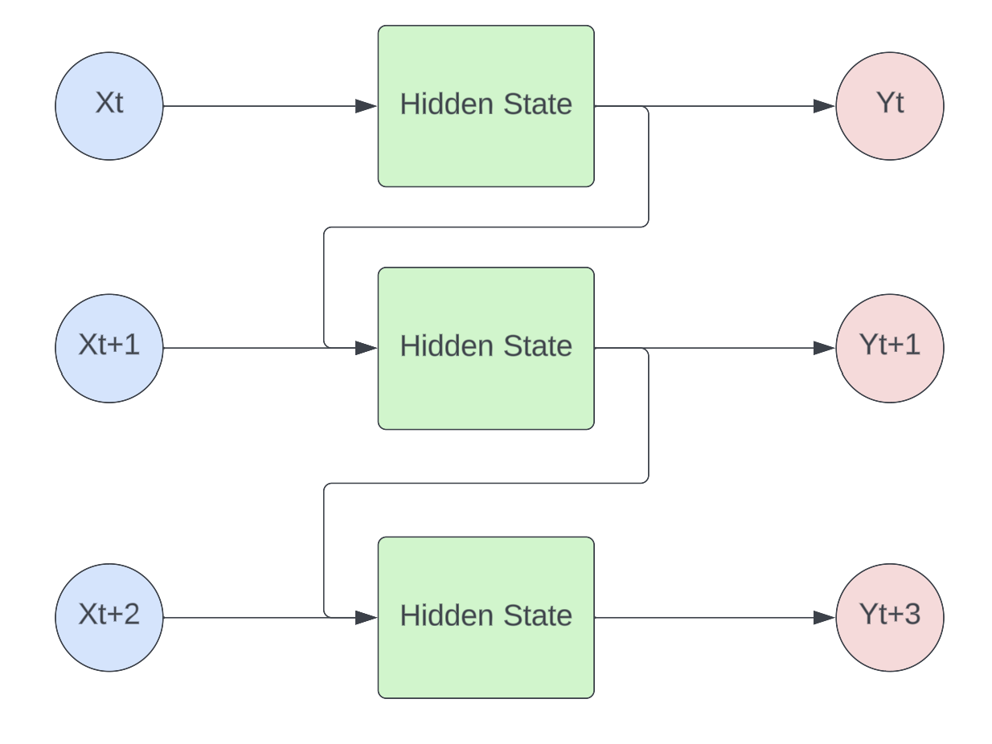
Recurrent Neural Network
Traditional Neural Network
Flowcharts made with Lucidchart

Slide 6
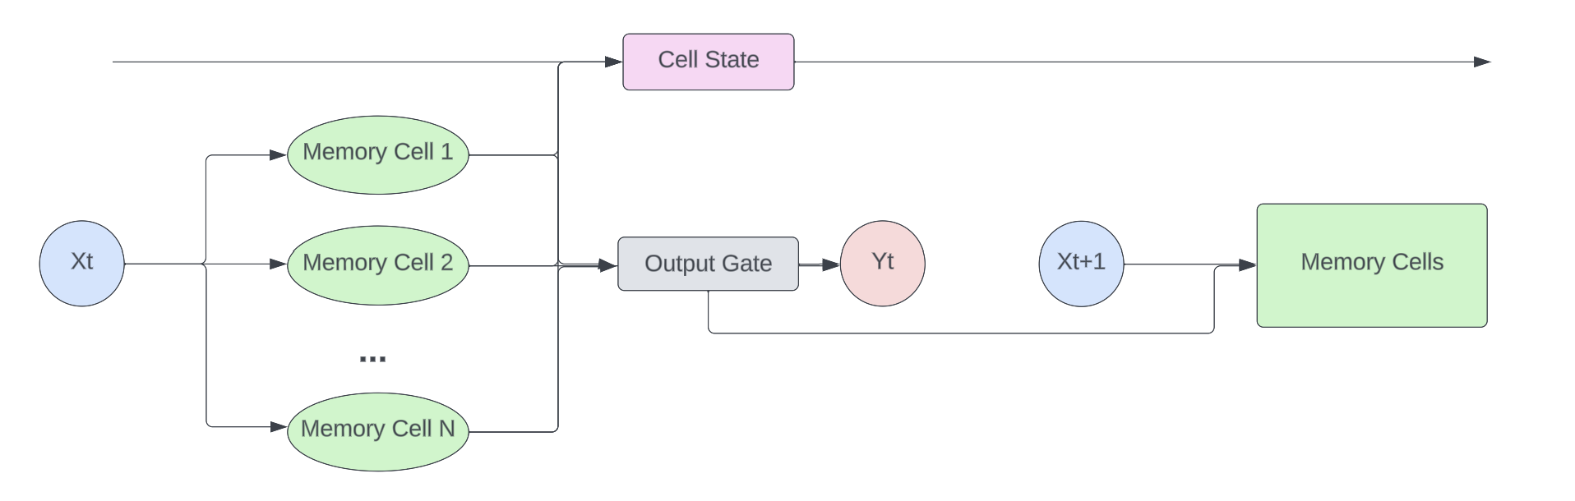
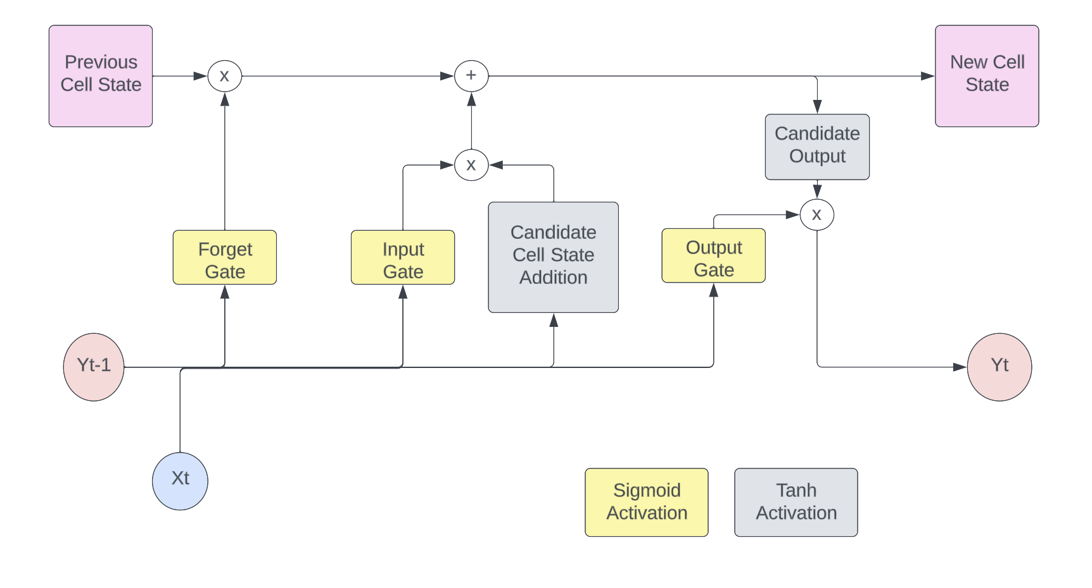
Long Short-Term Memory Networks
Flowchart made with Lucidchart

Slide 7
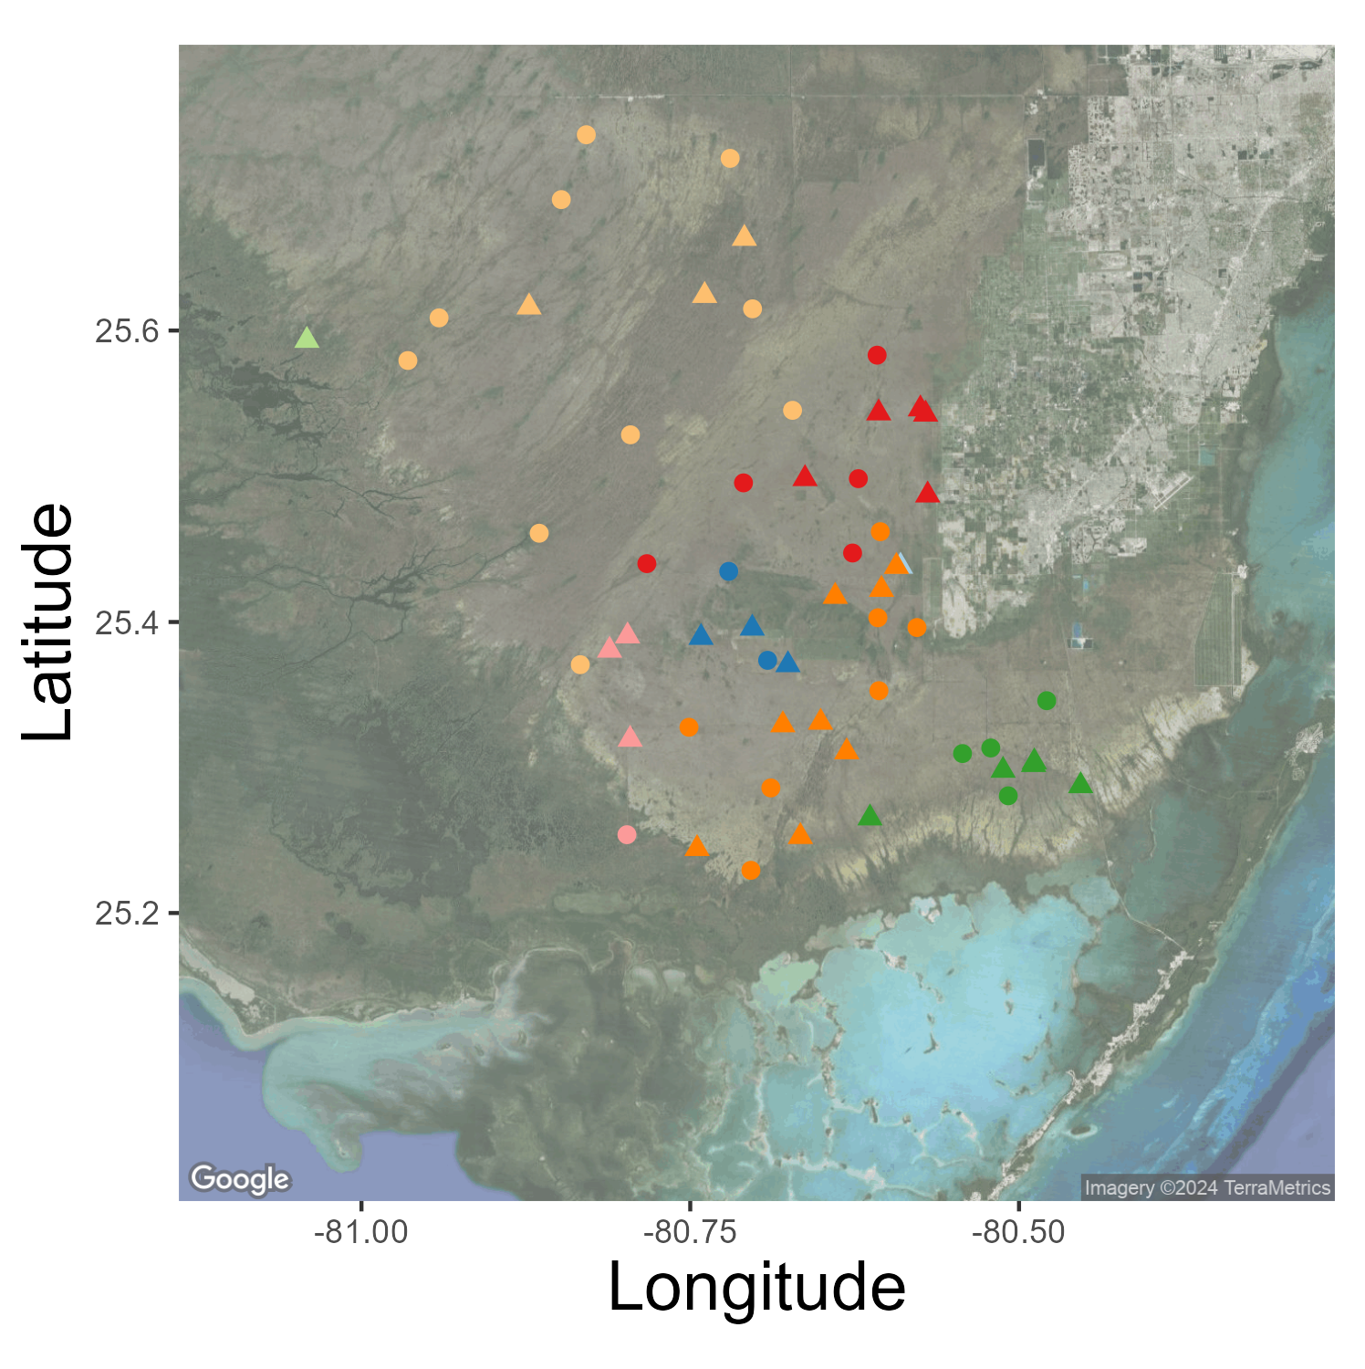
Motivation
Predict water depth for future dates
Comparison of Predictions and Observations allow for potential problems to be caught early
Explore non-traditional methods for time-series forecasting

Slide 8
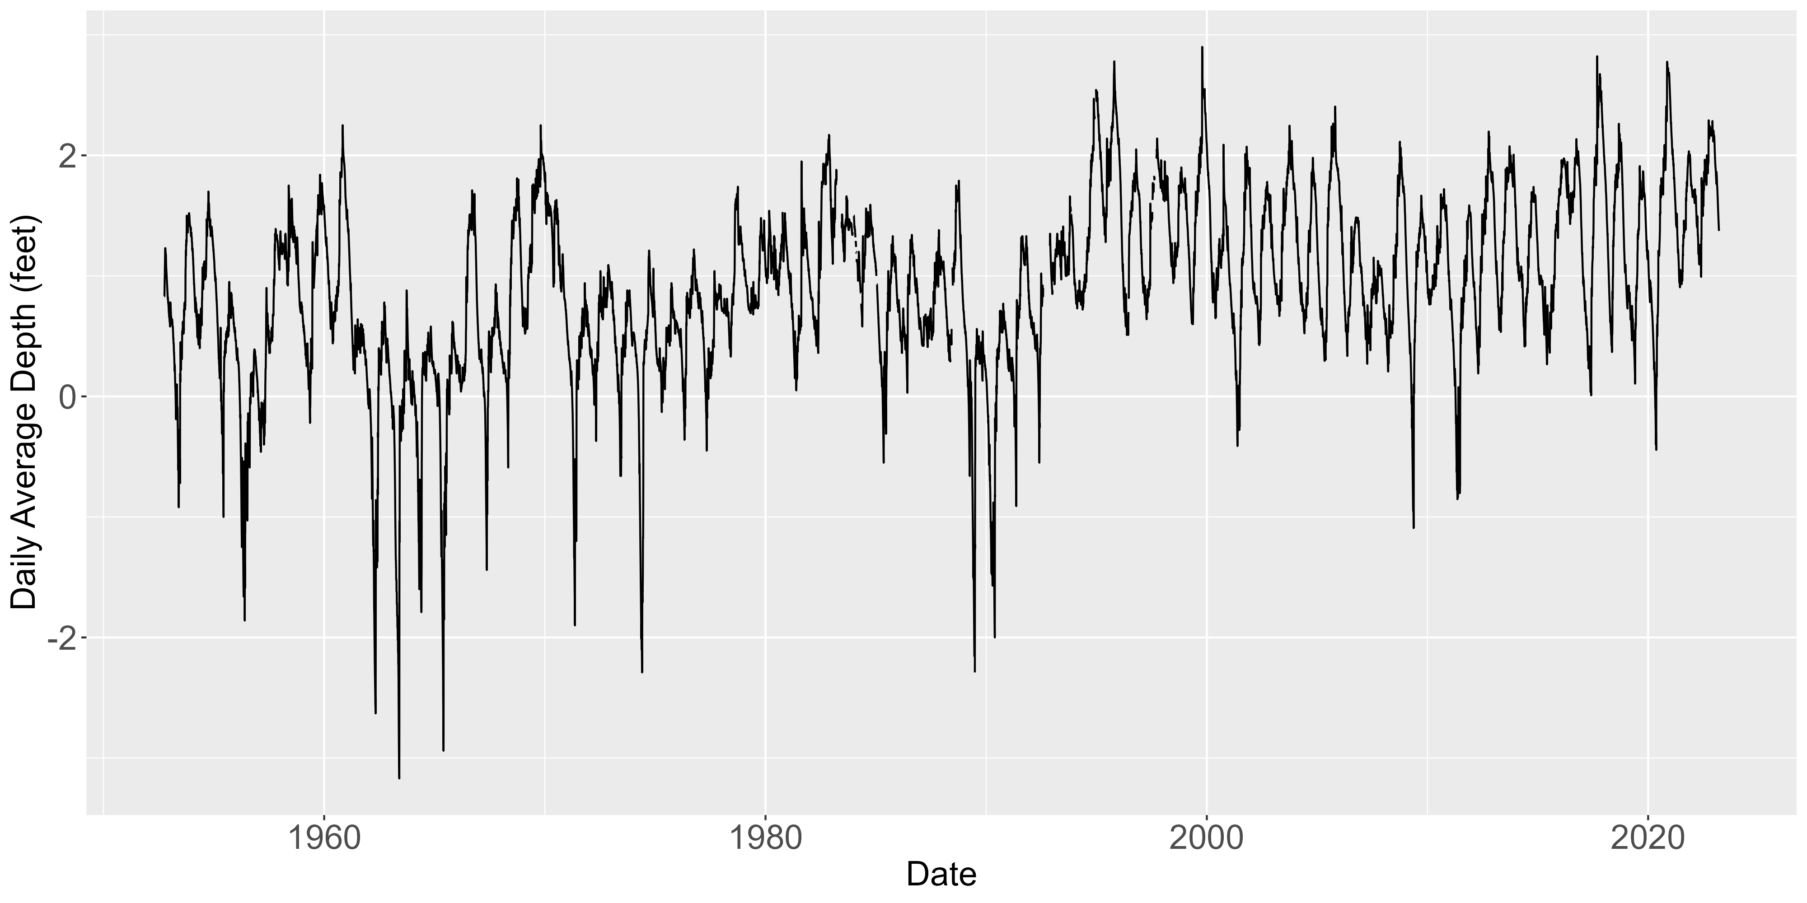
Data Available
Everglades National Park (EVER) telemetry stations monitor water depth
Range as far as 1952 – 2023
Various levels of missingness
Measurements are daily averages
Originally “Stage” (water elevation)
Converted to Depth based on station elevation

Slide 9
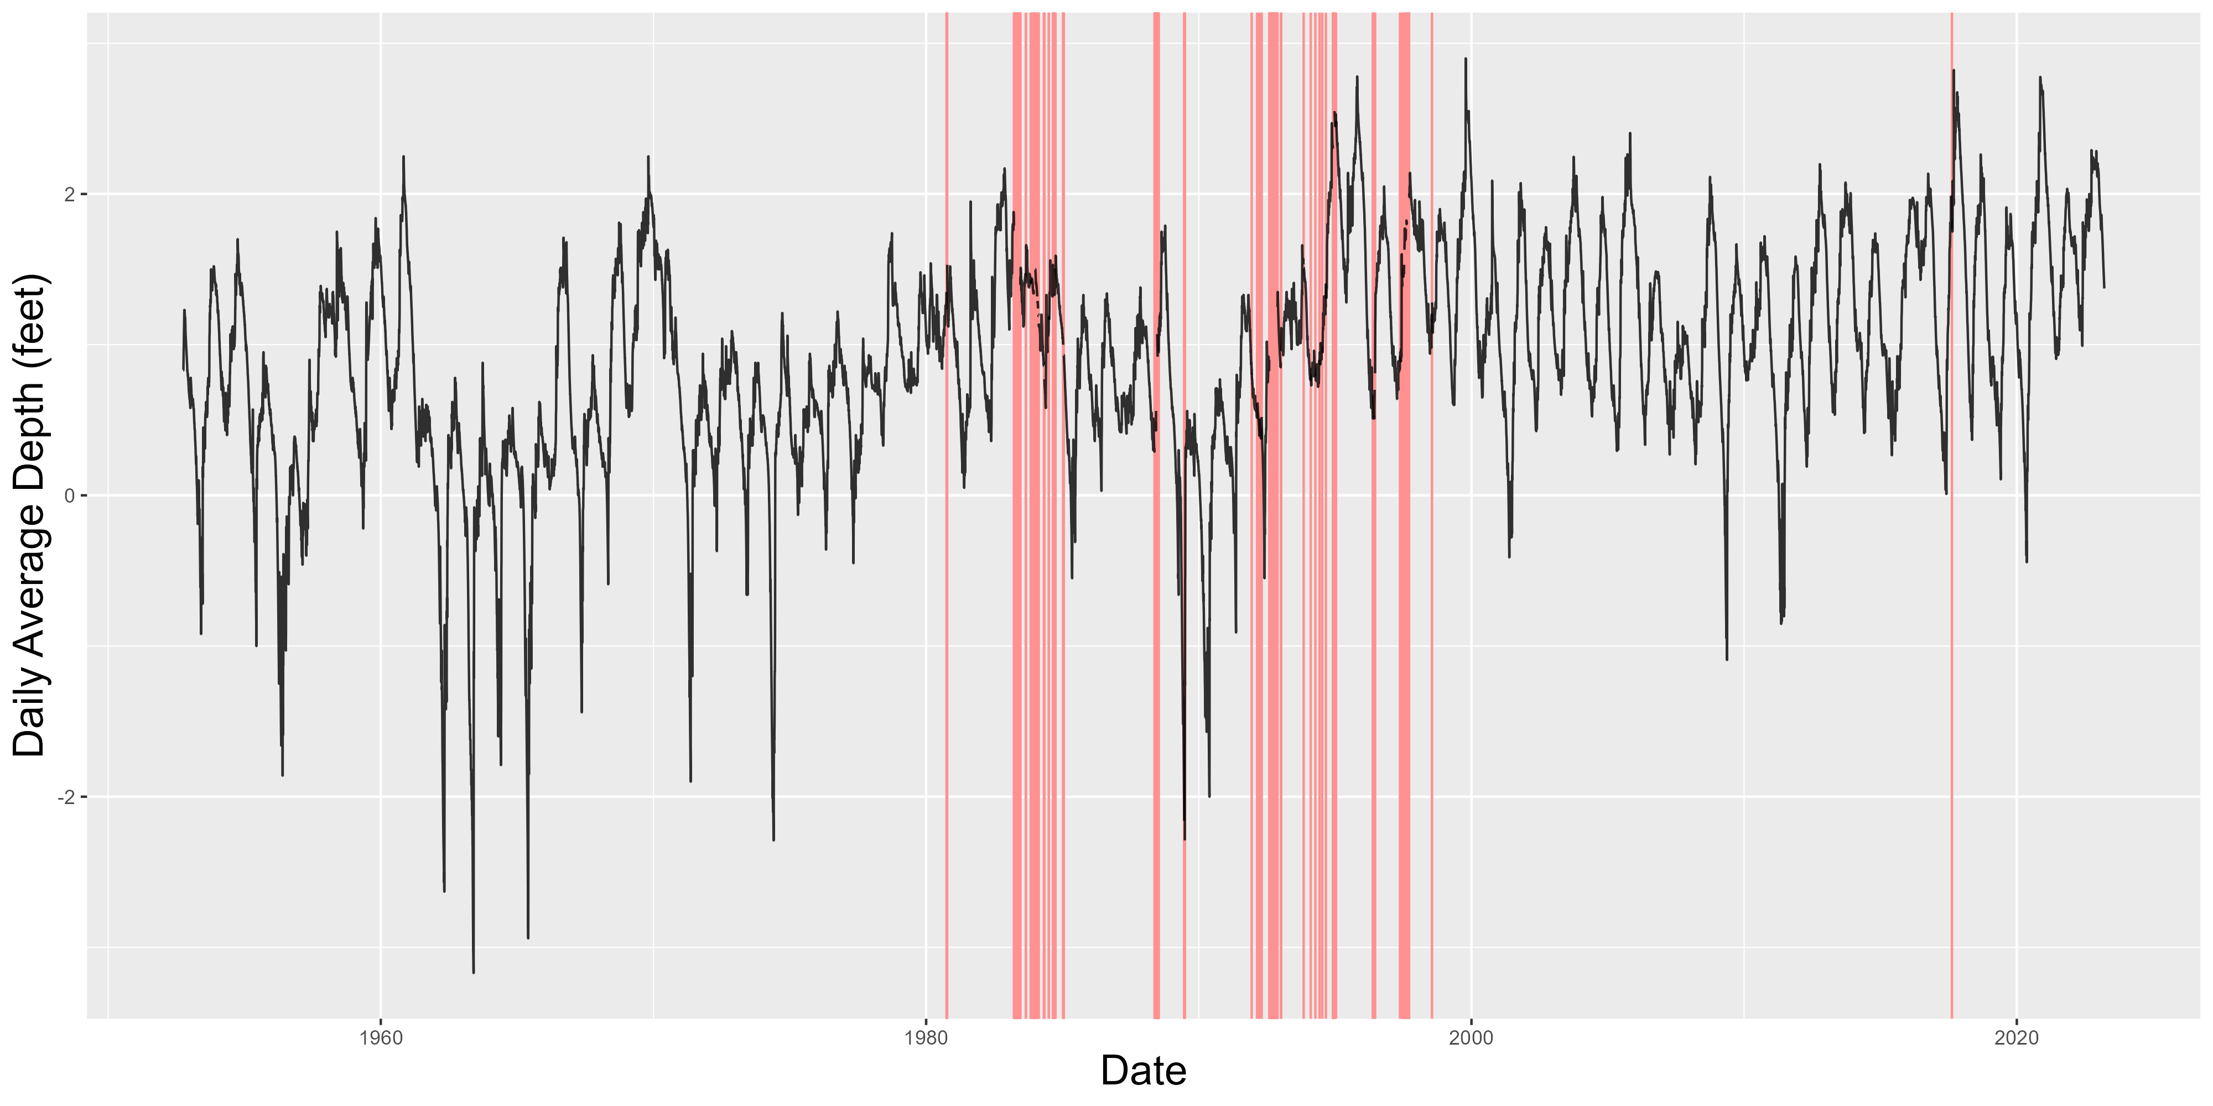
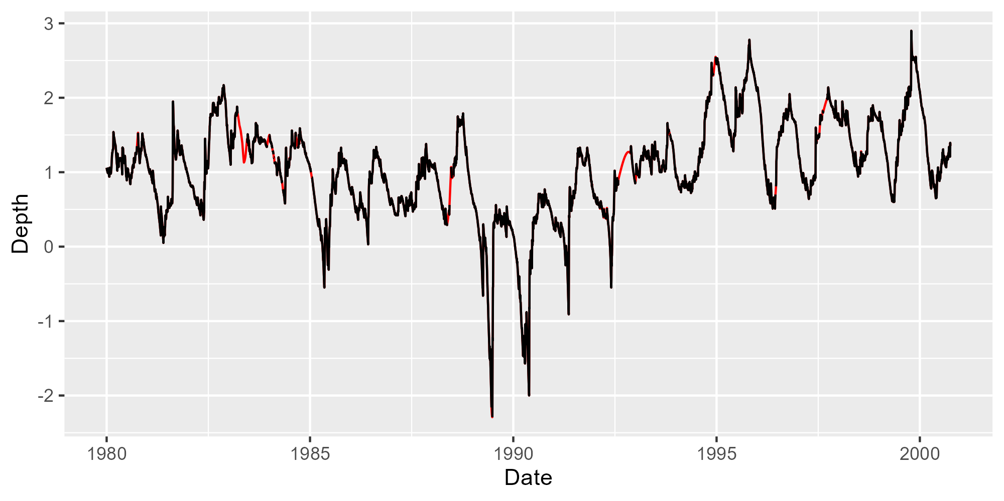
Issues Within the Data
Missingness when training NNs can lead to exploding gradients, so missing values must be imputed
A Kalman Filter was used to fill in those values

Slide 10
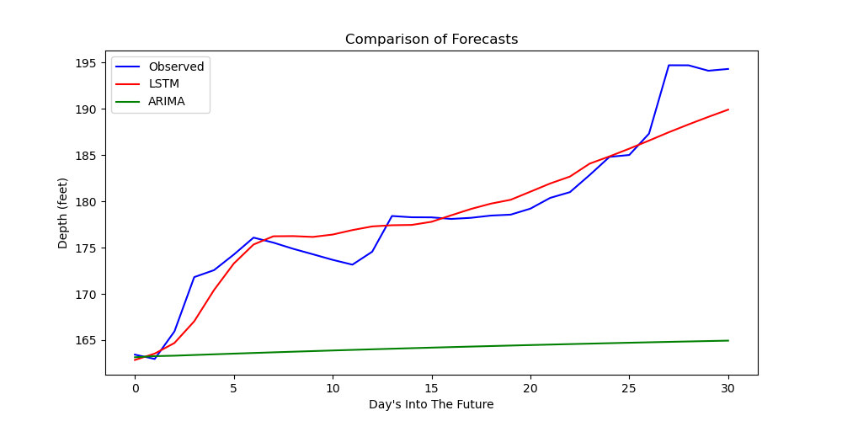
Results
LSTM and ARIMA trained on data since 1995
ARIMA: 1st order AR, 1st order Differencing, 4th order MA
Notes:
Add legend and axis labels to this plot

Slide 11
Next Steps
Bayesian Optimization for hyperparameter tuning
Expository paper by Snoek, Larochelle, and Adams (2012)
Compare to other methods
Holt-Winters
Exponential Smoothing
Obtain uncertainty intervals for LSTM predictions
Bootstrap from training sample
Bootstrap
Retrain Network
Obtain Predictions
Repeat
Notes:
Cite paper John sent over for Bayesian Optimization
“Expository paper by …”

Slide 12
References
Ruiz, P. (2019). ML approaches for time series. Medium.
Medsker, L. and Jain, L. C. (1999). Recurrent neural networks: design and applications. CRC press.
Lim, B. and Zohren, S. (2021). Time-series forecasting with deep learning: a survey. Philosophical Transactions of the Royal Society A, 379(2194):20200209.
Hebbar, N. (2021). Time series forecasting with rnn(lstm)— complete python tutorial—.
Snoek, J., Larochelle, H., and Adams, R. P. (2012). Practical bayesian optimizationof machine learning algorithms. In Pereira, F., Burges, C., Bottou, L., andWeinberger, K., editors, Advances in Neural Information Processing Systems,volume 25. Curran Associates, Inc.

