Slide 1
Long Short-Term Memory Networks for Time-Series Predictions
Eliot Liucci

Slide 2
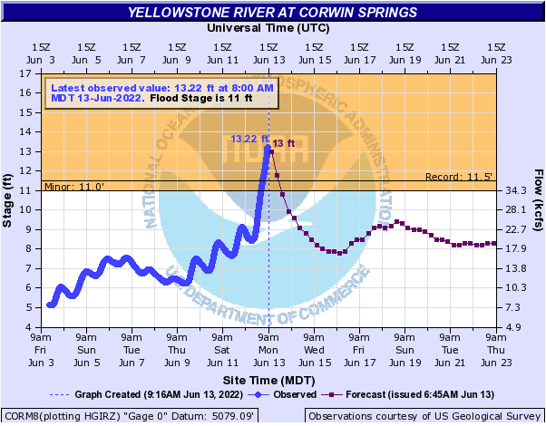
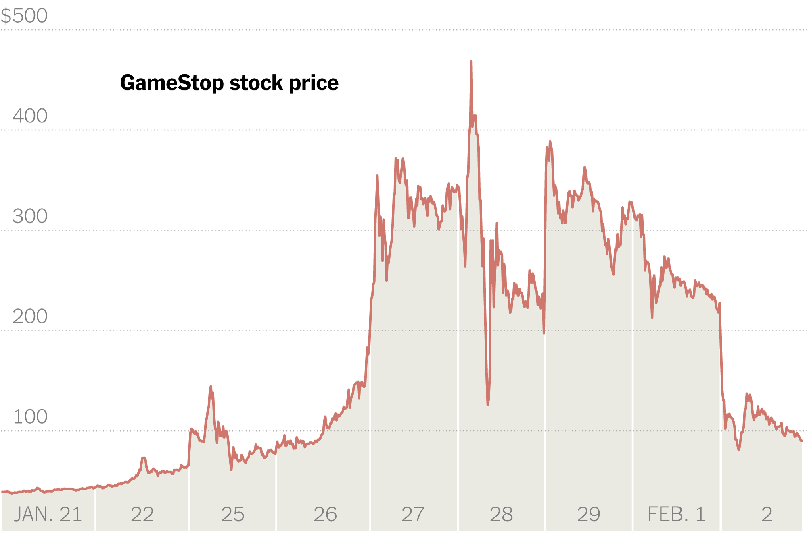
Time-Series Data
Used in almost every field
Predictions have powerful implications
https://www.kbzk.com/weather/historic-flooding-on-the-yellowstone
https://www.nytimes.com/2021/02/02/business/gamestop-investors-plunging-shares.html

Slide 3
Recurrent Neural Networks
Allow for multiple dependent inputs
Forecasts can be made based on batches of inputs
Too many inputs -> Exploding gradient
Long Short-Term Memory Networks provide a solution
Hidden State -> Memory Cells

Slide 4
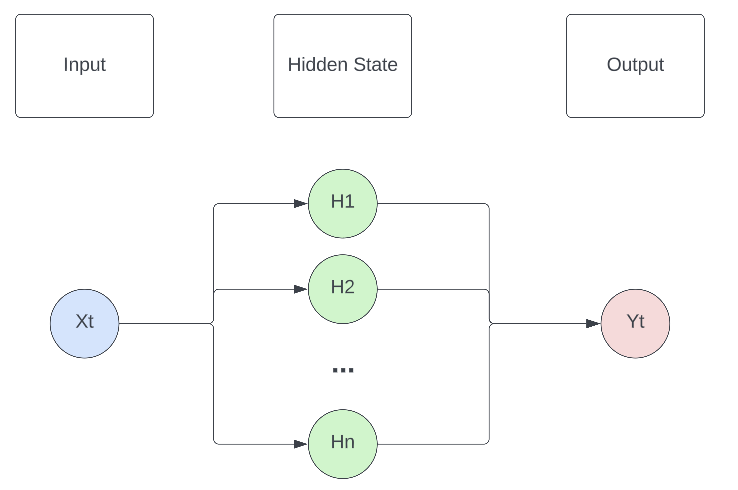
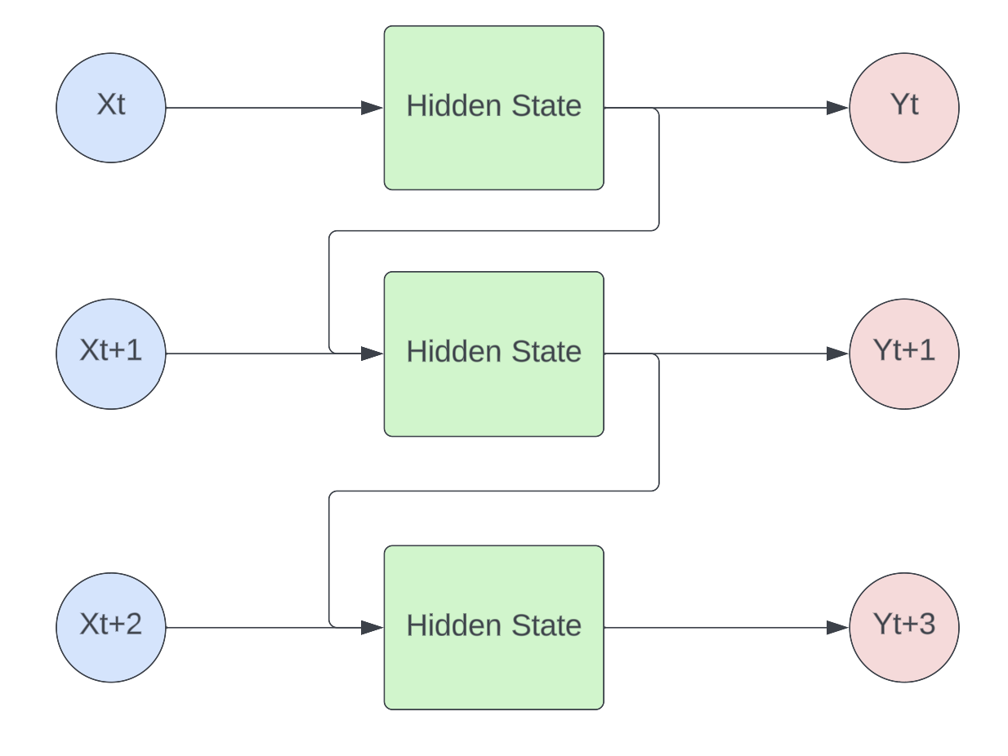
Recurrent Neural Network
Traditional Neural Network
Flowcharts made with Lucidchart

Slide 5
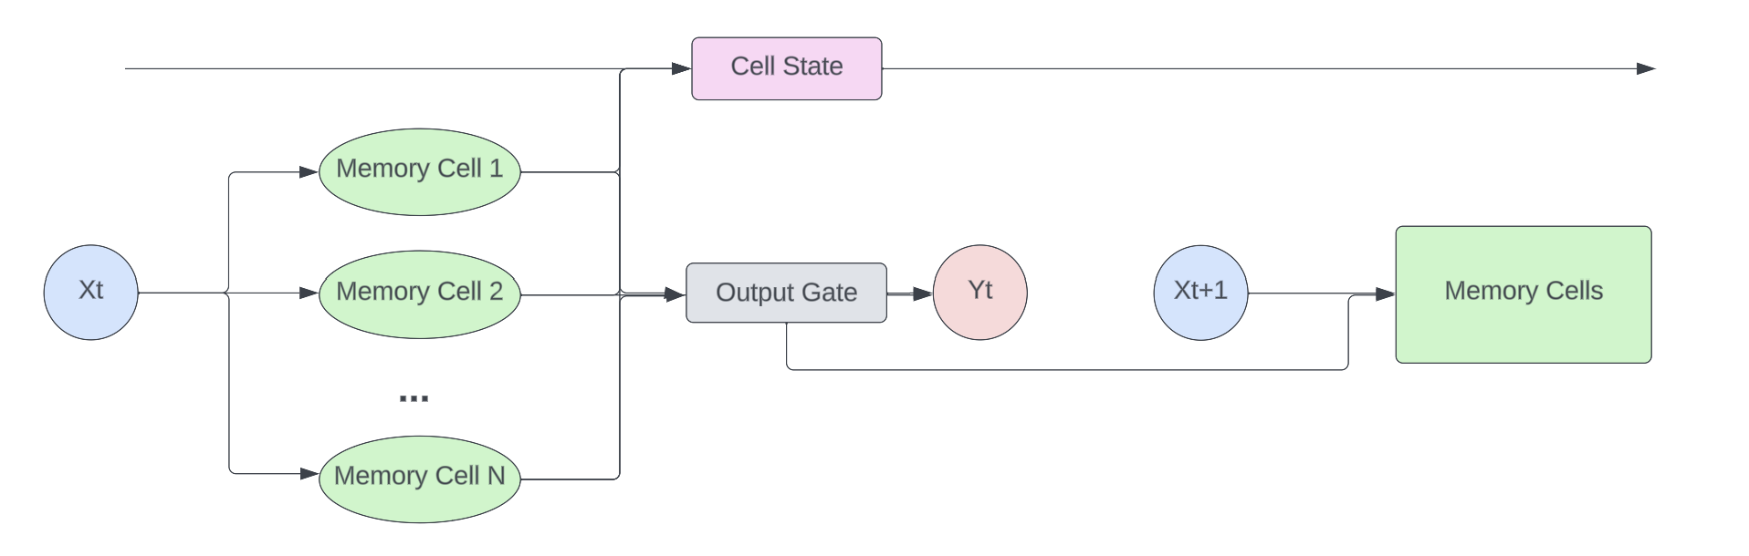
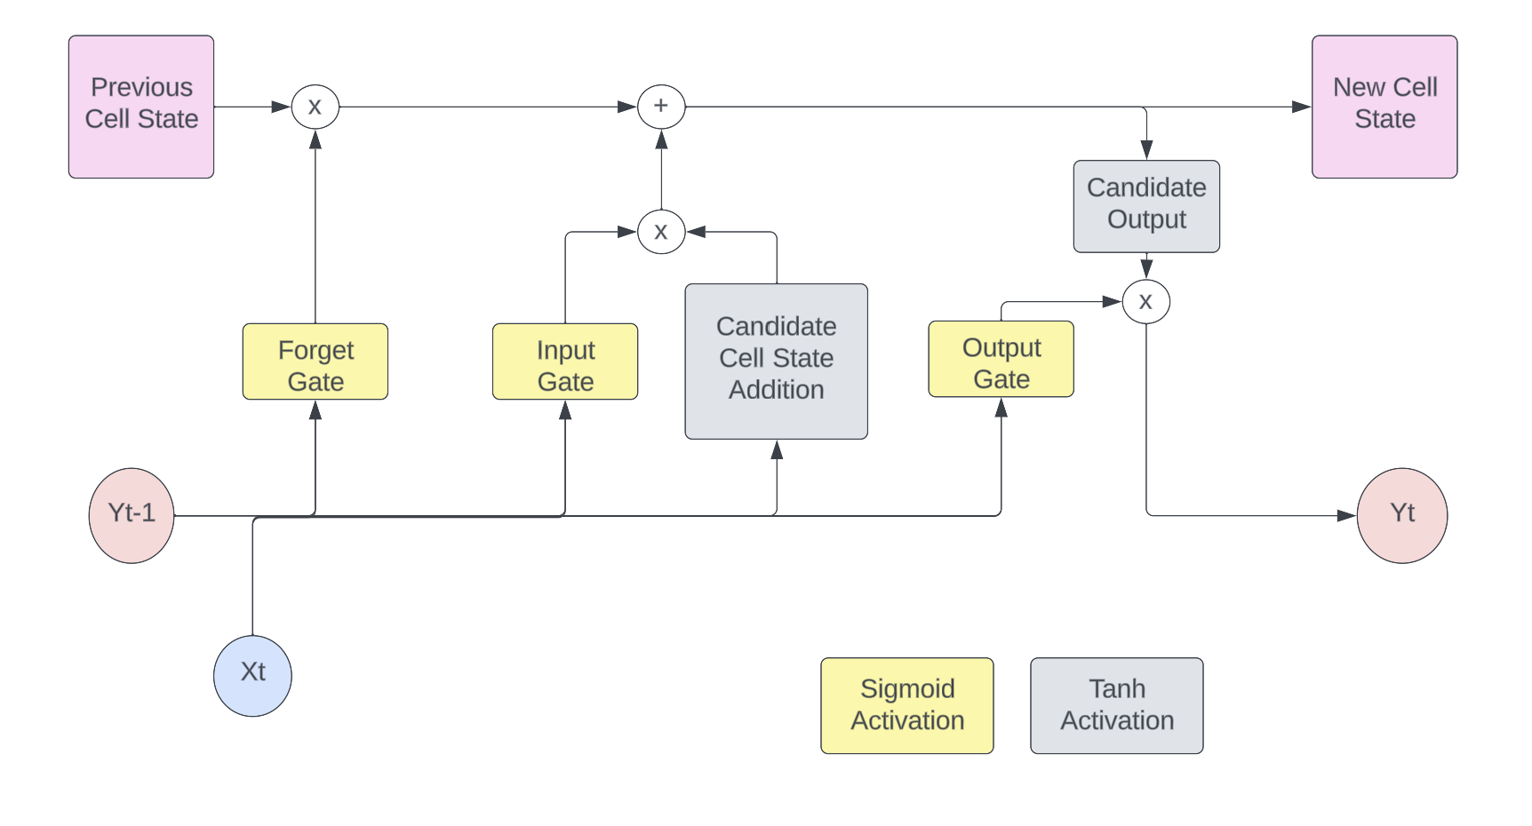
Long Short-Term Memory Networks
Flowchart made with Lucidchart

Slide 6
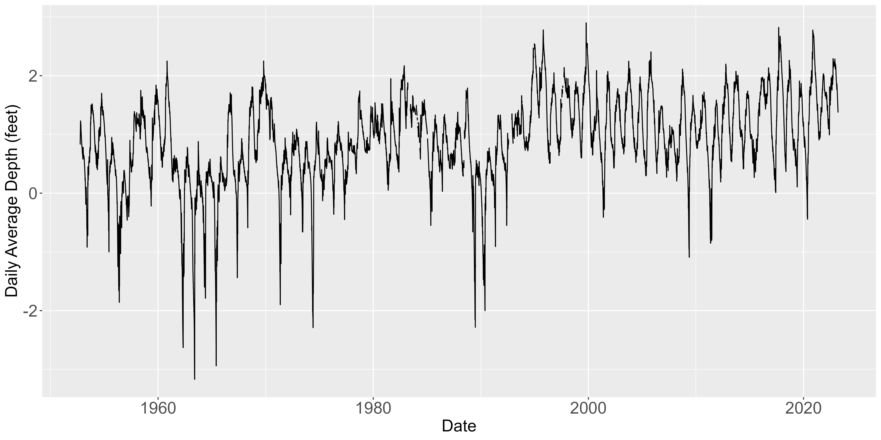
Data Available
Everglades National Park (EVER) telemetry stations monitor water depth
Range as far as 1952 – 2023
Various levels of missingness
Measurements are daily averages
Originally “Stage” (water elevation)
Converted to Depth based on station elevation

Slide 7
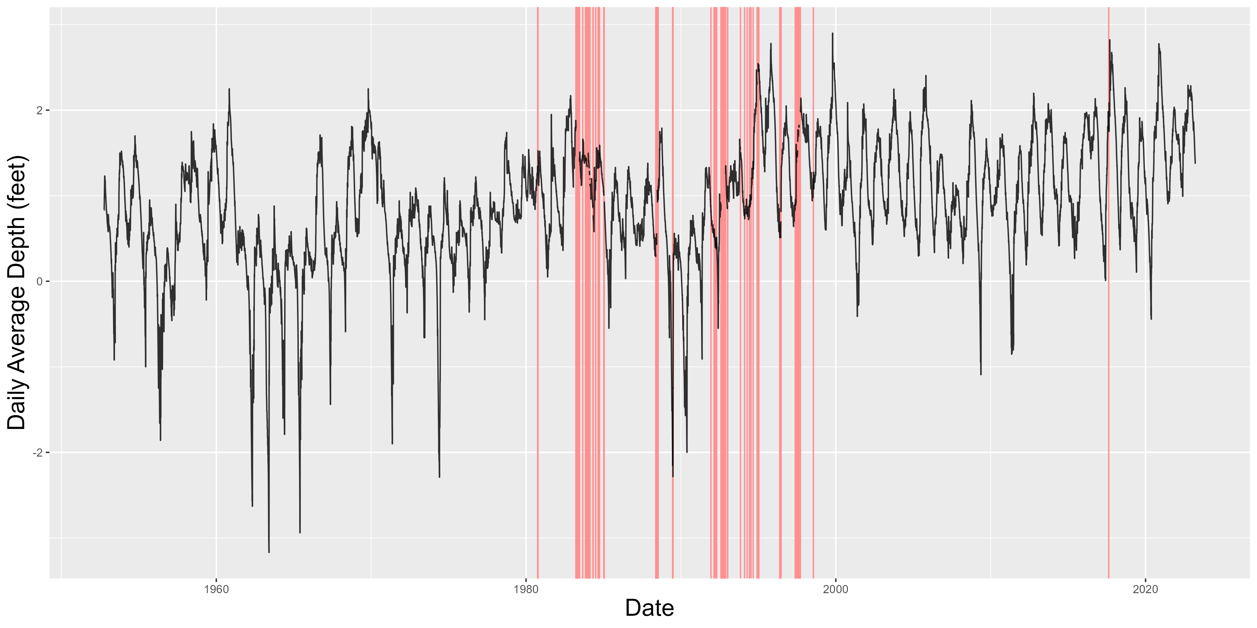
Issues Within the Data
Missingness when training NNs can lead to exploding gradients, so missing values must be imputed
A Kalman Filter was used to fill in those values

Slide 8
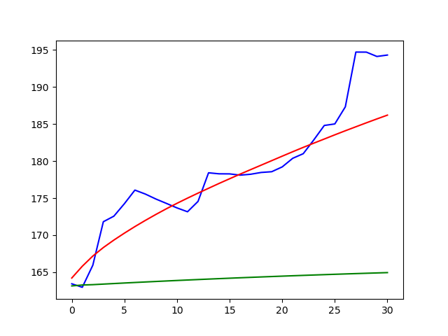
Results
LSTM and ARIMA trained on data since 1995
ARIMA: 1st order AR, 3rd order MA

Slide 9
Next Steps
Bayesian Optimization for hyperparameter tuning
Ideal architecture?
Compare to other methods
Holt-Winters
Exponential Smoothing
Obtain uncertainty intervals for LSTM predictions
Bootstrap from training sample
Bootstrap
Retrain Network
Obtain Predictions
Repeat

