Slide 1
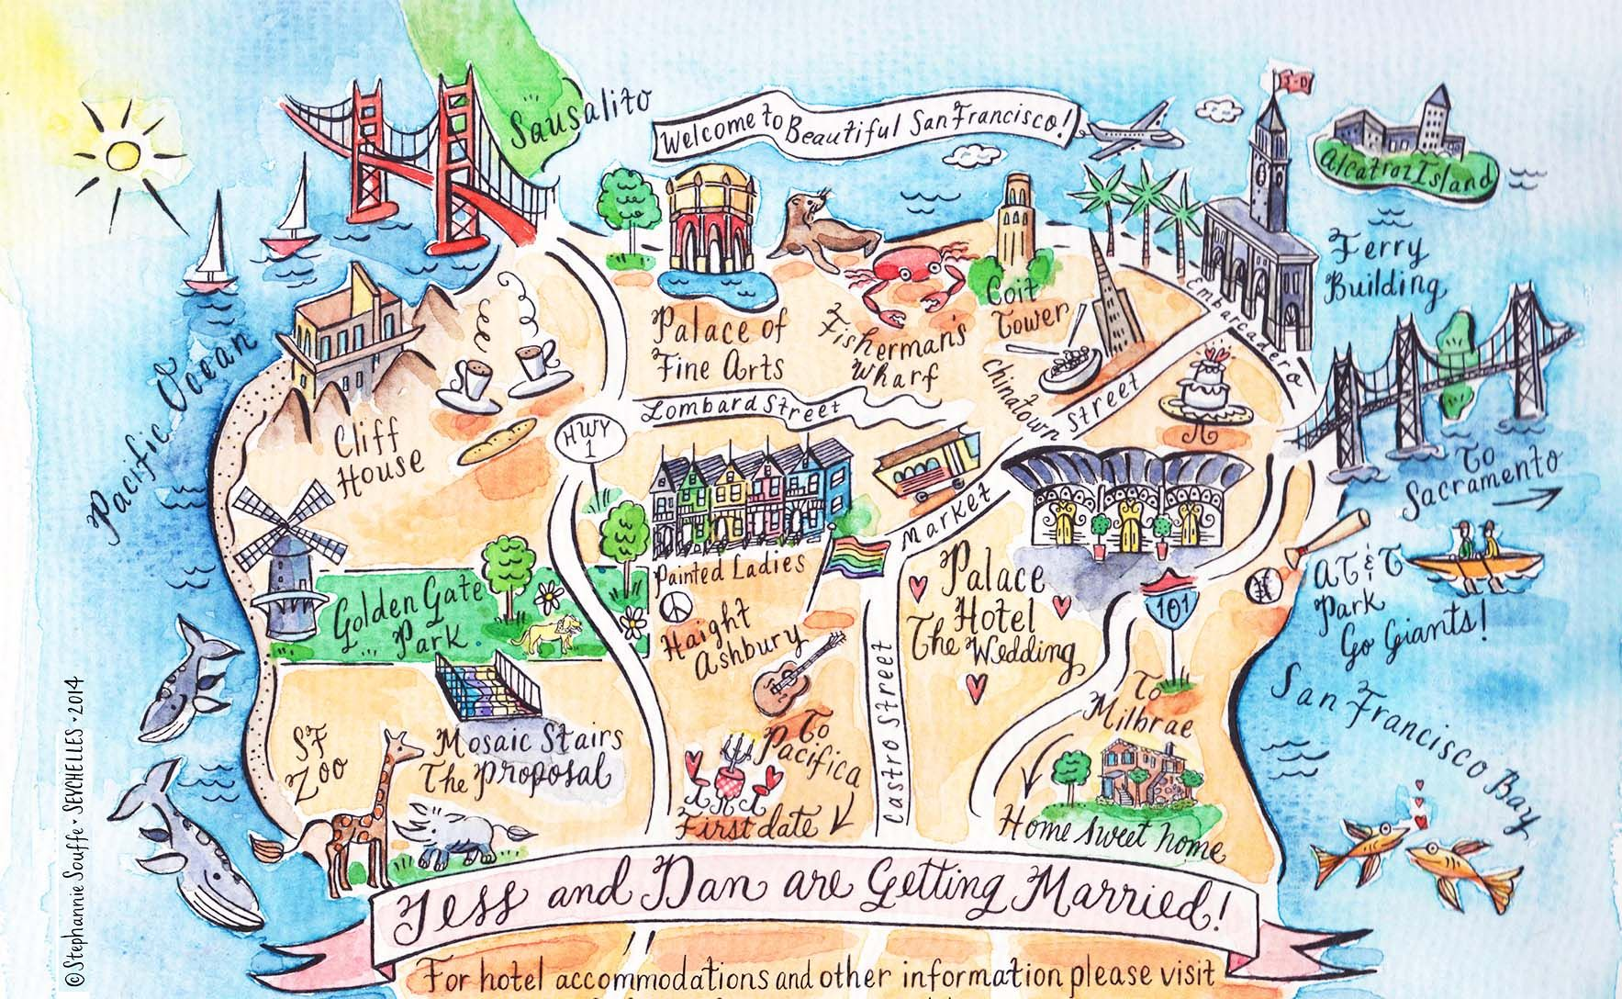
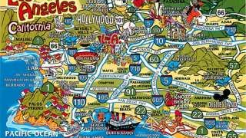
Lifestyle Between LA and San Francisco
Sofia Mbega, Lawson James, Jahangir Dewan & Sajad Yarzada

Slide 2
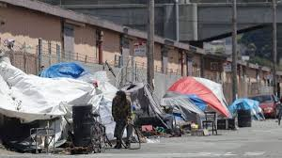
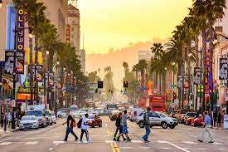

Overview and Purpose
Demonstrate the lifestyle of people in LA and the San Francisco
Housing-The median prices for homes, medium income, and diversity between these two cities.
Crime Rate: To visualize crime and crime hotspots in both cities.

Slide 3
Data Set
We also used Python 3 and Beautiful Soup to scrap the data from the following sites:
Housing: https://www.kaggle.com/camnugent/california-housing-prices
Diversity: https://data.diversitydatakids.org/dataset/19013_1_d-median-household-income--dollar--by-race-ethnicity/resource/2f4b0a56-6ddb-41a0-a980-151c00d7fc7b#dictionary_anchor
https://data.sfgov.org/resource/7a3q-s79u.json
https://data.lacity.org/Public-Safety/Crime-Data-from-2010-to-2019/63jg-8b9z

Slide 4
Challenges
Not being able to access and use various published APIs; Zillow, Trulia
Initially wanted to look on all of SF and LA but there was massive amount of data and we narrowed the data and selected data to a few zip codes
Learning curve
Too little time with the holidays in between.

Slide 5













Data Sets
Architecture
Databases
Data Analysis
Frontend

Slide 6

Use Case
Lifestyle between San Francisco and LA
San Francisco
Housing
Compare
Los Angeles
San Francisco
Crime
Los Angeles

Slide 7
Analysis and Data Visualizations

Slide 8
Life Style - Lawson

Slide 11
Crime Vision - Jahan

Slide 14
Conclusion and Future Works

