Slide 1
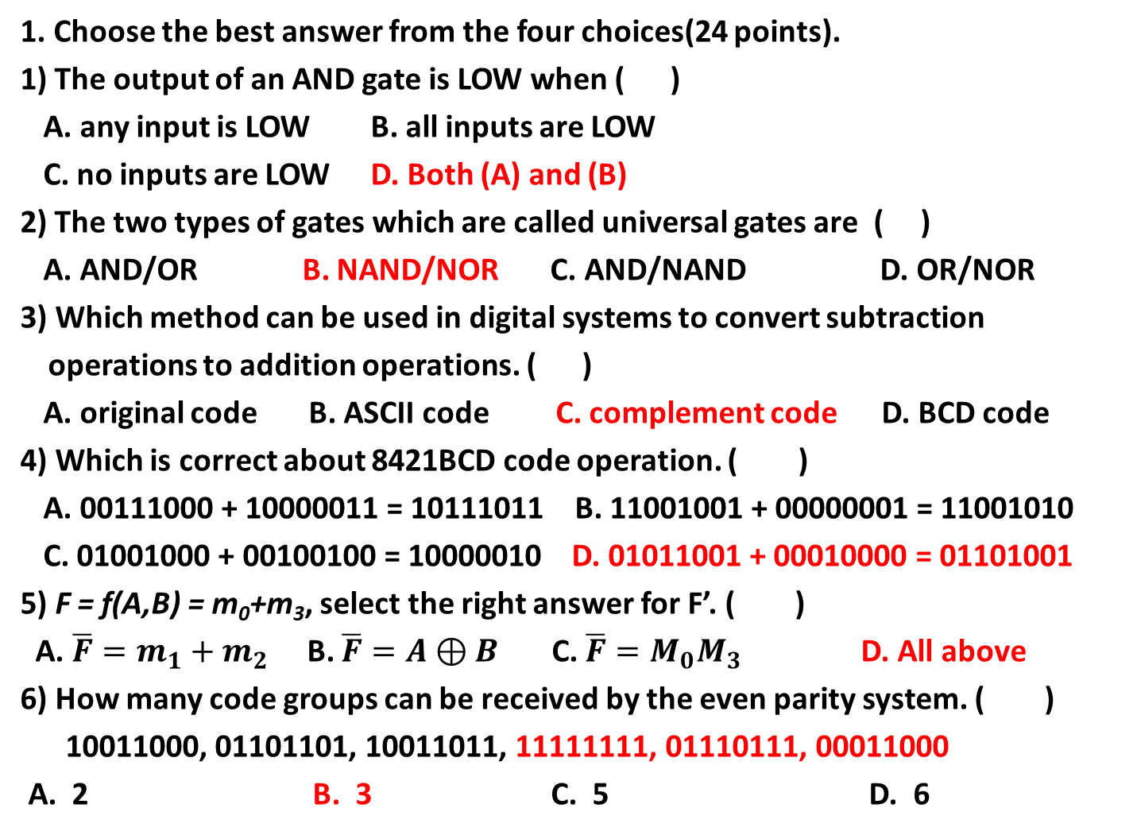
1. Choose the best answer from the four choices(24 points).
1) The output of an AND gate is LOW when ( )
A. any input is LOW B. all inputs are LOW
C. no inputs are LOW D. Both (A) and (B)
2) The two types of gates which are called universal gates are ( )
A. AND/OR B. NAND/NOR C. AND/NAND D. OR/NOR
3) Which method can be used in digital systems to convert subtraction operations to addition operations. ( )
A. original code B. ASCII code C. complement code D. BCD code
4) Which is correct about 8421BCD code operation. ( )
A. 00111000 + 10000011 = 10111011 B. 11001001 + 00000001 = 11001010
C. 01001000 + 00100100 = 10000010 D. 01011001 + 00010000 = 01101001
5) F = f(A,B) = m₀+m₃, select the right answer for F’. ( )
A. $\overline{F}=m_{1}+m_{2}$ B. $\overline{F}=A⊕B$ C. $\overline{F}=M_{0}M_{3}$ D. All above
6) How many code groups can be received by the even parity system. ( )
10011000, 01101101, 10011011, 11111111, 01110111, 00011000
A. 2 B. 3 C. 5 D. 6

Slide 2
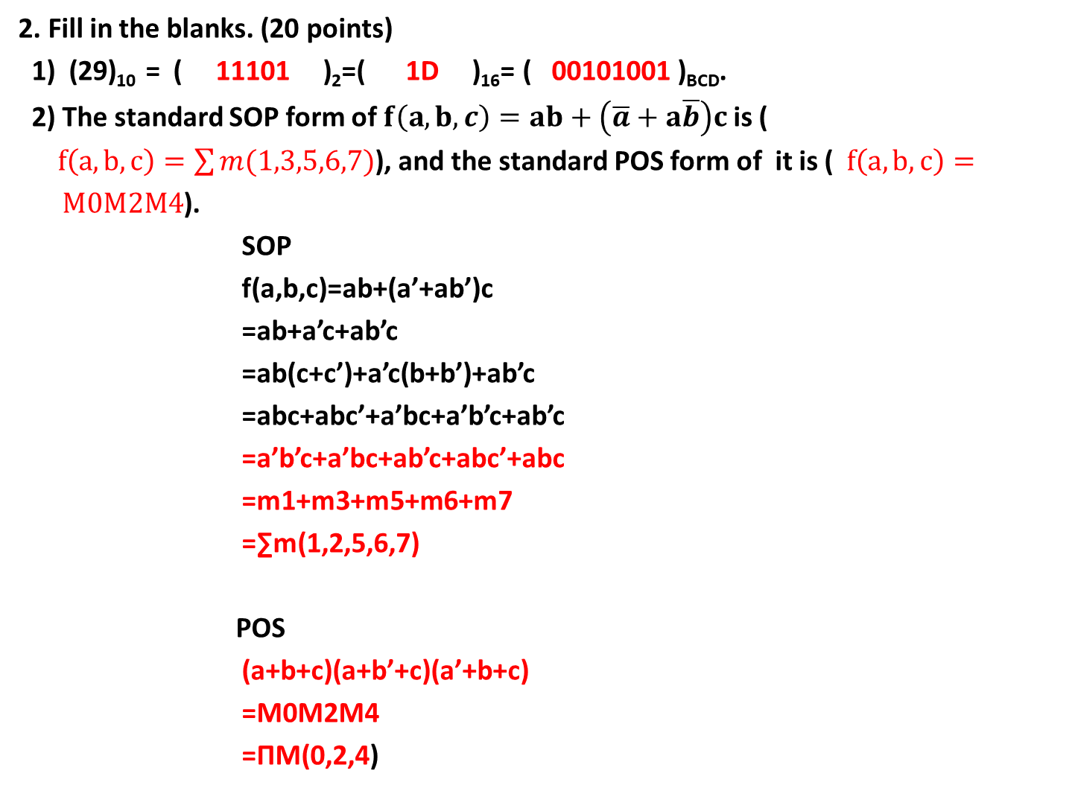
2. Fill in the blanks. (20 points)
1) (29)₁₀ = ( 11101 )₂=( 1D )₁₆= ( 00101001 )_{BCD}.
2) The standard SOP form of $f\left(a,b,c\right)=ab+\left(\overline{a}+a\overline{b}\right)c$ is (
$f\left(a,b,c\right)=\sum{m(1,3,5,6,7)}$), and the standard POS form of it is ($f\left(a,b,c\right)=M0M2M4$).
SOP
f(a,b,c)=ab+(a’+ab’)c
=ab+a’c+ab’c
=ab(c+c’)+a’c(b+b’)+ab’c
=abc+abc’+a’bc+a’b’c+ab’c
=a’b’c+a’bc+ab’c+abc’+abc
=m1+m3+m5+m6+m7
=∑m(1,2,5,6,7)
POS
(a+b+c)(a+b’+c)(a’+b+c)
=M0M2M4
=ΠM(0,2,4)

Slide 3
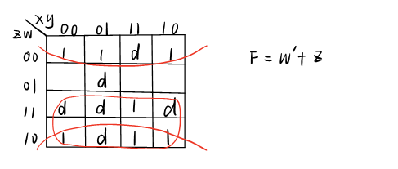
3. Simplify the following expression using karnaugh maps .(12points)
F= f(x, y , z, w) = ∑m(0, 2, 4, 8, 10, 14,15) + ∑d(3, 5, 6, 7, 11, 12)

Slide 4
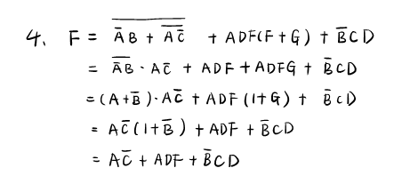

4. Simplify the following expression.(8points)
$$F=\overline{\overline{A}B+\overline{A\overline{C}} }+ADF\left(F+G\right)+\overline{B}CD$$

Slide 5
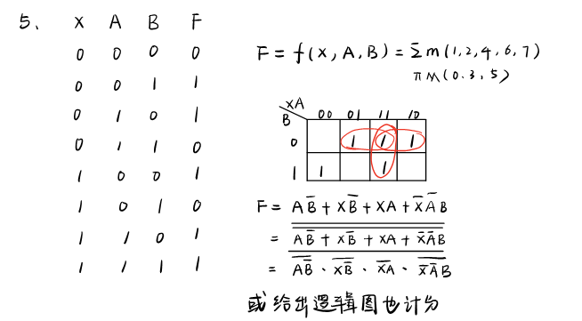
5. Design a logic circuit with a control switch X. When X is 0, the circuit can be used to implement F=A⊕B, when X is 1, the circuit can be used to implement F= A+B’. (a) construct the truth table; (b)write the logic expression and simplify it; (c)rewrite the logic expression with NOT and NAND only. (16points)

Slide 6
6. Develop a logic circuit for detecting whether a 8421BCD is more than 5. If it is, the output should be truth .
(a) construct the truth table;
(b) write the logic expression and simplify it;
(c) draw the logic circuit. (20points)

Slide 7
