Slide 1
project

Slide 2
Overview
Website name: Health Wizard
What is it: Provide health products and apps
Technology used: HTML5, CSS3, Javascript6

Slide 3

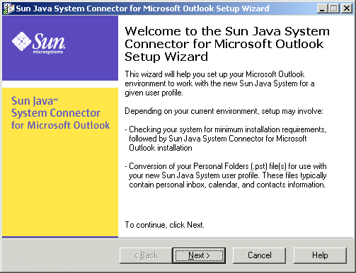
Brand name

Slide 4
Design

Slide 5
Why not bootstrap / Tailwind

Slide 6
All about responsive

Slide 7
Nav bar

Slide 8
Website function: apps

Slide 9
Website function: shpopping / product

Slide 10
Website function: contact list

Slide 11
UML

