Slide 1
project

Slide 2
Overview
Website name: Health Wizard
What is it: Provide health products and apps
Technology used: HTML5, CSS3, JavaScript

Slide 3

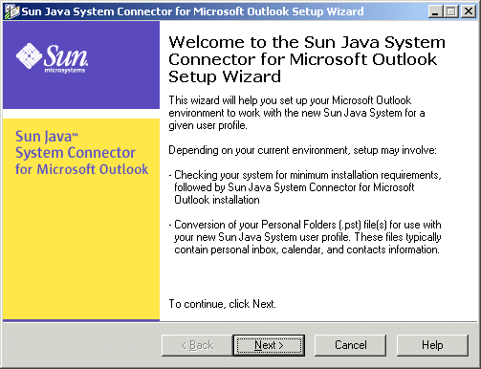
Brand name

Slide 4
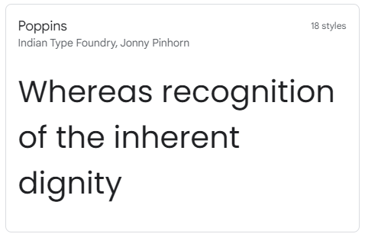
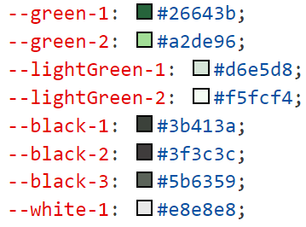

Design
:root

Slide 5
Home page animation
AOS library is being used

Slide 6
Why not bootstrap
Customizable
Pre-built components not good looking
Pre-built components not satisfy our need

Slide 7
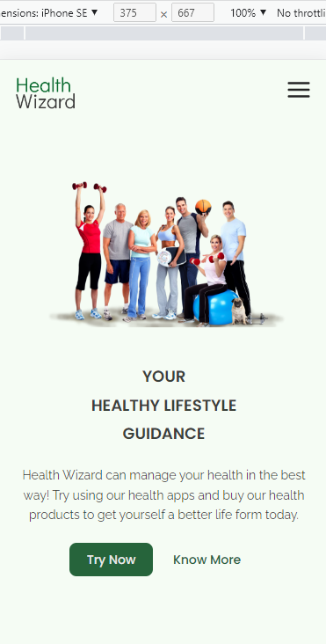
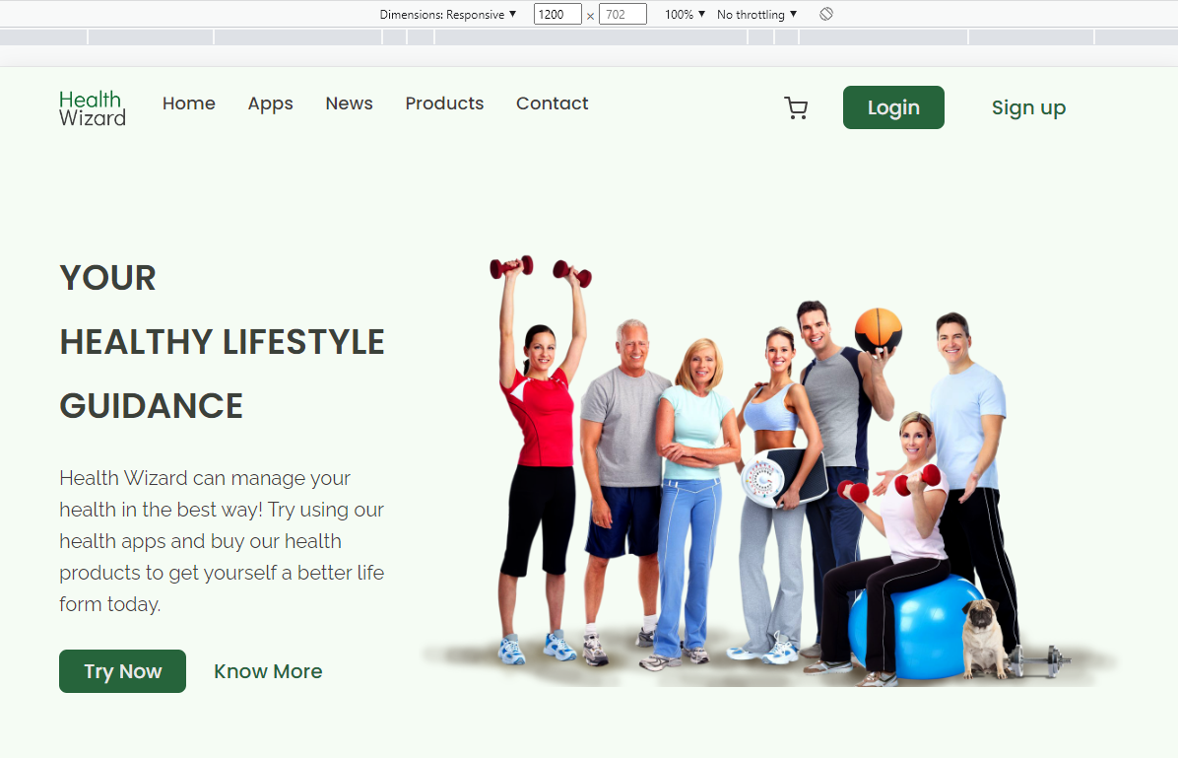
All about responsive

Slide 8
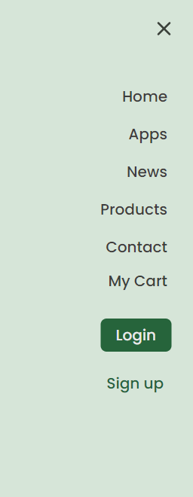
Nav bar

Slide 9
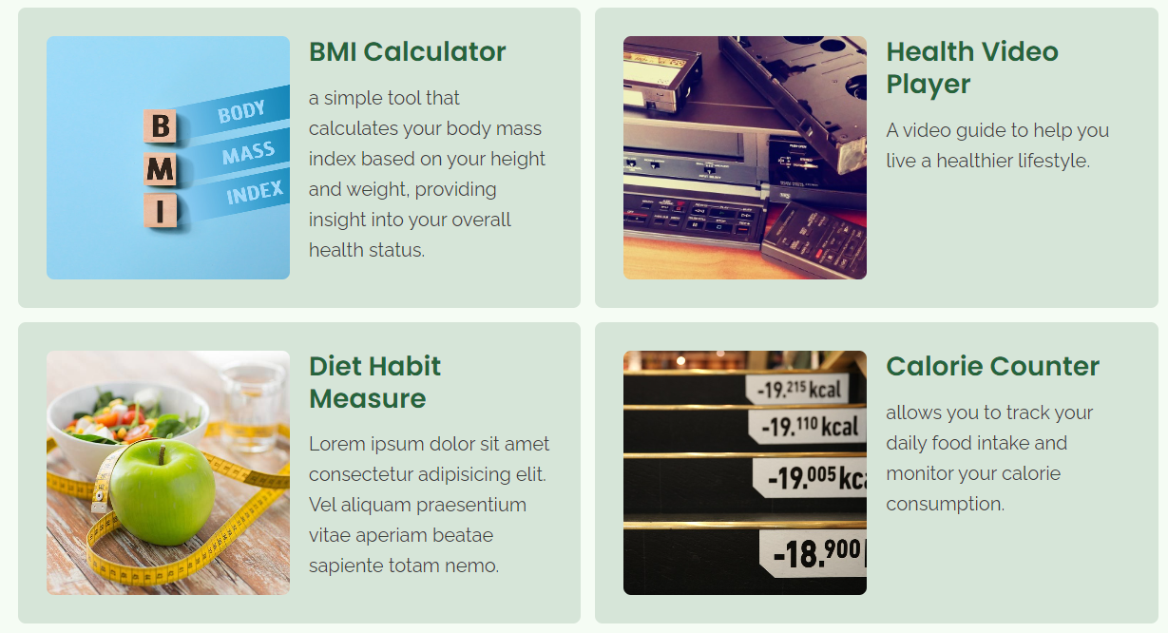
Website function: apps

Slide 10
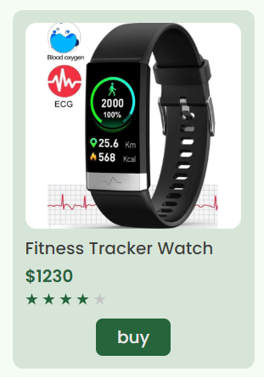
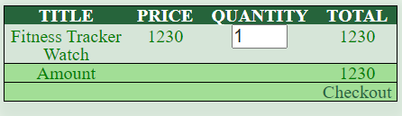
Website function: shpopping / product

Slide 11
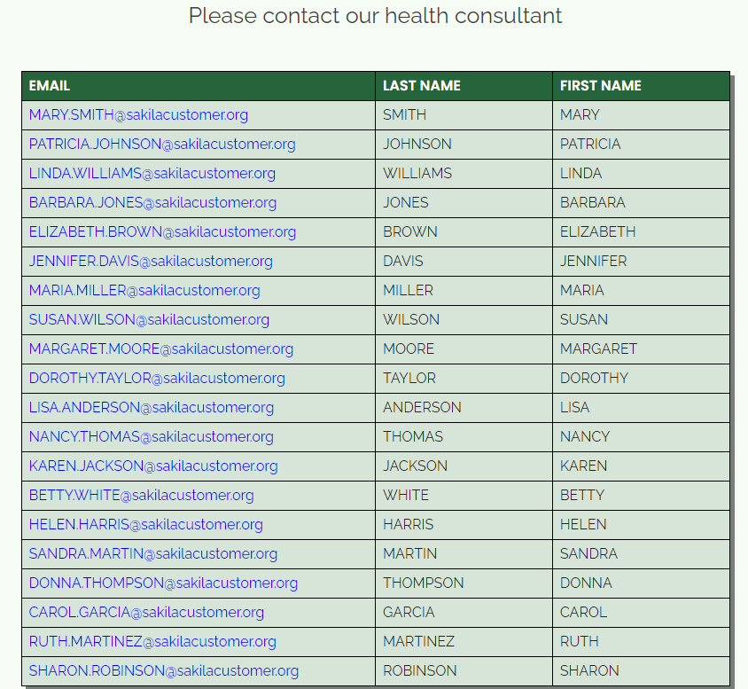
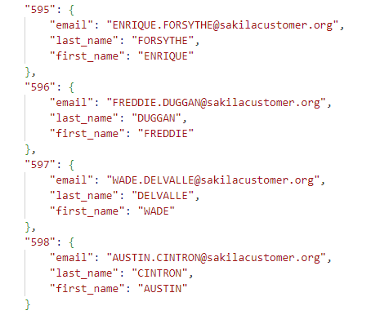
Website function: contact list

Slide 12
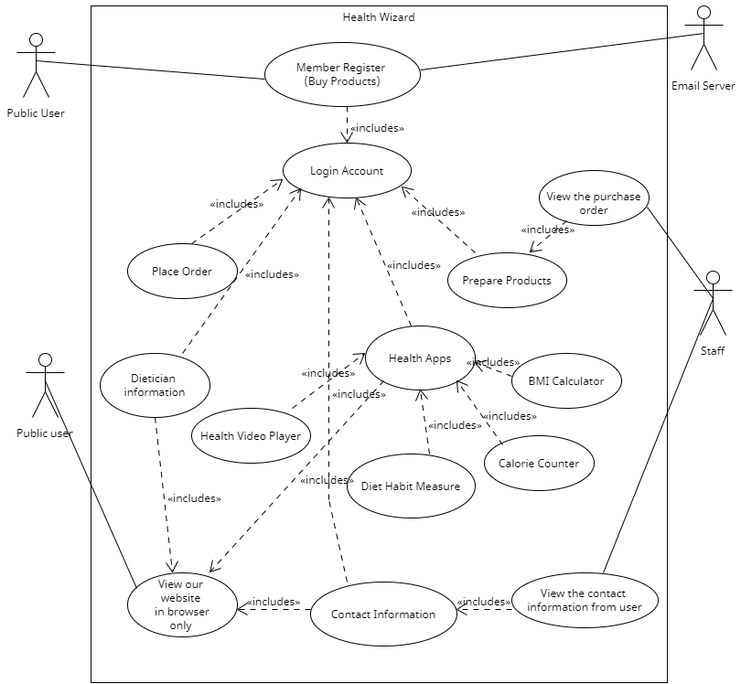
UML

