Slide 1

Project
Health Wizard
Lionel Chun (4)
Chan Chi Ho (8)
Mak Yiu Hong (13)
Chan Ka Yin (22)

Slide 2
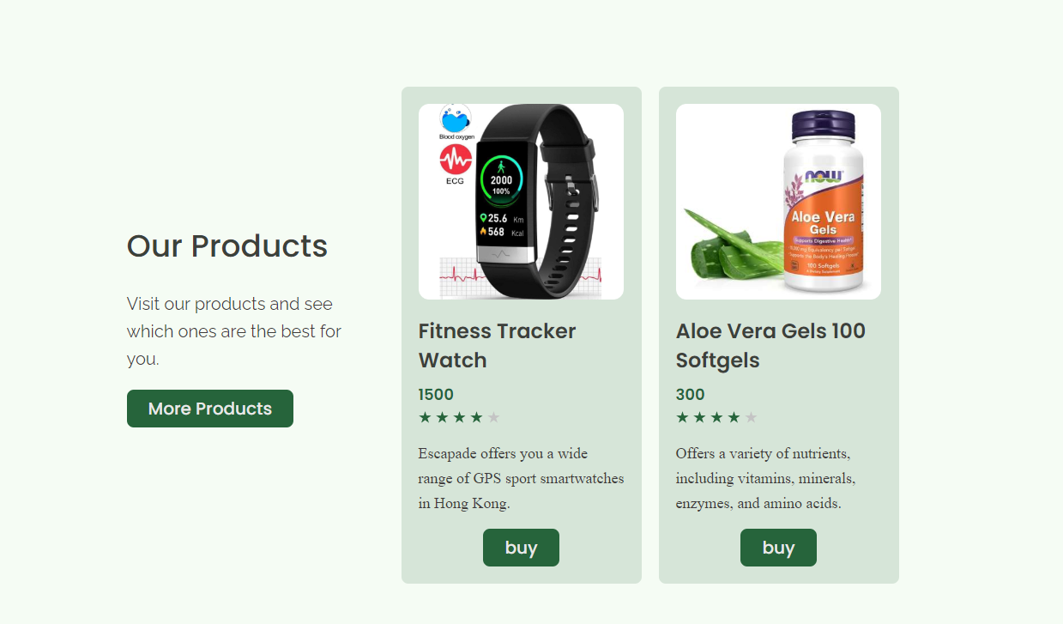
Overview
Website name: Health Wizard
What is it: Provide health products and apps
Technology used: HTML5, CSS3, JavaScript

Slide 3
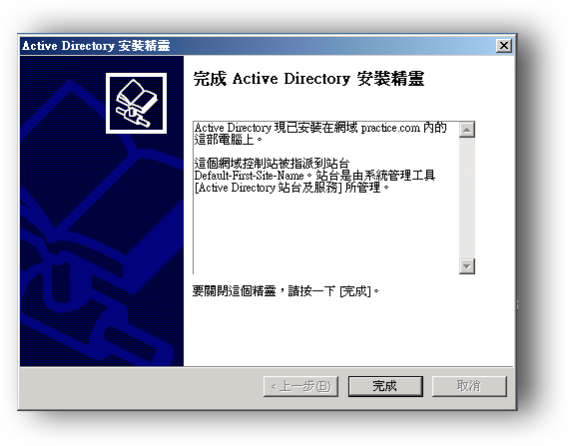
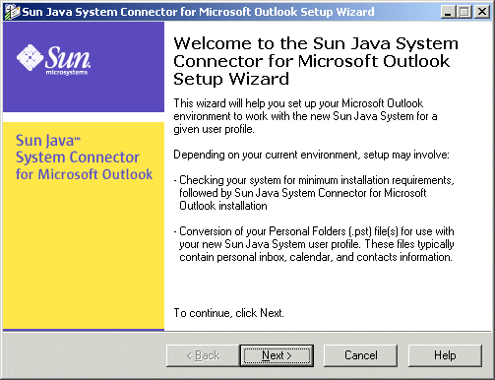
Brand name

Slide 4
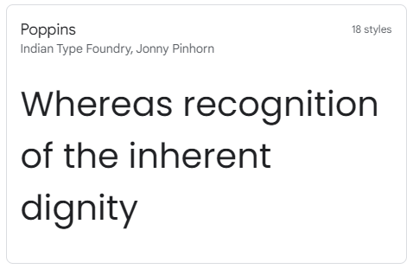
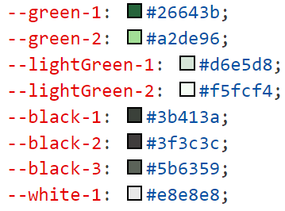
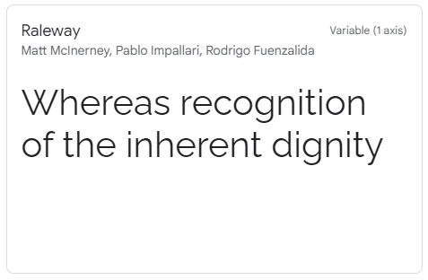
Design
:root

Slide 5

Logo
Logo match with our font-colors in website
“Health” --green-1
“Wizard” --black-1
Make whole website color more consistency

Slide 6
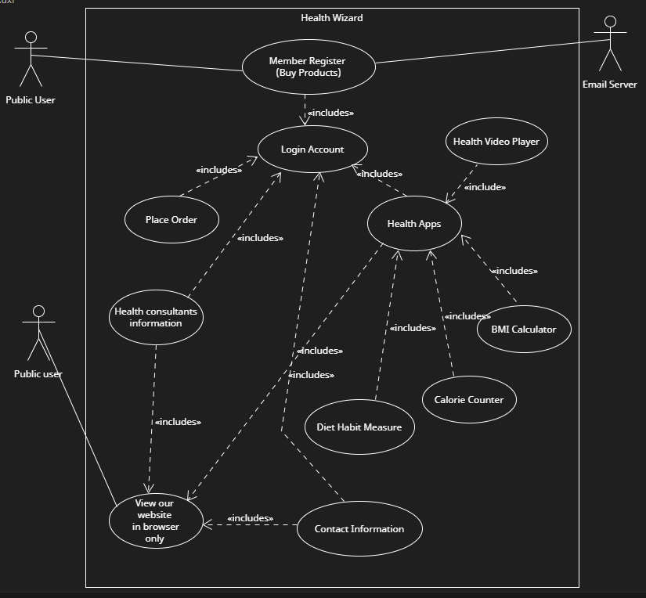
UML

Slide 7

Home page animation
AOS library is being used
Scroll down and animation appear

Slide 8
Why not bootstrap
Customizable
Pre-built components not good looking
Pre-built components not satisfy our need

Slide 9
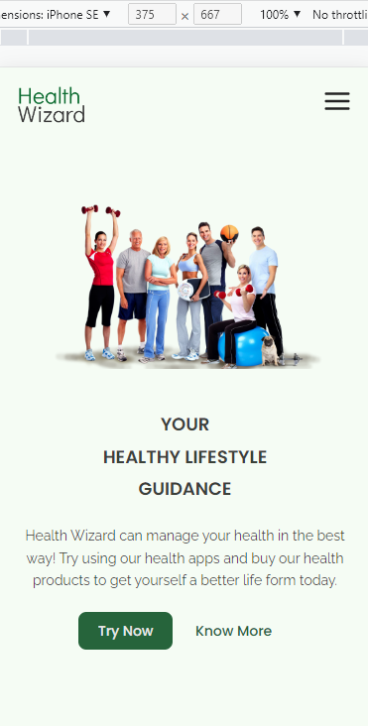
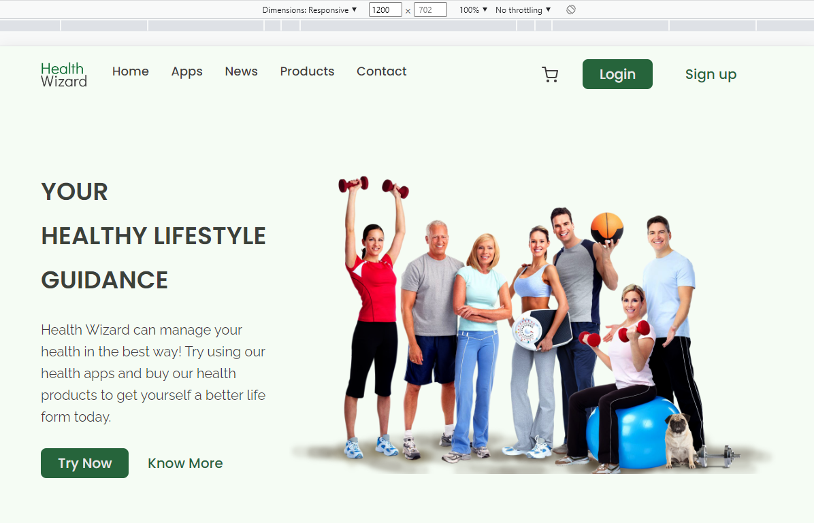
All about responsive

Slide 10
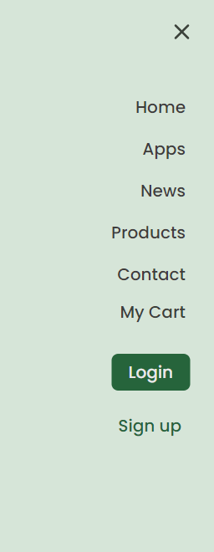
Nav bar

Slide 11
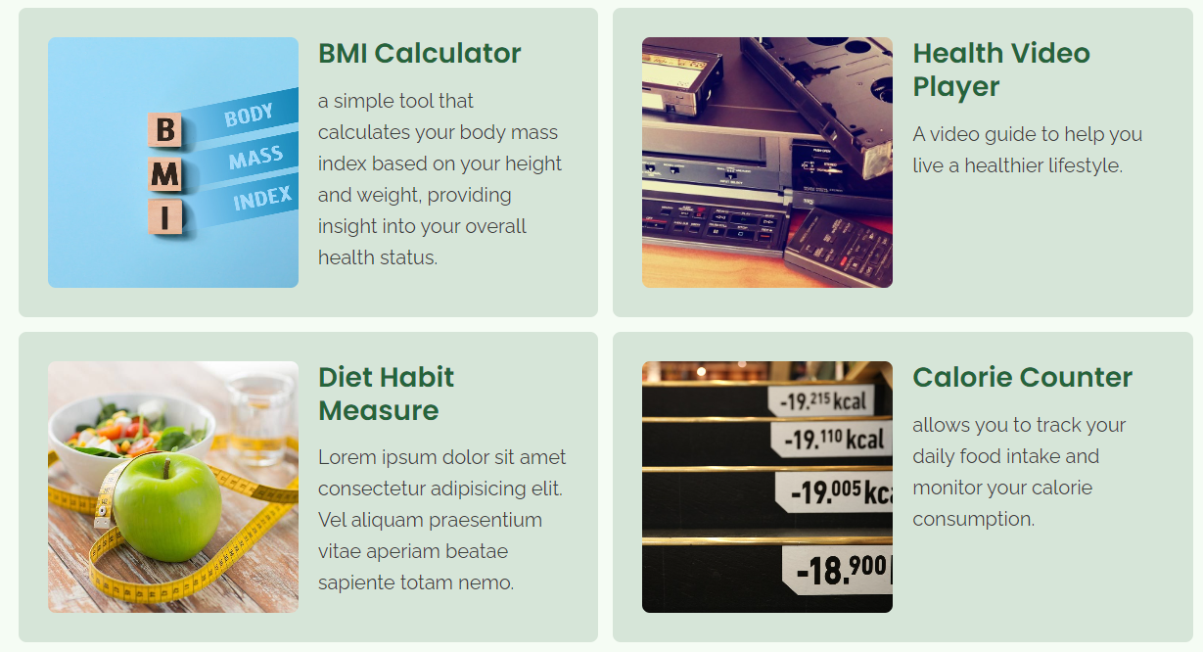
Website function: Apps

Slide 12
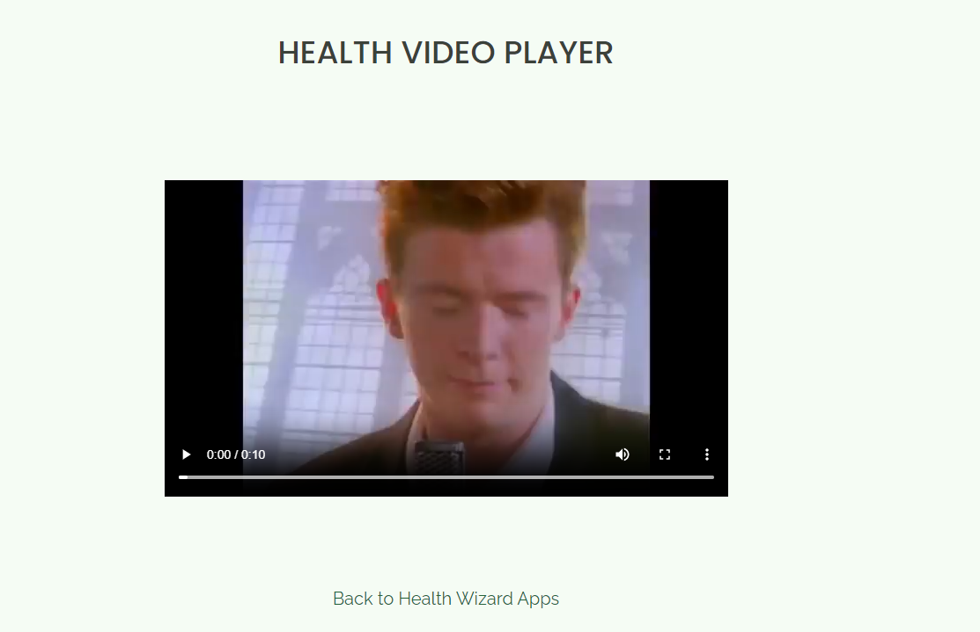
Health Video Player

Slide 13
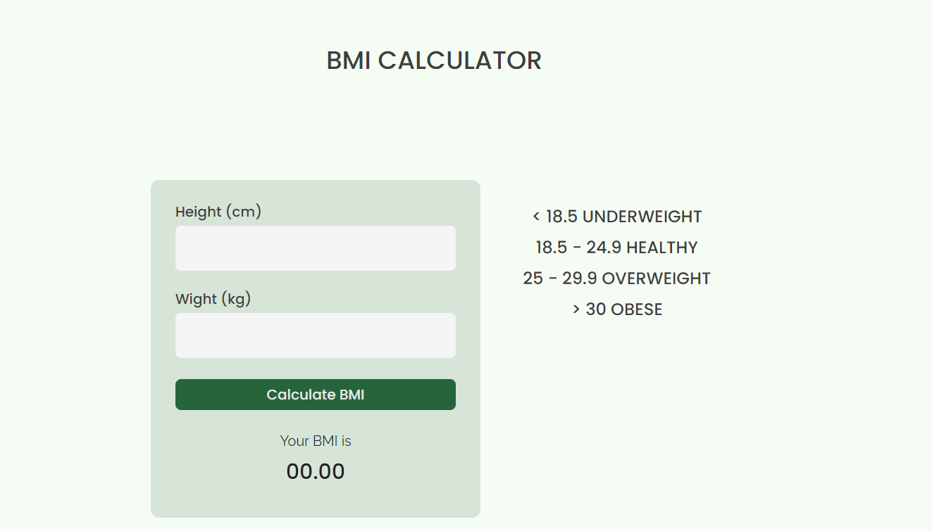
BMI Calculator

Slide 14
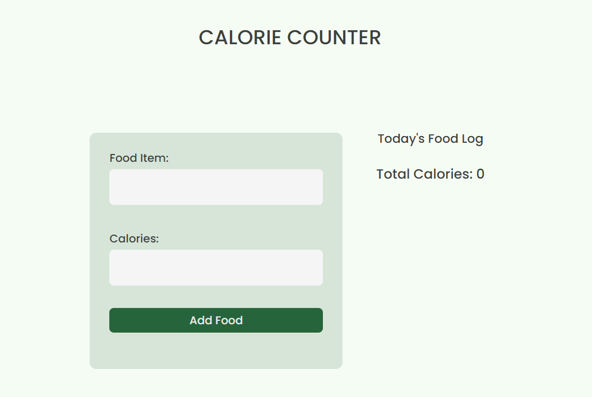
Calorie Counter

Slide 15
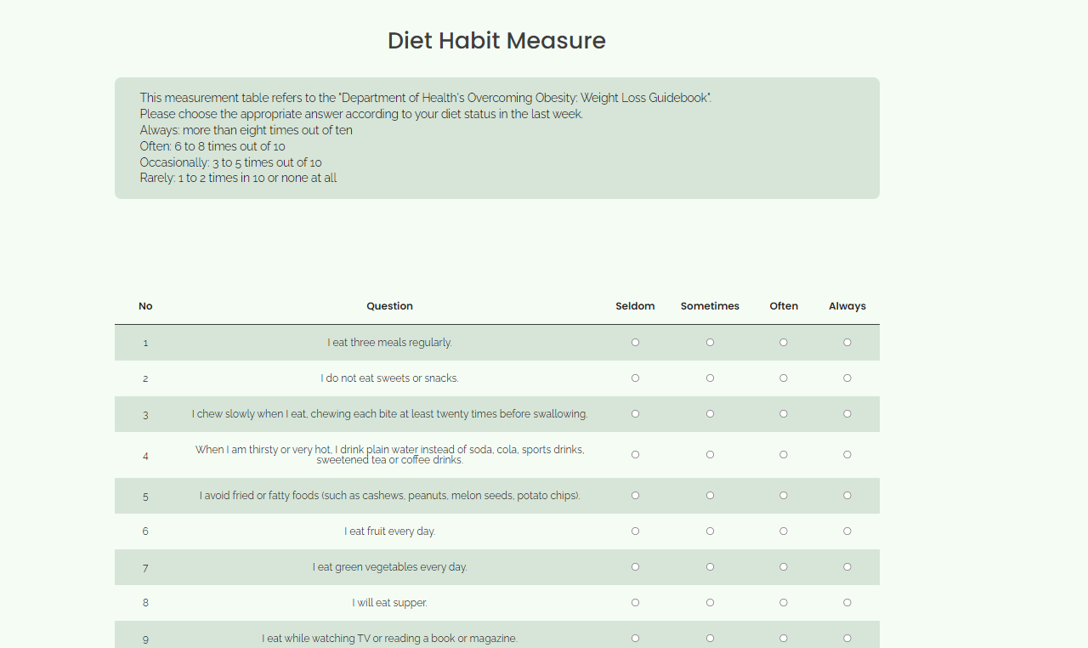
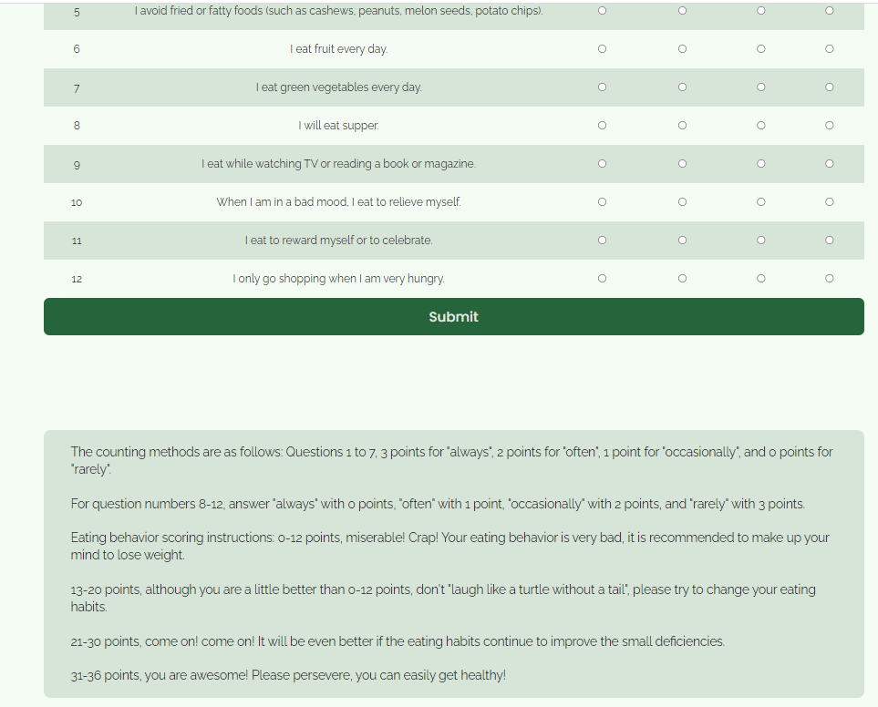
Diet Habit Measure

Slide 16
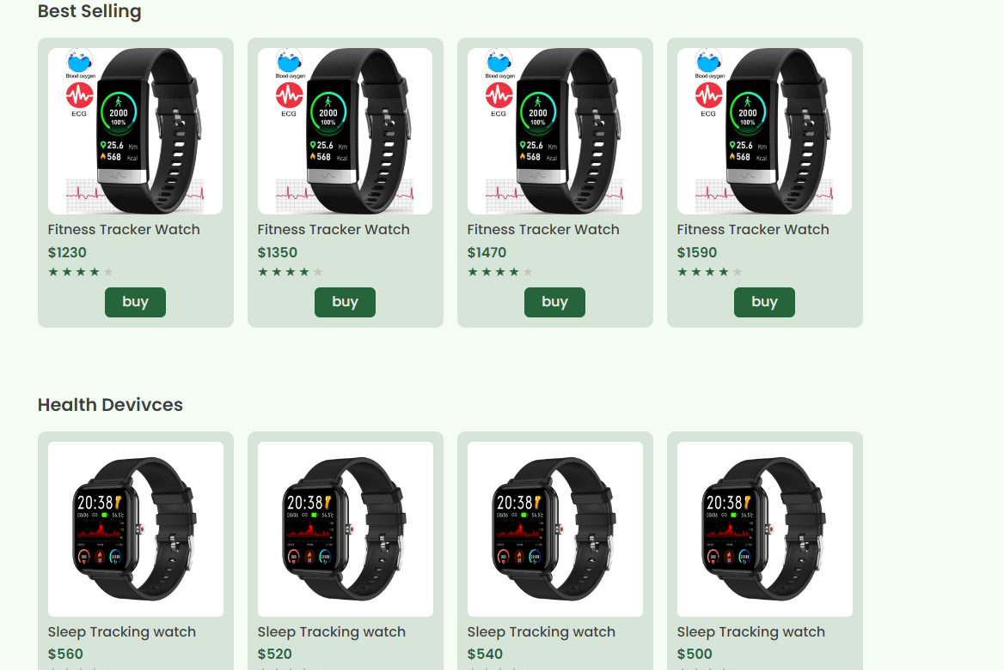
Product Pages

Slide 17
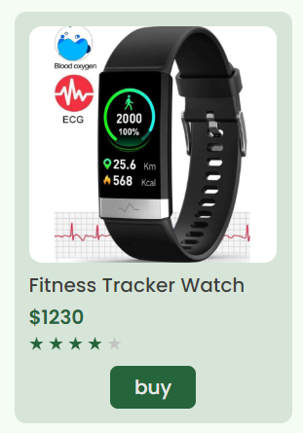
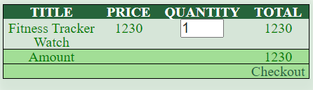
Website function: Shopping / products

Slide 18
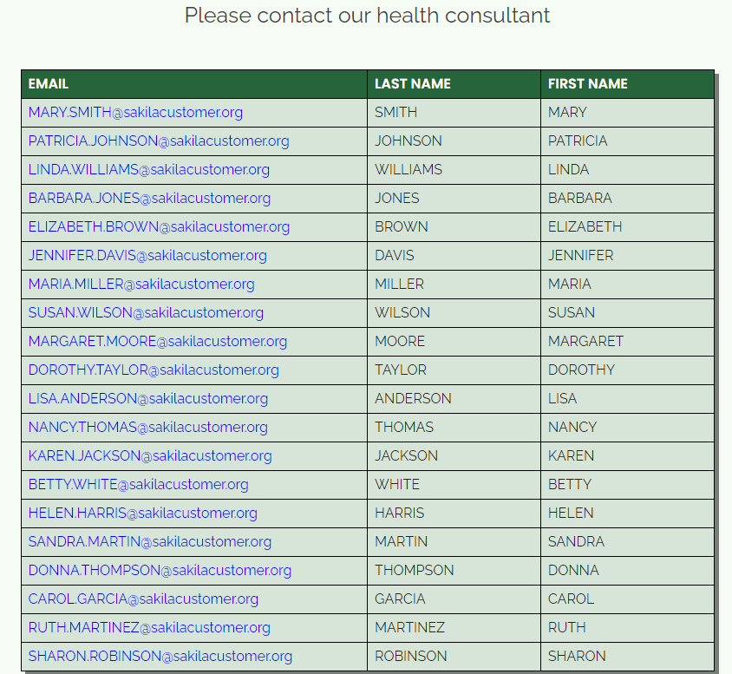
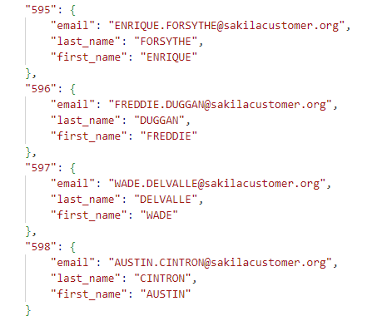
Website function: contact list

