Slide 1
Project 6
James xie

Slide 2
IMDB
Top25 movies
Scraped 30 reviews for each movie
5 comparatively frequent words chosen from 25 movie reviews: Best,Good,Great,Greatest,Perfect
X : the frequency of the above words on each movie
Y: Rate

Slide 3
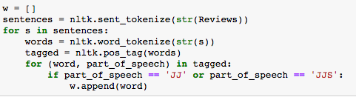
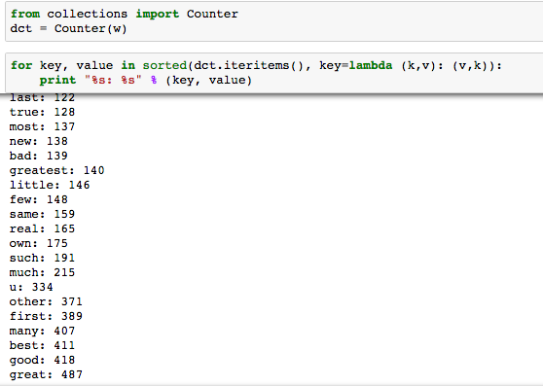
Why this 5 words?

Slide 4
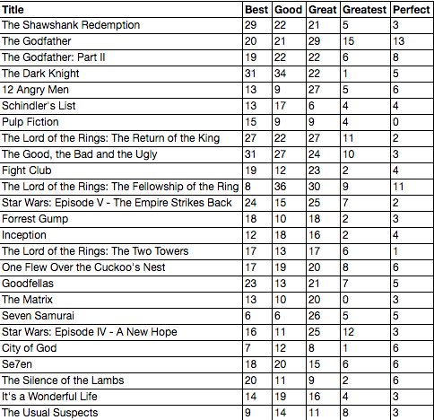

Slide 5
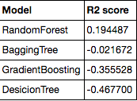
Coeff. Determination

Slide 6
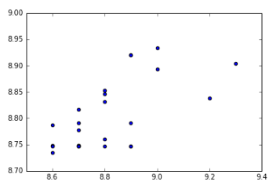
Random Forest
X represents actual rates. Y represents predicted rates

