Slide 1
Chapter 9
公钥密码学与RSA

Slide 2
§9.1 公钥密码体制的基本原理
传统密码体制只使用一个密钥
收发双方共享这个单一的密钥
密钥是对称的，双方是对等的；
因此，不能确保接收方伪造信息，并声称是该信息是发送方发送的
西安电子科技大学计算机学院

Slide 3
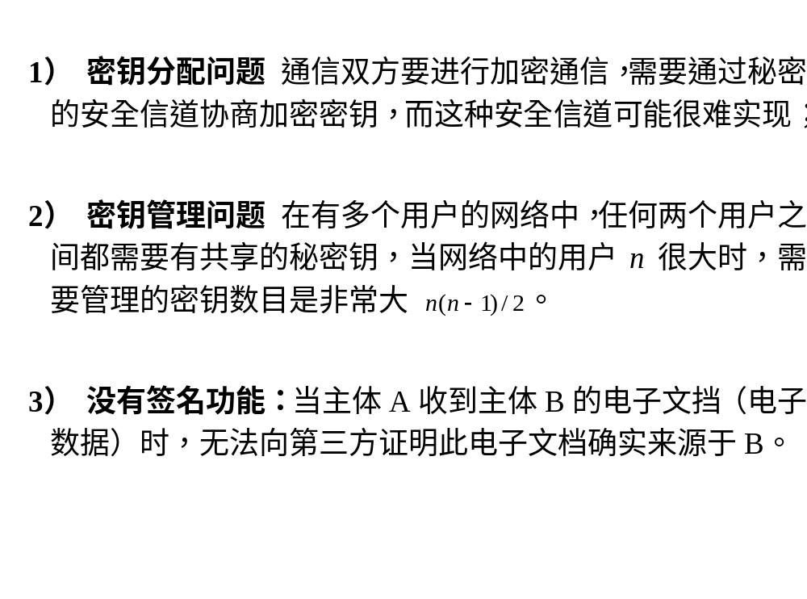
对称密码体制的缺陷
西安电子科技大学计算机学院

Slide 4
公钥密码体制
密码学发展历史中最伟大的一次革命
采用两个密钥：一个公钥，一个私钥
参与方不对等，所以是非对称的；
基于数论中的结论
是私钥密码的补充而不是代替
西安电子科技大学计算机学院
Notes:
Will now discuss the radically different public key systems, in which two keys are used. The development of public-key cryptography is the greatest and perhaps the only true revolution in the entire history of cryptography. It is asymmetric, involving the use of two separate keys, in contrast to symmetric encryption,which uses only one key. Anyone knowing the public key can encrypt messages or verify signatures, but cannot decrypt messages or create signatures, counter-intuitive though this may seem. It works by the clever use of number theory problems that are easy one way but hard the other. Note that public key schemes are neither more nor less secure than private key (security depends on the key size for both), nor do they replace private key schemes (they are too slow to do so), rather they complement them. Both also have issues with key distribution, requiring the use of some suitable protocol.

Slide 5
为什么需要公钥密码?
两个考虑：
  密钥分配 - KDC
  数字签名
公认该发明属于Stanford Uni 的Whitfield Diffie 和 Martin Hellman ，于1976年。
"New Directions in Cryptography", IEEE Trans. Information Theory, IT-22, pp644-654, Nov 1976
James Ellis (UK CESG) 在1970年曾提出此概念
西安电子科技大学计算机学院
Notes:
The concept of public-key cryptography evolved from an attempt to attack two of the most difficult problems associated with symmetric encryption: key distribution and digital signatures. The idea of public key schemes, and the first practical scheme, which was for key distribution only, was published in 1977 by Diffie & Hellman. The concept had been previously described in a classified report in 1970 by James Ellis (UK CESG) - and subsequently declassified [ELLI99]. Its interesting to note that they discovered RSA first, then Diffie-Hellman, opposite to the order of public discovery! There is also a claim that the NSA knew of the concept in the mid-60’s [SIMM93].

Slide 6
公钥密码体制
公钥/双钥/非对称 密码都是指使用两个密钥:
  公钥：可以对任何人公开的密钥，用于加密消息或验证签名。
  私钥：只能由接收者私存，用于解密消息或签名。
非对称
  用于加密消息或验证签名的人不能进行消息的解密或消息的签名。
西安电子科技大学计算机学院
Notes:
Emphasize here the radical difference with Public-Key Cryptography is the use of two related keys but with very different roles and abilities. Anyone knowing the public key can encrypt messages or verify signatures, but cannot decrypt messages or create signatures, all thanks to some clever use of number theory.

Slide 7
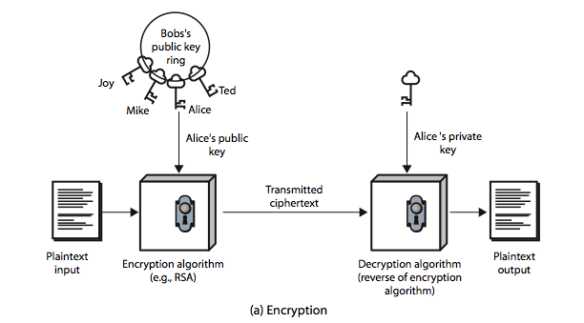
公钥密码体制
西安电子科技大学计算机学院
Notes:
Stallings Figure 9.1a “Public-Key Cryptography”, shows that a public-key encryption scheme has six ingredients: plaintext, encryption algorithm, public & private keys, ciphertext & decryption algorithm.
Consider the following analogy using padlocked boxes: traditional schemes involve the sender putting a message in a box and locking it, sending that to the receiver, and somehow securely also sending them the key to unlock the box. The radical advance in public key schemes was to turn this around, the receiver sends an unlocked box (their public key) to the sender, who puts the message in the box and locks it (easy - and having locked it cannot get at the message), and sends the locked box to the receiver who can unlock it (also easy), having the (private) key. An attacker would have to pick the lock on the box (hard).

Slide 8
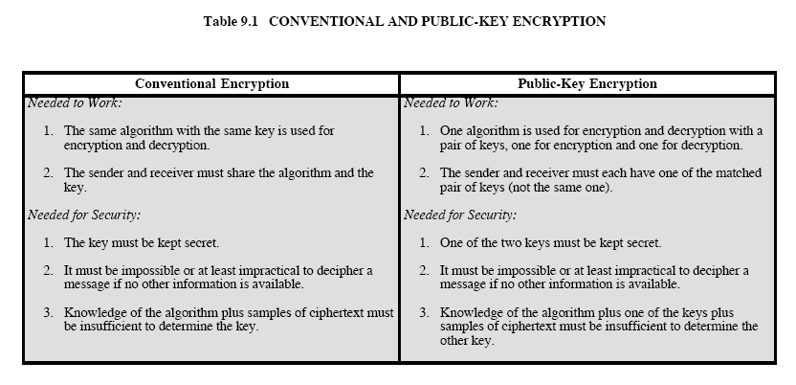
西安电子科技大学计算机学院

Slide 9
公钥密码体制特点
公钥密码算法依赖于:
  仅仅知道算法和加密密钥，推导解密密钥计算上是不可行的
  已知加解密密钥时，进行加解密运算计算上是容易的
  两个密钥中的任何一个都可以用来加密，而另一个用来解密。
西安电子科技大学计算机学院
Notes:
Asymmetric algorithms rely on one key for encryption and a different but related key for decryption. These algorithms have the following important characteristic: that it is computationally infeasible to determine the decryption key given only knowledge of the cryptographic algorithm and the encryption key. That is public key schemes utilise problems that are easy (P type) one way but hard (NP type) the other way, eg exponentiation vs logs, multiplication vs factoring. In addition, some algorithms, such as RSA, are also able to use either key as public & other private.

Slide 10
公钥密码体制特点
公钥密码算法应该满足的条件:
  产生一对密钥（公、私钥对）在计算上是容易的；
  已知公钥和要加密的消息，发送方产生相应的密文在计算上容易的；
  接收方使用其私钥对接收的密文解密以恢复明文在计算上是容易的；
  已知公钥时，攻击者要确定私钥在计算上不可行的；
  已知公钥和密文，攻击者要恢复明文在计算上不可行的；
  加密和解密函数的顺序可以交换（有用但非必要）。
西安电子科技大学计算机学院
Notes:
Asymmetric algorithms rely on one key for encryption and a different but related key for decryption. These algorithms have the following important characteristic: that it is computationally infeasible to determine the decryption key given only knowledge of the cryptographic algorithm and the encryption key. That is public key schemes utilise problems that are easy (P type) one way but hard (NP type) the other way, eg exponentiation vs logs, multiplication vs factoring. In addition, some algorithms, such as RSA, are also able to use either key as public & other private.

Slide 11
单向陷门函数
单向陷门函数：
  若k和X已知，则容易计算 Y = f_{k}(X).
  若k和Y已知，则容易计算X = f_{k}⁻¹(Y).
  若Y已知但k未知，则计算出X = f_{k}⁻¹(Y)是不可行的.
寻找合适的单向陷门函数是公钥密码体制应用的关键
单向陷门函数举例：
  离散对数
  大整数分解
  背包问题
西安电子科技大学计算机学院

Slide 12

公钥密码体制：保密性和认证
西安电子科技大学计算机学院
Notes:
Stallings Figure 9.4 “Public-Key Cryptosystems: Secrecy and Authentication” illustrates the essential elements of a public-key encryption scheme.
Note that public-key schemes can be used for either secrecy or authentication, or both (as shown here).
In this case, separate key pairs are used for each of these purposes. The receiver owns and creates secrecy keys, sender owns and creates authentication keys.
In practice typically DO NOT do this, because of the computational cost of public-key schemes. Rather encrypt a session key which is then used with a block cipher to encrypt the actual message, and separately sign a hash of the message as a digital signature - this will be discussed more later.

Slide 13
公钥算法分类
Public-Key Distribution Schemes (PKDS)
  用于交换秘密信息(依赖于双方主体)
  常用于对称加密算法的密钥
Public Key Encryption (PKE)
  用于加密任何消息
  任何人可以用公钥加密消息
  私钥的拥有者可以解密消息
  任何公钥加密方案能够用于密钥分配方案PKDS
  许多公钥加密方案也是数字签名方案
Signature Schemes
  用于生成对某消息的数字签名
  私钥的拥有者生成数字签名
  任何人可以用公钥验证签名
西安电子科技大学计算机学院

Slide 14
公钥密码体制的应用
分为三类:
  加密/解密 (提供保密性)
  数字签名 (提供认证)
  密钥交换 (会话密钥)
一些算法可用于上述三类，而有些只适用用于其中一类或两类。
西安电子科技大学计算机学院
Notes:
Public-key systems are characterized by the use of a cryptographic type of algorithm with two keys. Depending on the application, the sender uses either the sender’s private key or the receiver’s public key, or both, to perform some type of cryptographic function. In broad terms, we can classify the use of public-key cryptosystems into the three categories:
• Encryption/decryption: The sender encrypts a message with the recipient’s public key.
• Digital signature: The sender “signs”a message with its private key, either to the whole message or to a small block of data that is a function of the message.
• Key exchange: Two sides cooperate to exchange a session key. Several different approaches are possible, involving the private key(s) of one or both parties.
Some algorithms are suitable for all three applications, whereas others can be used only for one or two of these applications.

Slide 15
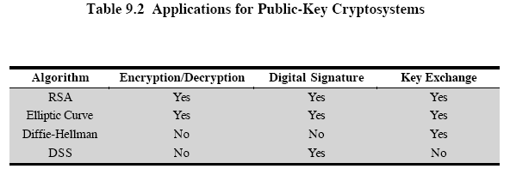
西安电子科技大学计算机学院

Slide 16
公钥密码体制安全性分析
一样存在穷举攻击
但所使用的密钥一般都非常大 ( >512bits )
安全性基于容易（加解密）和困难（破译）之间巨大的差别
许多算法没有得到证明是安全的。（包括RSA）
需要采用一些特别大的数字
与私钥密码体制相比，速度慢。
西安电子科技大学计算机学院
Notes:
Public key schemes are no more or less secure than private key schemes - in both cases the size of the key determines the security. Note also that you can't compare key sizes - a 64-bit private key scheme has very roughly similar security to a 512-bit RSA - both could be broken given sufficient resources. But with public key schemes at least there is usually a firmer theoretical basis for determining the security since its based on well-known and well studied number theory problems.

Slide 17
RSA 密钥的建立
每一个用户通过以下方法产生一个公钥/私钥对:
  随机地选择两个大的素数 p, q
  计算方案中的模数 n = p.q
    ø(n) = (p-1) (q-1)
  随机地选择一个加密密钥e
    满足 1< e < ø(n), (e, ø(n)) = 1
  求解下面的方程，以得到解密密钥d
    e.d ≡ 1 mod ø(n) and 0 ≤ d ≤n
  公开公钥: PU = {e, n}
  保密私钥: PR = {d, n}
西安电子科技大学计算机学院
Notes:
RSA key setup is done once (rarely) when a user establishes (or replaces) their public key, using the steps as shown. The exponent e is usually fairly small, just must be relatively prime to ø(n). Need to compute its inverse mod ø(n) to find d. It is critically important that the factors p & q of the modulus n are kept secret, since if they become known, the system can be broken. Note that different users will have different moduli n.

Slide 18
RSA 的使用
为了加密消息M，发送方:
  获得接收方的公钥 PU = { e, n }
  计算: C = Me mod n, 其中 0 ≤ M < n
为了解密密文C，接收者:
  使用自己的私钥 PR = { d, n }
  计算: M = C^{d} mod n
消息M一定要比模数 n小 (如果需要的话，可以进行分组)
西安电子科技大学计算机学院
Notes:
The actual RSA encryption and decryption computations are each simply a single exponentiation mod (n). Note that the message must be smaller than the modulus. The “magic” is in the choice of the exponents which makes the system work.

Slide 19
RSA的工作原理
Euler定理:
  a^{ø(n)} mod n ≡ 1 其中(a, n) = 1
RSA中:
  n = p.q
  ø(n) = (p-1) (q-1)
  仔细地选择 e 和 d 使得 mod ø(n) 下，两者互逆
  因此存在某个整数k，使得e.d = 1 + k.ø(n) 成立
所以 :
C^{d} = M^{e.d} = M^{1+k.ø(n)} = M¹.(M^{ø(n)})^{k}
≡ M¹.(1)^{k} = M¹ = M mod n
西安电子科技大学计算机学院
Notes:
Can show that RSA works as a direct consequence of Euler’s Theorem, so that raising a number to power e then d (or vica versa) results in the original number!

Slide 20
RSA 举例 – 密钥的建立
选择素数: p = 17 & q = 11
计算 n = p q =17 x 11 = 187
计算 ø(n) = (p–1) (q-1) = 16 x 10 = 160
选择 e: gcd(e, 160) = 1; 选择 e = 7
确定 d: d e = 1 mod 160 且 d < 160
d = 23 因为 23 x 7=161= 10x160+1
公钥 PU = { 7, 187 }
私钥 PR = { 23, 187 }
西安电子科技大学计算机学院
Notes:
Here walk through example RSA key generation using “trivial” sized numbers.
Selecting primes requires the use of a primality test.
Finding d as inverse of e mod ø(n) requires use of Euclid’s Inverse algorithm (see Ch4)

Slide 21
RSA 举例 – 加密/加密
明文消息 M = 88 ( 注意88 < 187)
加密:
  C = 88⁷ mod 187 ≡ 11
解密:
  M = 11²³ mod 187 ≡ 88
西安电子科技大学计算机学院
Notes:
Then show that the encryption and decryption operations are simple exponentiations mod 187.
Rather than having to laborious repeatedly multiply, can use the "square and multiply" algorithm with modulo reductions to implement all exponentiations quickly and efficiently (see next).

Slide 22
幂 运 算
可以用平方和乘法运算
N 次方，只需要 O(log₂ n) 次乘法运算
  如. 7⁵ = 7⁴.7¹ = 3.7 = 10 mod 11
  如. 3¹²⁹ = 3¹²⁸.3¹ = 5.3 = 4 mod 11
西安电子科技大学计算机学院
Notes:
To perform the modular exponentiations, you can use the “Square and Multiply Algorithm”, a fast, efficient algorithm for doing exponentiation.
The idea is to repeatedly square the base, and multiply in the ones that are needed to compute the result, as found by examining the binary representation of the exponent.

Slide 23
幂 运 算
c = 0; f = 1
for i = k downto 0
do c = 2 x c
f = (f x f) mod n
if b_{i} == 1 then
c = c + 1
f = (f x a) mod n
return f
西安电子科技大学计算机学院
Notes:
State here one version of the “Square and Multiply Algorithm”, from Stallings Figure 9.7.

Slide 24
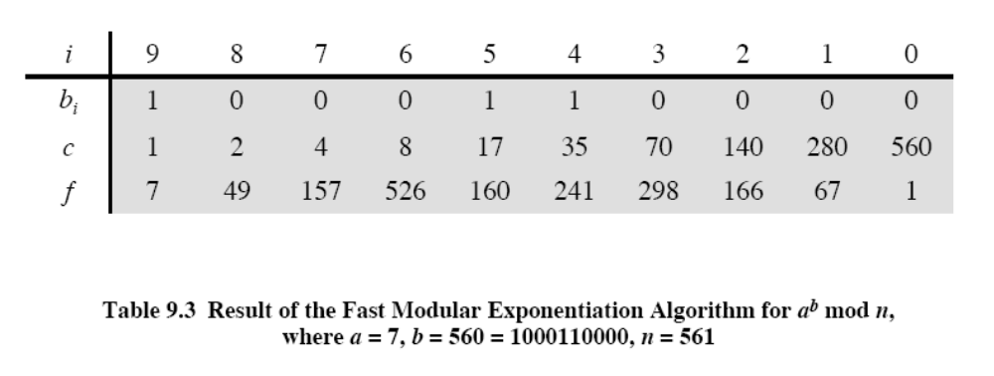
西安电子科技大学计算机学院

Slide 25
加密的效率
加密要计算 e 次方幂
若 e 较小, 计算将很快
  通常选择 e = 65537 (2¹⁶-1)
  或选择 e = 3 或 e = 17
但若 e太小 (如 e = 3)将易受到攻击
  用中国剩余定理
必须确保(e, ø(n)) = 1
西安电子科技大学计算机学院
Notes:
To speed up the operation of the RSA algorithm using the public key, can choose to use a small value of e (but not too small, since its then vulnerable to attack).
Must then ensure any p or q chosen are relatively prime to the fixed e (and reject and find another if not), for system to work.

Slide 26
解密的效率
解密计算d次方幂
  看起来很大，否则不安全
用中国剩余定理分别计算mod p和mod q，则可以得到所希望的答案
  比直接快约4倍
只有知道p和q及私钥的接收者可以直接采用这个技术进行计算
西安电子科技大学计算机学院
Notes:
To speed up the operation of the RSA algorithm using the private key, can use the Chinese Remainder Theorem (CRT) to compute mod p & q separately, and then combine results to get the desired answer. This is approx 4 times faster than calculating “C^d mod n” directly. Note that only the owner of the private key details (who knows the values of p & q) can do this, but of course that’s exactly where help is needed, since if e is small then d will be likely be large!

Slide 27
RSA 密钥的产生
RSA的用户必须:
  随机确定两个素数 p, q
  选择e或d，并求出另一个
素数 p, q 一定不能从n = p . q轻易得到
  意味着数要足够大
  典型地用猜测或可能性测试
指数e, d 是互逆的
西安电子科技大学计算机学院
Notes:
Before the application of the public-key cryptosystem, each participant must generate a pair of keys, which requires finding primes and computing inverses. Both the prime generation and the derivation of a suitable pair of inverse exponents may involve trying a number of alternatives. Typically make random guesses for a possible p or q, and check using a probabalistic primality test whether the guessed number is indeed prime. If not, try again. Note that the prime number theorem shows that the average number of guesses needed is not too large. Then compute decryption exponent d using Euclid’s Inverse Algorithm, which is quite efficient.

Slide 28
RSA 安全性分析
攻击RSA可能的方法有:
  穷举搜索 (对于给定的数字规模是不可行的)
  数学攻击 (基于计算ø(n)的困难性, 模n的因子分解的困难性)
  计时攻击 (基于解密的运行情况)
  选择密文攻击(RSA的已知特性)
西安电子科技大学计算机学院
Notes:
Note some possible possible approaches to attacking the RSA algorithm, as shown.
The defense against the brute-force approach is the same for RSA as for other cryptosystems, namely, use a large key space. Thus the larger the number of bits in d, the better. However because the calculations involved both in key generation and in encryption/decryption are complex, the larger the size of the key, the slower the system will run.
Will now review the other possible types of attacks.

Slide 29
RSA系统安全性与系统的参数
RSA系统安全性与系统的参数有很大关系，X.931标准, ISO/IEC 14752对此提出以下几点：
  如果公钥e是奇数，e应与p-1，q-1互质；
  如果公钥e是偶数，e必须与(p-1)/2, (q-1)/2互质，且 pq mod 8不成立；
  模数的长应该为1024 + 256x，x = 0, 1• • • • • • ；
  质数p，q 应通过质数检测，使出错的概率小于 ；
  p-1, q-1, p+1, q+1应有大质数因子；
  gcd(p-1, q-1)应该小；
  p/q不应靠近两个小整数比值，且；
  |p-q|应有大质数因子。
西安电子科技大学计算机学院

Slide 30
分解因子问题
数学攻击的三种形式:
  分解 n = p.q, 计算ø(n) 从而得到 d
  直接确定 ø(n) 并计算 d
  直接寻找d
对于因子分解问题
  很多年来进展很慢
    用“Lattice Sieve” (LS),算法，最好的是分解了200位十进制数(663 bit)
  最大的改进就是对改进算法的改良
    QS to GHFS to LS
  当前假设1024-2048bit RSA 是安全的
    确保 p, q 有相似的大小并满足其它约束
西安电子科技大学计算机学院
Notes:
We can identify three approaches to attacking RSA mathematically, as shown. Mathematicians currently believe all equivalent to factoring.
See Stallings Table 9.4 for progress in factoring, where see slow improvements over the years, with the biggest improvements coming from improved algorithms.
The best current algorithm is the “Lattice Sieve” (LS), which replaced the “Generalized Number Field Sieve” (GNFS), which replaced the “Quadratic Sieve”(QS).
Have to assume computers will continue to get faster, and that better factoring algorithms may yet be found.
Numbers of size 1024-2048 bits look reasonable at present, provided the factors meet other constraints.

Slide 31
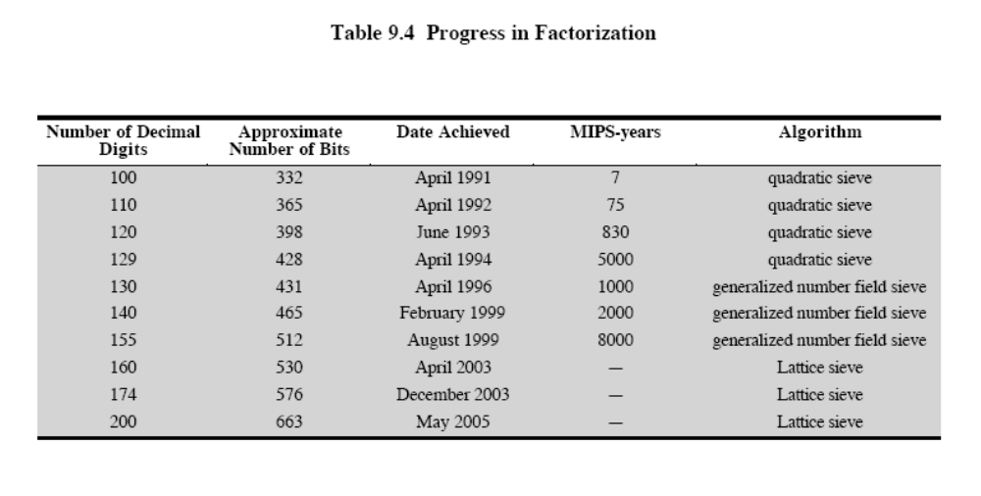
西安电子科技大学计算机学院

Slide 32
计 时 攻 击
20世纪90年代由Paul Kocher提出
探测操作中的时间变化
  eg. multiplying by small vs large number
  or IF's varying which instructions executed
基于所耗时间的大小，对操作数的大小进行猜测
RSA exploits time taken in exponentiation
Countermeasures(解决办法)
  use constant exponentiation time（不变的 幂运算时间）
  add random delays（随机时延）
  blind values used in calculations（隐蔽）
西安电子科技大学计算机学院
Notes:
Had a new category of attacks developed by Paul Kocher in mid-1990’s, based on observing how long it takes to compute the cryptographic operations. Timing attacks are applicable not just to RSA, but to other public-key cryptography systems. This attack is alarming for two reasons: It comes from a completely unexpected direction and it is a ciphertextonly attack. A timing attack is somewhat analogous to a burglar guessing the combination of a safe by observing how long it takes for someone to turn the dial from number to number.
Although the timing attack is a serious threat, there are simple countermeasures that can be used, including using constant exponentiation time algorithms, adding random delays, or using blind values in calculations.

Slide 33
选择密文攻击
RSA 对于选择密文来说是易受攻击的
  攻击者选择密文并得到相应明文
  选择密文可给密码分析者探测RSA的特性提供信息
  optimal asymmetric encryption padding (OAEP).
西安电子科技大学计算机学院
Notes:
The RSA algorithm is vulnerable to a chosen ciphertext attack (CCA). CCA is defined as an attack in which adversary chooses a number of ciphertexts and is then given the corresponding plaintexts, decrypted with the target’s private key. The adversary exploits properties of RSA and selects blocks of data that, when processed using the target’s private key, yield information needed for cryptanalysis. Can counter simple attacks with random pad of plaintext. More sophisticated variants need to modify the plaintext using a procedure known as optimal asymmetric encryption padding (OAEP).

Slide 34
小 结
  公钥密码的原理
    两个密钥：公钥/私钥
    单向陷门函数
  RSA算法，实现和安全分析
西安电子科技大学计算机学院
Notes:
Chapter 9 summary.

