Slide 1
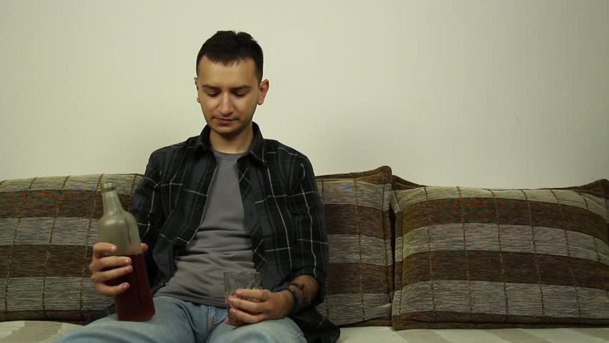
Is this You???
Yes it is!!

Slide 2

Don’t you wanna be theses people!!

Slide 3

What if I told you….
That you too could be COOL!!

Slide 4

Presenting…
The hottest new website…
LocateAMateFor.Me

