Slide 2
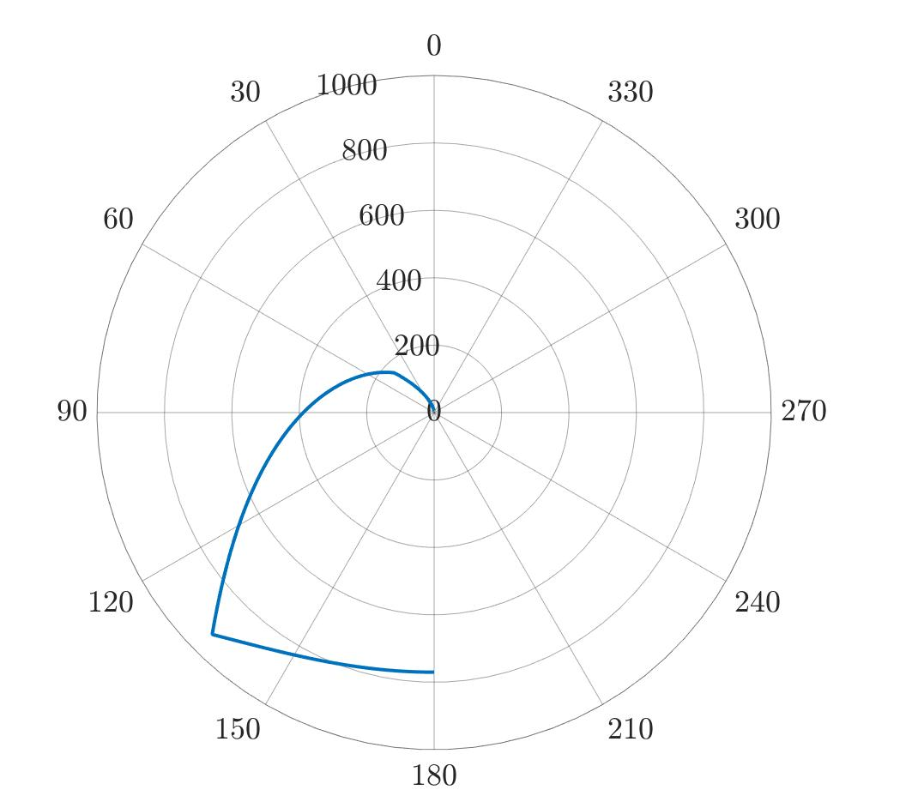
F(𝞪,v)
v_{trailer} = 33.6 km/h
trailer
v_{wind}=40 km/h
F_{max} (𝞪=136º)

Slide 3
0.01 mm
0.01 mm
original plant
growth on the first day
growth on the second day
……
W₀ (g) wood mass
W_{consumed} (g) wood mass
……

Slide 4

Fungi a
Fungi b
Competition
Safe
✓
✓
✓
✓
✓
✓
✓
✓
Condition (a) Condition (b)

Slide 5
