Slide 1

Location and Angular Velocity Detection using a Circular Frequency Diverse Array Radar
Zhehao Yu, Chong Han, Yingtao Zou, Xuyang Lu
UM-SJTU Joint Institute, Shanghai Jiao Tong University

Slide 2
Outline
Introduction
Applications and Prior Works
OAM Generation and Sensing
  OAM generation using Frequency Diverse Array
  Sensing algorithm
Simulation Results
Conclusion

Slide 3
Introduction
Orbital Angular Momentum (OAM)

Slide 4
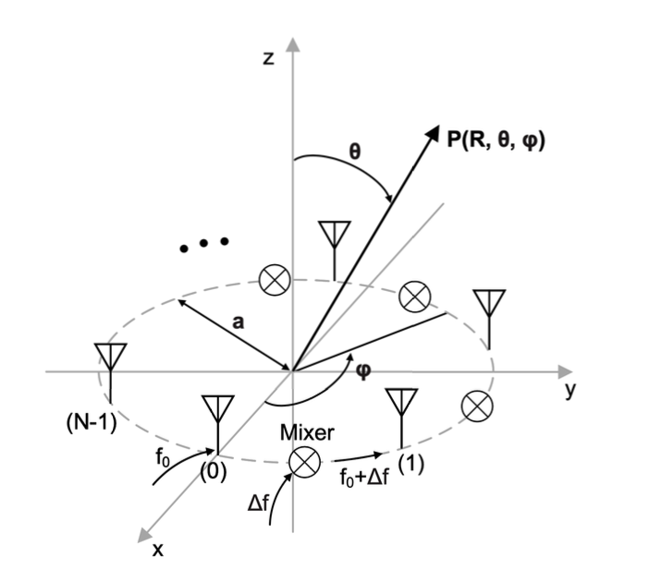
Introduction
Frequency diverse array (FDA)

Slide 5
Applications
Enhanced spectral efficiency
  Orthogonal modes support spatial multiplexing/demultiplexing

Slide 6
Applications
Rotational velocity sensing

Slide 7
Outline
Introduction
Applications and Prior Works
OAM Generation and Sensing
  OAM generation using FDA
  Sensing algorithm
Simulation Results
Conclusion

Slide 8
OAM generation using FDA
Rotational velocity sensing

Slide 9
Sensing algorithm
Rotational velocity sensing

Slide 10
Outline
Introduction
Applications and Prior Works
OAM Generation and Sensing
  OAM generation using Frequency Diverse Array
  Sensing algorithm
Simulation Results
Conclusion

Slide 11
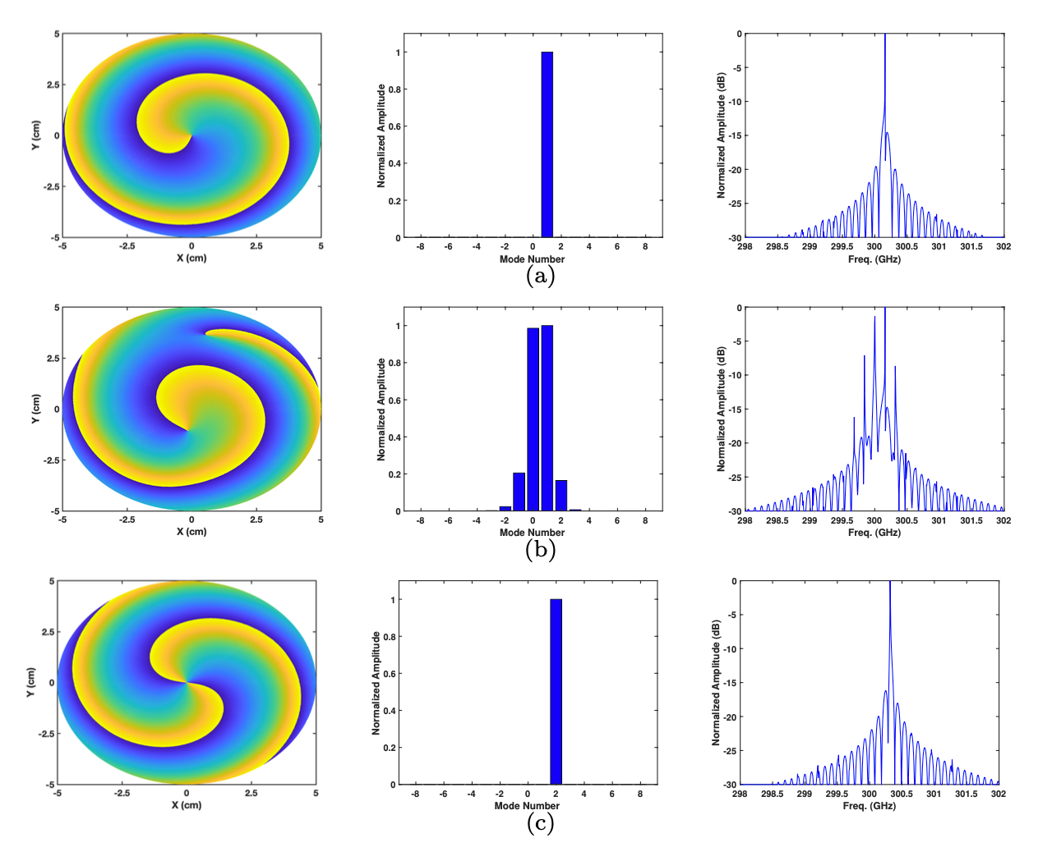
Simulation Results
Simulated FDA generated phase front, OAM spectrum of the transmitted wave, and frequency spectrum of the received echo wave at (a) t = t0, (b) t = t0 + 50 fs, (c) t = t0 + 100 fs.

Slide 12
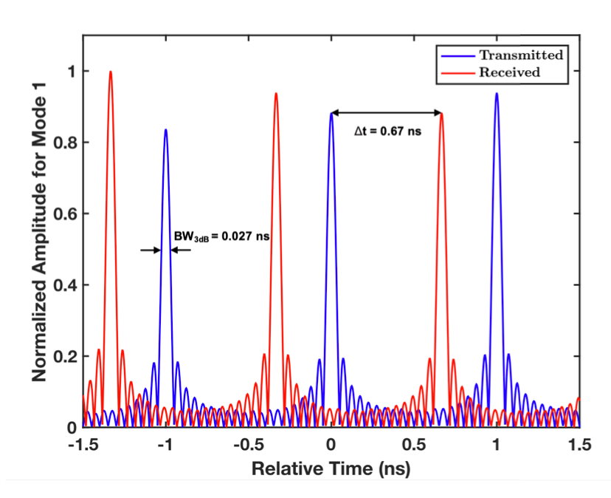
Simulation Results
Simulated transient OAM pulses generated by CFDA.

Slide 13
References

Slide 14

Thank You!

