Slide 1
Machine Learning & Pattern Recognition
Xin Xin(辛鑫)
xinxin@sdu.edu.cn
https://xinxin-me.github.io/

Slide 2
Iterative Optimization Technique

Slide 3

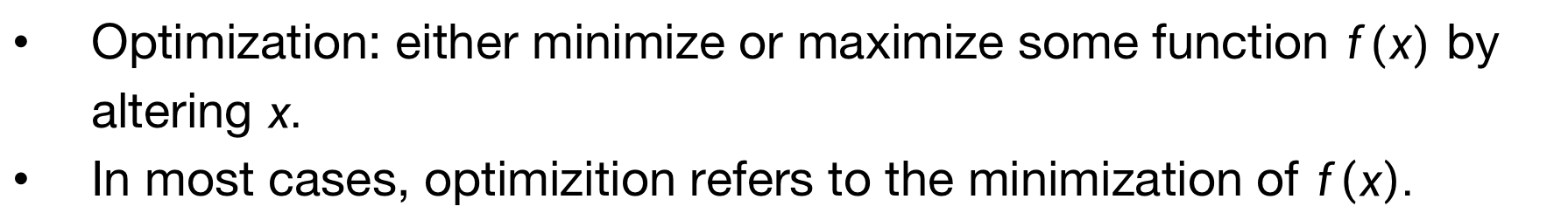
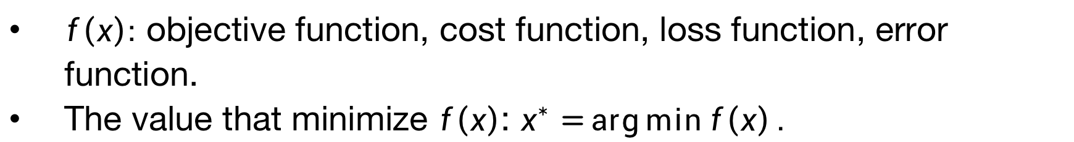

Optimization Methods
Optimization: either minimize or maximize some function $f(x)$ by altering $x.$
In most cases, optimizition refers to the minimization of $f\left(x\right).$
Maximization $f\left(x\right)$
Minimization $−f\left(x\right)$
$f\left(x\right):$ objective function, cost function, loss function, error function.
The value that minimize $f\left(x\right)$: $x^{∗}=\arg{\min{f\left(x\right)}}.$

Slide 4
Optimization Methods
Deterministic Optimization
The data for the given problem are known accurately.
Stochastic Optimization
Refers to a collection of methods for minimizing or maximizing an objective function when randomness is present.

Slide 5
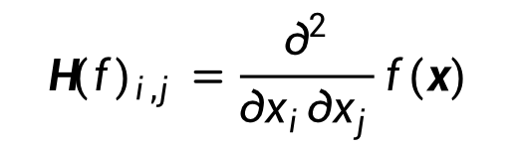

Deterministic Optimization
First-order methods: methods that use only the gradient.
Second-order methods: methods that also use the Hessian matrix.
$${H(f)}_{i,j}=\frac{∂^{2}}{∂x_{i}∂x_{j}}f(x)$$
$x$: multiple input dimensions.

Slide 6

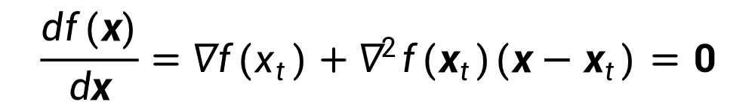
Newton’s Methods
Motivation: to minimize the local second-order Taylor approximation of $f$.
$\min_{x}{f(x)}≈\min_{x}{f\left(x_{t}\right)+∇f{\left(x_{t}\right)}^{T}\left(x−x_{t}\right)+\frac{1}{2}{\left(x−x_{t}\right)}^{T}∇^{2}f\left(x_{t}\right)\left(x−x_{t}\right)}$
Take the derivative of $x$ on both side, we have,
$$\frac{df(x)}{dx}=∇f\left(x_{t}\right)+∇^{2}f\left(x_{t}\right)\left(x−x_{t}\right)=0$$
Update rule: suppose $∇^{2}f\left(x_{t}\right)$ is positive definite,
$$x=x_{t}−{[∇^{2}f\left(x_{t}\right)]}^{−1}∇f\left(x_{t}\right)$$
Notes:
Optimization algorithms may fail to find a global minimum when there are multiple local minima or plateaus present. In the context of deep learning, we generally accept such solutions even though they are not truly minimal, so long as they correspond to significantly low values of the cost function.

Slide 7
Newton’s Methods
Advantage:
More accurate local approximation of the objective,
The convergence is much faster.
Disadvantage:
Need to compute the second derivatives
Need to compute the inverse of Hessian (time/storage consuming)
Notes:
Optimization algorithms may fail to find a global minimum when there are multiple local minima or plateaus present. In the context of deep learning, we generally accept such solutions even though they are not truly minimal, so long as they correspond to significantly low values of the cost function.

Slide 8
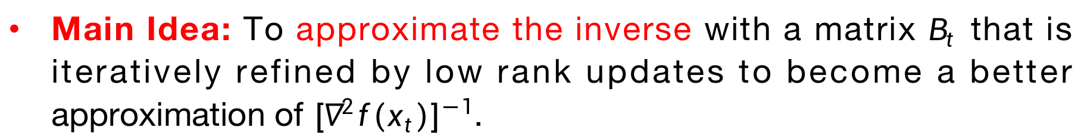
Quasi Newton’s Methods
Main Idea: To approximate the inverse with a matrix $B_{t}$ that is iteratively refined by low rank updates to become a better approximation of ${[∇^{2}f\left(x_{t}\right)]}^{−1}$.

Slide 9
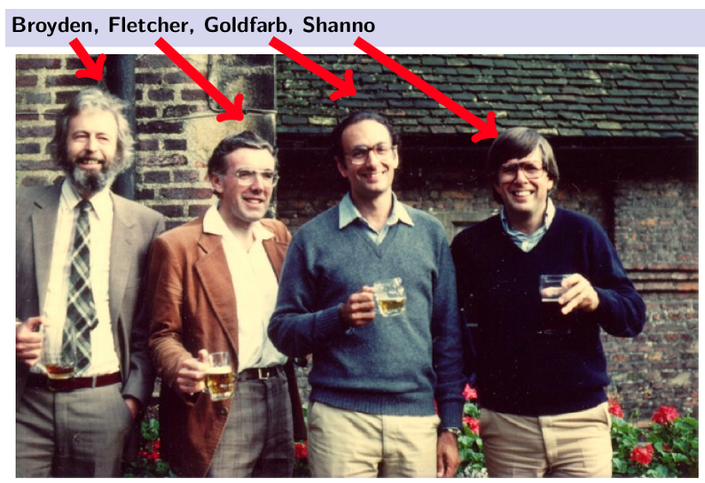
Quasi Newton’s Methods
BFGS (Broyden–Fletcher–Goldfarb–Shanno):
Notes:
$B_{t+1}$ is generated by (2) to satisfy the secant equation$B_{t+1}s_{t}=y_{t}$

Slide 10
Optimization Methods
Deterministic Optimization
The data for the given problem are known accurately.
Stochastic Optimization
Refers to a collection of methods for minimizing or maximizing an objective function when randomness is present.

Slide 11
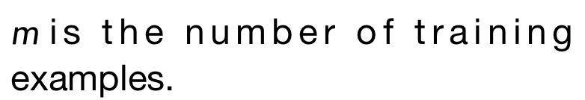
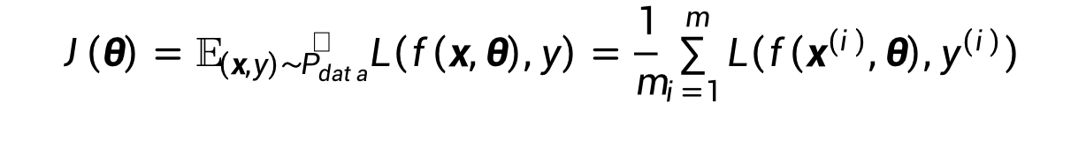
Stochastic Gradient Descent
We now minimize the empirical risk,
$m$ is the number of training examples.
$$J\left(θ\right)=𝔼_{\left(x,y\right)\sim {\hat{P}}_{data}}L\left(f\left(x,θ\right),y\right)=\frac{1}{m}\sum_{i=1}^{m}{L\left(f\left(x^{(i)},θ\right),y^{(i)}\right)}$$
Optimization algorithms that use the entire training set simultaneously are called deterministic or batch gradient methods.
This terminology “batch” can be somewhat confusing.
We use the term “batch size” to describe the size of a minibatch in the stochastic gradient descent.
We use the term “batch gradient descent” to imply the use of the full training set.

Slide 12

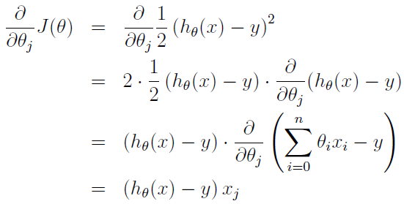

Stochastic Gradient Descent
Optimization algorithms that use only a single example at a time are sometimes called stochastic or sometimes online methods.
E.g., consider the cost function of linear regression as
Now, we ignore the superscript $i$, then for each $x$ we have ,
$$x∈ℝ^{n}$$

Slide 13
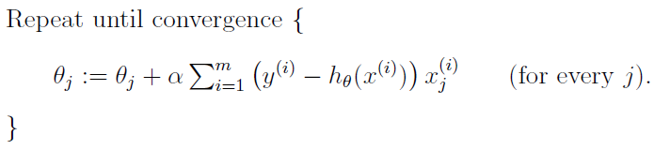
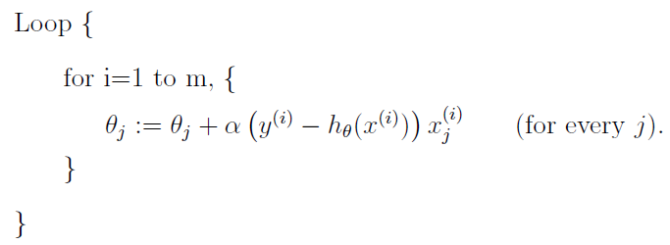


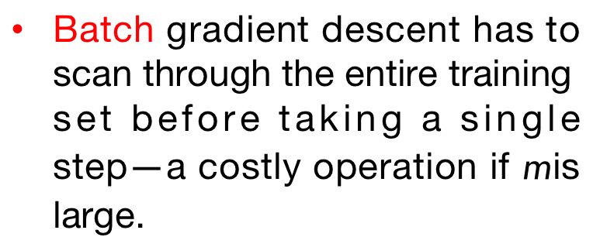
Batch vs Stochastic Gradient Descent
Batch gradient descent has to scan through the entire training set before taking a single step—a costly operation if $m$ is large.
Batch GD
$$λw$$
SGD can start making progress right away, and continues to make progress with each example it looks at.
Often, SGD gets $θ$ “close” to the minimum much faster than batch gradient descent.
SGD

Slide 14
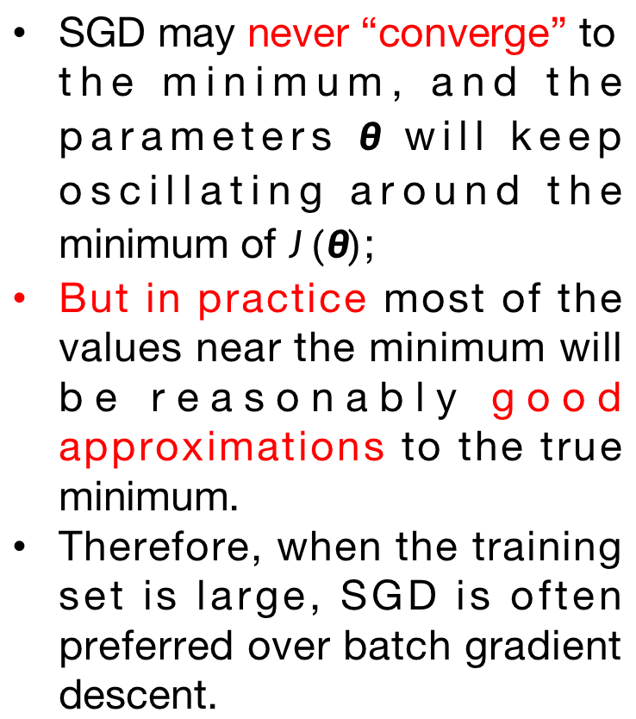
Batch vs Stochastic Gradient Descent
SGD may never “converge” to the minimum, and the parameters $θ$ will keep oscillating around the minimum of $J(θ)$;
But in practice most of the values near the minimum will be reasonably good approximations to the true minimum.
Therefore, when the training set is large, SGD is often preferred over batch gradient descent.
Batch GD
SGD

Slide 15
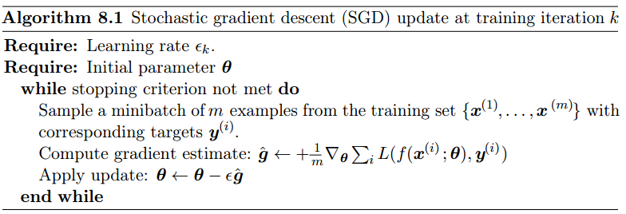
Stochastic Gradient Descent
Most algorithms (called minibatch or minibatch stochastic methods) fall somewhere in between, using more than one but less than all of the training examples.
Note: Confusing again…… It is now common to simply call them stochastic methods.

Slide 16
Accelerated SGD for Deep Learning
Polyak’s Classical Momentum [Polyak 1964]
Nesterov’s Momentum [Nesterov 1983]

Slide 17
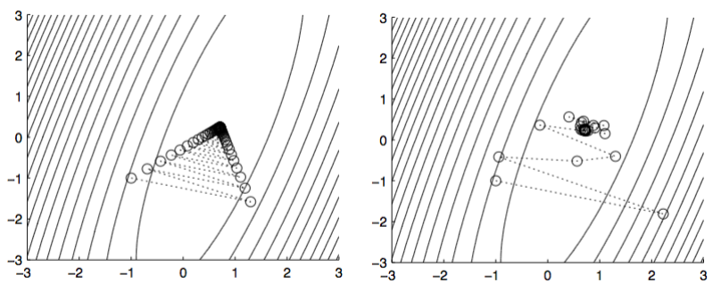
Polyak’s Classical Momentum [Polyak 1964]
Motivation: Key problem of Gradient Descent is “zig-zagging”.
(a) Zig-zagging problem of GD.
(a) Trajectory of CM on same problem.

Slide 18

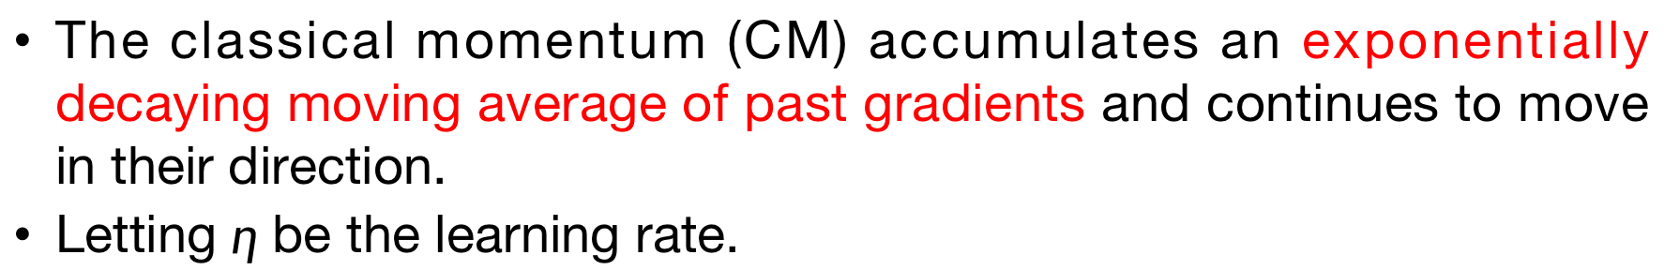
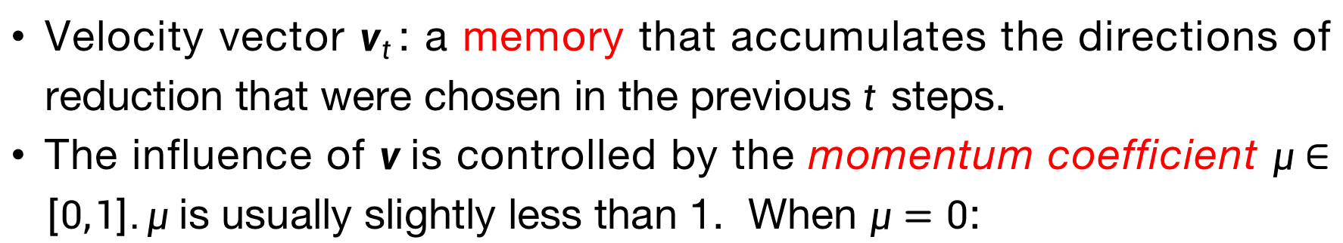

Polyak’s Classical Momentum [Polyak 1964]
The classical momentum (CM) accumulates an exponentially decaying moving average of past gradients and continues to move in their direction.
Letting $η$ be the learning rate.
$w_{t+1}=w_{t}+v_{t+1}$
$v_{t+1}=μv_{t}−η∇_{w_{t}}f$
Velocity vector $v_{t}$: a memory that accumulates the directions of reduction that were chosen in the previous$t$steps.
The influence of $v$is controlled by the momentum coefficient $μ∈\left[0,1\right].μ$ is usually slightly less than 1. When $μ=0$:

Slide 19
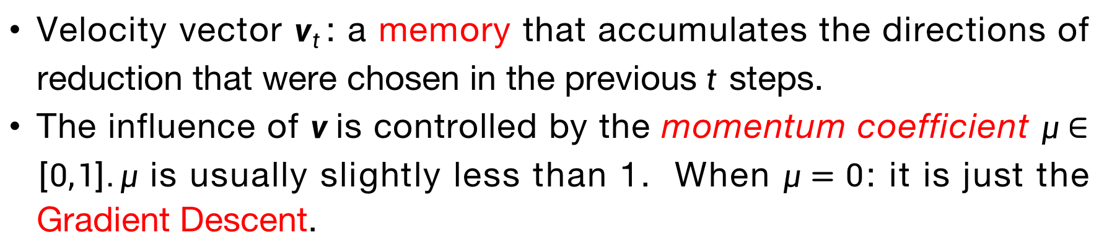
Polyak’s Classical Momentum [Polyak 1964]
The classical momentum (CM) accumulates an exponentially decaying moving average of past gradients and continues to move in their direction.
Letting $η$ be the learning rate.
$w_{t+1}=w_{t}+v_{t+1}$
$v_{t+1}=μv_{t}−η∇_{w_{t}}f$
Velocity vector $v_{t}$: a memory that accumulates the directions of reduction that were chosen in the previous$t$steps.
The influence of $v$is controlled by the momentum coefficient $μ∈\left[0,1\right].μ$ is usually slightly less than 1. When $μ=0$: it is just the Gradient Descent.

Slide 20


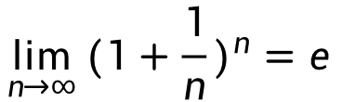

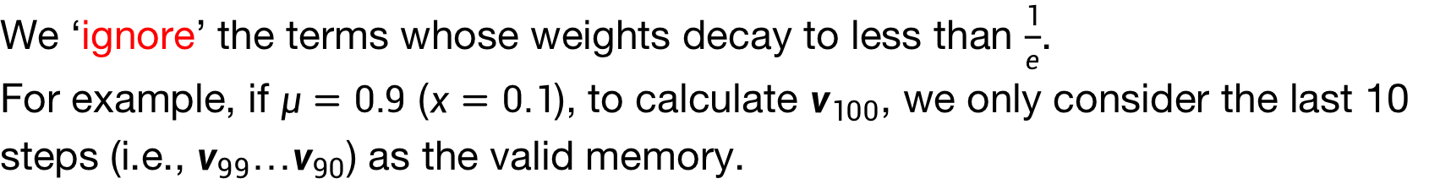

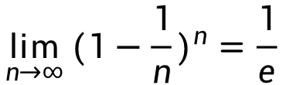
Polyak’s Classical Momentum [Polyak 1964]
Exponential decay
$$v_{t+1}{=μv_{t}−η∇_{w_{t}}f}$$
$$=μ(μv_{t−1}−η∇_{w_{t−1}}f)−η∇_{w_{t}}f$$
$$=μ^{t+1}v_{0}−(μ^{t}η∇_{w_{0}}f+…+μ^{1}η∇_{w_{t−1}}f+η∇_{w_{t}}f)$$
$$\lim_{n→∞}{{(1+\frac{1}{n})}^{n}}=e$$
$$\lim_{n→∞}{{(1−\frac{1}{n})}^{n}}=\frac{1}{e}$$
We know that
$$x=\frac{1}{n}→0$$
$${(1−x)}^{\frac{1}{x}}=\frac{1}{e}$$
Let
, we have
We ‘ignore’ the terms whose weights decay to less than $\frac{1}{e}$.
For example, if $μ=0.9$ ($x=0.1$), to calculate $v_{100}$, we only consider the last 10 steps (i.e., $v_{99}…v_{90}$) as the valid memory.

Slide 21
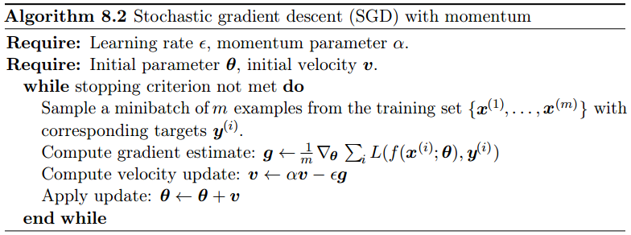




Polyak’s Classical Momentum [Polyak 1964]
The SGD algorithm with momentum is given as follows.
$w_{t+1}=w_{t}+v_{t+1}$
$v_{t+1}=μv_{t}−η∇_{w_{t}}f$
$$η$$
$$μ$$
$v←μv−ηg$

Slide 22
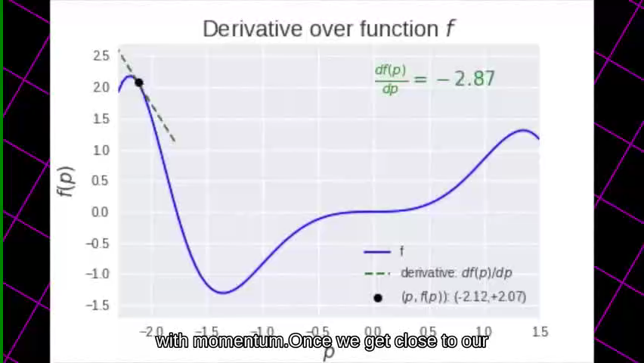
Polyak’s Classical Momentum [Polyak 1964]

Slide 23
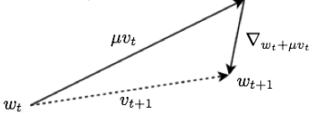
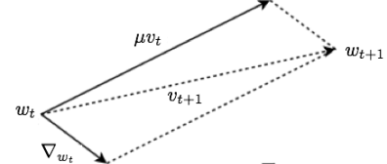

Nesterov’s Accelerated Gradient [Nesterov 1983]
The update equations of NAG are:
CM
$w_{t+1}=w_{t}+v_{t+1}$
$w_{t+1}=w_{t}+v_{t+1}$
$v_{t+1}=μv_{t}−η∇_{w_{t}+μv_{t}}f$
$v_{t+1}=μv_{t}−η∇_{w_{t}}f$
NAG
CM
Illustration of the comparison between CM and NAG.

Slide 24
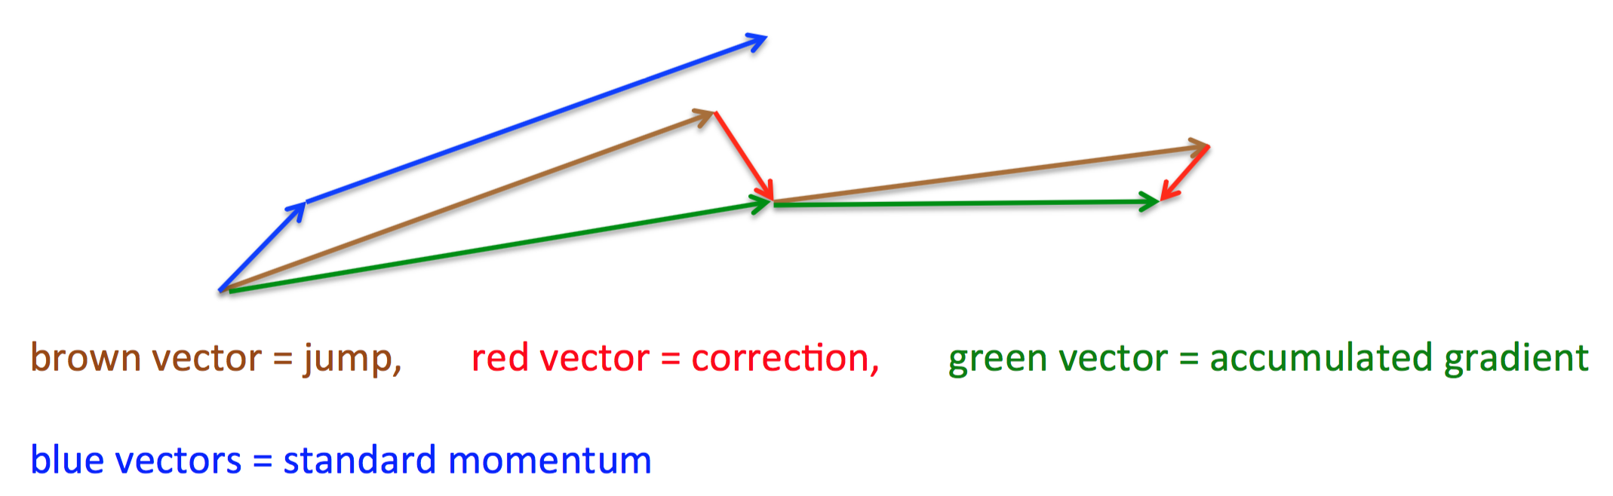
Nesterov’s Accelerated Gradient [Nesterov 1983]
First make a big jump in the direction of the previous accumulated gradient.
Then measure the gradient where you end up and make a correction.
$w_{t+1}=w_{t}+v_{t+1}$
$w_{t+1}=w_{t}+v_{t+1}$
$v_{t+1}=μv_{t}−η∇_{w_{t}+μv_{t}}f$
$v_{t+1}=μv_{t}−η∇_{w_{t}}f$
NAG
CM

Slide 25
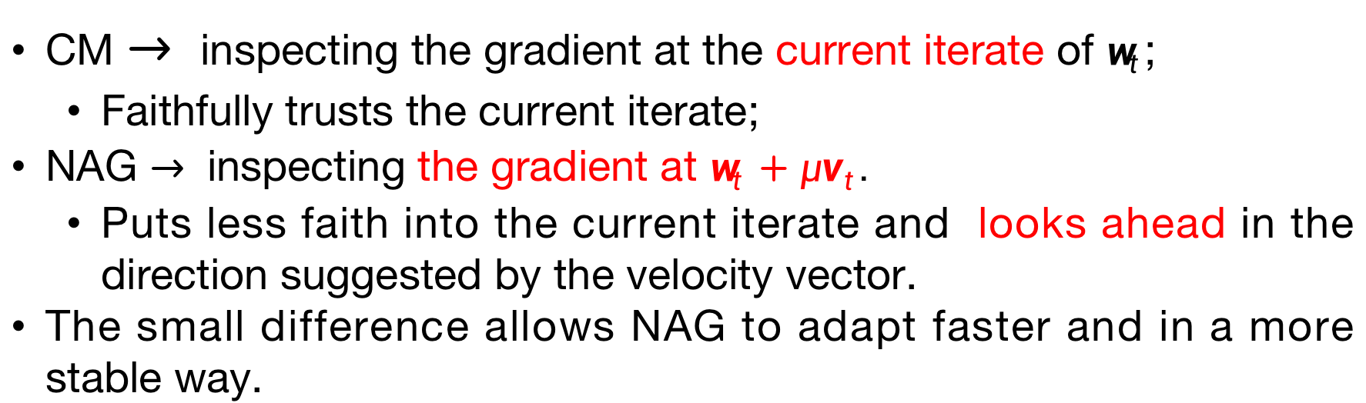
Nesterov’s Accelerated Gradient [Nesterov 1983]
The update equations of NAG are:
CM
$w_{t+1}=w_{t}+v_{t+1}$
$w_{t+1}=w_{t}+v_{t+1}$
$v_{t+1}=μv_{t}−η∇_{w_{t}+μv_{t}}f$
$v_{t+1}=μv_{t}−η∇_{w_{t}}f$
CM $→$inspecting the gradient at the current iterate of $w_{t}$;
Faithfully trusts the current iterate;
NAG $→$inspecting the gradient at $w_{t}+μv_{t}.$
Puts less faith into the current iterate and looks ahead in the direction suggested by the velocity vector.
The small difference allows NAG to adapt faster and in a more stable way.

Slide 26
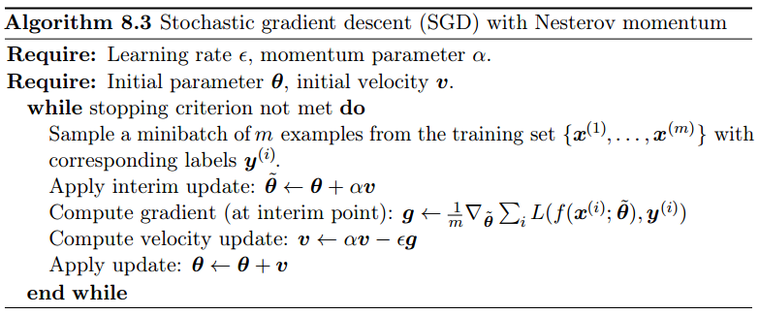
Nesterov’s Accelerated Gradient [Nesterov 1983]
The complete Nesterov momentum algorithm is presented as follows.
$w_{t+1}=w_{t}+v_{t+1}$
$v_{t+1}=μv_{t}−η∇_{w_{t}+μv_{t}}f$
$$η$$
$$μ$$
$$μ$$
$v←μv−ηg$

Slide 27
Algorithms with Adaptive Learning Rates
Researchers have long realized that the learning rate is the most difficult hyperparameter to set because it has a significant impact on model performance.
Recently, a number of methods have been introduced that adapt the learning rates of model parameters.
Adagrad
RMSProp
Adam

Slide 28



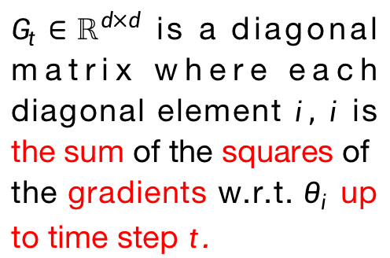
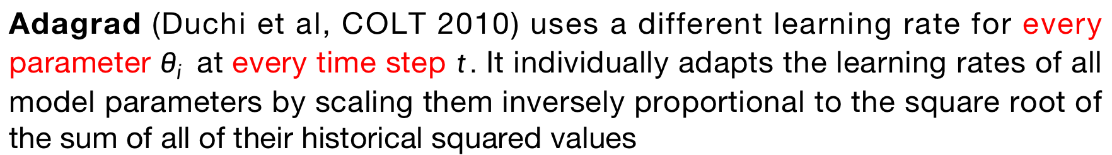
Adagrad
Adagrad (Duchi et al, COLT 2010) uses a different learning rate for every parameter $θ_{i}$ at every time step $t.$ It individually adapts the learning rates of all model parameters by scaling them inversely proportional to the square root of the sum of all of their historical squared values
The SGD update
$G_{t}∈ℝ^{d×d}$ is a diagonal matrix where each diagonal element $i, i$is the sum of the squares of the gradients w.r.t. $θ_{i}$up to time step $t$.
Weakness: Since every added term is positive, the accumulated sum keeps growing which in turn causes the learning rate to shrink and eventually become infinitely small.

Slide 29

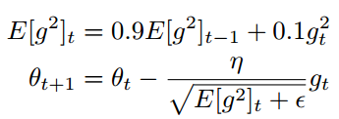
Adadelta & RMSprop
Adadelta is an extension of Adagrad that seeks to reduce its aggressive, monotonically decreasing learning rate. Instead of accumulating all past squared gradients, Adadelta restricts the window of accumulated past gradients to some fixed size w.
Via a decaying mechanism,
RMSprop is an unpublished, adaptive learning rate method proposed by Geoff Hinton in his Coursera Class. RMSprop and Adadelta have both been developed independently around the same time to resolve Adagrad’s radically diminishing learning rates.
衰减速率：可调超参
采用指数衰减平均，以丢弃遥远过去的历史。

Slide 30
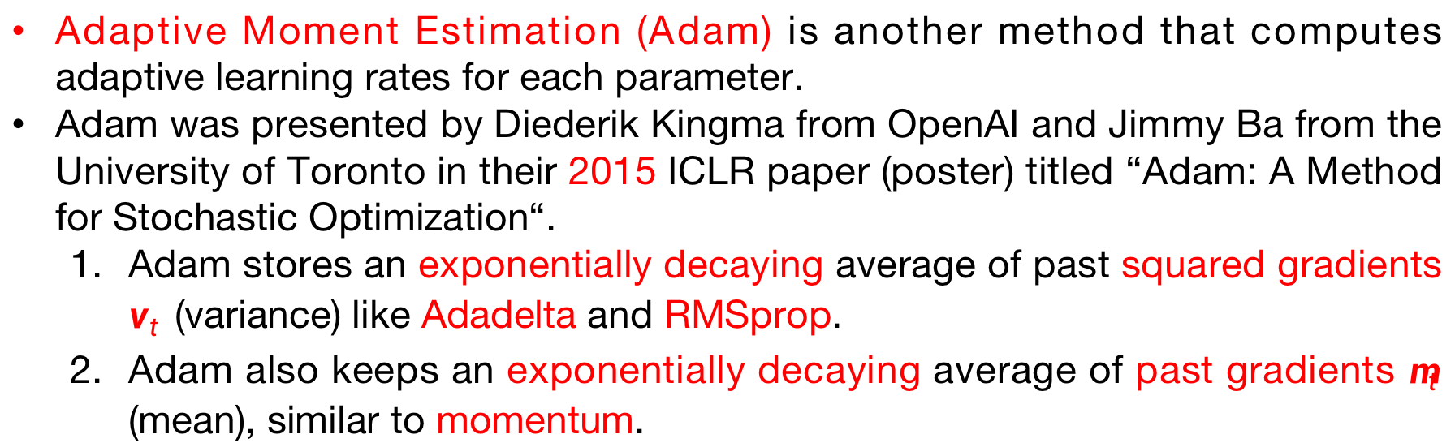
Adam
Adaptive Moment Estimation (Adam) is another method that computes adaptive learning rates for each parameter.
Adam was presented by Diederik Kingma from OpenAI and Jimmy Ba from the University of Toronto in their 2015 ICLR paper (poster) titled “Adam: A Method for Stochastic Optimization“.
Adam stores an exponentially decaying average of past squared gradients $v_{t}$ (variance) like Adadelta and RMSprop.
Adam also keeps an exponentially decaying average of past gradients $m_{t}$ (mean), similar to momentum.

Slide 31
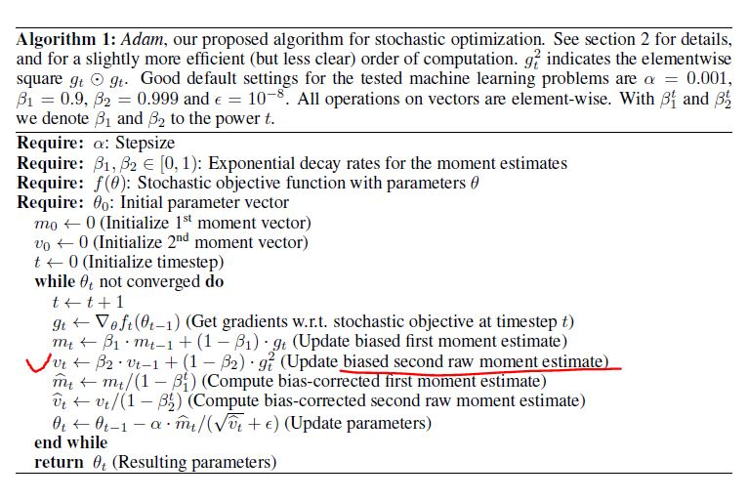
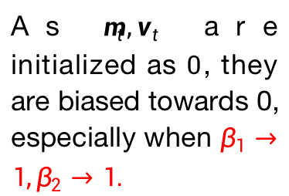
Adam
As $m_{t},v_{t}$ are initialized as $0$, they are biased towards 0, especially when $β_{1}→1,β_{2}→1.$

Slide 32
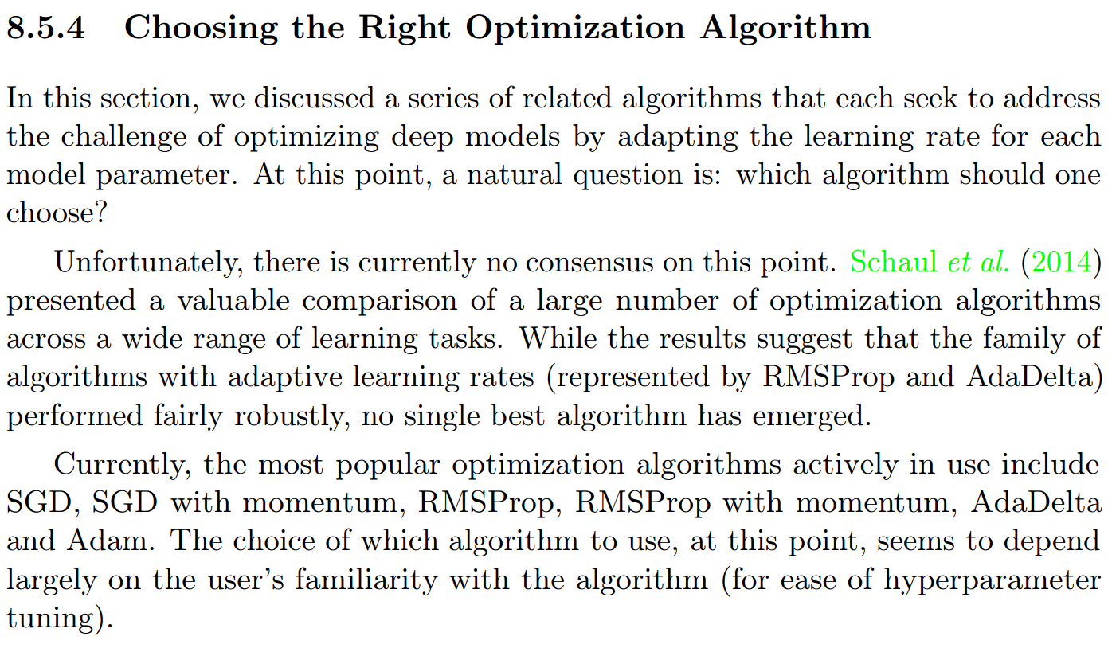

Slide 33
Summary
Deterministic Optimization
The data for the given problem are known accurately.
First order method: e.g., Gradient Descent.
Second order method: e.g., Newton’s method, Quasi Newton’s Methods (BFGS).
Stochastic Optimization
Using several samples of the training examples (minibatch).
SGD
SGD+Accelaration
Polyak’s Classical Momentum
Nesterov’s Momentum
Agrad/Adadelta/RMSprop/Adam

