Slide 1
Machine Learning & Pattern Recognition
Xin Xin(辛鑫)
xinxin@sdu.edu.cn
https://xinxin-me.github.io/

Slide 2
Supervised Feature Extraction
Linear Discriminant Analysis (LDA)

Slide 3
Feature Extraction
Feature extraction (dimensionality reduction/feature reduction) refers to the mapping of the original high‐dimensional data into a low‐dimensional space.
Criterion for feature reduction can be different based on different problem setting
Unsupervised setting: minimize the information loss
Supervised setting: maximize the class discrimination

Slide 4
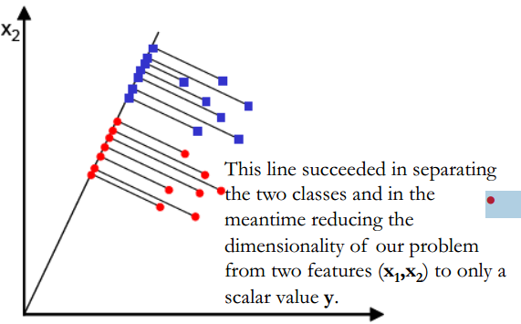
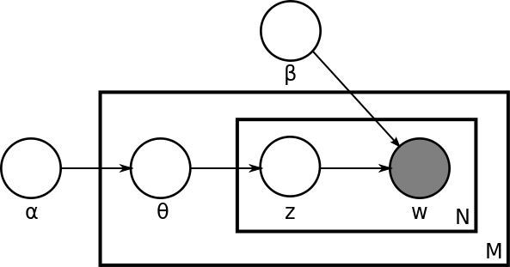
Linear Discriminant Analysis
Latent Dirichlet Allocation
Linear Discriminant Analysis, a method to find a linear combination of features that separates two or more classes of objects.
In natural language processing, latent Dirichlet allocation (LDA) is an example of a topic model.
https://en.wikipedia.org/wiki/Latent_Dirichlet_allocation

Slide 5
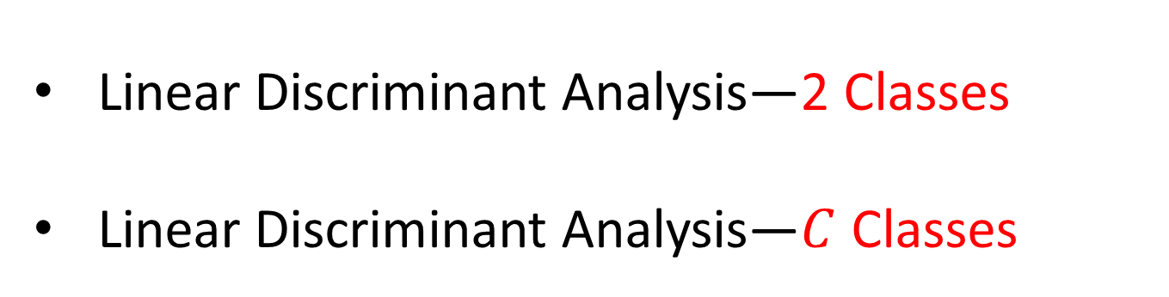
Linear Discriminant Analysis
Linear Discriminant Analysis—2 Classes
Linear Discriminant Analysis—$C$ Classes

Slide 6
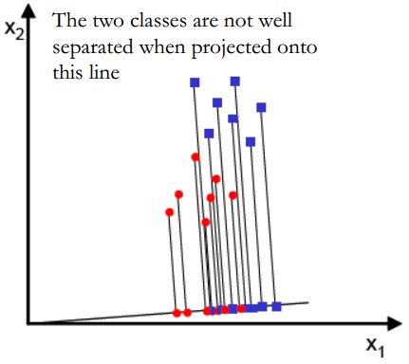
What is a Good Projection?
Given a set of points (2-d) from two classes, we want to project them to a line that can well separate them.

Slide 7
What is a Good Projection?
What is a good criterion?
Maximize the between-class distance (means)
Is it enough?

Slide 8
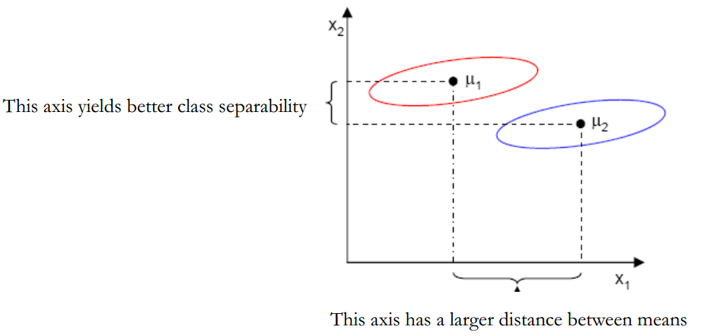
What is a Good Projection?
What is a good criterion?
Maximize the between-class distance (means)
Minimize the within-class variability (scatter)

Slide 9
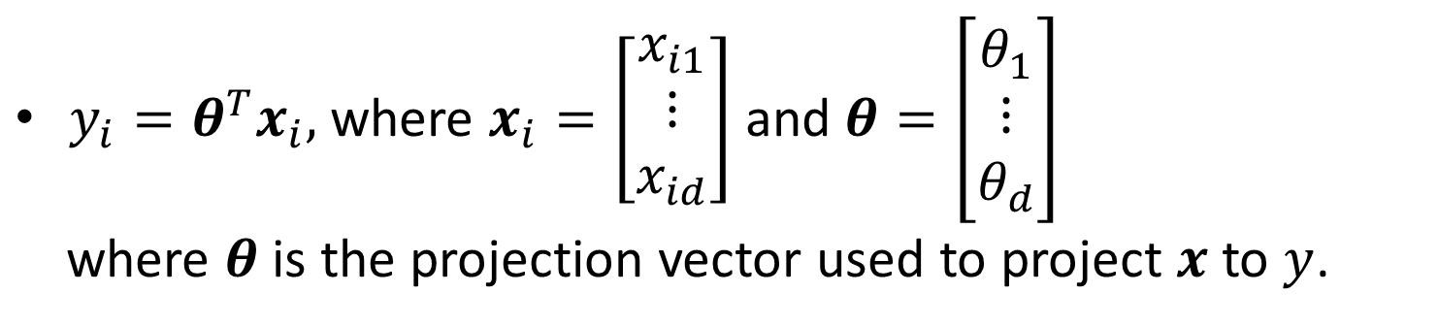
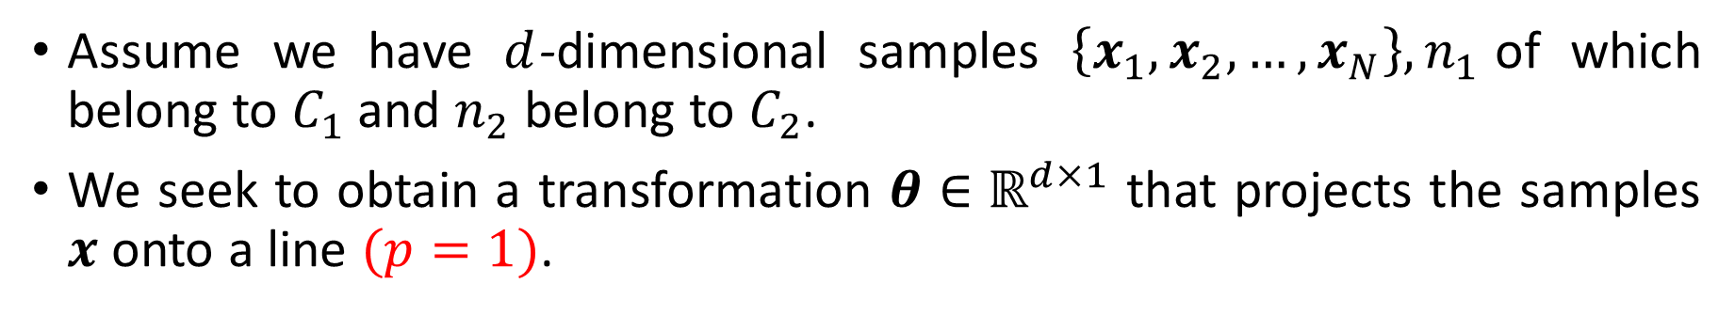
Linear Discriminant Analysis—Two Classes
Assume we have $d$-dimensional samples $\left\{x_{1},x_{2},…,x_{N}\right\},n_{1}$of which belong to $C_{1}$ and $n_{2}$ belong to $C_{2}$.
We seek to obtain a transformation $θ∈ℝ^{d×1}$ that projects the samples $x$ onto a line $(p=1)$.
$y_{i}=θ^{T}x_{i},$ where $x_{i}=\left[\begin{aligned}x_{i1} \\ ⋮ \\ x_{id}\end{aligned}\right]$ and $θ=\left[\begin{aligned}θ_{1} \\ ⋮ \\ θ_{d}\end{aligned}\right]$
where $θ$ is the projection vector used to project $x$ to $y$.

Slide 10

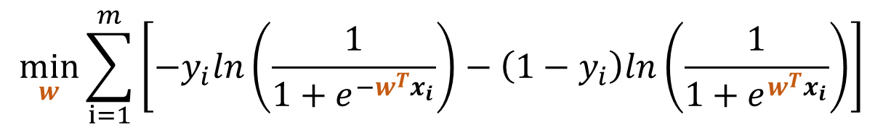
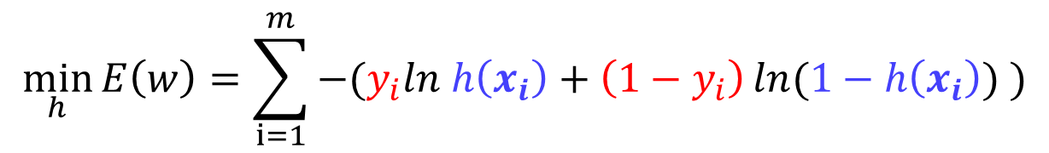

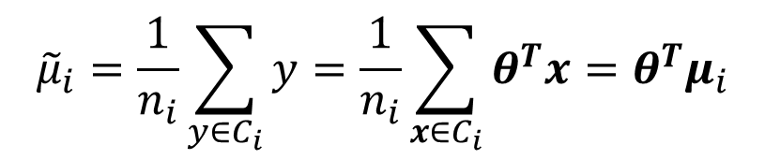

Linear Discriminant Analysis—Two Classes
The mean vector of each class in $x$ and $y$ feature space is:
Projecting $x$to $y$ will lead to projecting the mean of $x$ to the mean of $y$.
$$μ_{i}=\frac{1}{n_{i}}\sum_{x∈C_{i}}{x}$$
$${\tilde{μ}}_{i}=\frac{1}{n_{i}}\sum_{y∈C_{i}}{y}=\frac{1}{n_{i}}\sum_{x∈C_{i}}{θ^{T}x}=θ^{T}μ_{i}$$
Choose $θ$ to maximize the distance between the projected means:
$$J_{1}\left(θ\right)={({\tilde{μ}}_{1}−{\tilde{μ}}_{2})}^{2}={(θ^{T}μ_{1}−θ^{T}μ_{2})}^{2}$$
$$=θ^{T}\left(μ_{1}−μ_{2}\right){\left(μ_{1}−μ_{2}\right)}^{T}θ=θ^{T}S_{b}θ$$
Between-class scatter (类间散度矩阵):
$$S_{b}=(μ_{1}−μ_{2}){(μ_{1}−μ_{2})}^{T}$$
$${S_{b}∈ℝ}^{d×d}$$

Slide 11
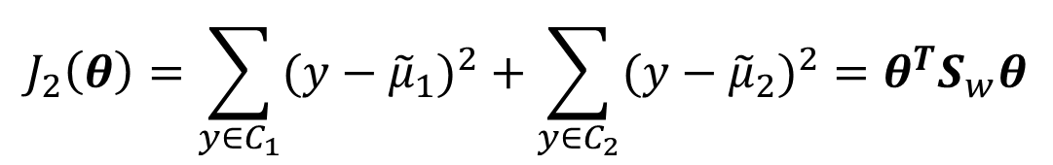



Linear Discriminant Analysis—Two Classes
Meanwhile, to achieve a small variance within each class, i.e., minimizing the class overlap,
$$s_{k}^{2}=\sum_{y∈C_{k}}{{(y−{\tilde{μ}}_{k})}^{2}}$$
We define the total within-class variance as $s_{1}^{2}+s_{2}^{2}.$
We want to choose $θ$to minimize
$$J_{2}\left(θ\right)=\sum_{y∈C_{1}}{{(y−{\tilde{μ}}_{1})}^{2}}+\sum_{y∈C_{2}}{{(y−{\tilde{μ}}_{2})}^{2}}=θ^{T}S_{w}θ$$
Within-class scatter (类内散度矩阵):
$S_{w}=\sum_{x∈C_{1}}{\left(x−μ_{1}\right){\left(x−μ_{1}\right)}^{T}}+\sum_{x∈C_{2}}{(x−μ_{2}){(x−μ_{2})}^{T}}$
$$S_{w}∈ℝ^{d×d}$$

Slide 12

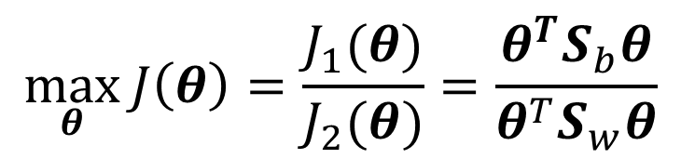
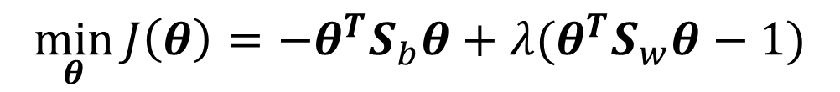


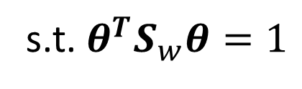
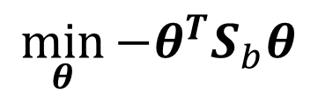
Linear Discriminant Analysis—Two Classes
We can finally express the Fisher criterion in terms of $S_{w}$ and $S_{b}:$
$$\max_{θ}{J\left(θ\right)=\frac{J_{1}(θ)}{J_{2}(θ)}=\frac{θ^{T}S_{b}θ}{θ^{T}S_{w}θ}}$$
If $θ$ is one solution, then $αθ$ would also be a solution.
$$\min_{θ}{−θ^{T}S_{b}θ}$$
s.t. $θ^{T}S_{w}θ=1$
Let $λ$ be a Lagrange multiplier
$$\min_{θ}{J\left(θ\right)=−θ^{T}S_{b}θ}+λ(θ^{T}S_{w}θ−1)$$

Slide 13

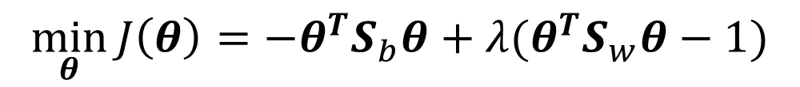

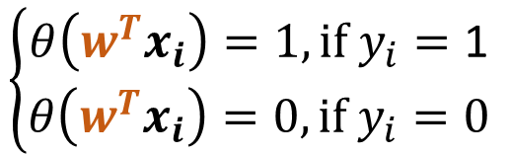
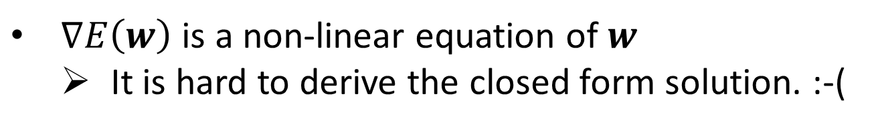


Linear Discriminant Analysis—Two Classes
Let $λ$ be a Lagrange multiplier
$$\min_{θ}{J\left(θ\right)=−θ^{T}S_{b}θ}+λ(θ^{T}S_{w}θ−1)$$
$$\frac{∂J\left(θ\right)}{∂θ}=$$
$${−2S_{b}θ}+2λS_{w}θ=0$$
$$⟹$$
$$S_{b}θ=λS_{w}θ$$
$θ:$ the eigenvectors of $S_{w}^{−1}S_{b}$, and $λ$ is the corresponding eigenvalue.
How to choose $θ$?

Slide 14





Linear Discriminant Analysis—Two Classes
Let $λ$ be a Lagrange multiplier
$$\min_{θ}{J\left(θ\right)=−θ^{T}S_{b}θ}+λ(θ^{T}S_{w}θ−1)$$
$$\frac{∂J\left(θ\right)}{∂θ}={−2S_{b}θ}+2λS_{w}θ=0$$
$$⟹$$
$$S_{b}θ=λS_{w}θ$$
Remember the objective function
$$\left\{\begin{aligned}\min_{θ}{−θ^{T}S_{b}θ} \\ \text{s}\text{.}\text{t}\text{. }θ^{T}S_{w}θ=1 \end{aligned}\right.$$
$$S_{b}θ^{∗}=λS_{w}θ^{∗}$$
$$⟹$$
$$−{θ^{∗}}^{T}S_{b}θ^{∗}=−λ{θ^{∗}}^{T}S_{w}θ^{∗}=−λ$$
How to choose?
The eigenvector corresponds to the largest eigenvalue.

Slide 15





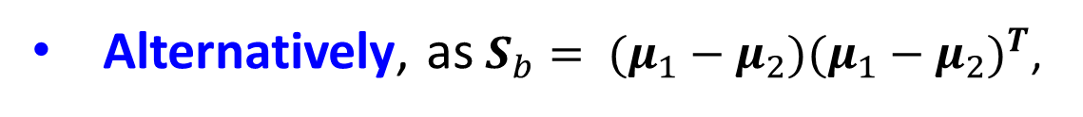
Linear Discriminant Analysis—Two Classes
Let $λ$ be a Lagrange multiplier
$$\min_{θ}{J\left(θ\right)=−θ^{T}S_{b}θ}+λ(θ^{T}S_{w}θ−1)$$
$$\frac{∂J\left(θ\right)}{∂θ}={−2S_{b}θ}+2λS_{w}θ=0$$
$$⟹$$
$$S_{b}θ=λS_{w}θ$$
Alternatively, as $S_{b}= (μ_{1}−μ_{2}){(μ_{1}−μ_{2})}^{T}$,
$$S_{b}θ=\left(μ_{1}−μ_{2}\right){\left(μ_{1}−μ_{2}\right)}^{T}θ$$
Let then
$$λ_{θ}$$
$$S_{b}θ=λ_{θ}(μ_{1}−μ_{2})$$
$$λ_{θ}\left(μ_{1}−μ_{2}\right)=λS_{w}θ$$
The scale of $θ^{∗}$does not matter, only direction matters.
$$θ^{∗}=S_{w}^{−1} (μ_{1}−μ_{2})$$

Slide 16

Linear Discriminant Analysis—Two Classes
Workflow of LDA for the binary classification
Build $X_{1}$ and $X_{2}$ from the training set
Compute $μ_{1}$ and $μ_{2}$
Compute $S_{w}$
Compute $S_{w}^{−1}$
Compute $θ^{∗}=S_{w}^{−1} (μ_{1}−μ_{2})$
Given a testing sample, $y={θ^{∗}}^{T}x$
Set the threshold $γ=\frac{n_{1}{θ^{∗}}^{T}μ_{1}+n_{2}{θ^{∗}}^{T}μ_{2}}{n_{1}+n_{2}}$.
Compare $y$ with $γ$ to determine the class.

Slide 17
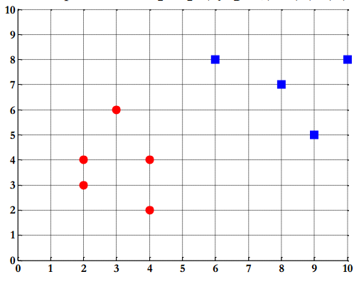



Example
Compute the Linear Discriminant projection for the following two dimensional dataset. – Samples for class $ω_{1}$: $X_{1}=(x_{1},x_{2})=\{(4,2),(2,4),(2,3),(3,6),(4,4)\}$ – Sample for class $ω_{2}$: $X_{2}=(x_{1},x_{2})=\{(9,10),(6,8),(9,5),(8,7),(10,8)\}$
$$x_{2}$$
$$x_{1}$$

Slide 18
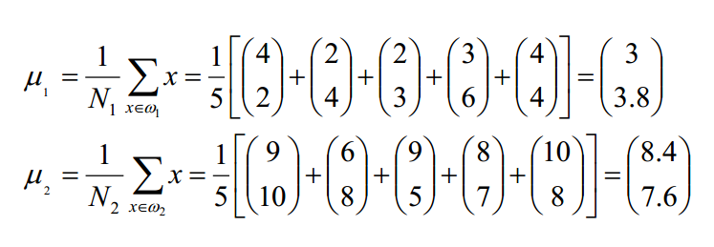
Example
Compute the Linear Discriminant projection for the following two dimensional dataset. – Samples for class $ω_{1}$: $X_{1}=(x_{1},x_{2})=\{(4,2),(2,4),(2,3),(3,6),(4,4)\}$ – Sample for class $ω_{2}$: $X_{2}=(x_{1},x_{2})=\{(9,10),(6,8),(9,5),(8,7),(10,8)\}$
Mean of each class:
$$x_{2}$$
$$x_{1}$$

Slide 19
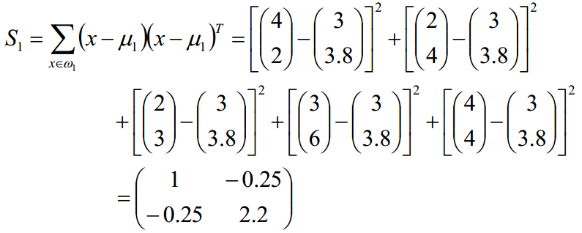
Example
Compute the Linear Discriminant projection for the following two dimensional dataset. – Samples for class $ω_{1}$: $X_{1}=(x_{1},x_{2})=\{(4,2),(2,4),(2,3),(3,6),(4,4)\}$ – Sample for class $ω_{2}$: $X_{2}=(x_{1},x_{2})=\{(9,10),(6,8),(9,5),(8,7),(10,8)\}$
Covariance matrix of the first class:
$$x_{2}$$
$$x_{1}$$

Slide 20
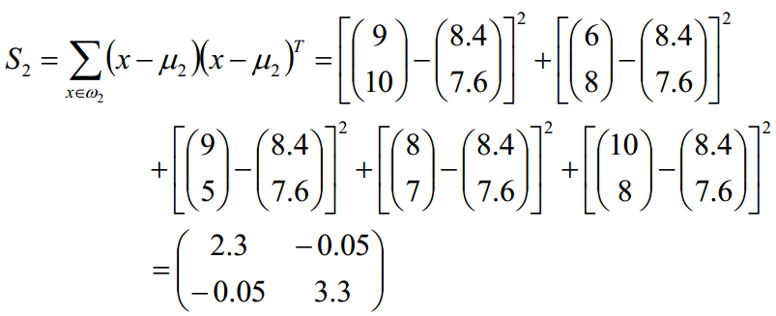
Example
Compute the Linear Discriminant projection for the following two dimensional dataset. – Samples for class $ω_{1}$: $X_{1}=(x_{1},x_{2})=\{(4,2),(2,4),(2,3),(3,6),(4,4)\}$ – Sample for class $ω_{2}$: $X_{2}=(x_{1},x_{2})=\{(9,10),(6,8),(9,5),(8,7),(10,8)\}$
Covariance matrix of the second class:
$$x_{2}$$
$$x_{1}$$

Slide 21
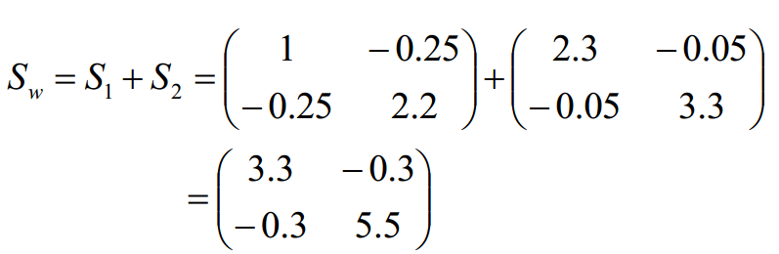
Example
Compute the Linear Discriminant projection for the following two dimensional dataset. – Samples for class $ω_{1}$: $X_{1}=(x_{1},x_{2})=\{(4,2),(2,4),(2,3),(3,6),(4,4)\}$ – Sample for class $ω_{2}$: $X_{2}=(x_{1},x_{2})=\{(9,10),(6,8),(9,5),(8,7),(10,8)\}$
Within-class scatter matrix:
$$x_{2}$$
$$x_{1}$$

Slide 22
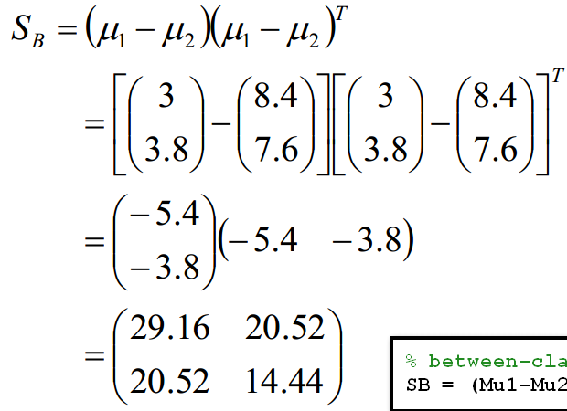
Example
Compute the Linear Discriminant projection for the following two dimensional dataset. – Samples for class $ω_{1}$: $X_{1}=(x_{1},x_{2})=\{(4,2),(2,4),(2,3),(3,6),(4,4)\}$ – Sample for class $ω_{2}$: $X_{2}=(x_{1},x_{2})=\{(9,10),(6,8),(9,5),(8,7),(10,8)\}$
Between-class scatter matrix:
$$x_{2}$$
$$x_{1}$$

Slide 23
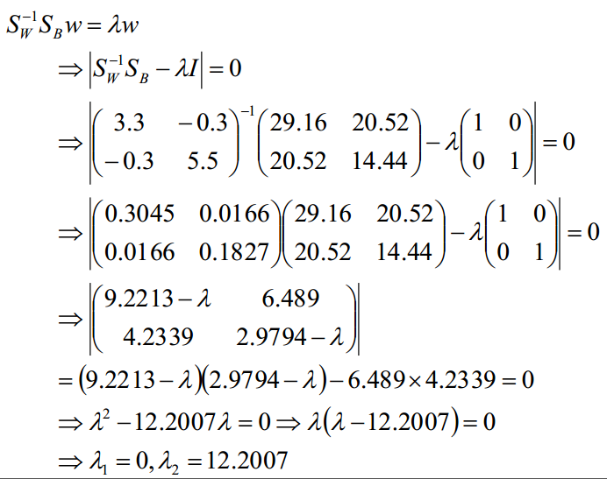
Example
Compute the Linear Discriminant projection for the following two dimensional dataset. – Samples for class $ω_{1}$: $X_{1}=(x_{1},x_{2})=\{(4,2),(2,4),(2,3),(3,6),(4,4)\}$ – Sample for class $ω_{2}$: $X_{2}=(x_{1},x_{2})=\{(9,10),(6,8),(9,5),(8,7),(10,8)\}$
$$x_{2}$$
$$x_{1}$$

Slide 24
Example
Compute the Linear Discriminant projection for the following two dimensional dataset. – Samples for class $ω_{1}$: $X_{1}=(x_{1},x_{2})=\{(4,2),(2,4),(2,3),(3,6),(4,4)\}$ – Sample for class $ω_{2}$: $X_{2}=(x_{1},x_{2})=\{(9,10),(6,8),(9,5),(8,7),(10,8)\}$
$$x_{2}$$
$$x_{1}$$

Slide 25
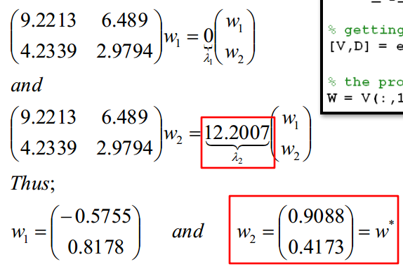

Example
Compute the Linear Discriminant projection for the following two dimensional dataset. – Samples for class $ω_{1}$: $X_{1}=(x_{1},x_{2})=\{(4,2),(2,4),(2,3),(3,6),(4,4)\}$ – Sample for class $ω_{2}$: $X_{2}=(x_{1},x_{2})=\{(9,10),(6,8),(9,5),(8,7),(10,8)\}$
The optimal projection is the one that minimizes $J=−θ^{T}S_{b}θ=−λ$
$$x_{2}$$
$$x_{1}$$

Slide 26
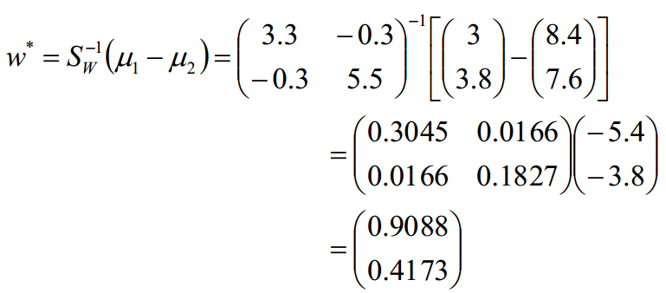

Example
Compute the Linear Discriminant projection for the following two dimensional dataset. – Samples for class $ω_{1}$: $X_{1}=(x_{1},x_{2})=\{(4,2),(2,4),(2,3),(3,6),(4,4)\}$ – Sample for class $ω_{2}$: $X_{2}=(x_{1},x_{2})=\{(9,10),(6,8),(9,5),(8,7),(10,8)\}$
Or directly,
$$x_{2}$$
$$∝$$
$$x_{1}$$
归一化

Slide 27
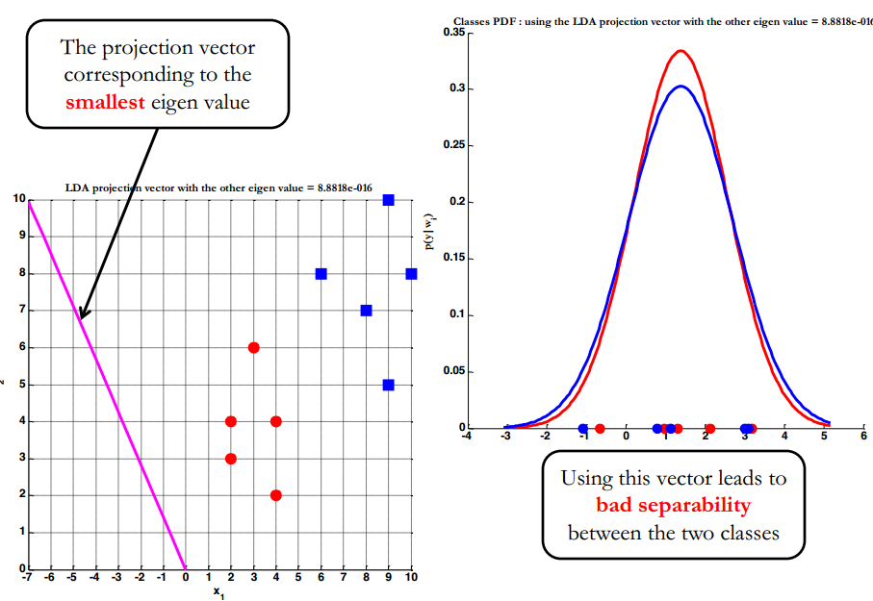


Example
概率密度函数
LDA--Projection
$$x_{2}$$
$$x_{1}$$

Slide 28
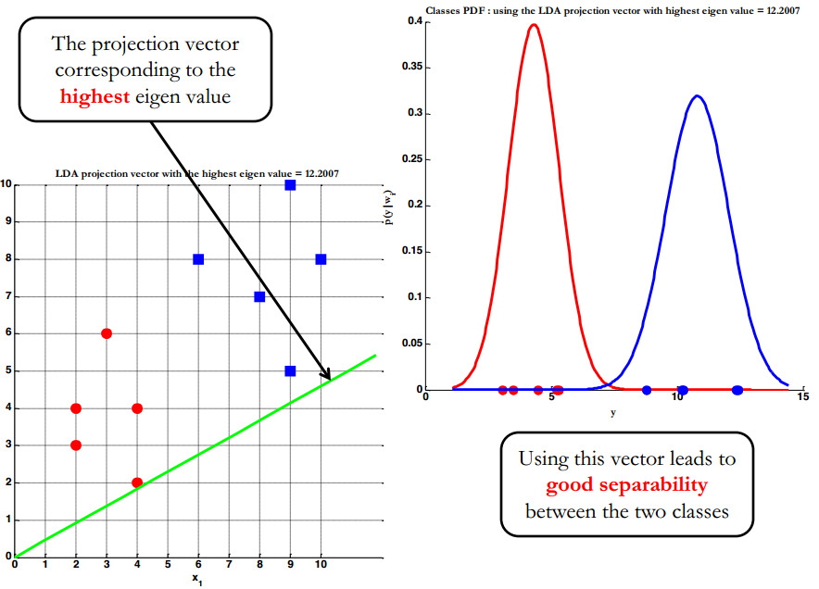

Example
LDA--Projection
$$x_{2}$$
$$x_{1}$$

Slide 29
Linear Discriminant Analysis—Two Classes
Workflow of LDA for the binary classification
Build $X_{1}$ and $X_{2}$ from the training set
Compute $μ_{1}$ and $μ_{2}$
Compute $S_{w}$
Compute $S_{w}^{−1}$
Compute $θ^{∗}=S_{w}^{−1} (μ_{1}−μ_{2})$
Given a testing sample, $y={θ^{∗}}^{T}x$
Set the threshold $γ=\frac{n_{1}{θ^{∗}}^{T}μ_{1}+n_{2}{θ^{∗}}^{T}μ_{2}}{n_{1}+n_{2}}$.
Compare $y$ with $γ$ to determine the class.

Slide 30

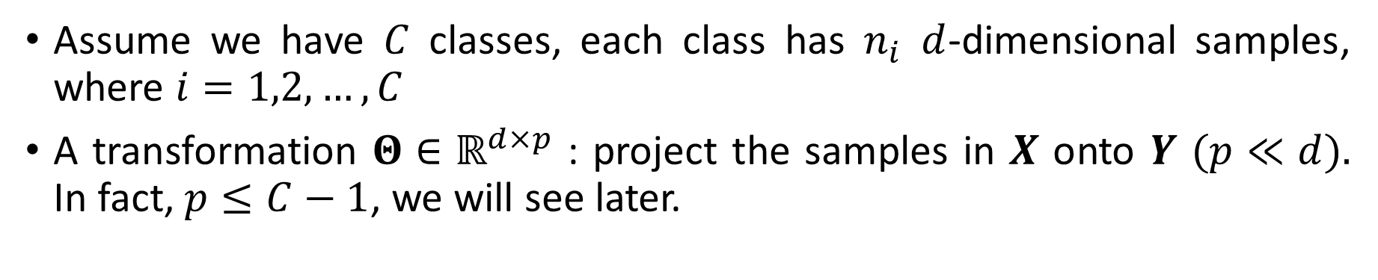
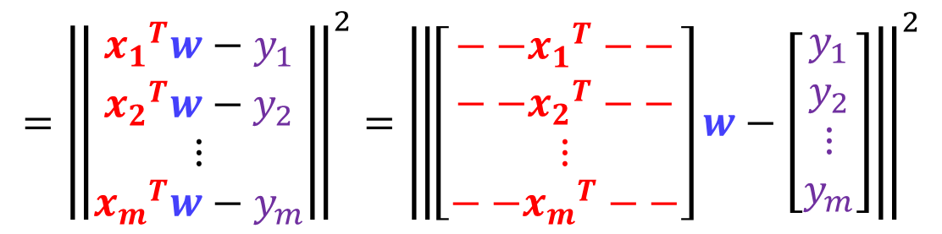



Linear Discriminant Analysis—$C$ Classes
Assume we have $C$ classes, each class has $n_{i}$ $d$-dimensional samples, where $i=1,2,…,C$
A transformation $Θ∈ℝ^{d×p}$ : project the samples in $X$ onto $Y$ $(p≪d).$ In fact, $p≤C−1$, we will see later.
$$y_{i}=Θ^{T}x_{i}$$
$$x_{i}=\left[\begin{aligned}x_{i1} \\ x_{i2} \\ ⋮ \\ x_{id}\end{aligned}\right]$$
$$y_{i}=\left[\begin{aligned}y_{i1} \\ y_{i2} \\ ⋮ \\ y_{ip}\end{aligned}\right]$$
$$Θ=\left[θ_{1},θ_{2},…,θ_{p}\right]∈ℝ^{d×p}$$

Slide 31

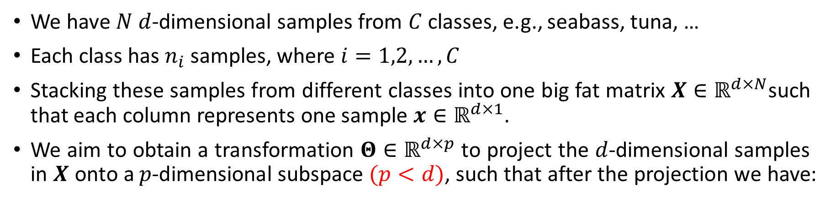
Linear Discriminant Analysis—$C$ Classes
We have $N$ $d$-dimensional samples from $C$ classes, e.g., seabass, tuna, …
Each class has $n_{i}$ samples, where $i=1,2,…,C$
Stacking these samples from different classes into one big fat matrix $X∈ℝ^{d×N}$such that each column represents one sample $x∈ℝ^{d×1}$.
We aim to obtain a transformation $Θ∈ℝ^{d×p}$ to project the $d$-dimensional samples in $X$ onto a $p$-dimensional subspace $(p<d)$, such that after the projection we have:
In fact, 𝑝≤𝐶−1, we will see later.
class means to be as far apart from each other as possible |  | the between-class scatter to be large
samples from the same class to be as close to their mean as possible |  | the within-class scatter to be small

Slide 32
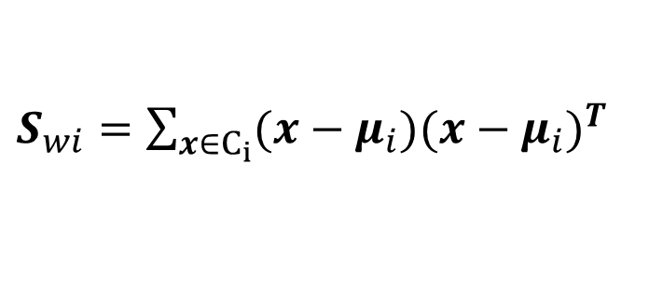
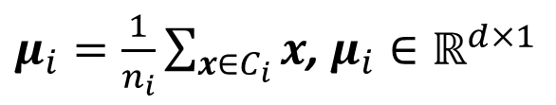




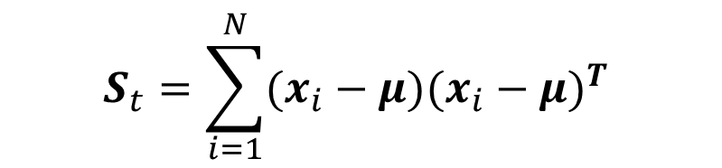
Linear Discriminant Analysis—$C$ Classes
The generalization of the within-class covariance matrix to the case of $C$ classes.
Within-class scatter:
$S_{w}=\sum_{i=1}^{C}{S_{wi}}$
$S_{wi}=\sum_{x∈C_{i}}{(x−μ_{i}){(x−μ_{i})}^{T}}$
$${S_{w}∈ℝ}^{d×d}$$
$μ_{i}=\frac{1}{n_{i}}\sum_{x∈C_{i}}{x}$, $μ_{i}∈ℝ^{d×1}$
Class mean vector (sample):
In order to find a generalization of the between-class covariance matrix, we follow Duda and Hart (1973) and consider the total covariance matrix first.
$$S_{t}=\sum_{i=1}^{N}{(x_{i}−μ){(x_{i}−μ)}^{T}}$$
$$μ=\frac{1}{N}\sum_{i=1}^{N}{x}$$

Slide 33


Linear Discriminant Analysis—$C$ Classes
The total covariance matrix can be decomposed into
$S_{t}=S_{w}+S_{b}$
Between-class scatter:
$S_{b}=\sum_{i=1}^{C}{n_{i}(μ_{i}−μ){(μ_{i}−μ)}^{T}}=\frac{1}{2N}\sum_{i,j=1}^{C}{n_{i}n_{j}(μ_{i}−μ_{j}){(μ_{i}−μ_{j})}^{T}}$
$${S_{b}∈ℝ}^{d×d}$$

Slide 34

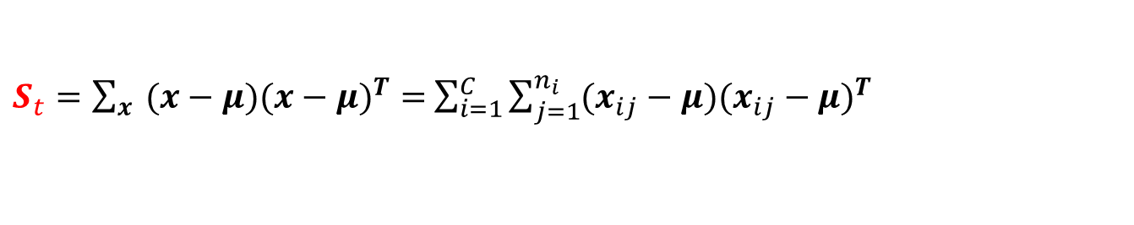


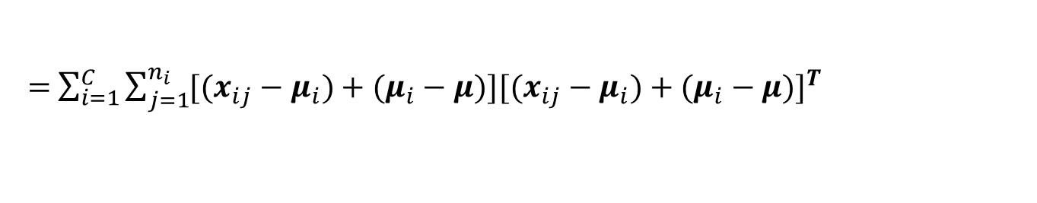

Linear Discriminant Analysis—$C$ Classes
$S_{t}=\sum_{x}{ (x−μ){(x−μ)}^{T}}=S_{w}+S_{b}$
$S_{w}=\sum_{i=1}^{C}{\sum_{x∈C_{i}}{(x−μ_{i}){(x−μ_{i})}^{T}}}$
$S_{b}=\sum_{i=1}^{C}{n_{i}(μ_{i}−μ){(μ_{i}−μ)}^{T}}$
$S_{t}=\sum_{x}{ (x−μ){(x−μ)}^{T}}=$ $\sum_{i=1}^{C}{\sum_{j=1}^{n_{i}}{(x_{ij}−μ){(x_{ij}−μ)}^{T}}}$
$$x_{ij}∈C_{i}$$
$=$ $\sum_{i=1}^{C}{\sum_{j=1}^{n_{i}}{[(x_{ij}−μ_{i})+(μ_{i}−μ){][(x_{ij}−μ_{i})+(μ_{i}−μ)]}^{T}}}$
$=$ $\sum_{i=1}^{C}{\sum_{j=1}^{n_{i}}{[\left(x_{ij}−μ_{i}\right){\left(x_{ij}−μ_{i}\right)}^{T}+\left(μ_{i}−μ\right){\left(x_{ij}−μ_{i}\right)}^{T}+\left(x_{ij}−μ_{i}\right){(μ_{i}−μ)}^{T}+\left(μ_{i}−μ\right){(μ_{i}−μ)}^{T}] }}$
$=\sum_{i=1}^{C}{\sum_{j=1}^{n_{i}}{\left[\left(x_{ij}−μ_{i}\right){\left(x_{ij}−μ_{i}\right)}^{T}+\left(μ_{i}−μ\right){\left(μ_{i}−μ\right)}^{T}\right]=S_{w}+S_{b}}}$
$\sum_{i=1}^{C}{\sum_{j=1}^{n_{i}}{\left(μ_{i}−μ\right){\left(x_{ij}−μ_{i}\right)}^{T}}}=\sum_{i=1}^{C}{\left(μ_{i}−μ\right)}$ ${\left(\sum_{j=1}^{n_{i}}{x_{ij}}−\sum_{j=1}^{n_{i}}{μ_{i}}\right)}^{T}=0$
Notes:
$\frac{1}{N}\sum_{i=1}^{C}{\sum_{j=1}^{n_{i}}{\left(x_{ij}−μ_{i}\right){(μ_{i}−μ)}^{T}}}=\frac{1}{N}\sum_{i=1}^{C}{\left(\sum_{j=1}^{n_{i}}{x_{ij}}−\sum_{j=1}^{n_{i}}{μ_{i}}\right)}$ ${\left(μ_{i}−μ\right)}^{T}=0$

Slide 35




Linear Discriminant Analysis—$C$ Classes
Assume we have $C$ classes, each class has $n_{i}$ $d$-dimensional samples, where $i=1,2,…,C$
A transformation $Θ∈ℝ^{d×p}$ : project the samples in $X$ onto $Y$ $(p≪d).$ In fact, $p≤C−1$, we will see later.
$$y_{i}=Θ^{T}x_{i}$$
$$x_{i}=\left[\begin{aligned}x_{i1} \\ x_{i2} \\ ⋮ \\ x_{id}\end{aligned}\right]$$
$$y_{i}=\left[\begin{aligned}y_{i1} \\ y_{i2} \\ ⋮ \\ y_{ip}\end{aligned}\right]$$
$$Θ=\left[θ_{1},θ_{2},…,θ_{p}\right]∈ℝ^{d×p}$$
$${\tilde{S}}_{w}=Θ^{T}S_{w}Θ$$
$${\tilde{S}}_{b}=Θ^{T}S_{b}Θ$$
$${\tilde{μ}}_{i}=Θ^{T}μ_{i}$$
$$\tilde{μ}=Θ^{T}μ$$

Slide 36
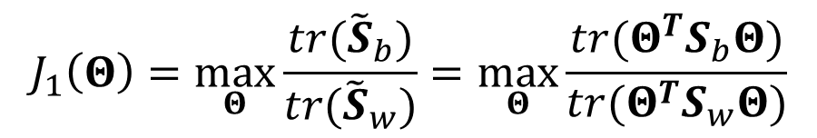

Linear Discriminant Analysis—$C$ Classes
Popular objective function:
$$J_{1}\left(Θ\right)=\max_{Θ}{\frac{tr({\tilde{S}}_{b})}{tr({\tilde{S}}_{w})}}=\max_{Θ}{\frac{tr(Θ^{T}S_{b}Θ)}{tr(Θ^{T}S_{w}Θ)}}$$
$$J_{2}\left(Θ\right)=\max_{Θ}{tr({\tilde{S}}_{w}^{−1}{\tilde{S}}_{b}) }=\max_{Θ}{tr({(Θ^{T}S_{w}Θ)}^{−1}Θ^{T}S_{b}Θ) }$$
$$J_{3}\left(Θ\right)=\frac{{|\tilde{S}}_{b}|}{{|\tilde{S}}_{w}|}$$
This technique was developed by R. A. Fisher (1936) for the two-class case and extended by C. R. Rao (1948) to handle the multiclass case.

Slide 37
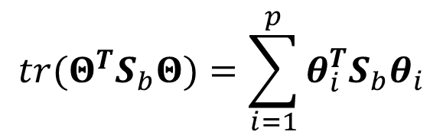

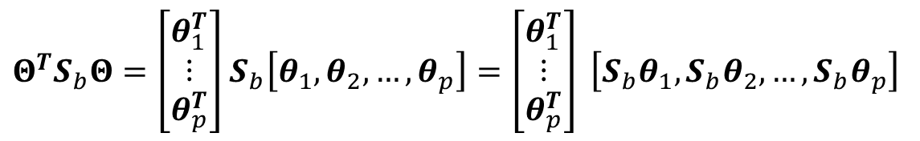
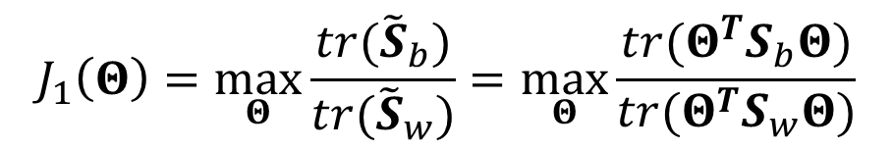


Linear Discriminant Analysis—$C$ Classes
In $J_{1}\left(Θ\right)$, what is the meaning of “trace”?
$$J_{1}\left(Θ\right)=\max_{Θ}{\frac{tr({\tilde{S}}_{b})}{tr({\tilde{S}}_{w})}}=\max_{Θ}{\frac{tr(Θ^{T}S_{b}Θ)}{tr(Θ^{T}S_{w}Θ)}}$$
$Θ^{T}S_{b}Θ=\left[\begin{aligned}θ_{1}^{T} \\ ⋮ \\ θ_{p}^{T}\end{aligned}\right]$ $S_{b}\left[θ_{1},θ_{2},…,θ_{p}\right]=\left[\begin{aligned}θ_{1}^{T} \\ ⋮ \\ θ_{p}^{T}\end{aligned}\right] \left[S_{b}θ_{1},{S_{b}θ}_{2},…,{S_{b}θ}_{p}\right]$
$$tr(Θ^{T}S_{b}Θ)=\sum_{i=1}^{p}{{θ_{i}^{T}S}_{b}θ_{i}}$$
$$tr(Θ^{T}S_{w}Θ)=\sum_{i=1}^{p}{{θ_{i}^{T}S}_{w}θ_{i}}$$

Slide 38









Linear Discriminant Analysis—$C$ Classes
Optimization $J_{1}\left(Θ\right)$:
Recall in two-classes case, we solved the eigenvalue problem.
For $C$-classes case, we have $p$ projection vectors,
$$\min_{θ}{−θ^{T}S_{b}θ}$$
$$⇒$$
$$S_{b}θ=λS_{w}θ$$
s.t. $θ^{T}S_{w}θ=1$
$${S_{w}^{−1}S}_{b}θ_{i}=λθ_{i}, i=1,2,…,p$$
Columns of $Θ^{∗}$ are eigenvectors corresponding to the largest eigenvalues:
$${S_{w}^{−1}S}_{b}Θ^{∗}=λΘ^{∗}$$
$$Θ^{∗}=\left[θ_{1}^{∗},θ_{2}^{∗},…,θ_{p}^{∗}\right]$$
$p≤C−1$, why?

Slide 39





Linear Discriminant Analysis—$C$ Classes
$S_{b}$ has a maximum rank of $C−1$.
$S_{b}$ is the sum of $C$ $rank=1$ matrices, and because only $C−1$ of these are independent,
$$S_{b}=\sum_{i=1}^{C}{\frac{n_{i}}{N}(μ_{i}−μ){(μ_{i}−μ)}^{T}}$$
Given a matrix $A_{m×n}$ and $B_{n×k}$,
$rank(AB)=min⁡(rank(A),rank(B))$
$rank\left(A+B\right)≤rank\left(A\right)+rank\left(B\right)$
$$rank\left(\left(μ_{i}−μ\right){\left(μ_{i}−μ\right)}^{T}\right)=rank\left(μ_{i}−μ\right)≤1$$
$$rank\left({S_{w}^{−1}S}_{b}\right)≤rank\left(S_{b}\right)≤C−1$$
${S_{w}^{−1}S}_{b}$ has at most $C−1$ nonzero eigenvalues.
Zero eigenvalue does not alter the value of $J_{1}\left(Θ\right)$.

Slide 40


Linear Discriminant Analysis—$C$ Classes
Workflow of LDA for the $C$-classification
Compute $μ_{i}$
Compute $S_{b}$
Compute $S_{w}^{−1}$
Compute the largest $p$ eigenvalues of $S_{w}^{−1}S_{b}$ and the corresponding eigenvectors $\{θ_{1},$ $θ_{2},…,θ_{p}$}.
Let $Θ=[θ_{1},$ $θ_{2},…,θ_{p}],$ then $y_{i}=Θ^{T}x_{i}$

Slide 41

Illustration-3 Classes

Slide 42


Slide 43

2

Slide 44


$$y=w_{1}^{T}x$$

Slide 45


$$y=w_{2}^{T}x$$

Slide 46

Apparently, the projection vector that has the highest eigenvalue provides higher discrimination power between classes.

Slide 47

Summary
Linear Discriminant Analysis—Two Classes
Minimize within-class scatter
Maximize between-class scatter
The eigenvector of the largest eigenvalue of $S_{w}^{−1}S_{b}$ (as $−{θ^{∗}}^{T}S_{b}θ^{∗}=−λ{θ^{∗}}^{T}S_{w}θ^{∗}=−λ$)
Or $θ^{∗}=S_{w}^{−1} (μ_{1}−μ_{2})$
Linear Discriminant Analysis—$C$ Classes
Dimension reduction. $Θ∈ℝ^{d×p}$ : $X→Y$ $(p≪d).$ In fact, $p≤C−1$.
Columns of $Θ^{∗}$ are eigenvectors of $S_{w}^{−1}S_{b}$ corresponding to the $p$ largest eigenvalues.

Slide 48
Backup Slides

Slide 49





Statistical Facts
Between-class scatter:
$S_{b}=\sum_{i=1}^{C}{n_{i}(μ_{i}−μ){(μ_{i}−μ)}^{T}}=\frac{1}{2N}\sum_{i,j=1}^{C}{n_{i}n_{j}(μ_{i}−μ_{j}){(μ_{i}−μ_{j})}^{T}}$
$\frac{1}{2N}\sum_{i,j=1}^{C}{n_{i}n_{j}(μ_{i}−μ_{j}){(μ_{i}−μ_{j})}^{T}}=\frac{1}{2N}\sum_{i,j=1}^{C}{n_{i}n_{j}[(μ_{i}−μ)+(μ−μ_{j})]{[\left(μ_{i}−μ\right)+(μ−μ_{j})]}^{T}}$
$=\frac{1}{2N}\sum_{i,j=1}^{C}{n_{i}n_{j}[\left(μ_{i}−μ\right){\left(μ_{i}−μ\right)}^{T}+\left(μ−μ_{j}\right){\left(μ_{i}−μ\right)}^{T}+(μ_{i}−μ){(μ−μ_{j})}^{T}+(μ−μ_{j}){(μ−μ_{j})}^{T}]}$
$=\frac{1}{2N}\sum_{i,j=1}^{C}{n_{i}n_{j}[\left(μ_{i}−μ\right){\left(μ_{i}−μ\right)}^{T}+(μ−μ_{j}){(μ−μ_{j})}^{T}]}$
$=\frac{1}{2}\sum_{i=1}^{C}{n_{i}\left(μ_{i}−μ\right){\left(μ_{i}−μ\right)}^{T}}+\frac{1}{2}\sum_{j=1}^{C}{n_{j}(μ−μ_{j}){(μ−μ_{j})}^{T}}$
$=\sum_{i=1}^{C}{n_{i}\left(μ_{i}−μ\right){\left(μ_{i}−μ\right)}^{T}}=$ $S_{b}$

Slide 50
Relation to Least Squares
The least-squares approach: based on the goal of making the model predictions as close as possible to a set of target values.
By contrast, the LDA (Fisher criterion) was derived by requiring maximum class separation in the output space.
It is interesting to see the relationship between these two approaches.

Slide 51


Relation to Least Squares
We adopt a slightly different target coding scheme instead of {1,-1}.
Then the least-squares solution becomes equivalent to the Fisher solution (Duda and Hart, 1973).
In particular, we shall take the targets ($y_{i}$) for class $C_{1}$ to be $\frac{N}{n_{1}}.$
For class $C_{2}$, we shall take the targets ($y_{i}$) to be $−\frac{N}{n_{2}}.$
$(n_{1}+n_{2}=N)$
$J=\frac{1}{2}\sum_{n=1}^{N}{{(w^{T}x_{n}+b−y_{n})}^{2}}$

Slide 52











Relation to Least Squares
$E=\frac{1}{2}\sum_{n=1}^{N}{{(w^{T}x_{n}+b−y_{n})}^{2}}$
$$\frac{∂E}{∂b}=0$$
$\sum_{n=1}^{N}{\left(w^{T}x_{n}+b−y_{n}\right)=0}$
$$⟹$$
$$\frac{∂E}{∂w}=0$$
$\sum_{n=1}^{N}{\left(w^{T}x_{n}+b−y_{n}\right)x_{n}=0}$
$$b=−w^{T}m$$
$$\sum_{n=1}^{N}{y_{n}}=n_{1}\frac{N}{n_{1}}−n_{2}\frac{N}{n_{2}}=0$$
$$⟹$$
$m=\frac{1}{N}\sum_{n=1}^{N}{x_{n}}$
$=\frac{1}{N}(n_{1}m_{1}+n_{2}m_{2})$

Slide 53








Relation to Least Squares
$$\frac{∂E}{∂w}=0$$
$\sum_{n=1}^{N}{\left(w^{T}x_{n}+b−y_{n}\right)x_{n}=0}$
$$b=−w^{T}m$$
$$⟹$$
$m=\frac{1}{N}(n_{1}m_{1}+n_{2}m_{2})$
$$\left(S_{w}+\frac{n_{1}n_{2}}{N}S_{b}\right)w=N(m_{1}−m_{2})$$
Leave for your homework
$S_{b}w$ is always in the direction of ${(m}_{2}−m_{1})$
$$w∝S_{w}^{−1}(m_{2}−m_{1})$$

Slide 54

Relation to Least Squares
This tells us that a new vector $x$ should be classified as belonging to class $C_{1}$ if $y(x)=w^{T}(x−m)>0$ and class $C_{2}$ otherwise.
For the two-class problem, LDA can be obtained as a special case of least squares.

