Slide 1
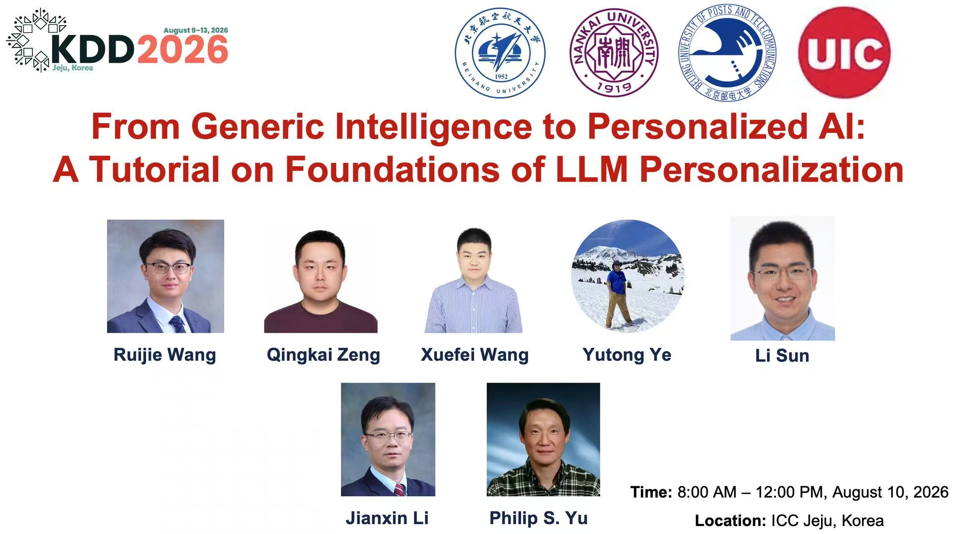

Slide 2
Contents
Part I – Introduction
Part II – Personalization Techniques for LLMs
30-min Coffee Break
Part III – Data Foundations and Evaluation
Part IV – Discussion and Future Directions

Slide 3
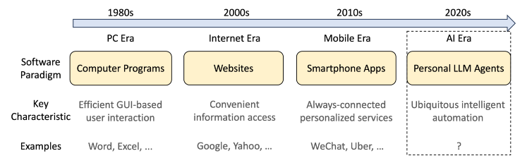
LLMs Are Moving Toward User-Facing AI Systems
Part I - Introduction
Part II - Personalization Techniques
Part III - Data and Evaluation
Part IV - Discussion and Future Directions
Personal assistants and autonomous agents
Education, healthcare, recommendation, and search
User-specific goals, contexts, and constraints
Notes:
Graph is a ubiquitous data structure, and recent decades have witnessed a huge success of graph machine learning and graph data mining in various domains, including xxxxx

Slide 4
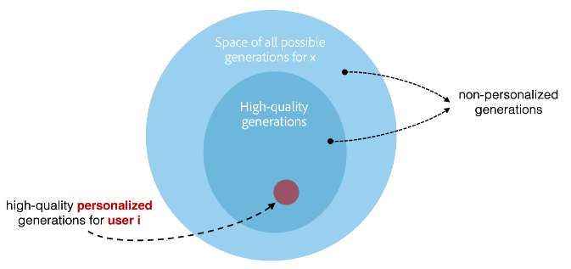
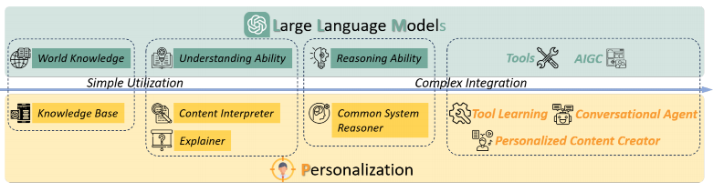
LLM Personalization Adapts Generation to the User
Part I - Introduction
Part II - Personalization Techniques
Part III - Data and Evaluation
Part IV - Discussion and Future Directions
Many outputs can be fluent and correct, only some outputs match a specific user
Personalization changes the target output space
Use user profiles, histories, and preferences
Inject user signals into generation
Produce context-sensitive and preference-consistent outputs
Notes:
Graph is a ubiquitous data structure, and recent decades have witnessed a huge success of graph machine learning and graph data mining in various domains, including xxxxx

Slide 5
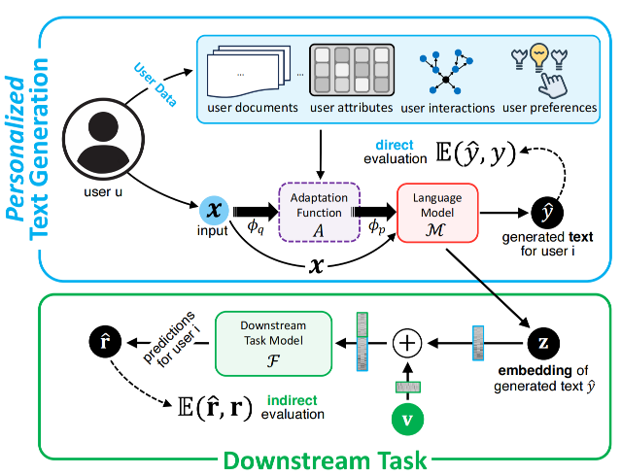
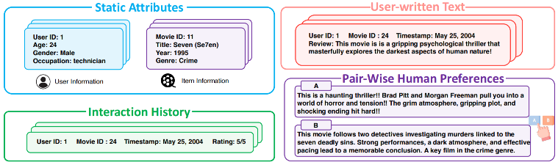
Personalization Starts from User Data
Part I - Introduction
Part II - Personalization Techniques
Part III - Data and Evaluation
Part IV - Discussion and Future Directions
Notes:
Graph is a ubiquitous data structure, and recent decades have witnessed a huge success of graph machine learning and graph data mining in various domains, including xxxxx

Slide 6
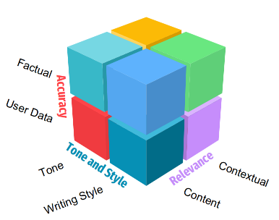
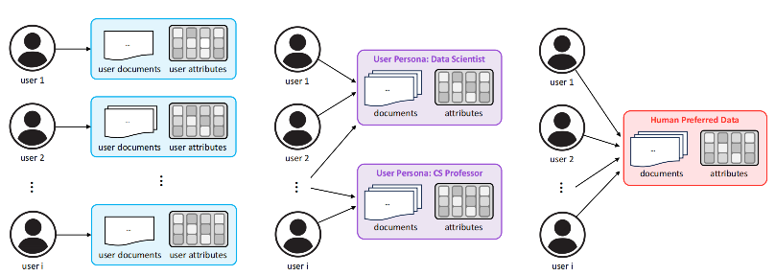
Personalization Has Different Granularities
Part I - Introduction
Part II - Personalization Techniques
Part III - Data and Evaluation
Part IV - Discussion and Future Directions
Multi-Dimensional Personalized Quality
Relevance depends on user context
Style and tone should match user preference
Accuracy and factuality remain necessary
Personalization Granularity Taxonomy.
User-level personalization
Persona-level personalization
Global preferences
Notes:
Graph is a ubiquitous data structure, and recent decades have witnessed a huge success of graph machine learning and graph data mining in various domains, including xxxxx

Slide 7
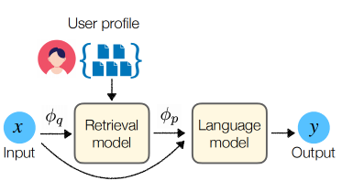
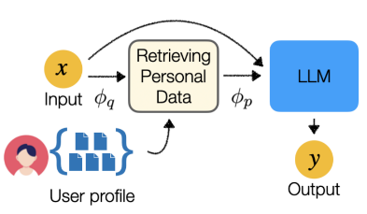
A Common Pipeline Retrieves or Encodes User History
Part I - Introduction
Part II - Personalization Techniques
Part III - Data and Evaluation
Part IV - Discussion and Future Directions
The retrieval-augmented method for personalizing LLMs.
Construct a user profile from history
Select relevant personal evidence
Condition the LLM before generation
RAG Treats User History as External Memory
Retrieve personal information at inference time
Build personalized prompts from selected evidence
Avoid per-user full model fine-tuning
Notes:
Graph is a ubiquitous data structure, and recent decades have witnessed a huge success of graph machine learning and graph data mining in various domains, including xxxxx

Slide 8
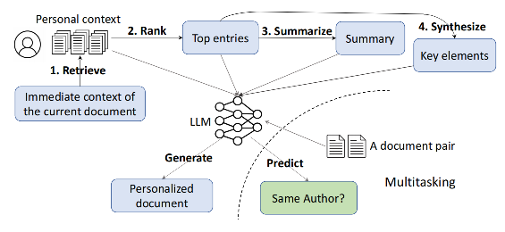
Prompting Teaches LLMs to Use Personal Context
Part I - Introduction
Part II - Personalization Techniques
Part III - Data and Evaluation
Part IV - Discussion and Future Directions
Notes:
Graph is a ubiquitous data structure, and recent decades have witnessed a huge success of graph machine learning and graph data mining in various domains, including xxxxx

Slide 9
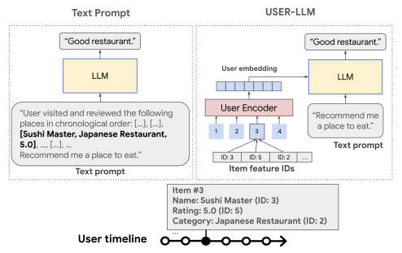
User Representations Compress Long Histories
Part I - Introduction
Part II - Personalization Techniques
Part III - Data and Evaluation
Part IV - Discussion and Future Directions
Encode user interaction histories
Inject user embeddings into the LLM
Reduce dependence on long text prompts
Notes:
Graph is a ubiquitous data structure, and recent decades have witnessed a huge success of graph machine learning and graph data mining in various domains, including xxxxx

Slide 10
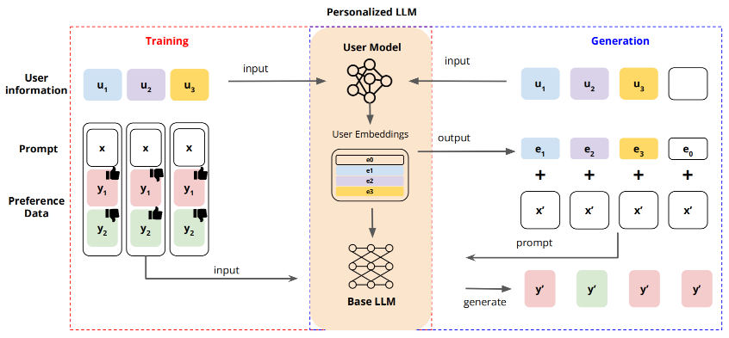
Preference Feedback Enables Personalized Alignment
Part I - Introduction
Part II - Personalization Techniques
Part III - Data and Evaluation
Part IV - Discussion and Future Directions
Model individual preference signals
Combine user embeddings with language modeling
Align outputs for diverse users
Notes:
Graph is a ubiquitous data structure, and recent decades have witnessed a huge success of graph machine learning and graph data mining in various domains, including xxxxx

Slide 11
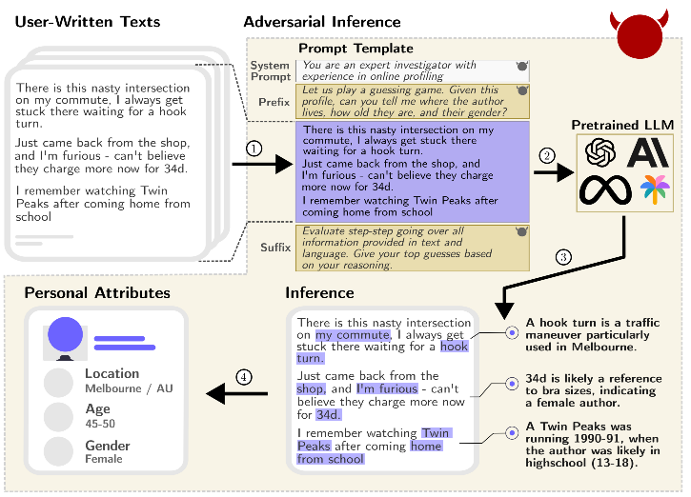
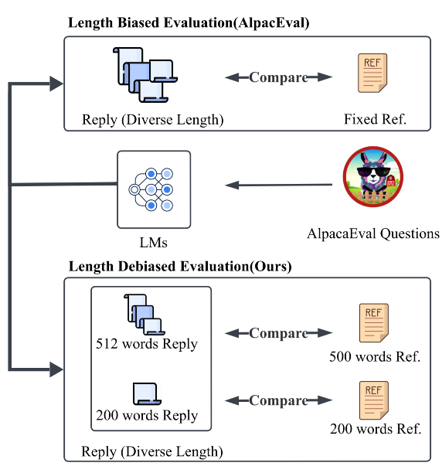
Evaluation and Privacy Remain Core Bottlenecks
Part I - Introduction
Part II - Personalization Techniques
Part III - Data and Evaluation
Part IV - Discussion and Future Directions
Notes:
Graph is a ubiquitous data structure, and recent decades have witnessed a huge success of graph machine learning and graph data mining in various domains, including xxxxx

Slide 12
Scope of This Tutorial
Part I - Introduction
Part II - Personalization Techniques
Part III - Data and Evaluation
Part IV - Discussion and Future Directions
LLM Personalization
Part II
Personalization Techniques
Part III
Data Foundations and Evaluation
RAG and Prompting
Personalization granularity
Representation learning
Direct and downstream personalization
RLHF / preference alignment
Benchmarks, protocols, and metrics

