Slide 1
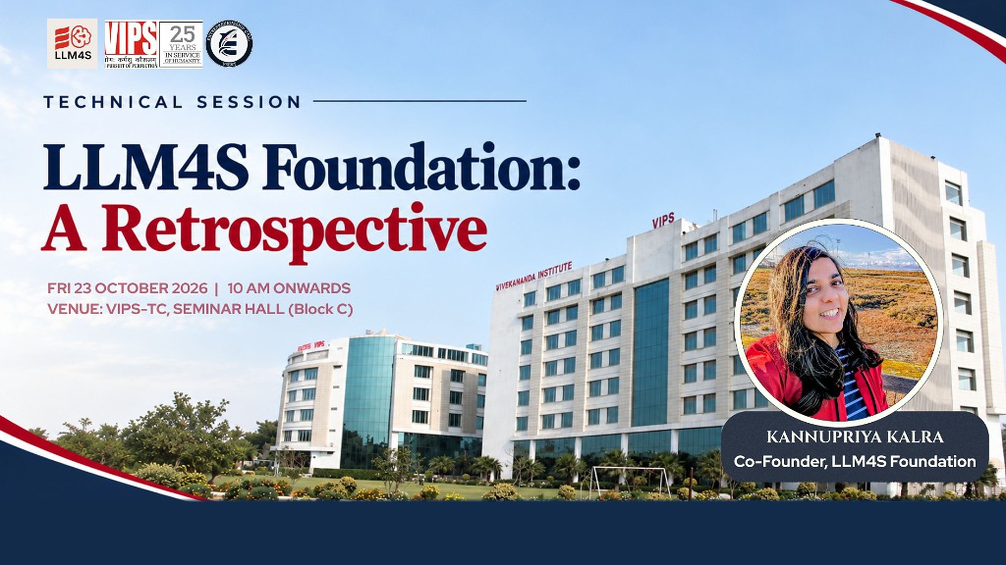
OUR MISSION Learn AI by building AI.
llm4s.org

Slide 2

OUR MISSION
Learn AI
by building AI.
Empowering developers through hands-on GenAI projects, open-source contribution and responsible AI education.
400+
50
15
Free
COMMUNITY MEMBERS
MENTORS
LOCAL CHAPTERS
TO JOIN

Slide 3
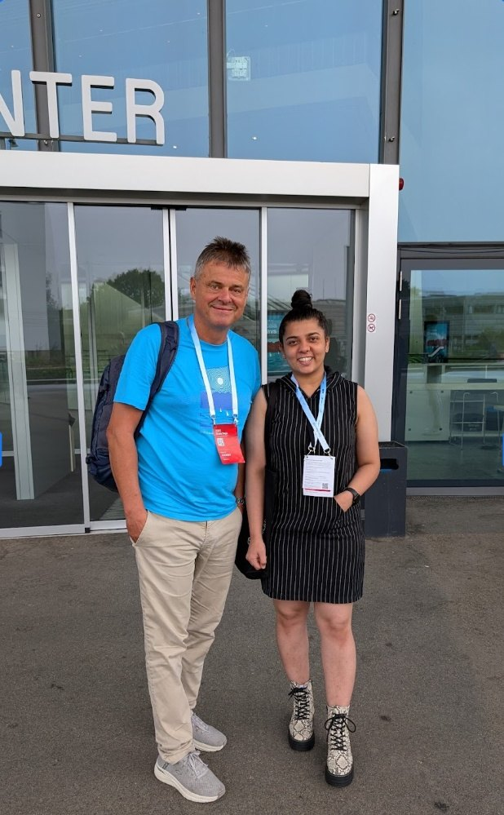
Kannupriya Kalra
ABOUT THE SPEAKER
Co-Founder, LLM4S Foundation · London · linkedin.com/in/kannupriyakalra
CREATOR
LLM4S, an AI-native platform for Scala and the JVM
OPEN SOURCE
Contributes to AI and Scala through the Scala Center and Google Open Source
GSOC
Led the Scala Center's Google Summer of Code programmes in 2024 and 2025
AUTHOR
Four AI courses with Manning Publications, New York
SPEAKER
AI, Scala and open source in more than ten countries
ENGINEER
Built scalable backend systems in functional Scala at Sky, London
With Martin Odersky, creator of Scala, at Scala Days 2025 in Lausanne, discussing LLM4S

Slide 4
How to become an AI engineer through open source
WHY THIS TALK
LLM4S is an AI non-profit that gives you real-world, corporate-style experience for your resume, free of charge.
01
Your edge
Open source, your portfolio, and how to start
FIRST COMMIT
29 Jan 2025
02
The LLM4S story
From one commit to a global community
03
The lessons
LATEST RELEASE
Five lessons for anyone building in public
v0.5.1, 15 Oct 2026
04
Your turn
What you can do this week
NEXT
1.0
05
For founders
Open source as a launchpad for your startup

Slide 5
Words you'll hear today
01 · YOUR EDGE
Open source
GitHub
Commit
Pull request
Code anyone can read, use and improve
The website where code projects live
One saved change, with a note
A proposed change, sent to be checked
Like: a recipe published for everyone to cook and improve
Like: Google Drive for code, with every change saved
Like: saving a version of your assignment
Like: suggesting mode in a shared Google Doc
Code review
Maintainer
Scrum call
LLM
An experienced person checks your change
Someone who looks after a project
A short team check-in: done, next, blocked
The kind of AI behind ChatGPT
Like: a teacher marking work before it goes on the board
Like: a magazine editor deciding what gets printed
Like: a cricket team's huddle between overs
Like: your phone's autocomplete, hugely scaled up

Slide 6




What is open source, and why does it matter?
01 · YOUR EDGE
Software whose code anyone can read, use, change and share, under a licence that says so.
YOU ALREADY USE IT EVERY DAY
Android
Linux
Read it
your phone
most of the internet's servers
Every line is public, so you learn how real systems are built
Python
PyTorch
Use it
the language of AI
training AI models
Free to use, including at work and in your own products
Kubernetes
Apache Spark
Change it
running cloud apps
big data, written in Scala
Adapt it to your needs, or fix what is broken
Share it
LLM4S is open source too, under the MIT licence: free to use, free to join.
Send your improvements back, and your name goes with them

Slide 7




Why your portfolio matters more than a certificate
01 · YOUR EDGE
A degree
A certificate
A portfolio
says you studied
says you finished a course
shows what you can do, and anyone can check it
WHAT AN OPEN-SOURCE PORTFOLIO PROVES
EXAMPLE RESUME LINE
You can work on real software, not just a class project
Open-source contributor, LLM4S Foundation
Built a feature for an open-source AI project; reviewed by senior engineers and shipped in a public release.
github.com/llm4s/llm4s/pull/…
You can take feedback and improve
You can collaborate with a team across time zones
You ship: your work is in a public release

Slide 8
Open source beats an expensive bootcamp
01 · YOUR EDGE
A PAID BOOTCAMP
OPEN SOURCE WITH LLM4S
COST
Course fees
Free: we don't charge anything. Google Summer of Code even pays a stipend
WHAT YOU BUILD
Capstone projects for a grade
Real software people use, shipped in 36 releases
WHO GUIDES YOU
Instructors on a fixed syllabus
Working engineers who check your work and reply fast
ON YOUR RESUME
A course certificate
Real-world experience: contributor to a real AI project, with work anyone can verify
YOUR NETWORK
One cohort
A global community of 400+ across time zones
STRUCTURE
A set curriculum and schedule
You pick the problems, and mentors help you scope them
Open source asks for initiative. In return it gives you real work, real reviewers and a public record of both.

Slide 9

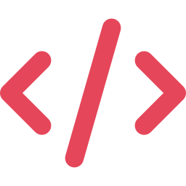




Not one exhausted maintainer. A whole team.
01 · YOUR EDGE
MOST OPEN-SOURCE PROJECTS
Senior mentors
Pair programming
60%
Frequent calls with mentors and maintainers, online weekly and in person, like today.
Two people, one screen. Every Sunday at Dev Hour, code with people worldwide.
of maintainers are unpaid
60%
A buddy mentor
Remote and global
have quit or considered quitting
Someone is assigned to onboard you fast, so you are never stuck on day one.
50 mentors in 12 countries and 15 local chapters: build global connections from Delhi.
Often one tired maintainer carries the whole load, and newcomers wait.
Fast reviews
Free, and non-profit
Tidelift open source maintainer survey, 2024 (two years ago)
539 changes accepted in the 30 days to 21 Oct 2026. Nobody waits weeks.
We don't charge anything. What you gain is real experience, on your resume.

Slide 10



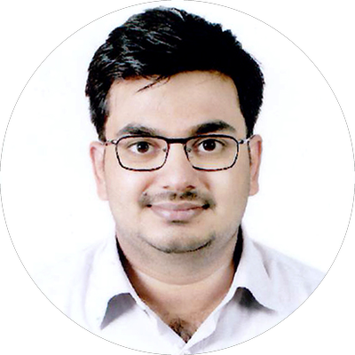




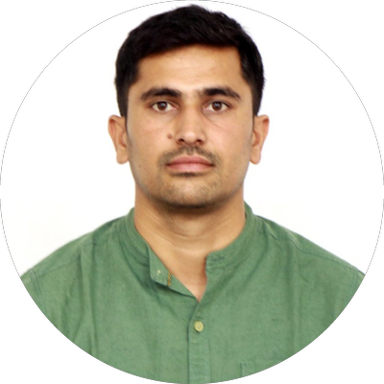

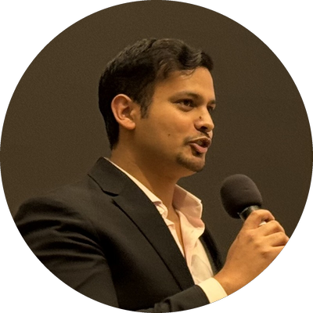

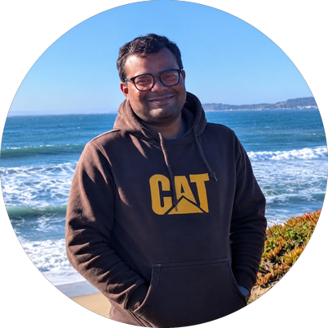

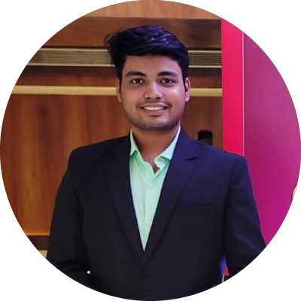

Your local chapter leads: 15 cities, 9 countries
01 · YOUR EDGE
Ansh K Shah
Dmitry Mamonov
Vitthal Mirji
Seattle
London
Germany
Aatif Ullah
Elvan Konukseven
New York
Switzerland
Vansh Sharma
DELHI · YOUR CITY
Olivier Nouguier
France
Lucky Shekhawat
Hyderabad
Giovanni Ruggiero
Pritish Yuvraj
Gopi Trinadh
Italy
San Francisco
Texas
Ipsit Sahoo
Yoshita Sharma
Silicon Valley
Abu Dhabi
Shubham Vishwakarma
Gagandeep Kalra
Mumbai
Singapore
Chapter leads organise local events and lead the LLM4S community in their city · Source: llm4s.org/people

Slide 11

How a real engineering team works, in the open
01 · YOUR EDGE
IN A COMPANY
IN LLM4S, WHERE YOU CAN WATCH AND JOIN
A stand-up or scrum call: a short team check-in
Sunday Dev Hour: we pick what to build, then code it together
A task board: who is doing what
GitHub issues and project boards
A senior checks work before it goes live
Every pull request is reviewed by a maintainer
Automatic quality checks
Automated tests check every change before it is accepted
Plans before big changes
17 design documents for large changes
Regular releases
36 releases, each with notes on what changed

Slide 12




Your path: from first issue to the global stage
01 · YOUR EDGE
STEP 1
STEP 2
STEP 3
STEP 4
STEP 5
STEP 6
Join the Discord
Watch Dev Hour
First change
Own a feature
Mentorship
Write and speak
Say hello, ask anything
Sundays at 14:30 IST
A beginner task, labelled for you
Scope it with a maintainer
Paired with an experienced mentor
Blogs, talks, conferences
50
mentors
IT HAPPENS
engineers and researchers in 12 countries
Shubham Vishwakarma built a real part of LLM4S with a mentor in 2025, then co-presented LLM4S at Oaisys 2025, an AI conference in Pune. Today he leads our Mumbai chapter.
India, the US, the UK, across Europe, Singapore and Ethiopia

Slide 13
It started with one commit
02 · THE LLM4S STORY
In January 2025, most LLM work happened in Python.
$ git log --reverse
2025-01-29 Rory Graves
Initial commit
2025-01-29 Rory Graves
Initial base code calling an llm
2025-02-04 Rory Graves
Update README.md
... 1,761 more
Teams building in Scala and Java had no reliable AI toolkit.
So the first commit did the smallest useful thing: ask an AI a question from Scala.
Everything since has grown from that one call.
Source: git history of github.com/llm4s/llm4s, 1,764 commits as of 21 Oct 2026

Slide 14
From one call to 1.0, in public
02 · THE LLM4S STORY
JAN 2025
APR 2025
JUL 2025
DEC 2025
OCT 2026
First commit: code that asks an AI a question
First release anyone can download
Weekly Dev Hour begins
Answers questions from your own documents
Rebuilt into smaller, plug-in parts
FEB 2025
MAY 2025
AUG 2025
FEB 2026
NEXT
First talk, in San Francisco
Four Google Summer of Code students join
Szork live on stage in Switzerland
A big reliability upgrade
Version 1.0: a promise of stability
Sources: CHANGELOG.md and git history of github.com/llm4s/llm4s; talks archive in the LLM4S README

Slide 15
Twenty-one months, by the numbers
02 · THE LLM4S STORY
1,764
36
70+
200+
commits
releases
code contributors
contributors
since 29 Jan 2025
v0.1.0 to v0.5.1
with commits on main
across the community
400+
14
7
4
community members
talks
countries
GSoC contributors
and growing
2025 to 2026, before today
across three continents
Google Summer of Code 2025
Sources: git history and CHANGELOG.md of github.com/llm4s/llm4s, read 21 Oct 2026; talks archive in the README; contributor and member counts from the LLM4S Foundation

Slide 16
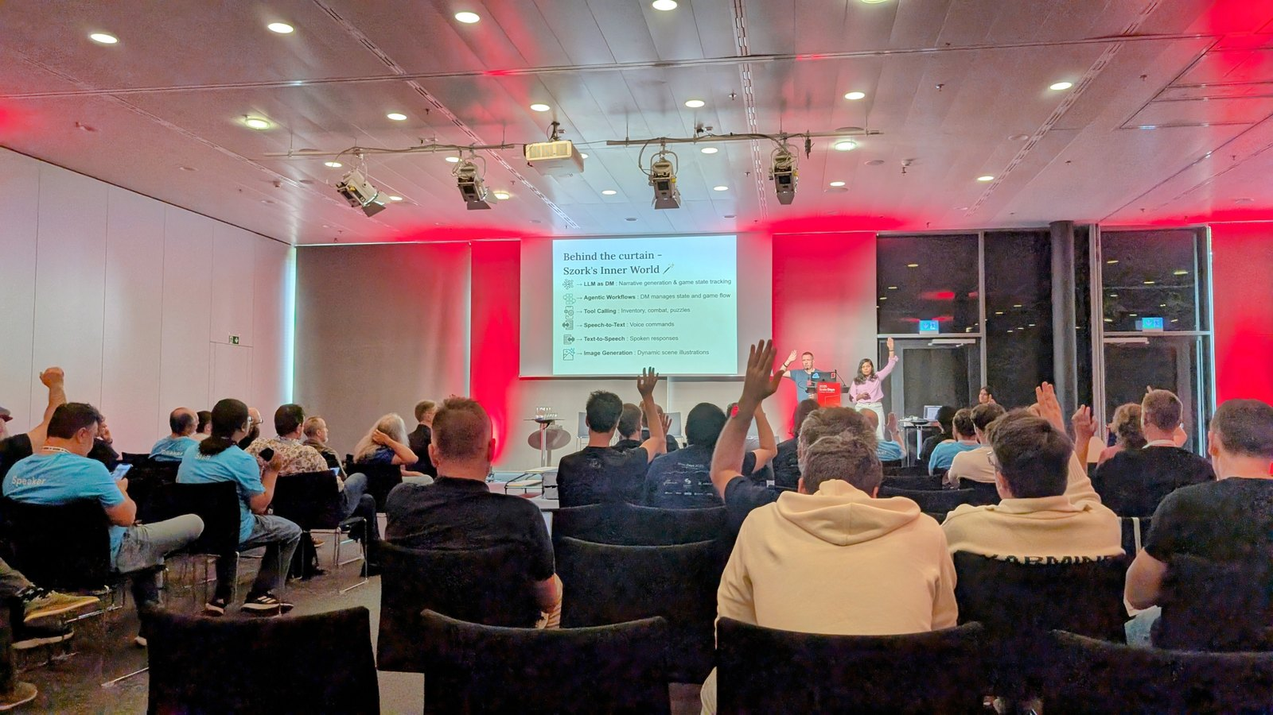





Szork: the demo that made it click
02 · THE LLM4S STORY
A voice-controlled text adventure that reimagines Zork. An LLM4S agent runs the game as its Dungeon Master.
Agent as Dungeon Master · story, world and inventory
Speak your moves · speech-to-text
Narrated aloud · text-to-speech
Illustrated scenes · AI art for every new location
WATCH THE TALK
Scala Days 2025, Lausanne
Scala Days 2025, SwissTech Convention Center, EPFL, Lausanne
youtube.com/watch?v=5od95FbNjiI

Slide 17
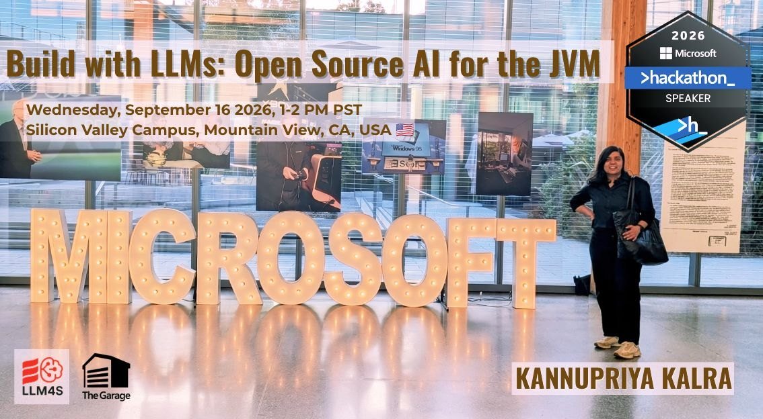
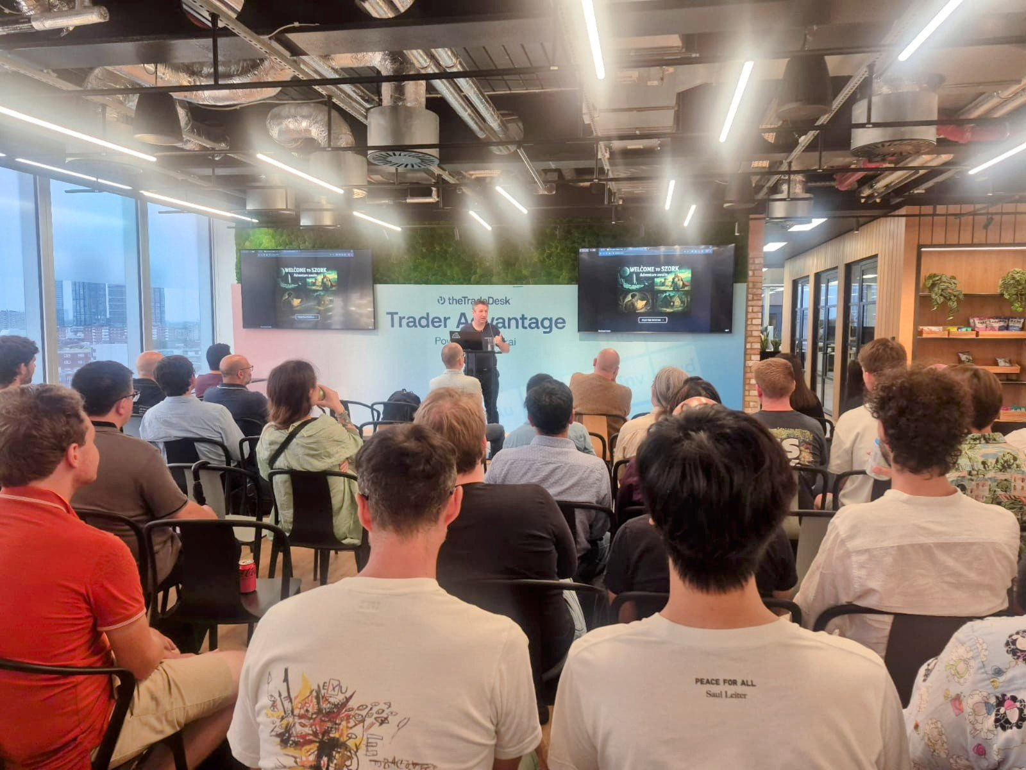
14 talks in 7 countries, before today
02 · THE LLM4S STORY
4
United States
San Francisco: Bay Area Scala · Dallas Scala Enthusiasts · San Jose: AI Compute & Hardware · Mountain View: Microsoft Global Hackathon
3
Switzerland
Lausanne: Scala Days and Scala Center lightning talks · Zürich Scala Enthusiasts
2
United Kingdom
London Scala Users Group · GenAI London
2
India
Scala India · Oaisys AI Practitioners Conference, Pune
1
Poland
Functional World, Gdańsk
1
Germany
Google Summer of Code Mentor Summit, Munich
1
Singapore
ICFP/SPLASH, Scala Workshop
NEXT LLM4S 1.0 talks · Singapore, 17 Nov · London, 25 and 26 Nov
Microsoft Global Hackathon, Mountain View, Sep 2026 (top); London Scala Users Group, Aug 2025

Slide 18
Five lessons for anyone building in public
03 · THE LESSONS
01
Ship the smallest thing that works.
Our first commit asked an AI one question. Everything else came later.
02
Make it weekly.
Dev Hour has been on every Sunday since July 2025. A fixed slot gives newcomers a standing way in.
03
Tell the story in public.
Fourteen talks in seven countries, each one in front of people who had never heard of us.
04
Mentor, and you multiply.
Four students, each with a mentor, built big parts of LLM4S in a single summer.
05
Clean up before you promise.
Fix your foundations before people depend on you, like repairing a house before guests move in.

Slide 19





Start this week
04 · YOUR TURN
Star the repo
Join the Discord
Join Dev Hour
Try it
Follow releases, read the code, open an issue.
Ask anything, find a first issue, meet the maintainers.
Live on Discord. Watch first, then drive.
Start with the beginner guide on llm4s.org.
Sundays
14:30 IST
github.com/llm4s/llm4s
discord.gg/4uvTPn6qww
09:00 London
llm4s.org
Students: LLM4S has mentored through Google Summer of Code. The next mentorship rounds are announced on Discord.

Slide 20
Building an AI non-profit is building a startup
05 · FOR FOUNDERS
IN A STARTUP
AT LLM4S
Build an MVP: the smallest version that works
First commit, January 2025: one call to an AI
Build in public and get feedback early
All work on GitHub, and live every Sunday at Dev Hour
Raise funding
Google funded paid student contributors through Summer of Code
Hire a team
50 mentors and 15 chapter leads in 9 countries
Market it
14 talks in 7 countries, before today
Ship, listen, improve
36 releases in 18 months

Slide 21
Open source first, startup later
05 · FOR FOUNDERS
2009 → 2013
LinkedIn → 2014
2011 → 2014
Apache Spark → Databricks
Apache Kafka → Confluent
GitLab → GitLab Inc.
A UC Berkeley research project, open-sourced in 2010. Its creators founded Databricks in 2013.
Built by engineers at LinkedIn, who founded Confluent in 2014. It filed to go public in 2021.
One developer's project, built at home in Ukraine. A company in 2014, then Y Combinator, then NASDAQ in 2021.
2009 → 2012
Oct 2022 → 2023
2004 → 2011
Elasticsearch → Elastic
LangChain → a company
Scala → Typesafe
Started by one developer in 2009. The company followed in 2012 and listed in New York in 2018.
An open-source AI library that became a funded company, LangChain Inc., within about six months.
Martin Odersky's language led him to co-found Typesafe (now Lightbend) in 2011. LLM4S is built in Scala.
THE PATTERN Build something useful in the open. Earn users and trust. Then build the business.

Slide 22
Traction: slow, then steady
05 · FOR FOUNDERS
About 270
GitHub stars (like bookmarks) by October 2026, from 1 in February 2025
Jun to Aug 2025
The steepest climb, 49 to 114: GSoC, the London Scala talk and Scala Days
Jan to Feb 2026
Another step, 178 to 210, around a major release
Approximate monthly values, read from the star-history chart in the LLM4S README on 21 Oct 2026

Slide 23





Test your startup idea in open source
05 · FOR FOUNDERS
Real users, early
A global network
Skills that compound
People around the world tell you what they actually need, before you spend a rupee.
50 mentors and 15 chapters: future co-founders, advisors and first customers.
AI, teamwork, shipping, writing and speaking, while you are still a student.
Funding pathways
Credibility
Low risk
Programmes like Google Summer of Code pay contributors; a public track record helps with grants and investors.
A public record of what you built, who reviewed it and who uses it.
Free, no office, no fees. Test the waters before you quit anything.
FOR TODAY'S PITCHES Show the smallest version that works, proof that real people want it, and the team behind it.

Slide 24
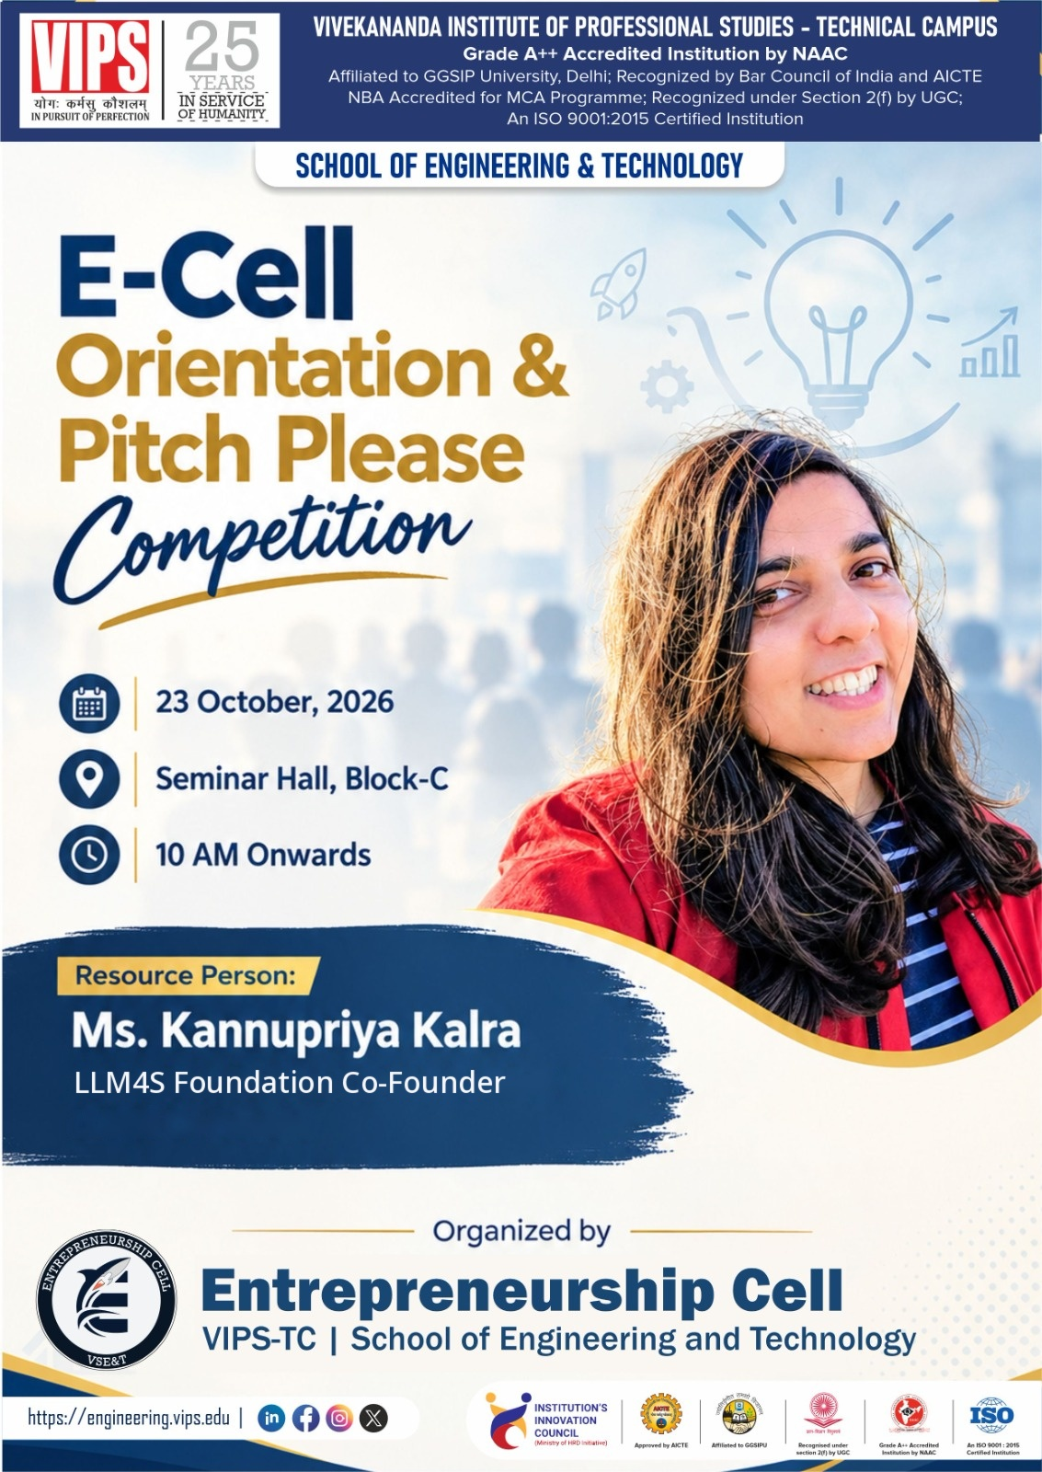


Thank you, VIPS-TC!
Questions?
Good luck to every team at Pitch Please.
EMAIL
kannupriya@llm4s.org
LINKEDIN
linkedin.com/in/kannupriyakalra
WEB
llm4s.org
LINKEDIN
GITHUB

