Slide 1

Slide 1: Title Slide
Page Layout: title
Visual Specification:
Background: Animated gradient transitioning between Scala red (#DC322F) and AI blue (#0066CC)
Logo: LLM4S Logo (bottom center)
Visual effect: Subtle particle animation suggesting neural connections

Slide 2
Scala Meets GenAI

Slide 3
Build the Cool Stuff with LLM4S
Presenters: Rory Graves & Kannupriya Kalra
Event: London Scala User Group | August 13th, 2024
Notes:
Instead of starting with introductions, we're going to jump right in. Can you build the coolest GenAI apps in Scala? Let's find out with a game!

Slide 4

Slide 2: Let's Play a Game!
SZork

Slide 5
Let's Play SZork!
Features:
• Real-time story generation
• Dynamic image creation
• Adaptive music
• Voice input support
100% Scala-Powered AI Adventure
Notes:
This is SZork - a fully AI-powered text adventure game. Everything you're about to see - the story, the images, the music - is generated in real-time by AI, orchestrated entirely through Scala and LLM4S.

Slide 6
Slide 3: Choose Your Adventure
VOTE NOW: What kind of adventure?
🏰 Classic Fantasy
Dungeons & Dragons style
🚀 Sci-Fi Space
Space exploration
🕵️ Mystery Mansion
Detective story
🌊 Underwater
Ocean depths
☢️ Post-Apocalyptic
Survival
⏰ Time Travel
Historical
🌃 Cyberpunk
Neo-noir
🤠 Wild West
Frontier
Notes:
Let's make this interactive! Show of hands - which adventure theme should we play? [Count votes] Great, looks like [winner] wins!

Slide 7
Slide 4: Choose Your Art Style
VOTE: Pick the art style!
Notes:
And now for the visual style - which one appeals to you? [Take vote] Perfect! Let's start the game with [chosen theme] in [chosen style].

Slide 8
Slide 5: The Magic Behind the Scenes
OpenAI GPT-4
(Story)
LLM4S
Scala
Suno AI
(Music)
DALL-E 3
(Images)
TTS
(Narration)
Whisper
(Speech)
AI Services Orchestra
Real-Time Integration:
• LLM4S (Scala) → OpenAI GPT-4 (Story)
• LLM4S (Scala) → DALL-E 3 (Images)
• LLM4S (Scala) → Whisper (Speech-to-Text)
• LLM4S (Scala) → TTS (Narration)
• LLM4S (Scala) → Suno AI (Music)
API Calls Per Turn:
• Story generation: 2-3 calls
• Image creation: 1 call
• Music generation: 1 call
• Total latency: ~5-8 seconds
Notes:
[Open browser dev tools] Look at this - every aspect is powered by different AI services, all orchestrated through LLM4S. No Python, no JavaScript AI libraries - pure Scala managing this complex multi-modal experience.

Slide 9


Slide 6: Who We Are
Meet the Founders
Rory Graves
Kannupriya Kalra
Co-founder & CTO
Co-founder & CEO
• 30+ years building tools
• Scala compiler contributor
• AI/ML research & mentorship
• GSoC admin Scala Center
• 10+ years functional programming
• International speaker
Our Journey
2021
2022
2023
2024
Project inception
Open source release
Google Summer of Code
Production ready
Notes:
We're both original founders of LLM4S. We built it because we needed GenAI in our production Scala systems, and Python wasn't cutting it for enterprise scale.

Slide 10
Slide 7: The LLM4S Story
Growth: 1,250 ⭐ | 45 Contributors
The Problem:
🐍 Python dominance in AI/ML
📊 Enterprise needs type safety
⚡ Production requirements
🔧 Integration challenges
The Solution:
✅ Pure Scala implementation
✅ Type-safe AI operations
✅ Production-ready features
✅ Seamless JVM integration
Notes:
We needed GenAI in our production Scala systems. Python libraries were great for prototypes but lacked the type safety and JVM integration we needed at scale.

Slide 11
Slide 8: Google Summer of Code Impact
Community Growth Metrics
• Students: 5 GSoC participants • New features: 12 major additions • Code contributions: 2,500+ commits • Documentation: 100+ pages
GSoC 2023 Contributions:
• Embedding support system • MCP integration • Enhanced testing framework • Comprehensive documentation • New sample applications
Notes:
Google Summer of Code transformed LLM4S from a useful tool to a comprehensive framework. Students added embedding support, MCP integration, and much more.

Slide 12
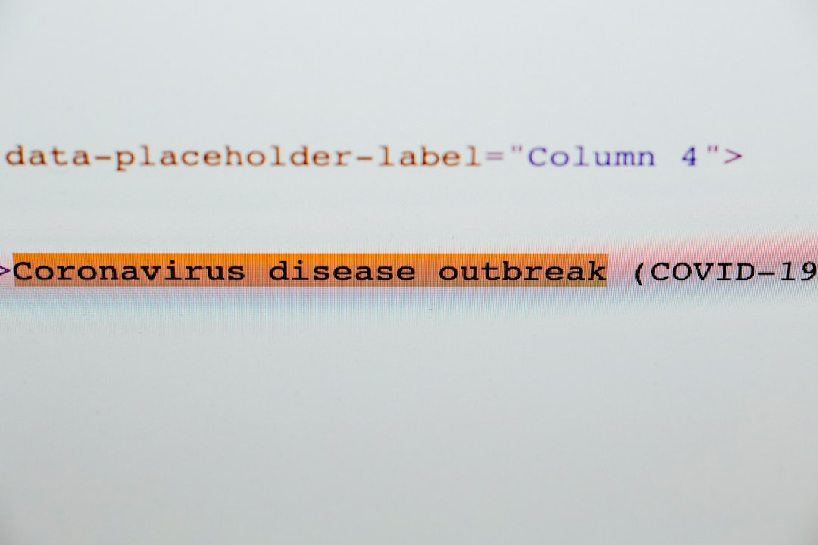
Slide 9: Image Understanding Demo
val analysis = client.analyzeImage(
imageFile = "screenshot.png",
prompt = "Describe this UI"
)
// Returns detailed analysis
Beyond Generation:
Image Understanding
• Input: Screenshots/Images
• Output: Structured Analysis
• Real-time Processing
Notes:
Not just generation - understanding too. Upload any image and get structured analysis. Perfect for automated testing, documentation, or accessibility compliance.

Slide 13
Slide 10: Agent Architecture
State Flow Diagram
1. Initialize
with query
Immutable Agent State Management
// Scala implementation handles state // transitions immutably, maintaining // complete conversation history case class AgentState( query: String, history: List[Message], context: Context )
2. Add to
conversation
history
3. Call LLM
with context
4. Process
tool calls
Key Principle: Immutable State Management
Every action creates a new state, maintaining complete history. No mutations - only transformations to new state objects.
5. Update
immutable
state
6. Return
new state

Slide 14
Execution Flow
Slide 11: Tool Calling System
Extensible Tool System
// Tool definition example
trait Tool {
def execute(params: Map[String, Any])
}
Available Tools:
• Weather API
• Database queries
• File operations
• Web scraping
• Custom functions
SZork Tools:
Image generation, music creation, state persistence
Notes:
Agents can call any tool you define. SZork uses tools for image generation, music creation, and game state management. You can add any tool with a simple trait implementation.

Slide 15
Slide 12: Document Processing
Capabilities:
📄 PDF extraction &
summarization
🔍 Semantic search
📊 Structured data
extraction
🌐 Multi-language
support
val summary = DocumentProcessor.fromPDF("report.pdf").summarize(maxTokens = 500)
val searchResults = semanticSearch(documents = loadedDocs, query = "performance metrics")
Notes:
Same agent pattern, different tools. Process PDFs, extract structured data, perform semantic search - all with type-safe Scala code.

Slide 16
Slide 13: Why Scala?
The Power of Type Safety
Scala:
def generateStory(theme: Theme, style: ArtStyle):
Either[LLMError, Story]
// Compile-time safety
Python:
def generate_story(theme, style):
# No compile-time guarantees
return result

Slide 17
Runtime errors possible
Benefits:
• ✅ Compile-time error prevention
• ✅ Immutable data structures
• ✅ Concurrent processing
• ✅ JVM ecosystem access
Performance: {data:metrics.performance.api_response_time} response time
Notes:
Why Scala matters - type safety prevents runtime errors that plague Python implementations. Plus immutability and JVM performance at scale.

Slide 18
Slide 14: What You Can Build
Complete AI Toolkit
All demonstrated today in SZork!
Notes:
Everything on this list - we've shown you today through SZork and our demos. This is a complete toolkit for building AI applications in Scala.

Slide 19
Slide 15: Production Features
Features: OpenAI/Anthropic/Cohere support • Langfuse integration • Either[Error, Success] pattern • 85+ production deployments
Notes:
This isn't just for demos - LLM4S is battle-tested in production. Multi-provider support, observability, error handling - everything you need for enterprise deployment.

Slide 20
Slide 16: Community & Ecosystem
Community Stats
• GitHub: 2.5K ⭐ • Contributors: 150 • Discord members: 500+ • Monthly downloads: 10K+
Ecosystem:
• Google Summer of Code • Corporate contributors • Academic research • Open source plugins
Get Involved
💬 Discord: discord.gg/llm4s 🐙 GitHub: github.com/llm4s 📚 Docs: docs.llm4s.org

Slide 21
Slide 17: Getting Started
Start Building Today
Add to build.sbt:
libraryDependencies +=
"com.llm4s" %% "llm4s-core" % "0.5.0"
Resources:
📁 Samples folder
🎮 SZork source code
📖 Documentation
💬 Discord support
Your First Agent:
// Quick Start with LLM4S
import org.llm4s.llmconnect.LLM
import org.llm4s.agent.Agent
// Initialize client (uses env vars)
val client = LLM.client()
// Create a simple agent
val agent = new Agent(client)
// Start conversation
val response = agent.chat(
"Tell me about Scala's type system"
)
// Type-safe response handling
response match {
case Right(message) =>
println(s"AI: ${message.content}")
case Left(error) =>
println(s"Error: ${error.message}")
}
Notes:
Getting started is simple - add one dependency, write a few lines of code. Check out the samples folder, explore SZork source, join our Discord for help.

Slide 22


Slide 18: Call to Action
Join Our Developer Community Today!
Contact Information
Email: contact@company.com
Website: www.company.com
Support: support@company.com
GitHub Repository
Discord Community

Slide 23
You Can Build the Cool Stuff!

Slide 24
Start Today:
🌟 Star us on GitHub
💬 Join Discord
🤝 Contribute: We're looking for contributors!
📧 Contact: founder@company.com
Coming Soon:
• Advanced RAG implementation
• Streaming responses
• More model providers
• Enhanced MCP support
Notes:
You can build the cool stuff! Everything you saw today is open source. Star the repo, join our Discord, contribute code. Let's build the future of Scala + AI together.

Slide 25
Slide 19: Thank You
Thank you for your attention
Contact Information
email@company.com
Phone: +1 (555) 123-4567
Follow Us
@company • LinkedIn: /company • Twitter: @company

Slide 26
Thank You!
Questions?
Rory Graves
• 🐦 @a_dev_musing
• 💼 linkedin.com/in/roryjgraves
Kannupriya Kalra
• 🐦 @KannupriyaKalra
• 💼 linkedin.com/in/kannupriyakalra
Project: github.com/llm4s/llm4s
Notes:
Thank you for joining us today! We have a few minutes for questions. Both of us are here to answer anything about LLM4S, SZork, or building AI applications in Scala.

Slide 27

Slide 20: Q&A
Q&A
Prepared Questions:
• How can we improve implementation strategies?
• What are the key performance indicators?
• How do we measure success?

Slide 28
Q&A
Prepared Topics:
• How does performance compare to Python?
• Can it work with local models?
• What about streaming responses?
• Rate limiting strategies?
• RAG implementation details?
• Production deployment tips?
• Contributing to LLM4S?
Notes:
[Prepared backup questions if needed]
• "How does RAG performance compare to vector DBs?" - We support multiple backends...
• "Can it work with Llama?" - Yes, through Ollama integration...
• "Performance vs Python?" - JVM advantages at scale...

