Slide 1
Laurie Mailloux
Presentation 6.2 Hypermedia Design
June 6, 2020

Slide 2
What is Hypermedia design?
Interlinked nonlinearly accessed media forms
Another name for everything we see, hear, and interact with on the Web
Most often used in the context of developing Web-based Application Programming Interfaces (APIs)
Different components communicating with each other simply
Referred to as ‘interactive hypermedia’
Text able to be hyperlinked to videos, pictures, music or files

Slide 3


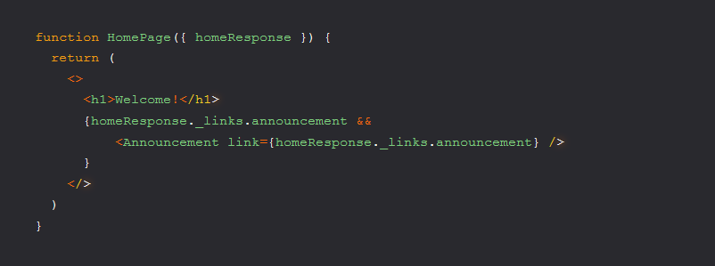
Advantages
Discoverability
Imagine it's your first day at your new job, and to complete the first task you need to learn how to interact with an external API because your business depends on this 3rd party service for a payments service. If you get links to related resources when you make a request, you can get a sense of what operations are available to you.
Extensibility
You can look at links as a way to extend the capabilities of your Web API as well. Say your business decides they want a new feature like the ability to display an announcement message on the home page. You could implement something like this, the announcement component would use the link to make an HTTP request to fetch the announcement resource and then render its info.

Slide 4

There are three jobs for hypermedia controls
They tell client how to construct HTtp request, what Http method must be used, what Url to use, and what http headers and or entity-boy to send.
they make promises about http response while suggesting status code, http headers, and or data the server will likely send in response to request.
they suggest how client integrates response into workflow.

Slide 5
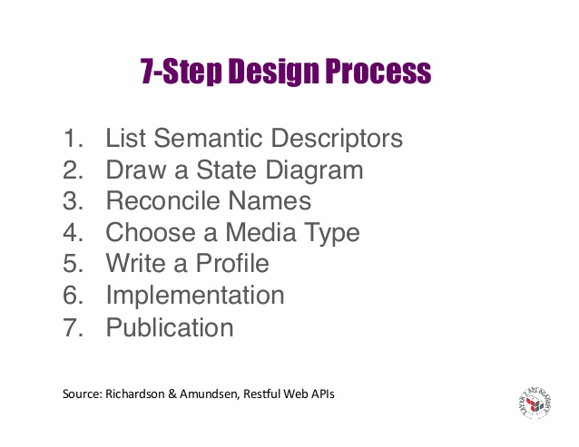

Slide 6
descriptors
Customer
First name
Last Name
Address
City
State
Zip Purchase
Item
Quanity
Price
Total Sale

Slide 7
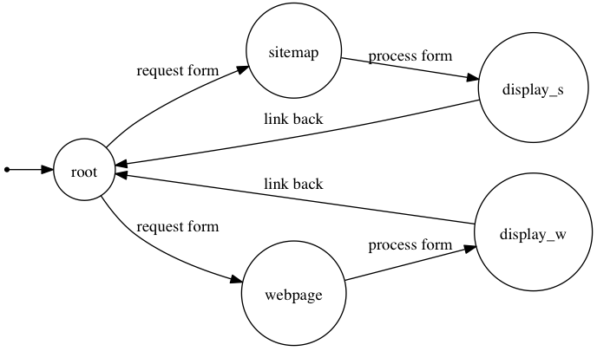
Designing hypermedia apis

Slide 8
Reconciled names
First Name => givenName (Person-schema.org)
Last Name => familyName (Person-schema.org)
Street Address => streetAddress (PostalAddress - schema.org)
City, State, Zip => part of streetAddress
Item bought +> item (Property - schema.org)
Quantity => orderQuantity (Property - schema.org)
Price => price (Property - schema.org)
Total => TotalPrice (Property - schema.org)

Slide 9
Media types
Collection + JSON
Supports use of semantic profiles
JSON – is Based for management and querying of simple collections
Supports CRUD - Create, Read, Update and Delete
HTTP Verbs used - GET, POST, PUT & DELETE

Slide 10
profile
<link rel=”profile” href=http://schema.org/Person>
<link rel=”profile” href=http://schema.org/PostalAddress>
<link rel=”profile” href=http://schema.org/Property>

Slide 11
Implement
Write code for api and implement the code

Slide 12
Publication
Publish
Publish your billboard url
Publish
Publish your profile
Register
Register new media types and new link relations

Slide 13
References
David, February 26. An introduction to hypermedia apiS. Retrieved on June 6, 2020 from https://dev.to/bolt04/an-introduction-to-hypermedia-apis-1n2d
Encyclopeida.com. May 21, 2020. retrieved on June 6, 2020 from https://www.encyclopedia.com/computing/news-wires-white-papers-and-books/hypermedia-and-multimedia

