Slide 1

SOAP
Laurie Mailloux
Web 420
Presentation 3.3 SOAP
May 15, 2020

Slide 2
SOAP (Simple Object Access Protocol) A XML-based messaging protocol for exchanging information between computers.
What is SOAP?

Slide 3
SOAP
SOAP is a communication protocol designed to communicate via Internet.
SOAP can extend HTTP for XML messaging.
SOAP provides data transport for Web services.
SOAP can exchange complete documents or call a remote procedure.
SOAP can be used for broadcasting a message.
SOAP is platform- and language-independent.
SOAP is the XML way of defining what information is sent and how.
SOAP enables client applications to easily connect to remote services and invoke remote methods.

Slide 4
SOAP Envelope
<Envelope> is the root element in every SOAP message, and contains two child elements, an optional <Header> element, and a mandatory <Body> element.

Slide 5
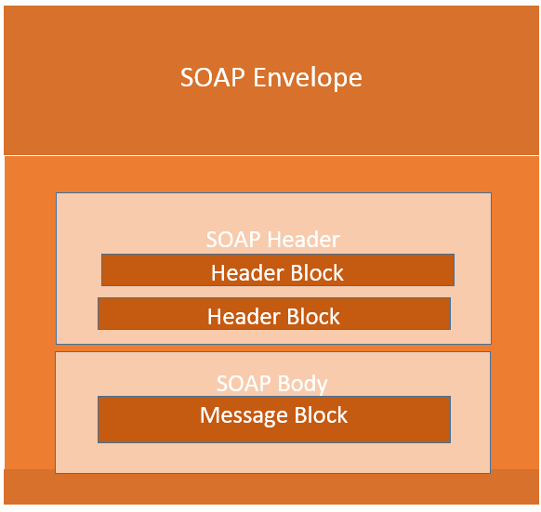
SOAP

Slide 6

SOAP Header
<Header> is an optional sub element of the SOAP envelope, and is used to pass application-related information that is to be processed by SOAP nodes along the message path.
The immediate child elements of the header are called header blocks. Header blocks are and application-defined XML element.
The SOAP header enables you to add features to a SOAP message in a decentralized manner without prior agreement between communicating parties.

Slide 7
SOAP Fault Element
Sub Element | Description
<faultcode> | A code for identifying the fault
<faultstring> | A human readable explanation of the fault
<faultactor> | Information about who caused the fault to happen
<detail> | Holds application specific error information related to the Body element
SOAP Fault element is used to indicate error messages. These are the sub elements.

Slide 8
SOAP Fault Codes Fault Code values must be used in the fault code element when describing faults.
Error | Description
VersionMismatch | Found an invalid namespace for the SOAP Envelope element
MustUnderstand | An immediate child element of the Header element, with the mustUnderstand attribute set to "1", was not understood
Client | The message was incorrectly formed or contained incorrect information
Server | There was a problem with the server so the message could not proceed

Slide 9
End-to-end data flow
SOAP services follow standards for sending and reveiving messages with a unique format. Most times SOAP messages contain the following:
Request-Response Data
Action performed
Header information
Error details if any failure messages

Slide 10
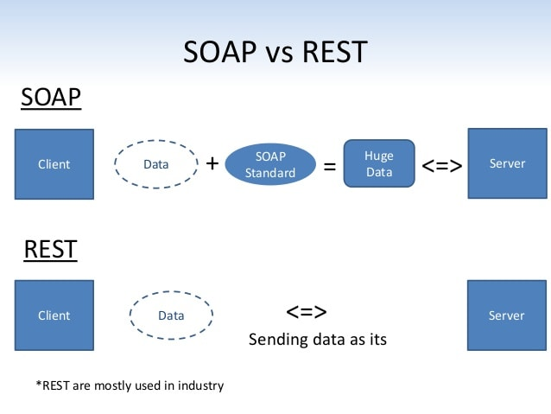
SOAP Diagram

Slide 11
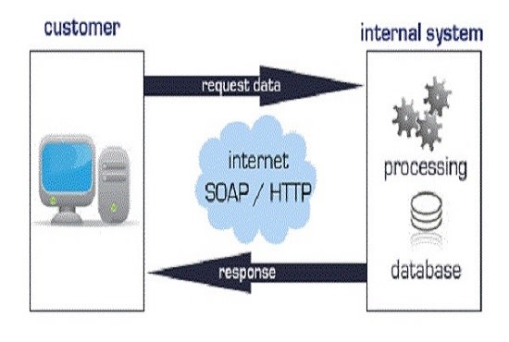
Diagram

Slide 12
References
IBM Knowledge Center. (ND) Retrieved on May 17, 2020 from https://www.ibm.com/support/knowledgecenter/SSMKHH_10.0.0/com.ibm.etools.mft.doc/ac55790_.html#ac55790_
W3schools.com. (ND) Retrieved on May 17, 2020 from http://w3schools.sinsixx.com/soap/soap_fault.asp.htm

