Slide 1
MicroServices
Laurie Mailloux
Presentation 8.3 – Microservices
June 17, 2020

Slide 2

What are microservices?
Microservices are an architectural approach in which single applications are composed of many loosely coupled and independently deployable smaller components or services. Most typically they will…
have their own stack, inclusive of the database and data model;
communicate with one another over a combination of REST APIs, event streaming, and message brokers; and
are organized by business capability, with the line separating services often referred to as a bounded context.

Slide 3
What is an Api gateway?
The api gateway takes all api calls and routes them to the appropriate microservice with request routing, composition and protocol translation. IT handles a request by invoking microservices and aggregating results to take best path. It translates between web protocols and web-unfriendly protocols that may be sued internally.

Slide 4
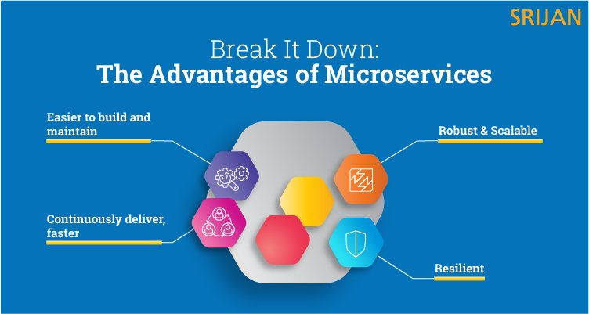
Advantages of microservices
Basic Benefits
Responsive –companies that adopt a microservice architecture can continuously deliver capabilities according to the customers changing needs.

Slide 5
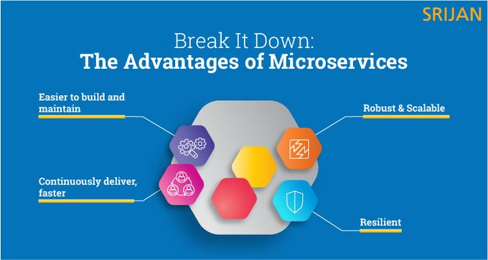
Microservice advantages
Responsive - Companies that adopt a microservice architecture can continuously deliver
capabilities according to the customer’s changing needs.
Continuous Delivery- Microservices built on the principles of Agile and DevOps help
the software teams run parallel projects while iterating quickly on discrete capabilities.
Scalability and Reliability - A successful microservice architecture prevents any system failure. Its repeatable automation, scaling application, and designing pattern features keep the system running.

Slide 6
Microservices disadvantages
Microservices has all the associated complexities of the distributed system.
There is a higher chance of failure during communication between different services.
Difficult to manage a large number of services.
The developer needs to solve the problem, such as network latency and load balancing.
Complex testing over a distributed environment.

Slide 7

Deploying microservices
Services are written using a variety of languages, frameworks, and framework versions
Each service consists of multiple service instances for throughput and availability
Service must be independently deployable and scalable
Service instances need to be isolated from one another
You need to be able to quickly build and deploy a service
You need to be able to constrain the resources (CPU and memory) consumed by a service
You need to monitor the behavior of each service instance
You want deployment to reliable
You must deploy the application as cost-effectively as possible

Slide 8
Scaling microservices
Microservices only run when they are needed making it easy to scale
Multiple instances of the same service can run on different servers in order to scale out
The api gateway or esb is used in conjunction with a load balancer which helps distribute the load to multiple servers.
This helps reduce latency for clients and allows for a greater number of connections and users.
Servers can also be modified to run more instances of the same microservice but this is often costly after a certain point and can only be done so much

Slide 9

Pros | Cons
Greater agility | Needs more collaboration (each team has to cover the whole microservice lifecycle)
Faster time to market | Harder to test and monitor because of the complexity of the architecture
Better scalability | Poorer performance, as microservices need to communicate (network latency, message processing, etc.)
Faster development cycles (easier deployment and debugging) | Harder to maintain the network (has less fault tolerance, needs more load balancing, etc.)
Easier to create a CI/CD pipeline for single-responsibility services | Doesn’t work without the proper corporate culture (DevOps culture, automation practices, etc.)
Isolated services have better fault tolerance | Security issues (harder to maintain transaction safety, distributed communication goes wrong more likely, etc.)
Platform- and language agnostic services
Cloud-readiness
PROS VS CONS OF MICROSERVICES

Slide 10
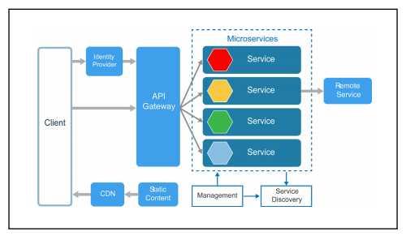

Slide 11
References
IMB. October 23, 2019 Retrieved on June 17, 2020 from https://www.ibm.com/cloud/learn/microservices
Nginx (no author) (n.d.) retrieved on June 17, 2020 from https://www.nginx.com/learn/api-gateway/
Javatpoint. (no Author) (n.d.) retrieved on June 17, 2020 from https://www.javatpoint.com/advantges-and-disadvantages-of-microservices
Dzone. March 28, 2018. top 5+ microservices architecture and design best practices. Retrieved on June 17, 2020 from https://dzone.com/articles/top-5-microservices-architecture-and-design-best-p

