Slide 1
OAuth
Laurie Mailloux
June 28, 2020
Presenetation 9.2

Slide 2
What is Oauth?
Open authentication is an authorization platform that allows for a secure authentication process.
Oauth is an open standard protocol, meaning it is available and free for anyone to use.
It is important to remember that oauth is not a service, or an api, but rather a standard.

Slide 3
How does oauth work?
The user requests an action. In this initial step, you’ll let the social media management tool know that you want to automatically publish posts using their service.
The consumer gets permission from the service provider. The social media management tool will ask Facebook to grant them permission to access your account and publish posts. In return, Facebook will send them a token with a unique signature or secret that verifies the management tool’s actions.
The user is redirected to the service provider. Once the social media management tool has the token, they’ll redirect you to Facebook’s login page.
The user gives the consumer permission. When you’re redirected to Facebook’s login page, it will ask for your username and password and to confirm that you want the social media management tool to be able to post on your behalf. Once permission has been granted, the token will be approved and used every time the social media management tool makes a request.
The consumer accesses protected permissions. Now that the social media management tool has the token, they are able to complete tasks because the token delegates what permissions they have access to.

Slide 4

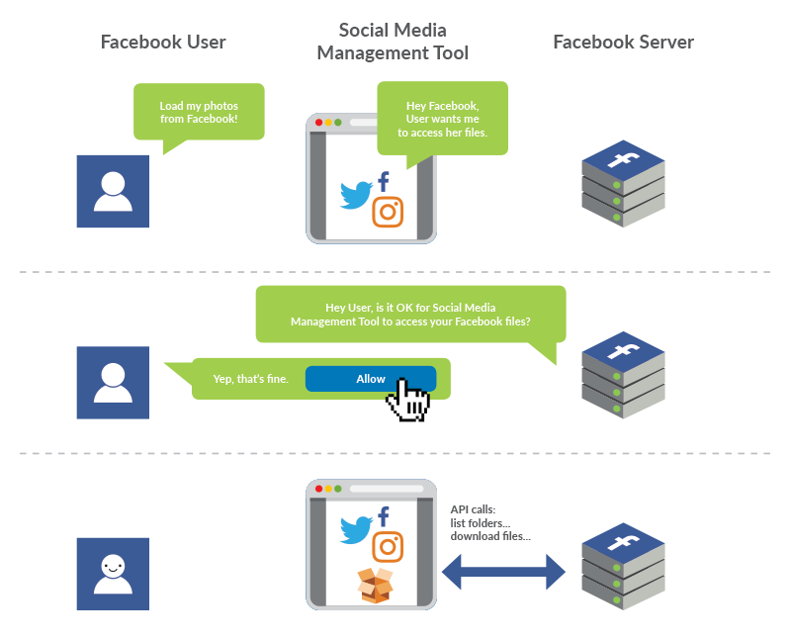
Imagine that you as the user wants to use a social media management tool to be able to schedule and publish Facebook post. Here’s an example with Facebook as the service provider and social media management tool is the consumer.

Slide 5
So how did OAuth and, essentially, OAuth 2 come about?
Before OAuth, applications just had users share the usernames and passwords directly with third-party services.
There were varying protocols for different platforms, but the core was the same.
If a web app wanted data from another service, it asked for the user's credentials to that service.
So for instance, if you wanted to provide your data from Twitter to a service, you would provide your Twitter username and password to the service.
And this is where the drawbacks began.

Slide 6
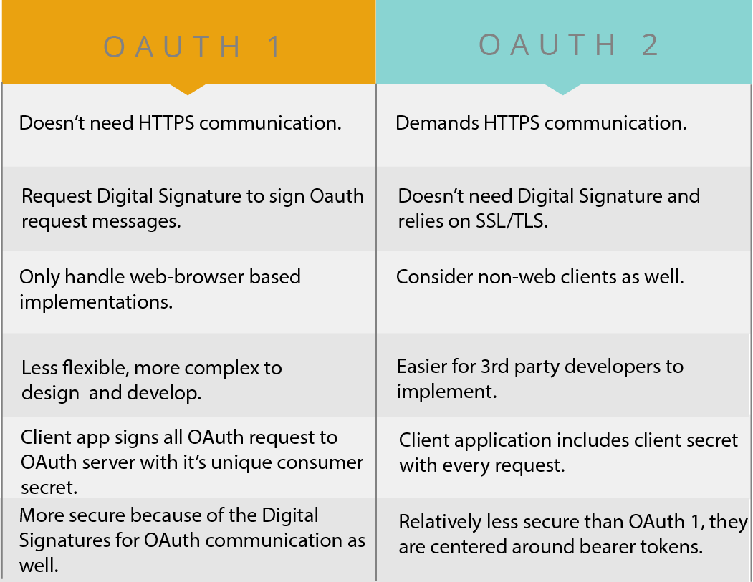

Slide 7
Why is oauth so popular?
Oauth is popular because a lot of the infrastructure required for building an authentication platform is already done.
It is secure and easy to use.
If using OAuth2 it is easier to design and implement.

Slide 8
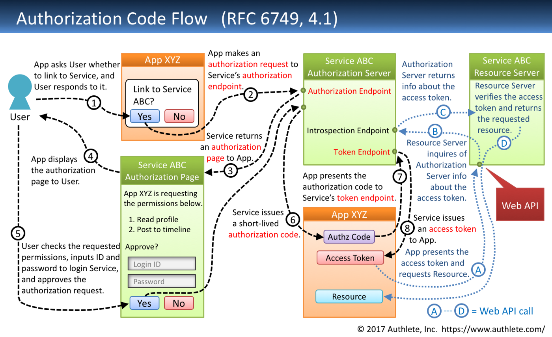
Authorization code flow

Slide 9
Oauth 2.0 Terminology
Resource Owner: the entity that can grant access to a protected resource. Typically this is the end-user.
Client: an application requesting access to a protected resource on behalf of the Resource Owner.
Resource Server: the server hosting the protected resources. This is the API you want to access.
Authorization Server: the server that authenticates the Resource Owner and issues Access Tokens after getting proper authorization. In this case, Auth0.
User Agent: the agent used by the Resource Owner to interact with the Client, for example a browser or a native application.

Slide 10
Obtaining Oauth 2. access tokens
Request an access token
User consent decision
Handle response from Google
Exchange authorization code for refresh and access tokens
Process response and store tokens

Slide 11
References
What is Oauth. No author. November 30, 2017. What is Oauth|Learn the Basics of Open Authorization. Retrieved on June 28, 2020 from https://swoopnow.com/what-is-oauth/
Perch, Kassandra. April 20, 2016. Everything You Wanted To Know About OAuth2. Retrieved on June 28, 2020 from https://auth0.com/blog/everything-you-wanted-to-know-about-oauth-2-but-were-too-afraid-to-ask/
Kawaski, Takaiko. May 26, 2017. Diagrams and Movies of all the Oauth 2.0 Flows. Retrieved on June 28, 2020 from https://medium.com/@darutk/diagrams-and-movies-of-all-the-oauth-2-0-flows-194f3c3ade85

